Slide 1
E-MELA

Slide 2
Team Member | Team Member Name
1 | Manav
2 | Vyshnavi
3 | Madhu
4 | Deepika

Slide 3
Introduction To The Project
Quick-commerce platform to support the small and independent businesses in our neighborhood by providing them with a means to exhibit their products online and spread their reach to a wider and targeted customer base.
Allows the different independent businesses such as handicrafts, boutique clothing stores, custom pc building, small event planning etc to immediately tap into the opportunities provided by a unified online market.

Slide 4
Introduction To The Project Cont.
The global social commerce market is expected to reach $2.9 trillion by 2026 (Kapoor, 2022).
More than 50% of small businesses report difficulties in gaining visibility on large e-commerce platforms dominated by major brands (Chatterjee et al., 2021).
60% of online shoppers engage more with brands that provide storytelling and authenticity in their marketing strategies (Singh & Verma, 2023).
Commission rates on popular platforms like Amazon and IndiaMART go upto 30% sellers (Nair, 2022).

Slide 5
Survey Of Existing Platforms
Amazon Karigar supports Indian artisans but charges commissions, lacks instant payments, & offers limited visibility for small sellers.
E-Mela removes commissions, ensures instant payments, and enhances visibility for independent businesses.
Udaan is a B2B wholesale platform that lacks B2C selling, curated storefronts, and niche business support.
E-Mela provides a direct-to-consumer marketplace with personalized storefronts and dedicated support for small sellers.
Indiamart is primarily a B2B directory with no logistics support, personalized storefronts, or local business focus.
E-Mela simplifies the buying process with logistics integration, localized business discovery, and a seamless selling experience for independent businesses.

Slide 6
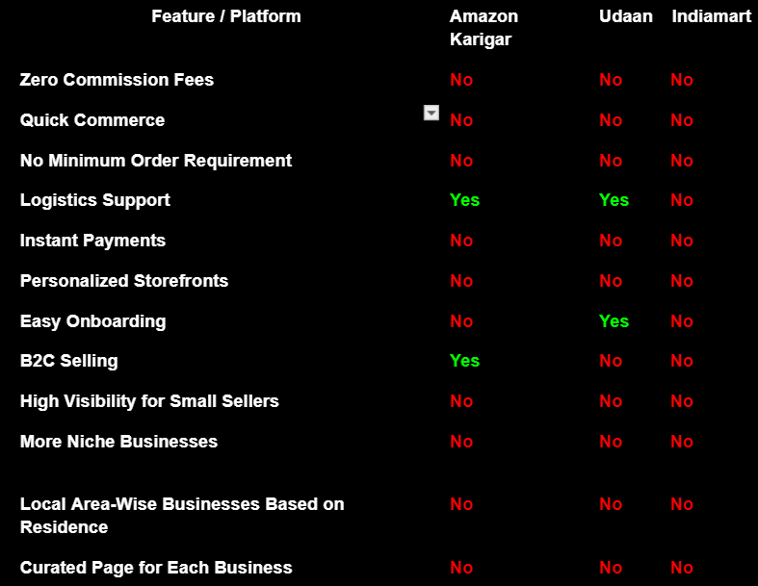
Survey Of Existing Platforms Cont.

Slide 7
Survey Of Existing Platforms Cont.
Lack of dedicated online marketplaces focusing exclusively on small and independent businesses.
Limited exposure to niche and artisanal markets, preventing them from reaching a targeted audience.
Insufficient tools for storytelling and brand building, which are crucial for engaging consumers.
Absence of community-driven engagement, which traditional Melas provide but digital platforms lack.
Doesn’t integrate quick commerce, thereby, diminishing possibilities of local economic growth and preservation of local identity and culture.

Slide 8
Technology Stack
Front-end Technologies: HTML,CSS, SPRING FRAMEWORK
Back-end Technologies: JDBC WITH MONGODB DRIVER
Request handler: SPRINGBOOT TO HANDLE HTTP REQUESTS

Slide 9
Design & Architecture
Model (M) - Data Layer
Manages database operations
Uses JDBC integrated with MongoDB for handling data
Stores data for users, products, orders, payments, and logistics for Supply Chain
View (V) - Presentation Layer
Frontend built lightweight Spring framework &
Structure + Styling using html, css, javscript
Displays product listings, order status, and curated pages, mobile responsiveness, etc
Controller (C) - Business Logic Layer
Request Handling using Sprint Boot
Processes orders, payments, and notifications &
Implements authentication and security measures.
Connects with payment services

Slide 10
Features & Functionality
A commission-free platform for small businesses.
A unified marketplace focused on niche businesses like local handicrafts, boutique clothing, and event planning.
Instant payment processing.
Localized business discovery.
Personalized storefronts for each and different businesses.
Community engagement with a reliable review and rating system.
Dynamic changes based on the festive season currently prevailing.

Slide 11
Development Workflow
1. Idea proposal & literature survey
2. Defining the structure and arriving it a robust design
3. Iterative development begins
4. Testing the application
5. Deployment & hosting

Slide 12
Role & Contribution Of Each Member
Deepika
Defining the project and conducting a literature survey to analyse existing platforms to conclude the final features.
Front-end to achieve a seamless user experience and create curated pages for each business and their mission.
Supply side logic and visualisation along with some elementary AIML.
Vyshnavi
Reviewing & Documenting each development made to ensure the integrity of the original idea
Front-end for mobile responsive and intriguing design that capture the essence of each business.
APIs to locate businesses in your area and assign the nearest ones.
Madhu
Analysing performance overheads with respect to data handling and resolving them immediately.
Implementing JDBC along with the usage of MongoDB database and handling how the data must be stored.
Integrating the appropriate payment gateways and flexibility in payment methods.
Manav
Establishing how the pages must be linked together and structuring the page redirection to avoid any confusion.
Request handling to ensure dynamic nature of the application and avoid any delays in data transmission.
Creating a robust community system to simulate real time melas.

