Slide 1
CMOS Digital Lock with 2-Bit Attempt Counter and Lockout Logic
2310040040-D.Rahul
2310040042-K.Harshavardhan reddy

Slide 2
INTRODUCTION
The CMOS Digital Lock with 2-Bit Attempt Counter and Lockout Logic is a secure access control circuit designed using low-power CMOS logic.
It enhances traditional password-based systems by limiting the number of wrong attempts and triggering a lockout after repeated failures.
Designed a low-power CMOS digital lock with a 2-bit attempt counter and lockout logic to restrict access after three incorrect password attempts.

Slide 3
METHODOLOGY
The CMOS digital lock was designed and simulated in Cadence Virtuoso at 90 nm technology.
A 2-bit counter built using D flip-flops and XOR gates increments with each wrong attempt.
When the counter reaches ‘11’, the lockout logic activates an AND gate output to block further inputs until reset.

Slide 4
APPLICATIONS
Used in ATMs, banking terminals, and smart door locks to prevent unauthorized access through brute-force password attempts.
Ideal for IoT and embedded systems where low-power, hardware-based security is essential for reliable operation.
Can be integrated into ASIC or FPGA platforms to enable fast, real-time authentication in modern digital security systems.

Slide 5
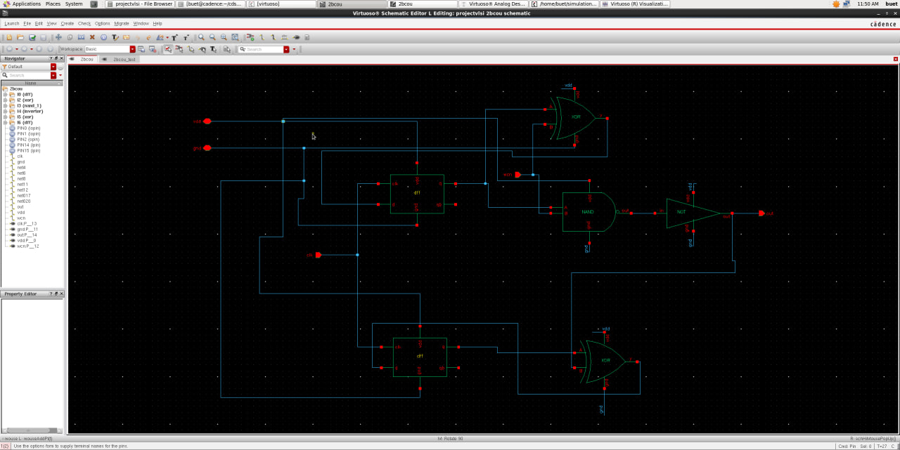
CIRCUIT DIAGRAM

Slide 6
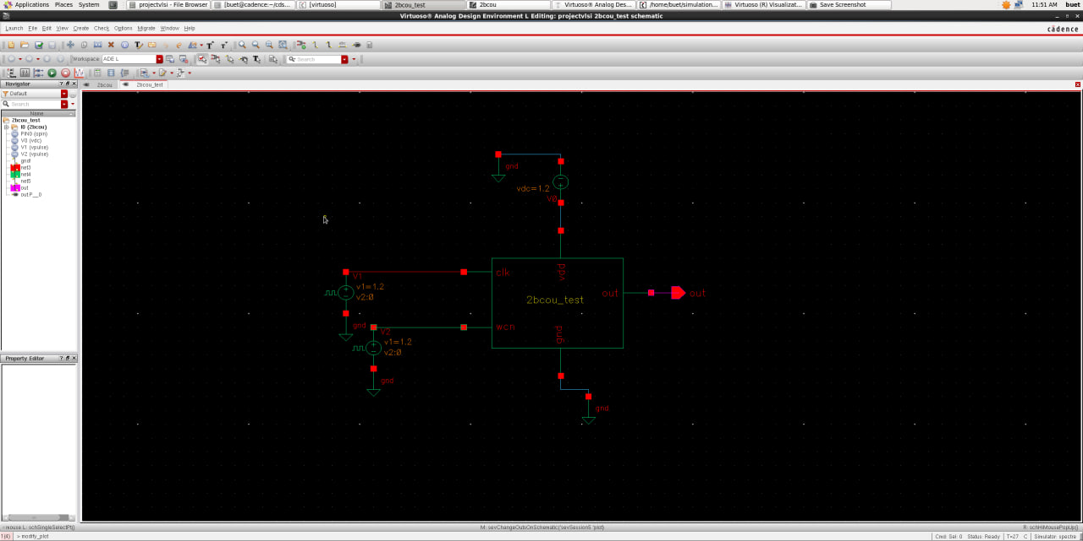
TESTING

Slide 7
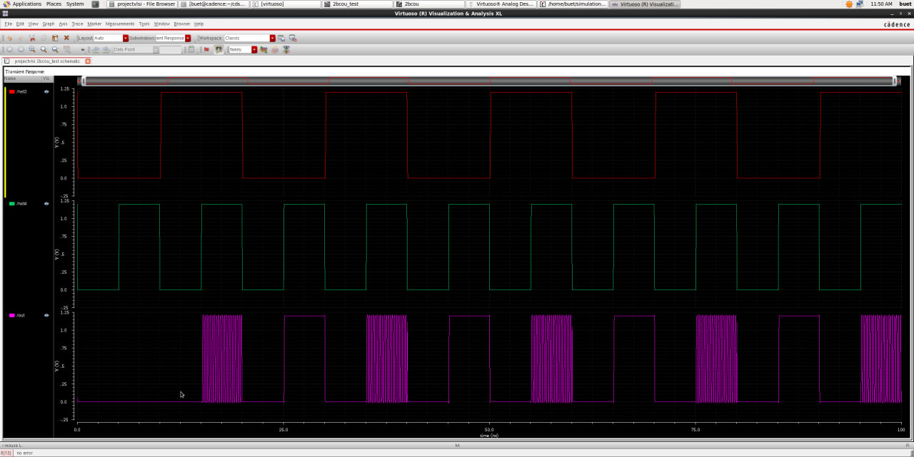
TESTING OUTPUT

Slide 8
Conclusion & Future Scope
The CMOS digital lock efficiently restricts access after three wrong attempts using low-power logic.
It provides secure and reliable operation with minimal power consumption.
Future enhancements include integration with biometric or RFID authentication systems.

