Slide 1
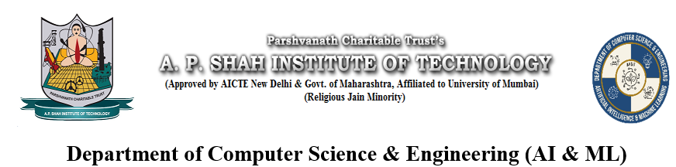
VOICERA : Realistic Speech Generation through ML
Group Members Student ID
KAUSTUBH BHOIR - 23106066
VIGNESH GUNDARI - 23106008
VARUN BURA - 23106129
ATHANG JADHAV - 23106039
Project Guide
Prof. Yogeshwari Hardas

Slide 2
Outline
Introduction
Literature Survey
Problem statement
System Design
Implementation
Technology Stack
Conclusion and future work
References

Slide 3
Introduction
Progress: TTS evolved from rule-based → neural models with natural voices.
Issues:
Accessibility: Robotic, non-personalized voices for visually impaired/elderly.
Personalization: Lack of voice cloning/familiar voices in assistants.
Content creation: Costly/time-consuming voiceovers for e-learning, podcasts, etc.
Cloud TTS limits: No short-sample cloning, expensive, online-only, low personalization.
Open-source TTS limits: High expertise & GPU needed, no easy interface.

Slide 4
Motivation
Accessibility: Visually impaired users struggle with robotic voices → need human-like, customizable TTS.
Content creation: Teachers/creators lack affordable pro voice-overs → voice cloning can help.
Feasibility: Open-source TTS (e.g., Coqui, transformers) makes short-sample cloning possible.
Objectives
User-friendly app: Web-based, text input + short audio for speech generation.
Personalized TTS: Voice cloning from 5–15 sec samples.
Multilingual support: Multiple languages for wider use.
Efficiency: Optimized for GPU and CPU setups.

Slide 5
Sustainable Development Goal
Quality education and strong infrastructure are essential pillars of sustainable development.
SDG 4: Quality Education focuses on ensuring inclusive, equitable, and lifelong learning opportunities for all. It empowers individuals, drives social mobility, and builds the foundation for innovation.
SDG 9: Industry, Innovation and Infrastructure emphasizes building resilient infrastructure, promoting sustainable industrialization, and fostering innovation. These elements create jobs, boost productivity, and support technological advancement.
Together, these goals form a powerful combination: education equips people with knowledge and skills, while innovation and infrastructure provide the tools and platforms to apply them driving progress toward a sustainable future.

Slide 6
Problem Statement
Core Problem
Neural TTS is advanced but not accessible as simple, user-friendly web apps.
Existing tools:
Need heavy local setup + GPU.
Cloud APIs = black boxes (limited control, online-only).
Poor usability (no history, storage, or simple voice-cloning UI).
Solution (voice_cloner)
Self-hostable, user-authenticated web app.
Personalized TTS with short-sample voice cloning.
Includes storage, history, and user management.
Developer-friendly workflow

Slide 7
Specific problems addressed
Accessibility: Current demos need ML skills & scripts → provide simple web UI (text + ref audio → TTS output).
Personalized TTS: Long datasets impractical → enable reliable cloning from 5–15s clips.
Data management: Outputs are hard to track → store files with metadata (user, text, language, timestamp, ref clip).
Resource limits: TTS needs GPUs → offer CPU/small-model fallback + clear setup docs.
Ethics & misuse: Risk of impersonation → add consent checks, policies, watermarking/logging.

Slide 8
​literature survey
Title | Conference / Journal Details | Key Points | Improvements Proposed | Citation
OpenVoice: Versatile Instant Voice Cloning | MIT & Tsinghua University, 2024 | Can clone voice with short audio; controls style like accent and emotion | Use less training data and easier deployment | [1]
MiniMax-Speech: Intrinsic Zero-Shot Text-to-Speech | arXiv, 2025 | Clones voices in 30+ languages with emotion and style | Reduce high computing cost | [2]
F5R-TTS: Flow-Matching Text-to-Speech | arXiv, 2025 | Improves speech quality and speaker similarity | Make training simpler | [3]

Slide 9
Title | Conference / Journal Details | Key Points | Improvements Proposed | Citation
Voice Cloning: A Comprehensive Survey | IEEE Access, 2025 | Reviews many voice cloning methods and ethics | Suggest practical new models | [4]
Real Time Voice Cloning Using Deep Learning | IJCS, 2023 | Fast real-time cloning with good tech base | Add better style and multilingual support | [5]
Real Time Voice Cloning | JETIR, 2020 | Early system using Tacotron 2 and WaveNet with few seconds of audio | Make voice sound more natural | [6]

Slide 10
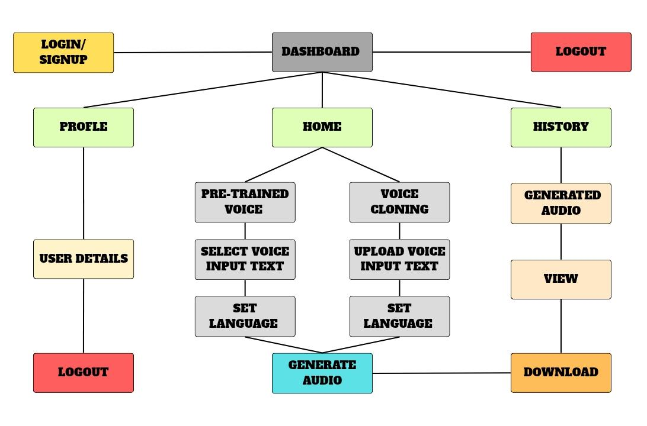
System Design

Slide 11
a. User Interface
Text input field
Voice sample upload option
Audio playback and download section
b. Backend Processing
If no sample: • Text → Speech using pretrained TTS model
If sample uploaded: • Extract voice embedding • Generate mel-spectrogram using text + embedding • Convert to audio using vocoder
c. Audio Management
Generated audio stored and linked to user session
Media served dynamically for download/playback

Slide 12
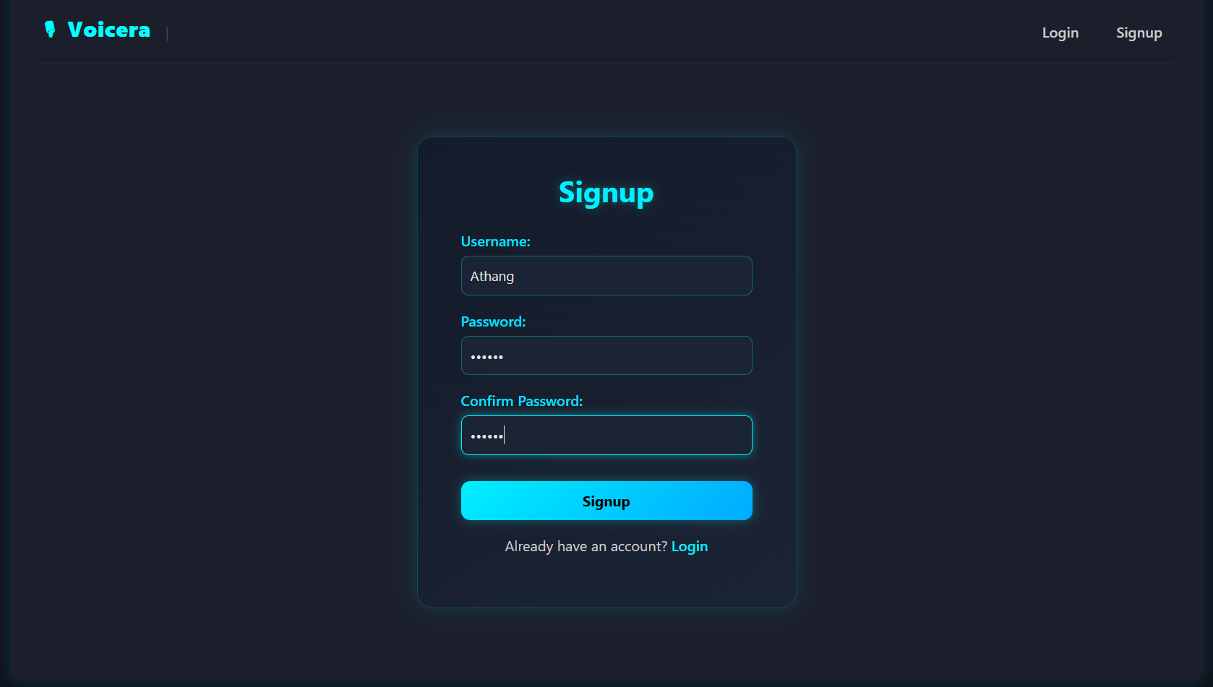
Implemantation

Slide 13
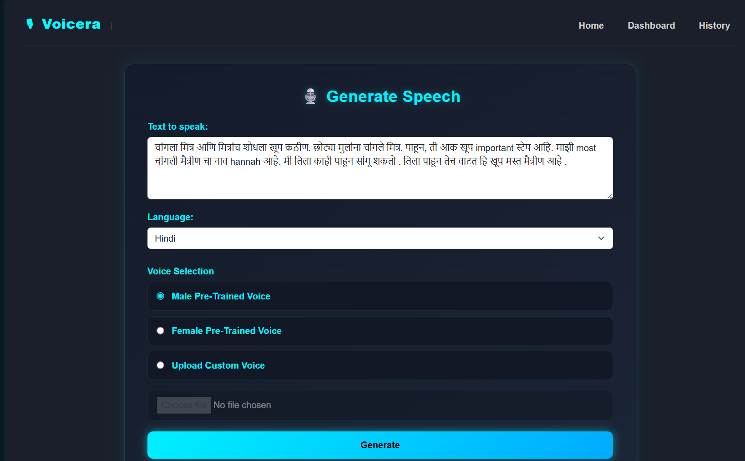

Slide 14
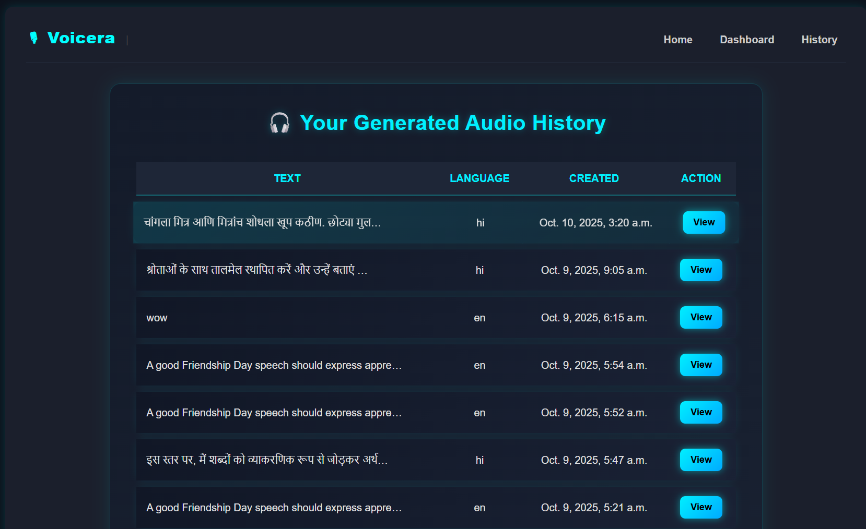

Slide 15
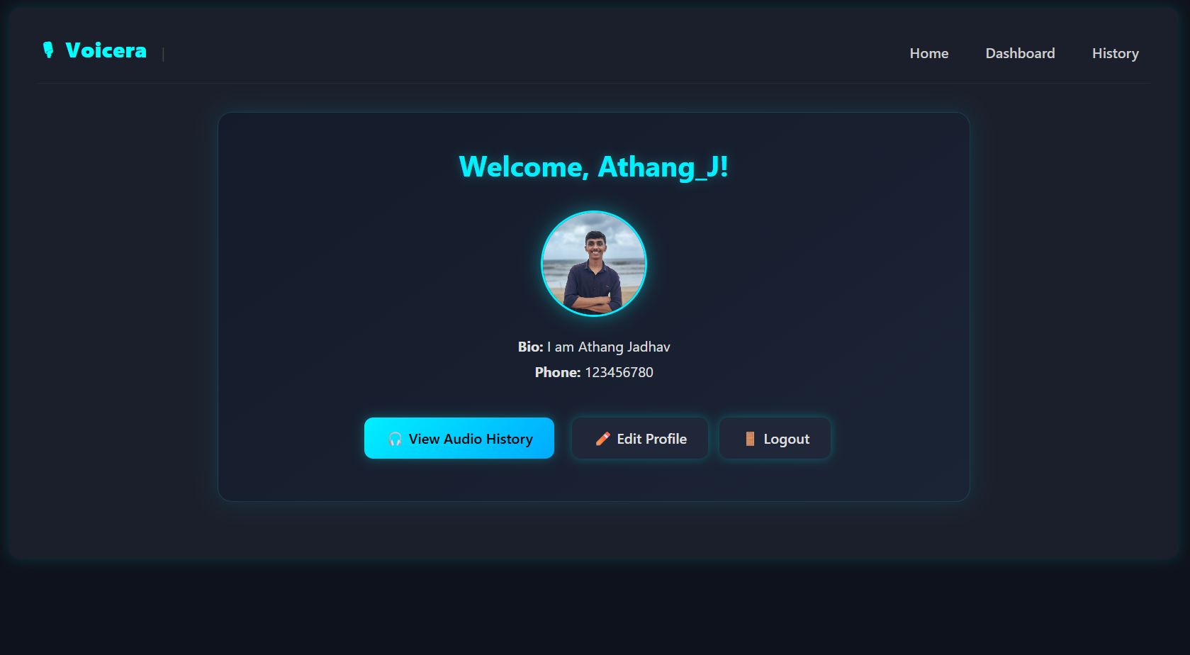

Slide 16
Technologies and Methodologies
Front-End: Web-based UI using HTML, CSS, JavaScript.
Back-End: Server-side logic implemented using Python, Django and Django REST Framework.
Database: Django Media file system for data management.
ML Layer: Coqui TTS, Real-Time Voice Cloning.

Slide 17
Conclusion
TTS technology is powerful but still hard to use, expensive, and not very personal. Our solution is a simple web app that lets users create natural, customized voices from short audio clips. It is easy to use, supports multiple languages, manages user data, and includes safeguards to prevent misuse—making speech technology more accessible and practical for everyone.

Slide 18
References
[1] Z. Qin, W. Zhao, X. Yu, and X. Sun, “OpenVoice: Versatile Instant Voice Cloning,” MIT & Tsinghua University, 2024.
[2] T. Wang, J. Li, et al., “MiniMax-Speech: Intrinsic Zero-Shot Text-to-Speech with a Learnable Speaker Encoder,” arXiv, 2025.
[3] Y. Li, C. Huang, et al., “F5R-TTS: Improving Flow-Matching Text-to-Speech with Group Relative Policy Optimization,” arXiv, 2025.
[4] P. K. Singh, A. Roy, et al., “Voice Cloning: A Comprehensive Survey,” IEEE Access, 2025.
[5] R. Sharma, S. Kumar, and N. Gupta, “Real Time Voice Cloning Using Deep Learning,” International Journal of Computer Science (IJCS), 2023.
[6] A. Patel and R. Mehta, “Real Time Voice Cloning,” Journal of Emerging Technologies and Innovative Research (JETIR), 2020.

Slide 19
Thank You...!!

