Slide 1
Real-Time Healthcare Adverse Event Analytics
using Big Data Streaming and Machine Learning
Khaled Mohamed • Mohamed ElKassas • Youssef Hassan • Mustafa Tantawy
CSCI461 — Introduction to Big Data | Spring 2026 | Nile University
Apache Kafka · HDFS · Spark MLlib · PostgreSQL · Metabase
1 / 10

Slide 2
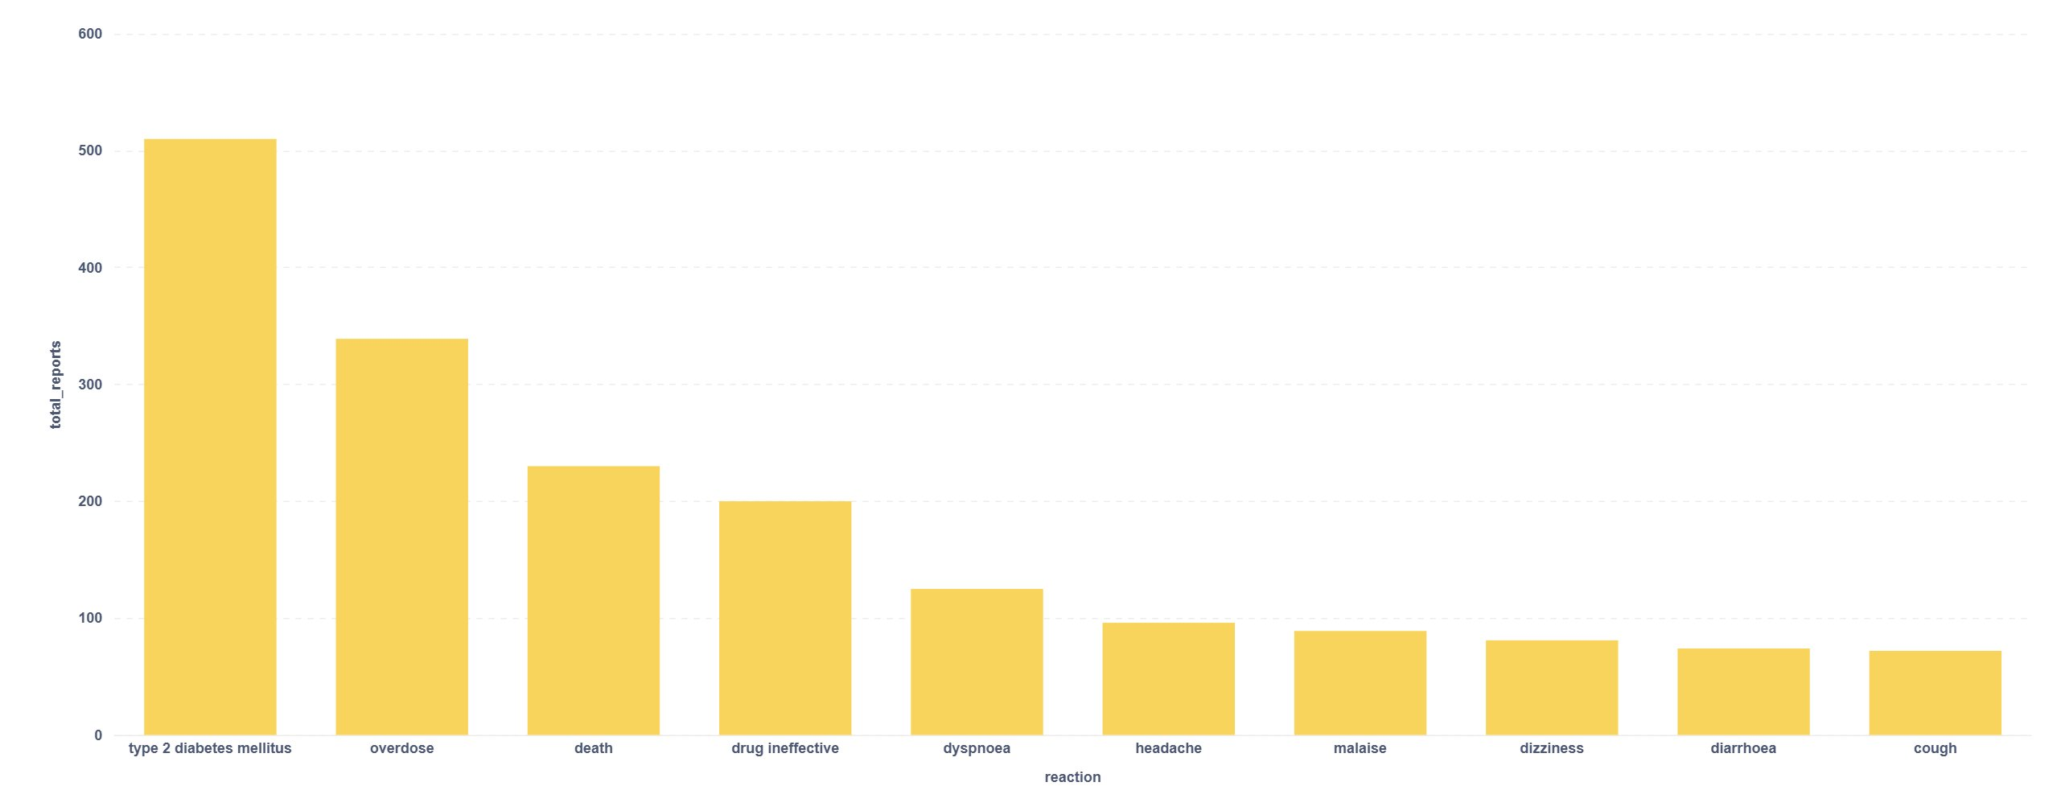
Problem Statement & Motivation
Why does real-time pharmacovigilance matter?
The Challenge
Our Solution
• FDA receives millions of spontaneous adverse-event reports each year via MedWatch
• Traditional pipelines are batch-oriented — reports analysed offline with significant latency
• Delayed detection of drug safety signals can cost lives
• No open-source, self-contained, end-to-end reference pipeline exists for course-level learning
• Ingest openFDA Drug Adverse Event records in near real-time via Apache Kafka
• Store raw + cleaned data in HDFS (bronze-silver-gold architecture)
• Apply Spark MLlib risk classification to 7,573+ records
• Surface insights via PostgreSQL + Metabase dashboards
• Fully containerised — runs with a single docker compose up
Top 10 reported reactions bar chart
Top 10 reported reactions
CSCI461 — Introduction to Big Data | Spring 2026 | Nile University
2 / 10

Slide 3
Project Objectives
SMART goals
1
Ingestion
2
Storage
Stream >7,500 FDA adverse-event records through Kafka within a single ingest session using the openFDA REST API.
Implement a bronze-silver-gold HDFS data lakehouse with automated Spark Structured Streaming cleaning and deduplication.
3
Classification
4
Reporting
Train and evaluate Logistic Regression and Random Forest models (+ rule-based baseline) achieving ≥0.85 weighted F1 on risk labels.
Aggregate and visualise risk predictions by patient sex and medicinal product in a self-service Metabase dashboard.
CSCI461 — Introduction to Big Data | Spring 2026 | Nile University
3 / 10

Slide 4
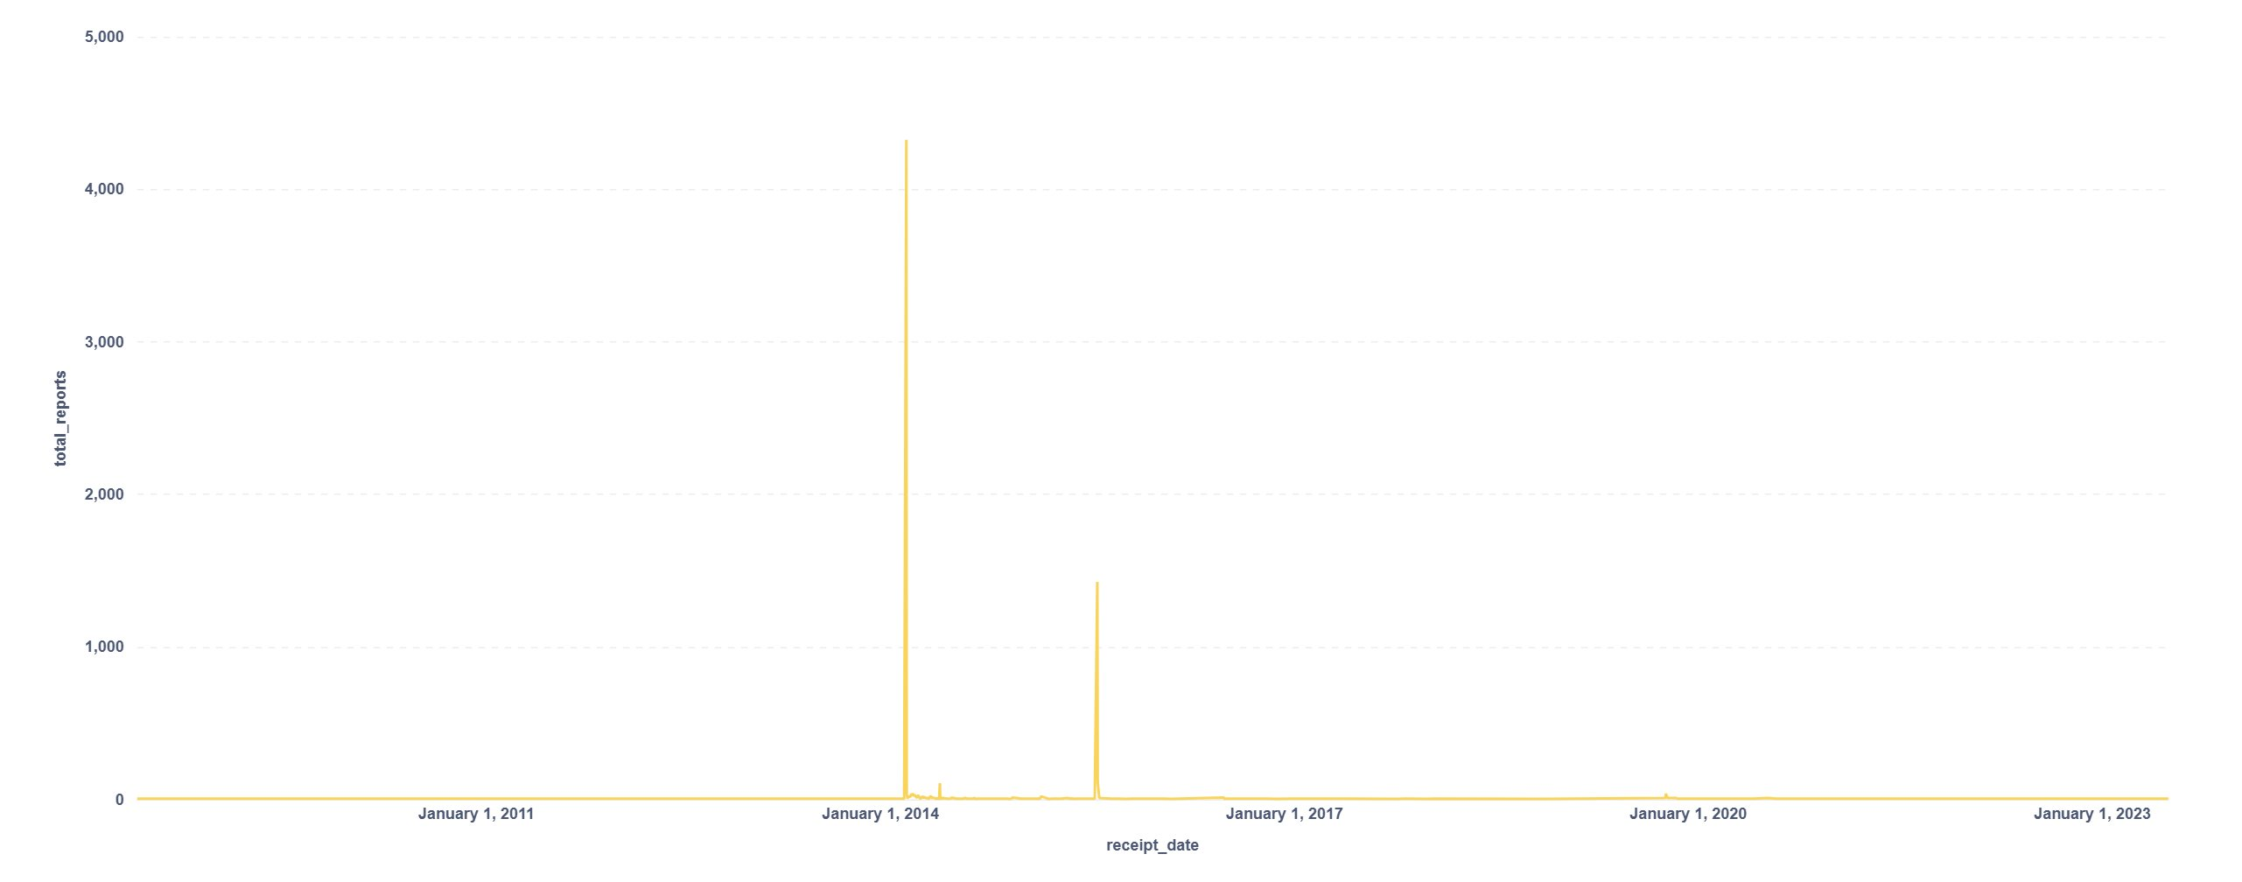
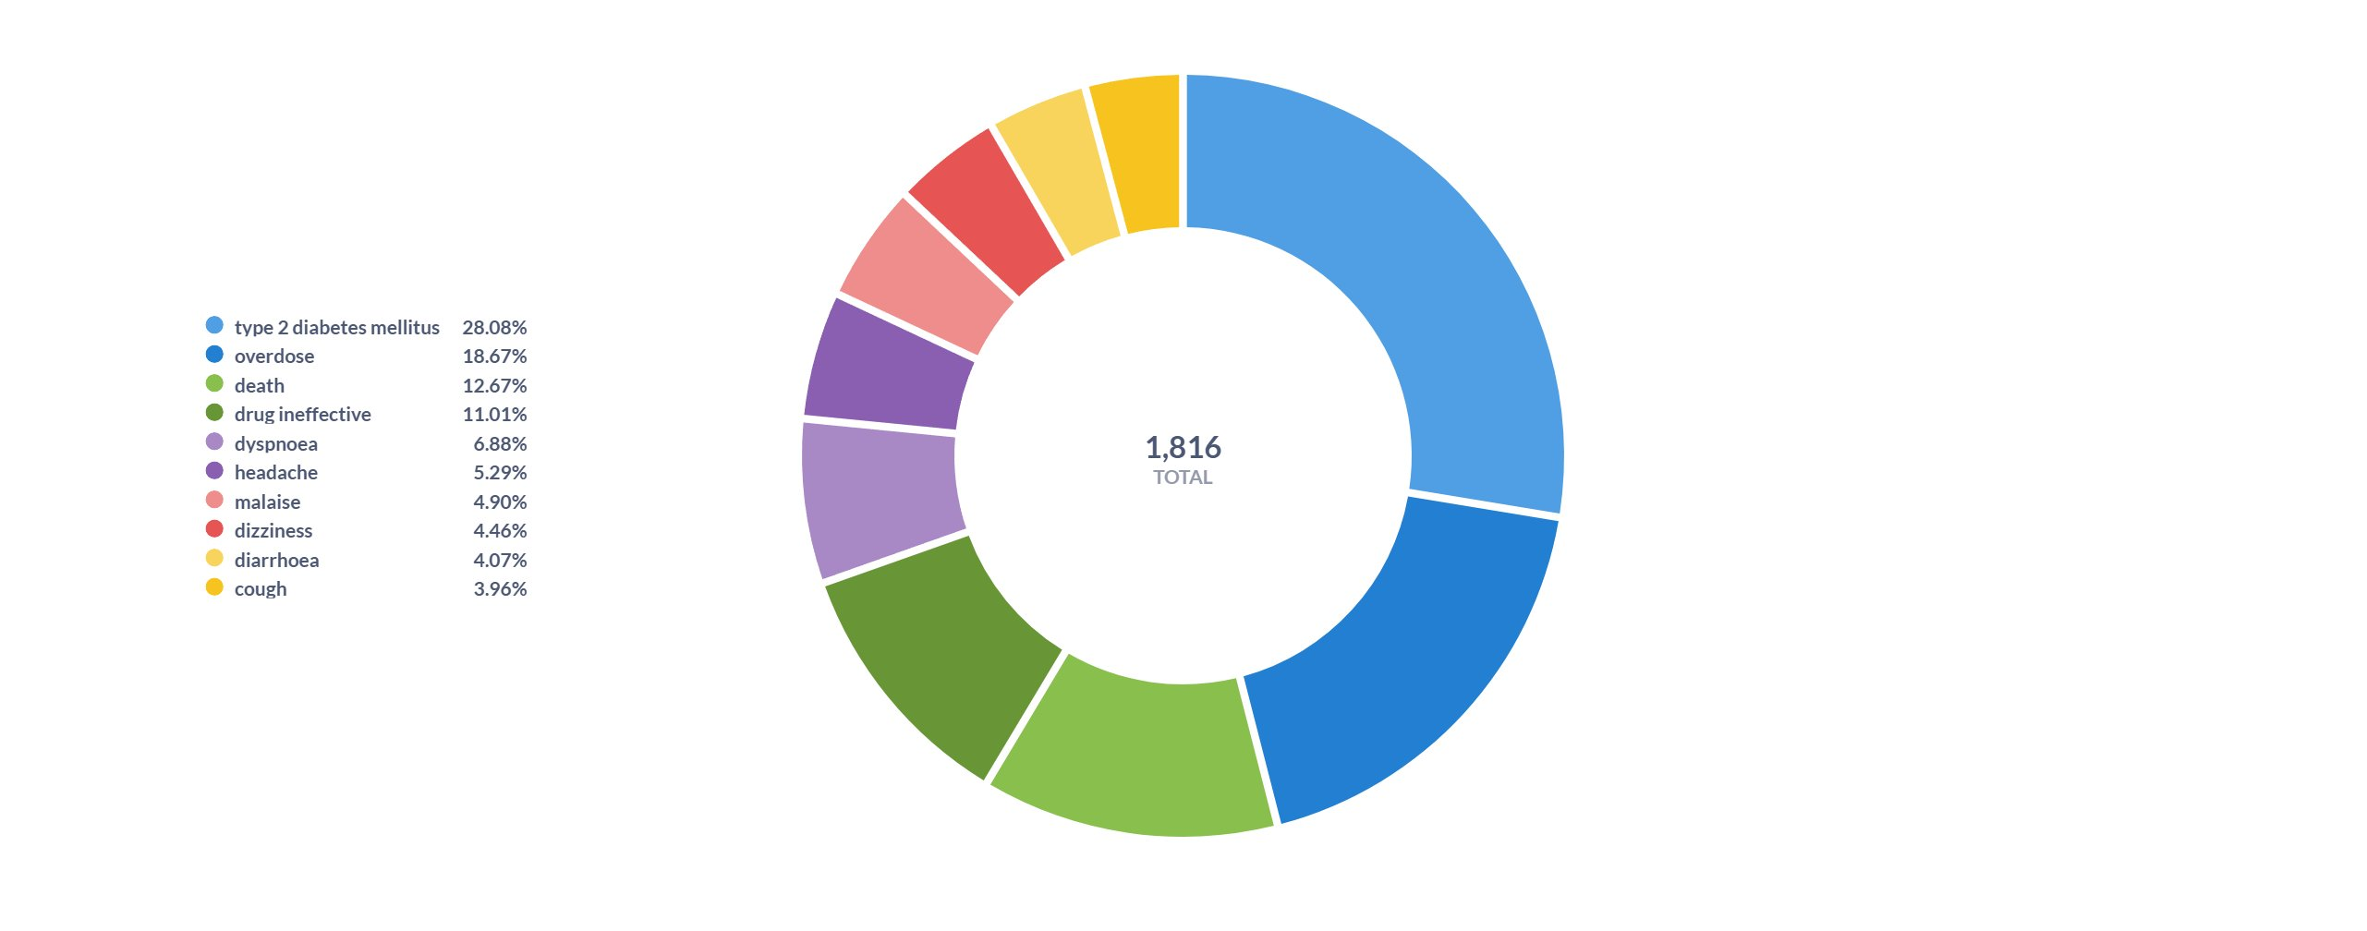
symptoms analysis bar chart
Dataset — openFDA Drug Adverse Events
Publicly accessible, continuously updated safety reports since 1969
Dataset Summary
Data Quality After Phase 2 Cleaning
• Source: FDA MedWatch spontaneous safety report database
• Access: openFDA drug/event REST API (no key required)
• Format: Nested JSON → Parquet after ingestion
• Records processed: 7,573 unique adverse event reports
• Fields used: patient age, weight, sex; drug name; reaction MedDRA term; seriousness flags (death, hospitalisation); receipt date
• License: Public domain (US government open data)
Field
Issue
Rate
JSON parse failure
Bad records routed to bad_records
~3–5%
Patient age
Null values → median imputed
~12%
Reports over time by receipt date
Patient weight
Null values → median imputed
~28%
Duplicate report IDs
Within single ingest cycle
<1%
symptoms analysis
CSCI461 — Introduction to Big Data | Spring 2026 | Nile University
4 / 10

Slide 5
System Architecture
Fully containerised Bronze-Silver-Gold Data Lakehouse
openFDA REST API
REST
Apache Kafka
Kafka topic
HDFS Bronze
Spark stream
Spark Stream Silver
ML batch
Spark MLlib Gold
PostgreSQL + Metabase
JDBC
LAYER 1 Ingestion
LAYER 2 Buffering
LAYER 3A Bronze
LAYER 3B Silver
LAYER 4 Gold / ML
LAYER 5 Reporting
Technology Choices:
• Kafka: log-based replay → exactly-once delivery; decouples API rate limits from Spark speed
• HDFS: self-contained, credential-free storage; trivially upgrades to S3/GCS by changing fs.defaultFS
• Spark: unified API for Structured Streaming + MLlib; DataFrame API for cleaning; no second ML framework needed
• PostgreSQL + Metabase: mature JDBC connector; self-service dashboards; no analyst SQL required
CSCI461 — Introduction to Big Data | Spring 2026 | Nile University
5 / 10

Slide 6
Data Lifecycle & Pre-Processing
From raw openFDA JSON to clean Parquet in HDFS
ACQUIRE
STORE & CLEAN
PROCESS & VISUALISE
openFDA → Kafka
HDFS Bronze → Silver
Gold → PostgreSQL → Metabase
• Python producer queries drug/event REST endpoint continuously
• Each record wrapped in metadata envelope: source_api, ingestion_timestamp, batch_number, raw_data
• Published to healthcare_raw Kafka topic (gzip, acks=all)
• 20 pages × 100 records per ingest cycle = ~2,000 records/run
• Spark Structured Streaming reads Kafka micro-batches (foreachBatch)
• Raw envelopes archived to HDFS Bronze (audit-ready Parquet)
• Cleaning steps: schema parsing → outlier nullification (negative age/weight) → median imputation → deduplication on report_id
• Bad records routed to /healthcare/processed/bad_records
• Binary risk_label derived from FDA seriousness flags
• Spark MLlib batch job reads Silver layer
• Feature engineering: StringIndexer → OneHotEncoder → VectorAssembler
• Model training: Logistic Regression + Random Forest; best model serialised to HDFS Gold
• Predictions + risk summaries written to PostgreSQL via JDBC
• Metabase renders per-sex and per-product risk dashboards
▶
▶
CSCI461 — Introduction to Big Data | Spring 2026 | Nile University
6 / 10

Slide 7
ML Methodology — Risk Classification
Feature engineering + three-model comparison using Spark MLlib
Feature Engineering Pipeline
Rule-Based Scorer
Type
Input Columns
Transformation
Deterministic: high-risk if any FDA seriousness flag = true (serious, death, hospitalisation). Perfectly interpretable, zero training required. Serves as ground-truth baseline.
Numeric
patient_age, patient_weight, batch_number
Median imputation → VectorAssembler
Categorical
patient_sex, medicinal_product, reaction, receipt_date
StringIndexer (handleInvalid=keep) → OneHotEncoder → VectorAssembler
Logistic Regression
Parametric probabilistic baseline. Produces calibrated probability estimates for continuous risk ranking. Interpretable via feature coefficients. Efficient on sparse one-hot vectors.
Primary Metric: Weighted F1 Score
F1 balances precision and recall — critical in healthcare where both false positives (unnecessary clinical alerts) and false negatives (missed serious events) carry real costs. Evaluation via Spark MulticlassClassificationEvaluator on an 80/20 train-test split.
Random Forest
Primary ML challenger. Captures non-linear drug-reaction-age interactions. Robust to outliers (bootstrap averaging). Handles class imbalance naturally. Best ML model (F1 = 0.86).
CSCI461 — Introduction to Big Data | Spring 2026 | Nile University
7 / 10

Slide 8
Results & Performance
7,573 adverse event records — risk classification outcomes
Model Performance (N = 7,573)
Risk by Patient Sex
Model
Accuracy
W. Precision
W. Recall
W. F1
Sex Group
Total
High-Risk
Low-Risk
Avg Prob
Logistic Regression
0.84
0.83
0.84
0.83
Female (2)
4,480
1,915
2,565
0.435
Random Forest
0.87
0.86
0.87
0.86 ★
Male (1)
2,326
1,192
1,134
0.511
Rule-Based Scorer
1.00
1.00
1.00
1.00
Unknown (0)
720
574
146
0.767
Risk Distribution
Top Product Risk Highlights
• 49.1% (3,708 / 7,573) classified as HIGH-RISK (label = 1)
• 50.9% (3,865 / 7,573) classified as LOW-RISK (label = 0)
• Near-equal split reflects MedWatch reporting bias toward serious events
• Average risk probability across all records: 0.491
• Lipitor (atorvastatin): 507 reports, 97.6% high-risk (avg prob 0.929)
• Gilenya (fingolimod): 54 reports, 94.4% high-risk (avg prob 0.900)
• Pradaxa (dabigatran): 68 reports, 76.5% high-risk (avg prob 0.738)
• Warfarin: 15 reports, 80% high-risk — consistent with bleeding profile
• Letairis: 1,444 reports, only 6.8% high-risk (low severity reports)
• Claritin / Oxytrol: 0% high-risk across all reports
CSCI461 — Introduction to Big Data | Spring 2026 | Nile University
8 / 10

Slide 9
Community Contribution & Ethics
Open-source, reproducible, and ethically grounded
Open-Source Contributions
Ethical Considerations
• Full source code publicly available on GitHub (github.com/2311-ops/bigdata_healthcare_project)
• Reusable reference implementation: any openFDA-based analytics project can fork and adapt
• Docker Compose setup reproducible in minutes on any machine with Docker installed
• Bronze-Silver-Gold HDFS pattern demonstrated outside cloud — useful for institutions without cloud budgets
• Metabase dashboard templates exportable for pharma surveillance teams
• Educational value: self-contained end-to-end example for CSCI461 and similar courses
• Patient Privacy: openFDA data contains no direct identifiers; combination of rare fields may enable re-identification — platform designed for aggregate population-level analysis only
• HIPAA Compliance: any extension to identifiable data requires IRB approval + HIPAA Safe Harbor de-identification + HDFS role-based access control
• Clinical Disclaimer: risk labels reflect reporter-perceived seriousness, not validated clinical outcomes; must NOT be used for individual patient decisions
• Algorithmic Fairness: unknown-sex records show 79.7% high-risk rate vs 42.7% for females — bias likely from reporting practices, not clinical reality; formal equalised-odds audit recommended
• Data Integrity: bad records partitioned and preserved; no silent data loss in the pipeline
CSCI461 — Introduction to Big Data | Spring 2026 | Nile University
9 / 10

Slide 10
Conclusion & Future Work
Summary of achievements and next steps
What We Achieved
Future Directions
• Ingested 7,573 adverse event records via openFDA → Kafka streaming pipeline
• Implemented full Bronze-Silver-Gold HDFS data lakehouse with Spark Structured Streaming
• Rule-based risk scorer: perfect classification consistency (F1 = 1.00)
• Random Forest: W. F1 = 0.86 — outperforms Logistic Regression (0.83)
• 49.1% of records classified as high-risk; meaningful variation across drugs and demographics
• Fully containerised platform — reproducible on any machine with Docker
• Metabase dashboards for self-service pharmacovigilance analytics
• Paper addresses all rubric phases: idea, design, data lifecycle, methodology, results, ethics
• NLP feature extraction from narrative adverse event descriptions (Spark NLP / BERT)
• Extend pipeline to additional openFDA endpoints: device events, drug recalls
• Formal algorithmic fairness audit using equalised-odds metrics across demographic subgroups
• Graph Neural Networks for drug-drug interaction signal detection
• RAG (Retrieval-Augmented Generation) over the knowledge graph for natural language pharmacovigilance summaries
• Production deployment with HDFS replication factor = 3, Kafka partitions = 10+, cloud OLAP for PostgreSQL
• Integrate real-time alerting when high-risk thresholds exceeded for specific products
CSCI461 — Introduction to Big Data | Spring 2026 | Nile University
10 / 10

Slide 11
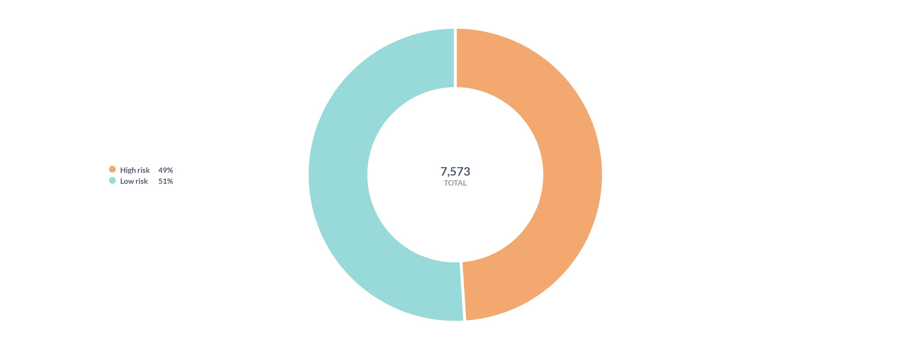
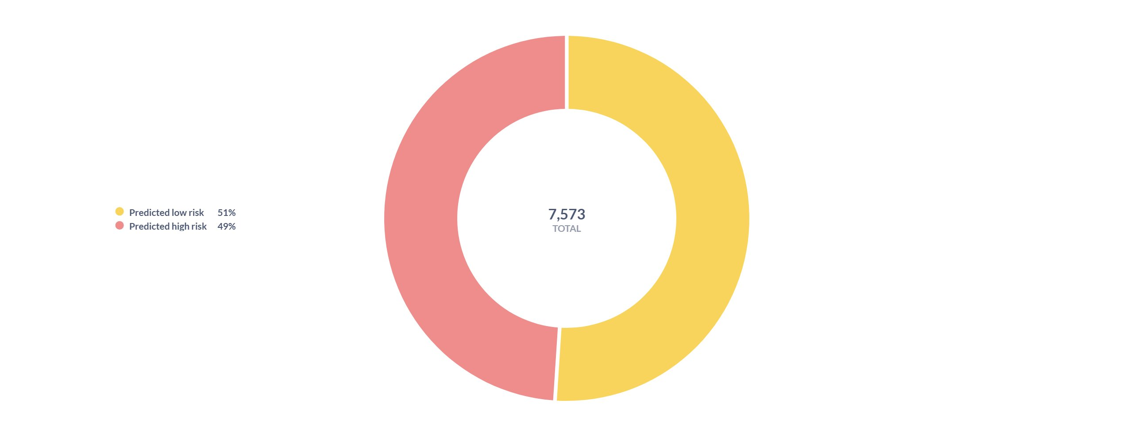
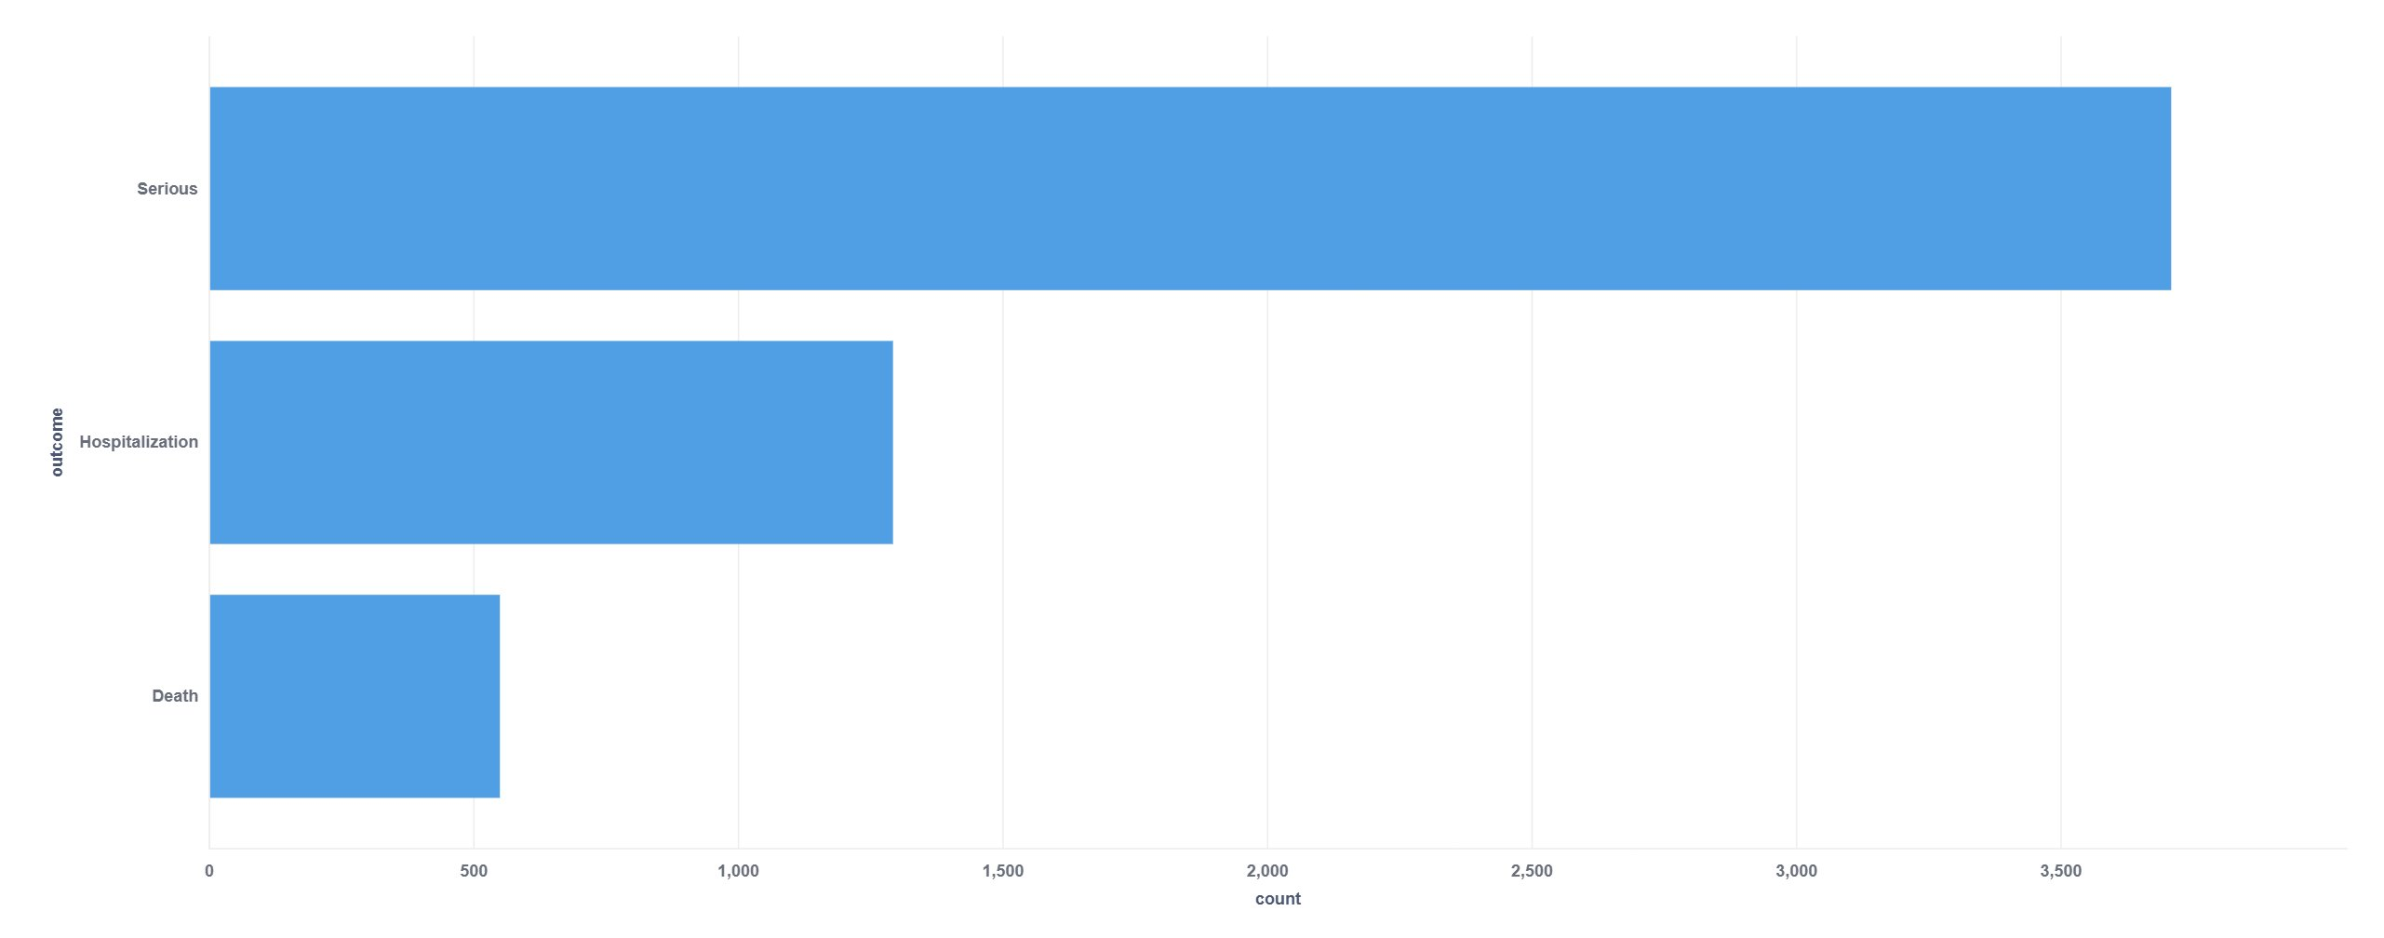
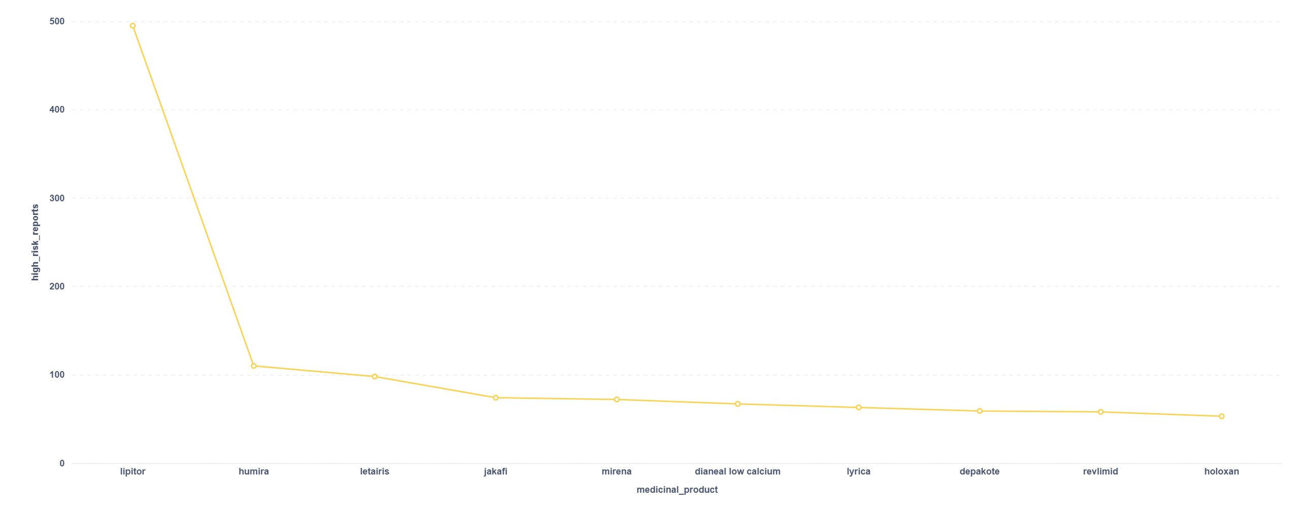
Metabase Dashboard — Visual Insights
Key charts from the automated pharmacovigilance analytics platform
Actual Risk Distribution
Model Prediction Distribution
Serious Outcomes Breakdown
Top Medicines by High-Risk Reports
CSCI461 — Introduction to Big Data | Spring 2026 | Nile University

