Slide 1


HotOrNot: Tracking company attractiveness and profitability from financial news streams
Euan O’Neill
Notes:
Hello, my name is Euan and my project was on Tracking company attractiveness and profitability from financial new streams

Slide 2

Motivation
Create a tool to aide financial traders
Use sentiment of articles to calculate an attractiveness score of a company
Notes:
So, the main motivation of the project was to create a tool that could aide financial traders in deciding what companies to invest in
This would be done by analysing the sentiment of articles to calculate an attractiveness score and award a Hot or Not verdict for a given company

Slide 3

Background
Notes:
Before work could begin on the project some background work was done to better understand the projects domain

Slide 4
Academic Review
Machine learning
Stock Prediction
Named Entity Recognition
Sentiment Analysis
Sentence Extraction
Notes:
The project covered various fields, ranging from Machine learning to sentiment analysis
And as such various research papers were read throughout the project to better understand these fields

Slide 5
Competitors
Investing.com
Trading View
Stock Analysis
Notes:
Competitor sites were also analysed to gauge the key features and attributes of similar sites and the systems we could potentially implement into our own system
Investing.com, Trading View and Stock analysis were among the sites reviewed with each having its own pros and cons
It was found that all sites provided easy searching functionality and displayed key financial and statistical data
Therefore it was decided we should do the same

Slide 6
Requirements
Notes:
With the background work done the next step was to work out what the requirements of the system would be

Slide 7
Requirements Gathering
User Studies
Backend & Frontend
MoSCoW
Must
Should
Could
Won’t Have
Notes:
In order to gather these requirements, various user stories were created to identify the actions and tools a potential user would need
These user stories were then turned into a list of frontend requirement for the webapp
And from these frontend requirements a list of backend requirements could be created by looking at what was needed to facilitate those features
In order to rank the importance of each requirement the MoSCoW method was used to organise them into Must, Should, Could and Won’t Have categories.

Slide 8
Backend Requirements
Must
Article Collector
Data storage
Context Identification
Sentence Extraction
Sentiment Analysis
Stock Prediction
Should
Accurate context analysis
Accurate Sentiment analysis
Accurate Prediction
Variety of Companies
Could
Prediction Options
Deployed and accessible
Notes:
Here we can see the list of Backend requirements created

Slide 9
Frontend Requirements
Must
Home Page
Company Page
Search Bar
Filters and Tags
Prediction Results
Stock Graph
Should
Related Companies
Website Design
Could
Additional Company information
Personalization
Article Snippets
Notes:
And here Is the frontend requirements created

Slide 10
Design
Notes:
So, with the list of requirements for the project complete we could then move to Design

Slide 11
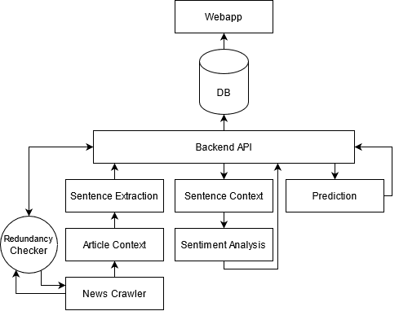
System Architecture Original
Notes:
An initial design of the system Architecture was created and used for the first couple months of the project
however, as the system progressed it was realized that this design could be improved upon

Slide 12
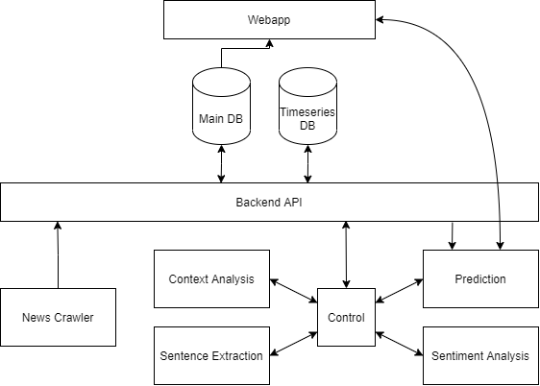
System Architecture Revised
Components
Backend API
Context Analysis
Control
Main DB
News Crawler
Prediction
Sentence Extraction
Sentiment Analysis
Time series DB
Webapp
Notes:
Therefore a revised architecture was created that took advantage of a more modular design, with components acting more as services to the overall system.
Well go through each part of the system and discuss it in more detail

Slide 13
Backend
News Cralwer
Sentence Extraction
Context Analysis
Sentiment Analysis
Prediction
Backend API
Swagger Documentation
Control Component
Management logic
Notes:
The backend system is where Articles and sentences are processed
And predictions are made for companies/
The backend consist of seven components and we’ll discuss each ones role and purpose in the system

Slide 14
New Crawler
Collects Articles from seven well established news sources
Inputs Articles directly into the database
Wall Street Journal
TIME
BBC
Economic Times
CNBC
Financial Times
Fortune
Notes:
The news crawler is what collects article for the system
And crawls these articles from finical RSS feeds from seven well established news sources
These Articles are then inserted directly into the database

Slide 15
Sentence Extraction
Extracts sentences from Articles Transcript
Input: Transcript of Article
Output: List of sentences
Notes:
When New articles enter the system they are divided into separate sentences using the sentence extraction component
Dividing articles in to sentence allows for different contexts and sentiments to be captured across a single article

Slide 16
Context Analysis
Analyses text of Articles and sentences to understand what companies are being discussed
Input: Transcript of Article
Output: List of potential Companies
Input: Text of Sentence
Output: Stock code of company
Notes:
The context analysis component is used to understand what companies are being discussed in an Article of Sentence

Slide 17
Sentiment Analysis
Awards sentiment score ranging from 1 to -1
Input: Text of Sentence
Output: Sentiment polarity score
Notes:
The sentiment analysis component is used to award sentences a sentiment score ranging from 1 to -1
With one being very positive and -1 being very negative
This stage is important as the sentiment score awarded here will be used in the prediction component

Slide 18
Stock Price Prediction
Predicts future price stock price for a company
Input: Stock code of company
Output: Price predictions and verdict
Input: Stock code of company and time frame
Output: Price predictions for given time frame
Notes:
The prediction component is what makes the future stock price predictions and gives Hot or Not verdicts for companies
The component has a standard prediction used to calculate the verdict displayed on the main page of the webapp
And also a custom prediction option

Slide 19
Control Component & Backend API
Backend API acts as gateway to database
Control component communicates with components
Notes:
The backend API acts as a gateway to the database providing various APIs outlined using Swagger
The context analysis, stock prediction, sentence extraction and sentiment analysis components acts as microservices to the control component
with each exposing different APIs to help process Articles and sentences
The control component then contains the management logic for processing Articles and sentences in the system and is responsible for sending them to the right components and then
Using the backend API to update the database with the results.

Slide 20
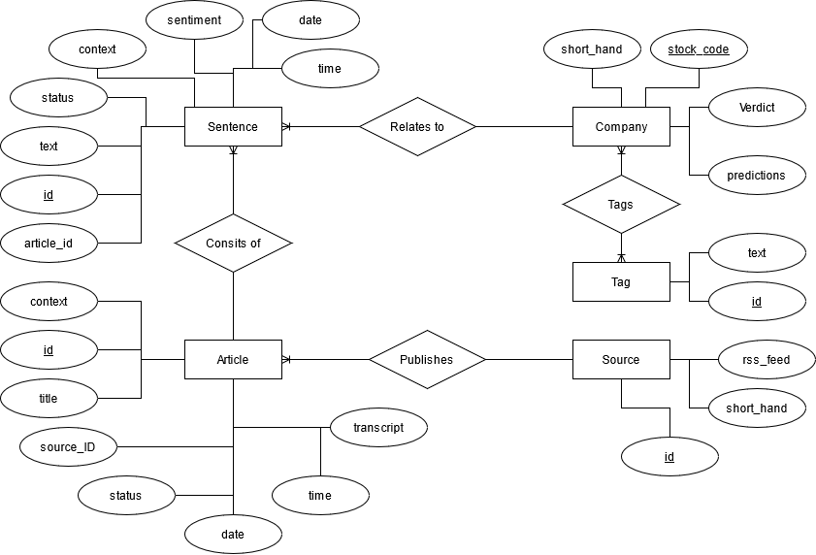
Database
Main Database
Source
Article
Sentence
Company
Tag
Time series Database
Prediction Datapoints
Notes:
Moving onto the database now it was decided the system would have two databases
First the “Main database” would house all the information regarding Sources, Articles, Sentences, Companies and Tags
Then Second the Time series database would contains all the sentiment datapoint.
Having a separate time siries database allows for much easier and faster querying of temporal data for the prediction component

Slide 21
Webapp
Home page
Company page
Iterative Wireframe designs
Notes:
With the backend and database design outlined the only thing to do was to decide on the webapp designs
The webapp has two main pages, that being the Home page and company page
An iterative wireframe design was used to ensure that all requirements could be met with the design

Slide 22
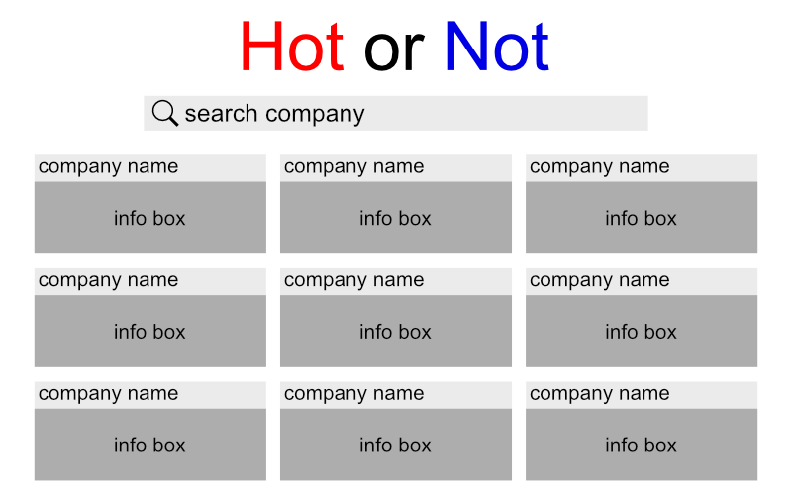



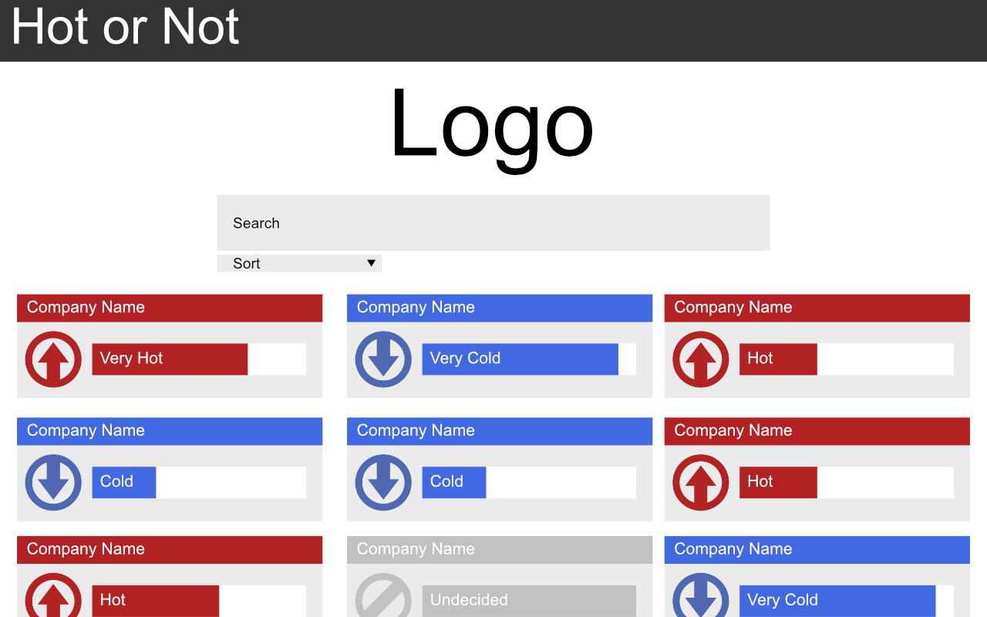
Frontend: Home Page
Displays list of companies to select from
Hot, Not or Hold verdict
Notes:
The Home page is the first page a user will go to when entering the system and contains a broad list of the companies in the system
Each company is represented as a box with its hot or not verdict being shown.

Slide 23
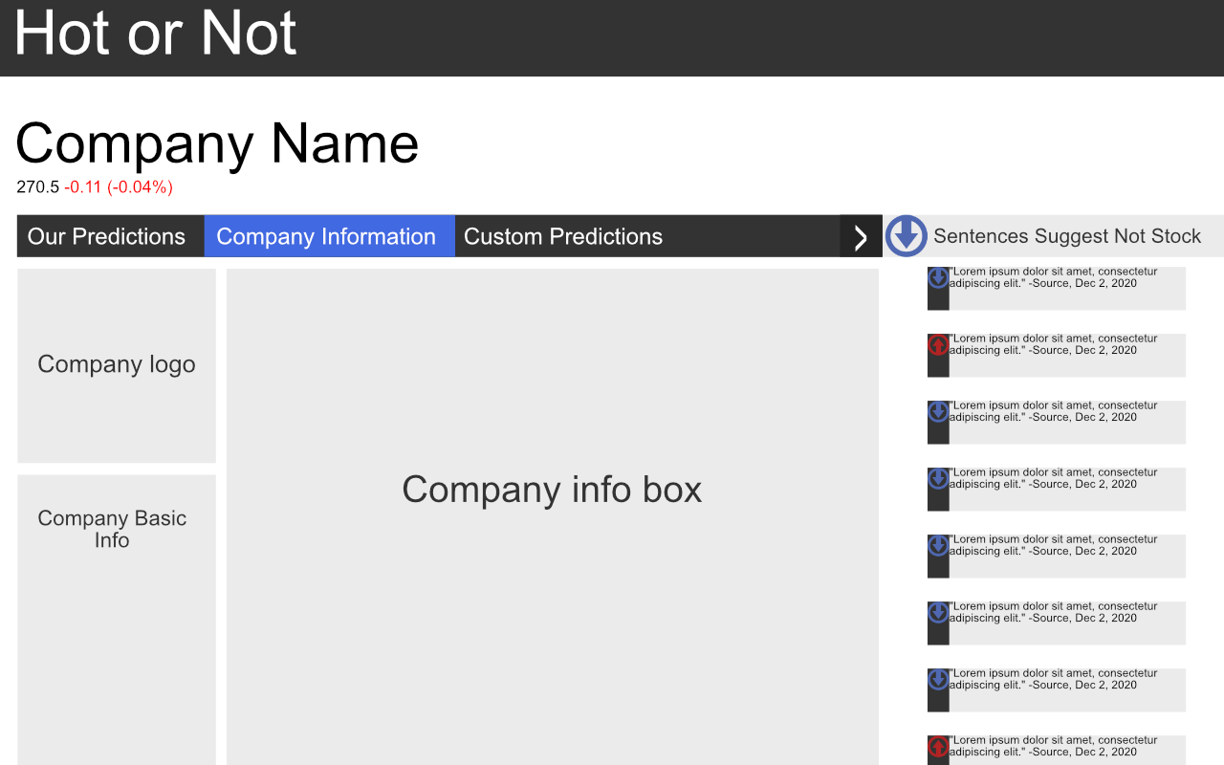
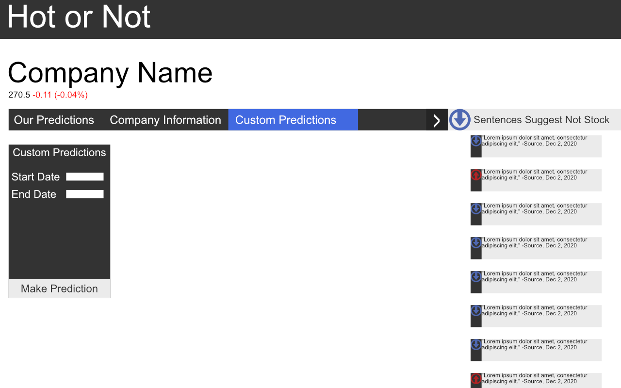
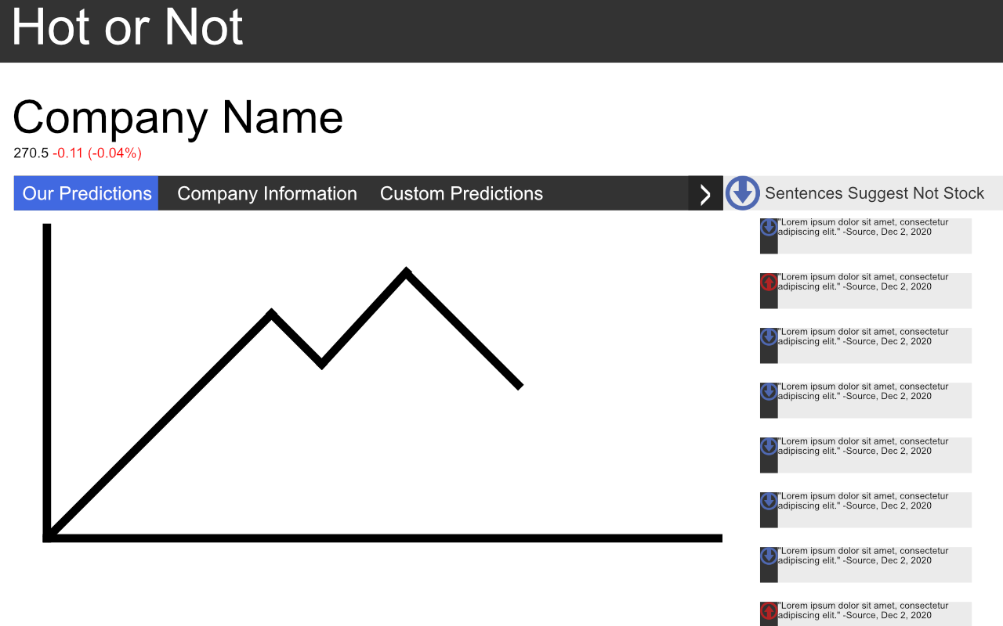
Frontend: Company Page
Our predictions tab
Company information tab
Custom predictions tab
Sentences relating to company
Notes:
The company page houses the company specific information and has four key parts
-Our predictions tab shows the historical stock price and predicted price for the company
-The company information tab has general company profile
-The Custom prediction tab is where users can create their own predictions
- And finally at the side of the company page a rundown of the various sentences for the company is shown

Slide 24
Implementation
Notes:
With the design of the project outlined we can move onto how it was implemented

Slide 25
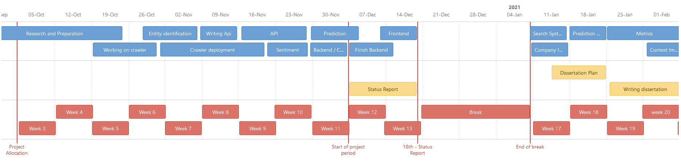
Software Engineering
Github
Confluence
Notes:
Github was used as the change management system for the project
And Confluence was used to manage time keeping and road mapping for the project

Slide 26



Backend
Flask
SQLAlchemy
NLTK
Spacy
Vader Sentiment
Scikit-learn
Yfinance
Notes:
To implement the backend components Flask was widely used to create the various APIS each component needed to expose.
The backend API was implemented using SQL alchemy which, through the use of models, creates various helpr functions to query the database
- The sentence extraction component tokenizes article transcripts into a list of sentences through the use of NLTKs natural language processing model
Spacy’s named entity recognition model was used in the context analysis component to find organisation entities in text
VaderSentiment was used in the sentiment analysis component to award the sentiment polarity score
Scikit-learn allowed for the easy creation of different models for the prediction component with Yfinacne being used to retrieve the finical information for a given company
An SVM model is use to predict both future sentiment and future stock prices for a company
The control component was implemented as a basic python script which is notified when a new article enters the system.
When it receives a notification it is then able to process the article accordingly

Slide 27


Database
Database implanted using PostgreSQL
pgAdmin allowed for easy implementation
Time Scale for Timeseries database
Notes:
The databases were both implemented using the Potsgres
pgAdmin a graphic interface for postgres allowed for the databases and their tables to be easily implemented
To achieve the time series functionality, Timescale an extension for postgres was added to the timesreis databes
which through the use of Hyper tables partitions data for quicker time based query

Slide 28

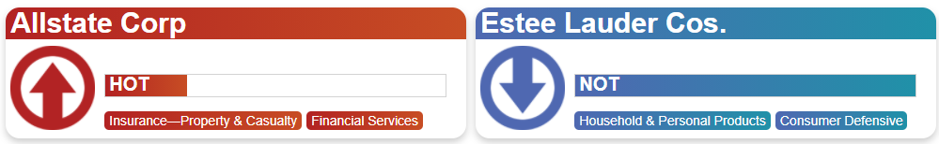
Frontend
Implemented using Django Framework
Time taken to keep consistent and simple design
Notes:
The frontend was implemented using the Djnago and a lot of time was spent getting the design of the webpage right
We will see more of the frontend later during the demonstration

Slide 29


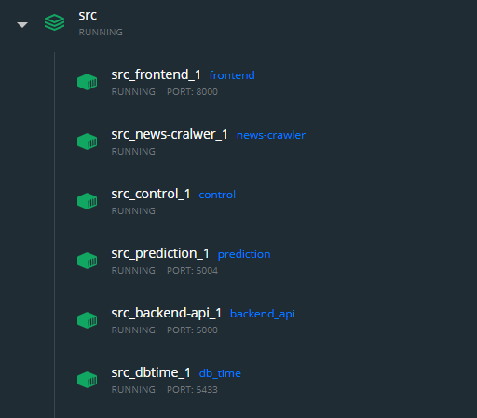
Containerization
Docker used to turn component into containers
Docker-compose used to turn containers into single application
Notes:
Once the components were operational they were containerized through Docker and then turned into a single application with Docker compose
This allowed for the system to be easily run across different machines

Slide 30
Evaluation
Notes:
With implementation complete we can now move onto the evaluation of the project

Slide 31
Backend
Context Analysis
System switched from Spacy to Stanza NER
Minor overall prediction improvement
Sentiment Analysis
System switched from Vader to Text Blob
Minor overall prediction improvement
Stock Prediction
System switched from SVM model to Decision Tree Model
Major overall prediction improvement
Notes:
Throughout the project the backend system was evaluated to better improve the performance of predictions
Context analysis, Sentiment Analysis and Stock prediction were the three key components evaluated
Individual component evaluation was preformed to assess what technologies and models should be used
And once an improvement was seen on the individual level, end to end testing was applied to see if there was an improvement in the overall prediction performance.

Slide 32
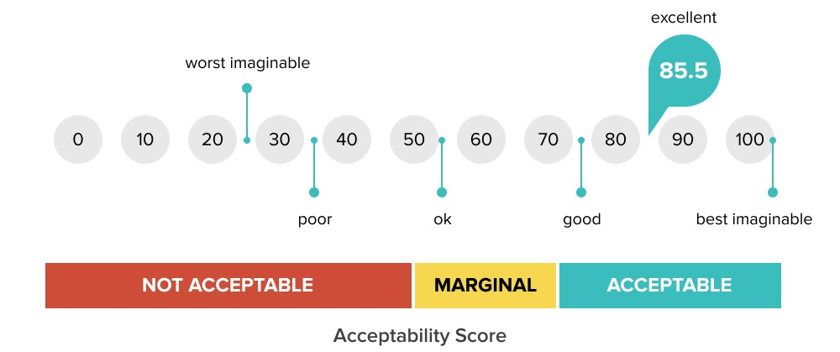
Frontend User study
System Usability Scale used as questionnaire
Six participants took the test
Average score: 88.75
Notes:
Once the frontend was complete a user study was carried out using the system usability scale
This asked users to answer ten question giving them a score of 1 to 5 with one being strongly disagree and 5 being strongly agree
Averaging the scores from the six participants the system score 88.75 which is an acceptable score

Slide 33
Demonstration
Notes:
We will now move onto a demonstration of the final system

Slide 34
Conclusion
Notes:
In conclusion we created a system which is able to collect news articles, analyze those articles
and given an attractiveness score for companies
This Verdict is then displayed for users through a webapp along with other key information
Overall this has been an invaluable experience into how to undertake a large project

Slide 35
Thanks for watching
Notes:
In conclusion we created a system which is able to collect news articles, analyze those articles
and given an attractiveness score for companies
This Verdict is then displayed for users through a webapp along with other key information

