Slide 1
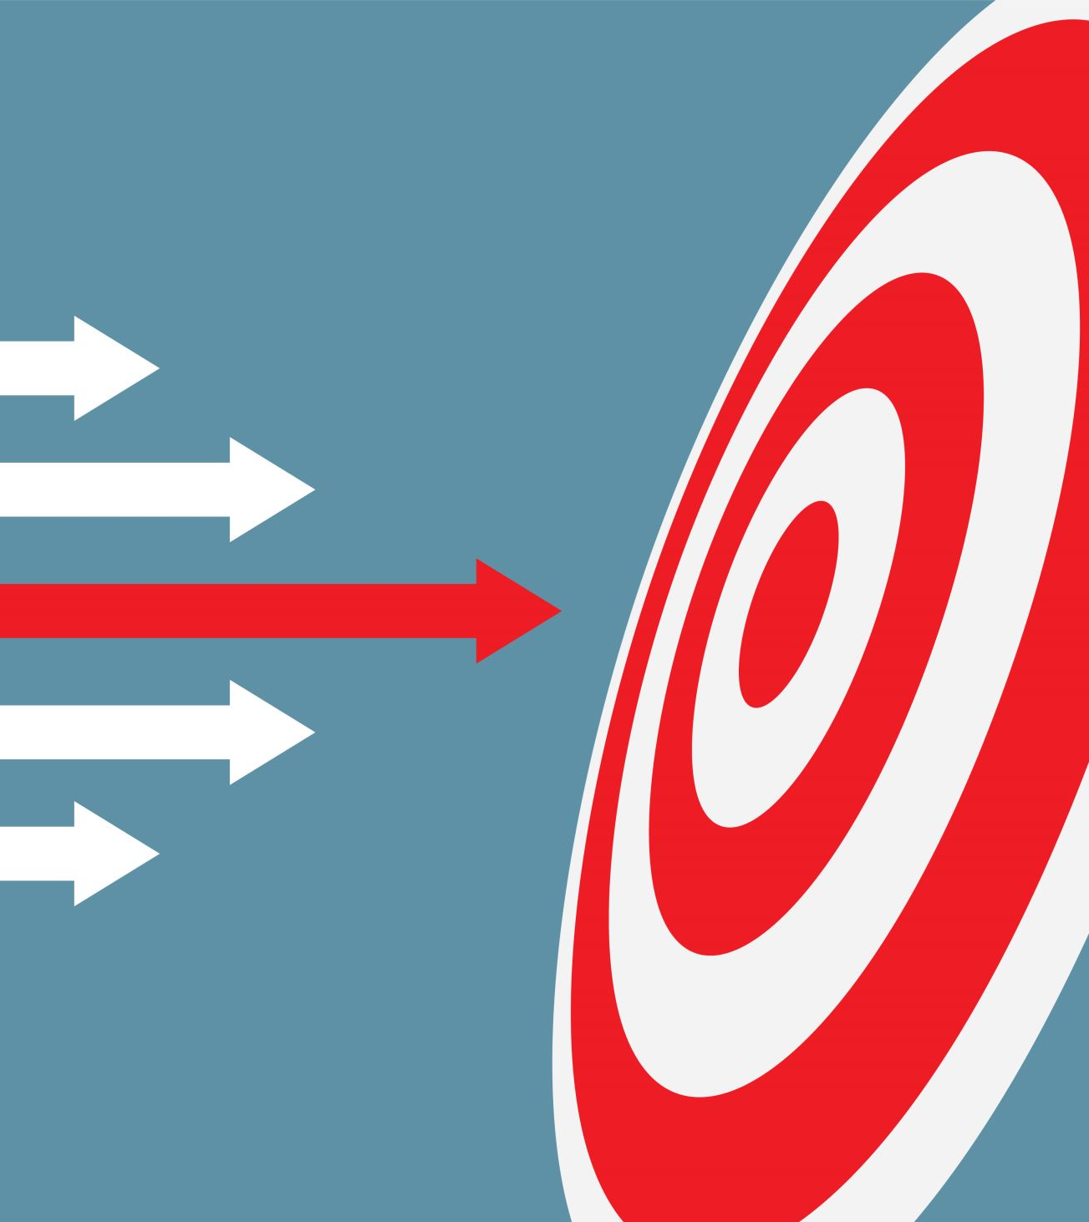
Mall Customer Segmentation Analysis
Unveiling Customer Patterns for Targeted Marketing
ZHANG ZEKAI

Slide 2
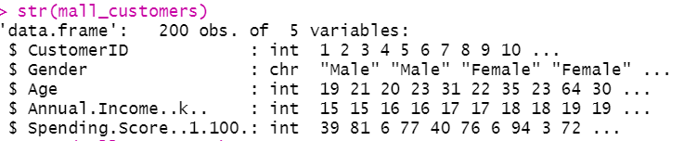
Dataset: Mall customer data with 200 entries
Features: Customer ID, Gender, Age, Annual Income, Spending Score
Objectives:
Identify distinct customer segments
Understand customer characteristics
Develop targeted marketing strategies

Slide 3
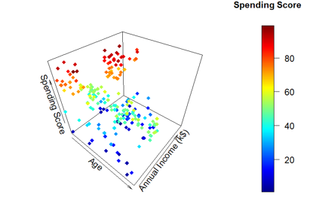
Methodology
Exploratory Data Analysis (EDA)
Principal Component Analysis (PCA)
K-means Clustering
Tools used: R with tidyverse, cluster, factoextra, and Rmixmod packages

Slide 4
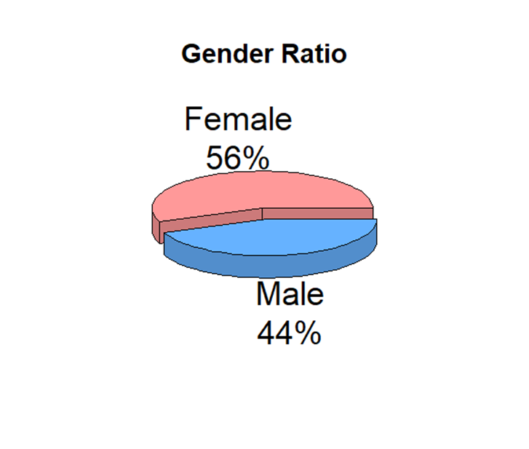
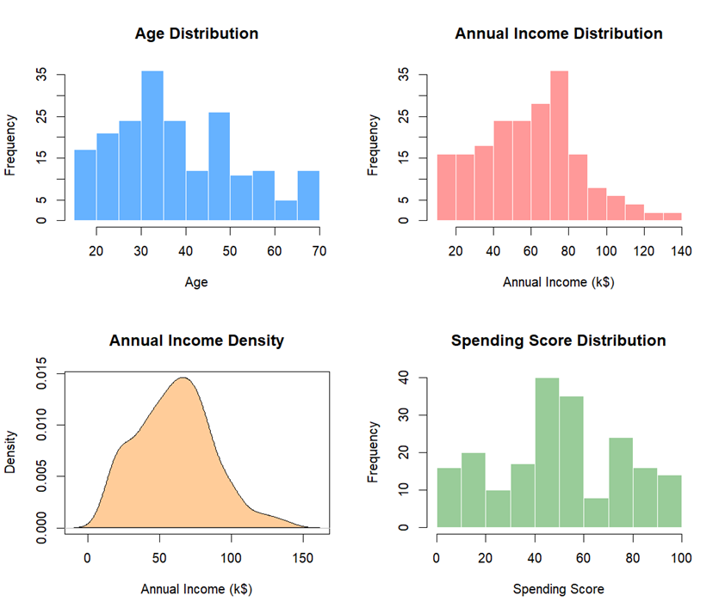
Exploratory Data Analysis
Age: Range 18-70, Mean 38.85, SD 13.97
Annual Income (k$): Range 15-137, Mean 60.56, SD 26.26
Spending Score: Range 1-99, Mean 50.20, SD 25.82
Gender: Female 56%, Male 44%

Slide 5
Exploratory Data Analysis
Age: The average age is 38.85 years with a standard deviation of 13.97, indicating a fairly wide age distribution.
Annual Income: The average annual income is $60.56k, with a standard deviation of $26.26k, showing a diverse income range among the customers.
Spending Score: The mean spending score is 50.20 with a standard deviation of 25.82, indicating varying spending habits.

Slide 6
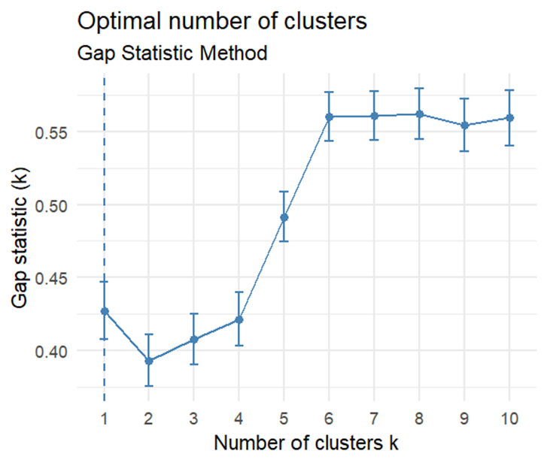
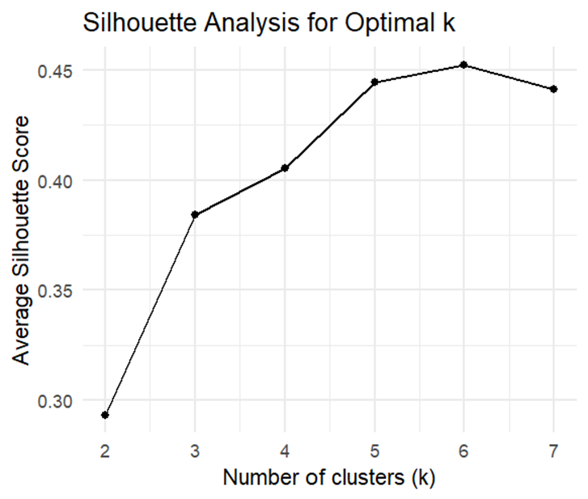
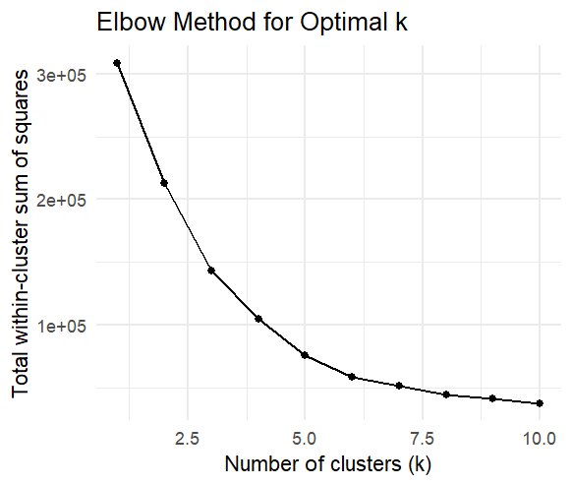
Determining Optimal Clusters
Methods used:
Elbow method
Silhouette analysis
Gap statistic
Optimal number of clusters: 6

Slide 7
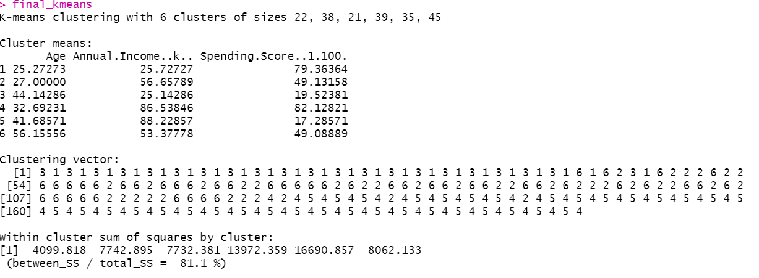
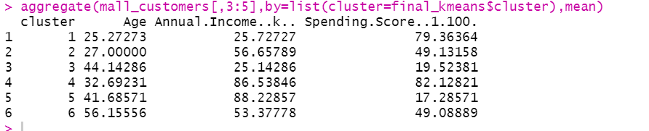
K-means Clustering Results
Cluster sizes: 22, 44, 38, 35, 22, 39
Between SS / Total SS: 81.1%
Revealing that a significant portion of the total sum of squares is within the clusters.

Slide 8
Cluster Characteristics
Cluster 1: Young, low income, high spenders (n=22)Age: 25.27, Income: 25.73k, Spending: 79.36
Cluster 2: Senior, average income & spending (n=44)Age: 56.34, Income: 53.70k, Spending: 49.39
Cluster 3: Young adults, above-average income, average spending (n=38)Age: 27.00, Income: 56.66k, Spending: 49.13
Cluster 4: Middle-aged, high income, low spending (n=35)Age: 41.69, Income: 88.23k, Spending: 17.29
Cluster 5: Middle-aged, low income, low spending (n=22)Age: 44.32, Income: 25.77k, Spending: 20.27
Cluster 6: Young adults, high income, high spending (n=39)Age: 32.69, Income: 86.54k, Spending: 82.13

Slide 9
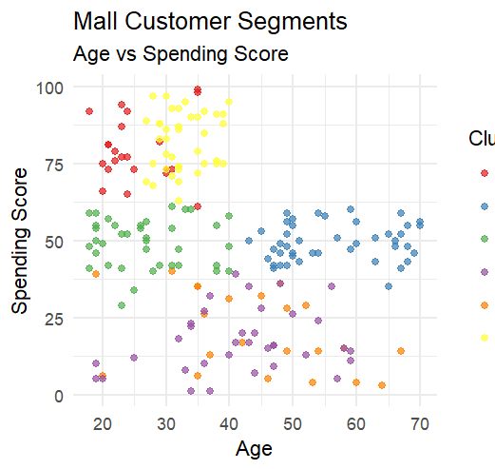
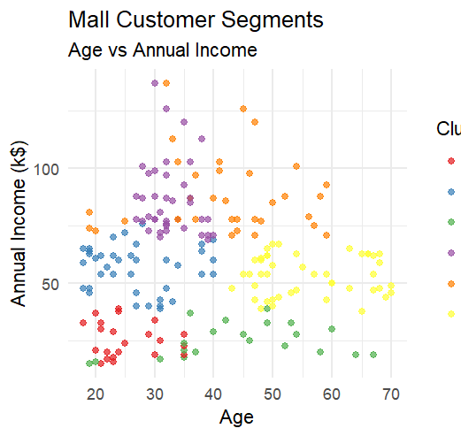
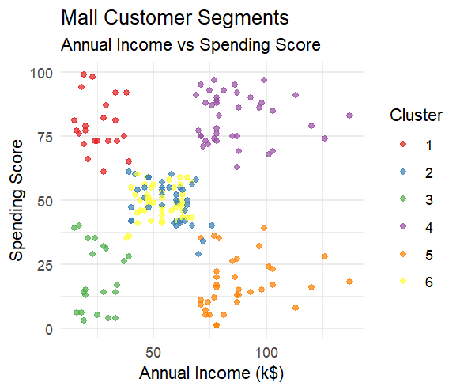
Cluster Visualizations
Annual Income vs Spending Score
Age vs Spending Score
Age vs Annual Income
color-coded by cluster

Slide 10
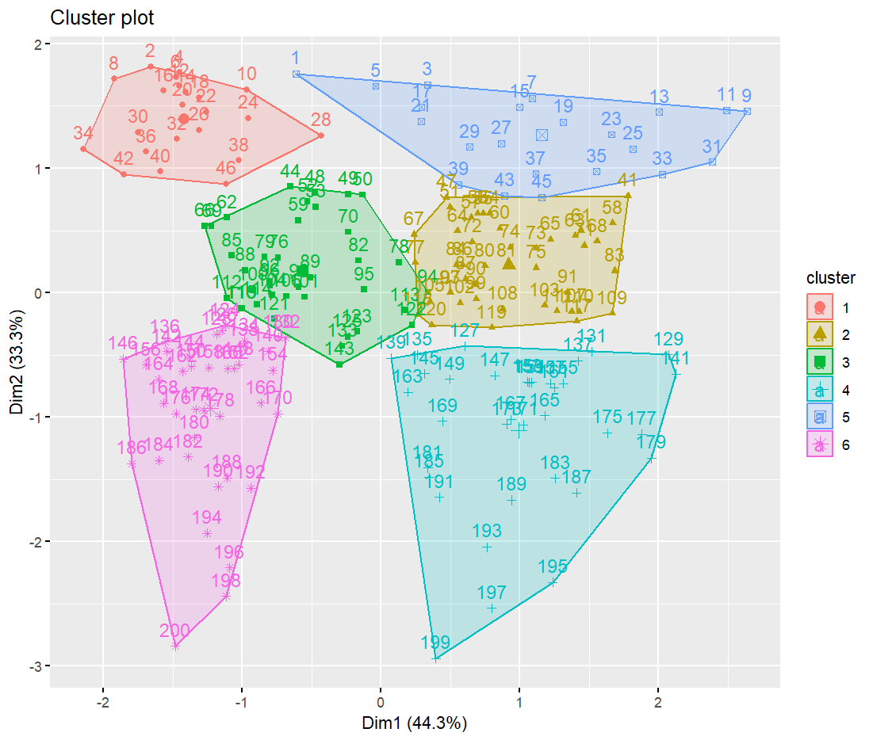
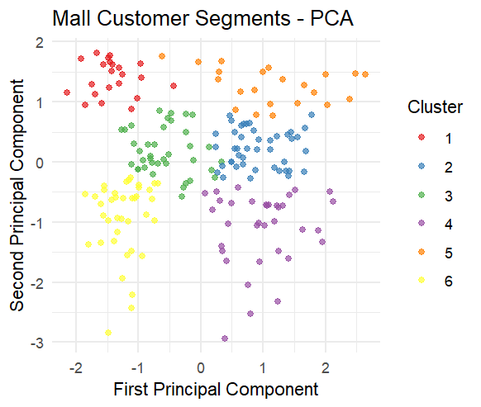
PCA Visualization
Scatter plot of first two principal components
PC1: Primarily age and spending score (opposite directions)
PC2: Primarily annual income

Slide 11
PCA Visualization
The first two principal components (PC1 and PC2) explain 77.58% of the total variance.
01
PC1 is strongly influenced by age and spending score, while PC2 is mainly driven by annual income.
02
The PCA results provide a useful dimensionality reduction for visualizing customer segments.
03

Slide 12
Conclusions and Recommendations
Identified 6 distinct customer segments
Key factors: Age, Income, and Spending
Patterns Recommendations:
Target young, high-income, high-spenders with premium products
Develop loyalty programs for senior, average spenders
Create budget-friendly options for low-income segments
Investigate reasons for low spending in high-income, middle-aged group
Tailor marketing messages and channels to each segment's characteristics

Slide 13

Conclusions and Recommendations
PCA:
PCA visualization confirms the separation of clusters: The PCA plot shows clear separation between the six segments, indicating that the chosen features effectively capture the underlying customer differences.
Future Research:
Explore additional features such as purchase history, frequency of visits, and product preferences to refine the customer segmentation model.
Investigate the use of other clustering algorithms, such as hierarchical clustering or DBSCAN, to compare their performance with K-means.
Evaluate the impact of different marketing strategies on customer retention and profitability for each segment.
Conclusion:
This study demonstrates the effectiveness of K-means clustering for customer segmentation in a mall setting. By understanding the unique characteristics of each segment, retailers can develop targeted marketing strategies to enhance customer satisfaction, increase sales, and foster long-term loyalty.

