Slide 1
Brian AI
20 documents
Industrial knowledge intelligence for Bharat Refinery, Jamnagar
18 compliance clauses
3 failure alerts
Built for a working prototype demo, not a concept mockup.
Brian AI | ET AI Hackathon
01

Slide 2
THE OPERATING PROBLEM
Critical plant knowledge is scattered when engineers need it most.
•
Evidence sits across P&IDs, SOPs, work orders, inspection records, manuals, incidents, regulatory files, and expert memory.
The cost is not search time alone. It is delayed action.
•
Manual evidence search takes hours, and compliance gaps surface late.
•
Repeated failure patterns are easy to miss when records are disconnected.
Brian AI | ET AI Hackathon
02

Slide 3
WHAT BRIAN AI DOES
Brian AI turns a document pile into a decision surface.
AI Copilot
Knowledge Graph
Compliance Intelligence
Streaming answers with citations.
Equipment, documents, clauses, alerts.
18 OISD/PESO checks with evidence.
Failure Alerts
Field PWA
Expert Capture
Recurring patterns from work orders and inspections.
Camera scan, manual tag fallback, sunlight mode.
Interview flow into searchable knowledge.
Brian AI | ET AI Hackathon
03

Slide 4
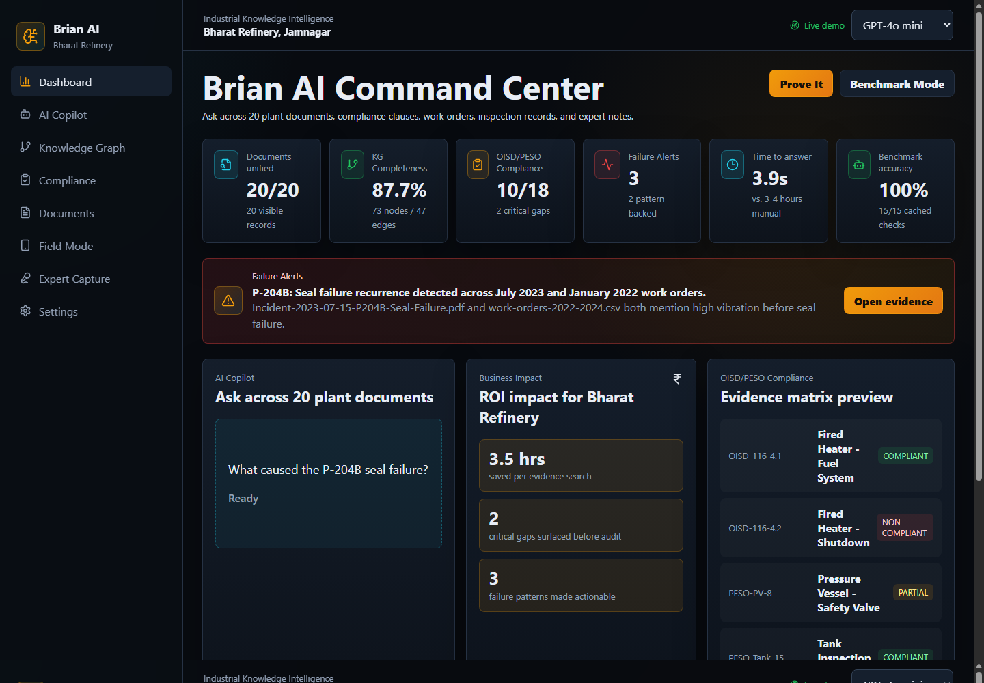
WORKING PROTOTYPE
The command center already runs against a refinery corpus.
Dashboard KPIs, ROI impact, failure alerts, compliance preview, benchmark mode, and evidence query are live.
•
20 generated industrial documents are loaded.
•
P-204B seal failure can be answered with citations.
•
Benchmark mode spot-checks cached answers against live retrieval.
Brian AI | ET AI Hackathon
04

Slide 5
TECHNICAL IMPLEMENTATION
A reliable local demo with clean provider upgrade hooks.
React + Vite
FastAPI
Backend services
Seeded data layer
Provider path
→
→
→
→
Dashboard, Copilot, Field PWA, Settings
REST and SSE endpoints
Ingestion, RAG, graph, compliance, OCR, alerts
107 cached chunks, benchmark cache, graph manifest
OpenRouter, SQLite vectors, Neo4j AuraDB
Brian AI | ET AI Hackathon
05

Slide 6
BUSINESS IMPACT
The value is faster evidence, earlier gaps, and fewer missed patterns.
3.5 hrs
2
3
15/15
saved per evidence search
critical compliance gaps surfaced
failure patterns made actionable
cached benchmark checks available
Brian AI | ET AI Hackathon
06

Slide 7
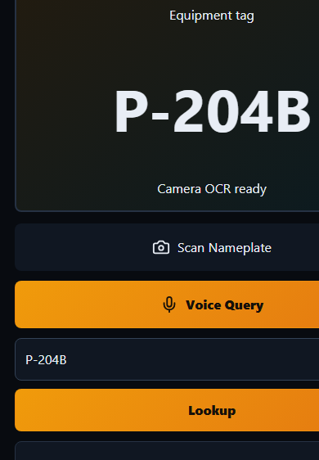
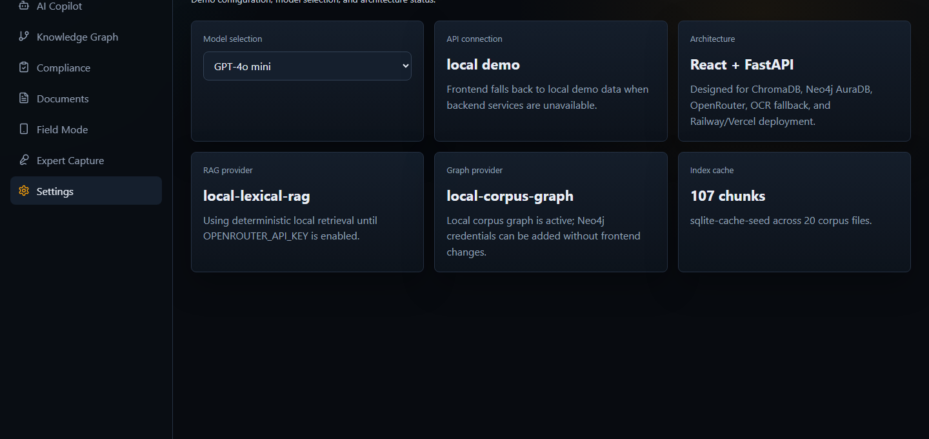
FIELD AND READINESS
Field mode is built for plant conditions; Settings shows deployment readiness.
Camera scan, manual tag fallback, voice query, cached answer, and sunlight mode are visible in the field surface.
Brian AI | ET AI Hackathon
07

Slide 8
NEXT STEP
Pilot Brian AI on a real plant corpus and turn search into action.
•
Connect exported DMS, SAP PM, and inspection documents.
The prototype is ready to demo today.
•
Enable OpenRouter and Neo4j AuraDB; SQLite vectors require no separate credentials.
•
Run a refinery safety and maintenance pilot around compliance gaps and repeated failures.
Brian AI | ET AI Hackathon
08

