Slide 1
Android App Development
Getting stared with Android

Slide 2

Learning Outcomes
Introduction to Android Platform
Introduction to Android Apps Core Components
Build a Basic App
Setup your Environment
Run your App on a Real Device
Run your App on a Virtual Device

Slide 3
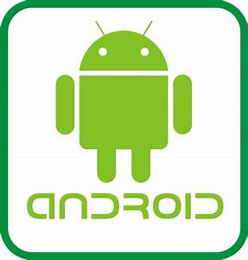
What is Android?
Android is an operating system which uses Linux kernel, and it is Java based
It is maintained by Google and it was purchased from Android, Inc. in 2005
It runs in many handheld devices such as tablets, smartphones, smart watches, TVs, etc
It is the 1st mobile operating system and is the most used one worldwide
It has over 2.5 million apps published in the Play Store
There are over 3 billion active Android devices worldwide, and that number is still growing.
Google releases code periodically as open source
Easy to use, customise and license than other mobile OS
Notes:
Android is the most popular mobile operating system worldwide,
There are billions of Android users worldwide, all waiting to download your next great idea
Android is a comprehensive open-source platform based on Linux and championed by Google
It’s a powerful development framework that includes everything you need to build great apps
What’s more, it enables you to deploy those apps to a wide variety of devices—phones, tablets, and more

Slide 4

Number of available applications in the Google Play Store from December 2009 to June 2023
Google Play: number of available apps 2009-2023
Note(s): Worldwide; December 2009 to June 2023; figures have been rounded
Further information regarding this statistic can be found on page 8.
Source(s): Android; Google; Data.ai; AppBrain; ID 266210
2

Slide 5
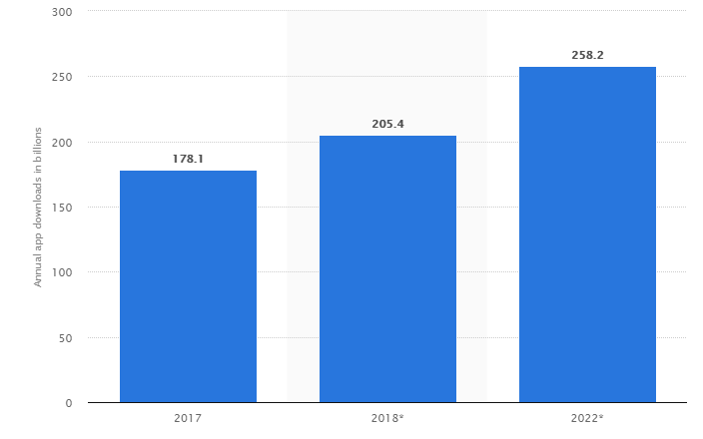
Why Develop for Android?
Why a mobile app and not a mobile website?
A number of factors should be considered, including target audiences, available budget, intended purpose and required features
A mobile app is preferred if you develop the following¹:
Interactivity/Gaming
Regular Usage/Personalization
Complex Calculations or Reporting
Native Functionality or Processing Required
No connection Required
People love mobile apps
Figure 1: Annual app downloads for year 2017, 2018 and 2022²
1 https://www.hswsolutions.com/services/mobile-web-development/mobile-website-vs-apps/
2 © Statista 2020

Slide 6
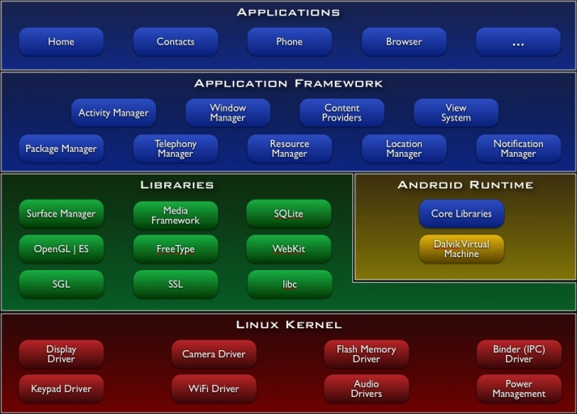
Android Architecture
Figure 2: Android Architecture¹
1 provided by SIMPLE DEVELOPER

Slide 7
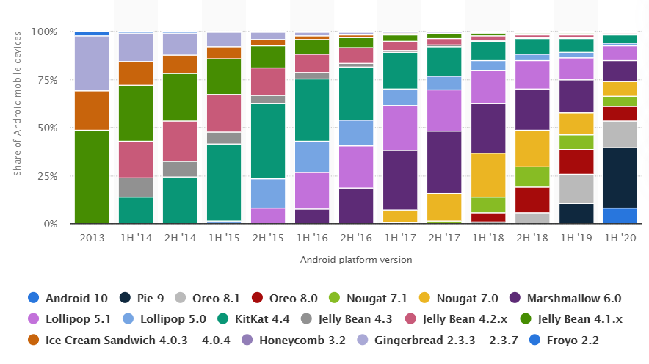
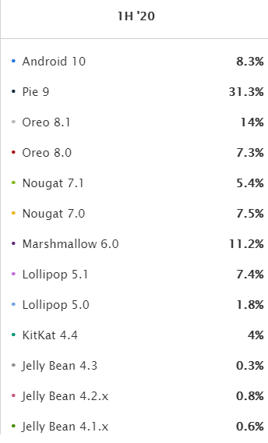
Android Platform Version
Figure 3: Android Platform Version¹
1 © Statista 2021
Check the latest Android SDK: https://developer.android.com/studio/releases/platforms#10
Check the latest distribution dashboard: https://developer.android.com/about/dashboards

Slide 8
Leading Android apps in the Google Play Store in Great Britain in September 2022, by revenue (in U.S. dollars)
Leading Android apps in Great Britain 2022, by revenue
Revenue in U.S. dollars
34
Description: In September 2022, Coin Master was the highest-grossing app in the Google Play Store in Great Britain. The game generated more than 6.38 million U.S. dollars in revenues from Android users. Mobile gaming app Candy Crush Saga was the second-most popular app with over 2.16 million U.S. dollars in revenues from British users in the examined period. Read more
Note(s): United Kingdom (Great Britain); September 2022; total revenue in Google Play Store; downloads to devices in Great Britain.
Source(s): Airnow

Slide 9
Android Studio Development Kit (SDK)
Ladybug | 2024.2.1
Ladybug | 2024.2.1
Ladybug | 2024.2.1
Android Studio provides the fastest tools for building apps on every type of Android device
It replaces previous Eclipse-based-environment
Based on Intellij IDEA editor
Latest version stable version is Ladybug | 2024.2.1
It is free and requires just few clicks to download
It is also available for Windows, macOS, Linux, Chrome OS
It supports Java, Kotlin and C++

Slide 10
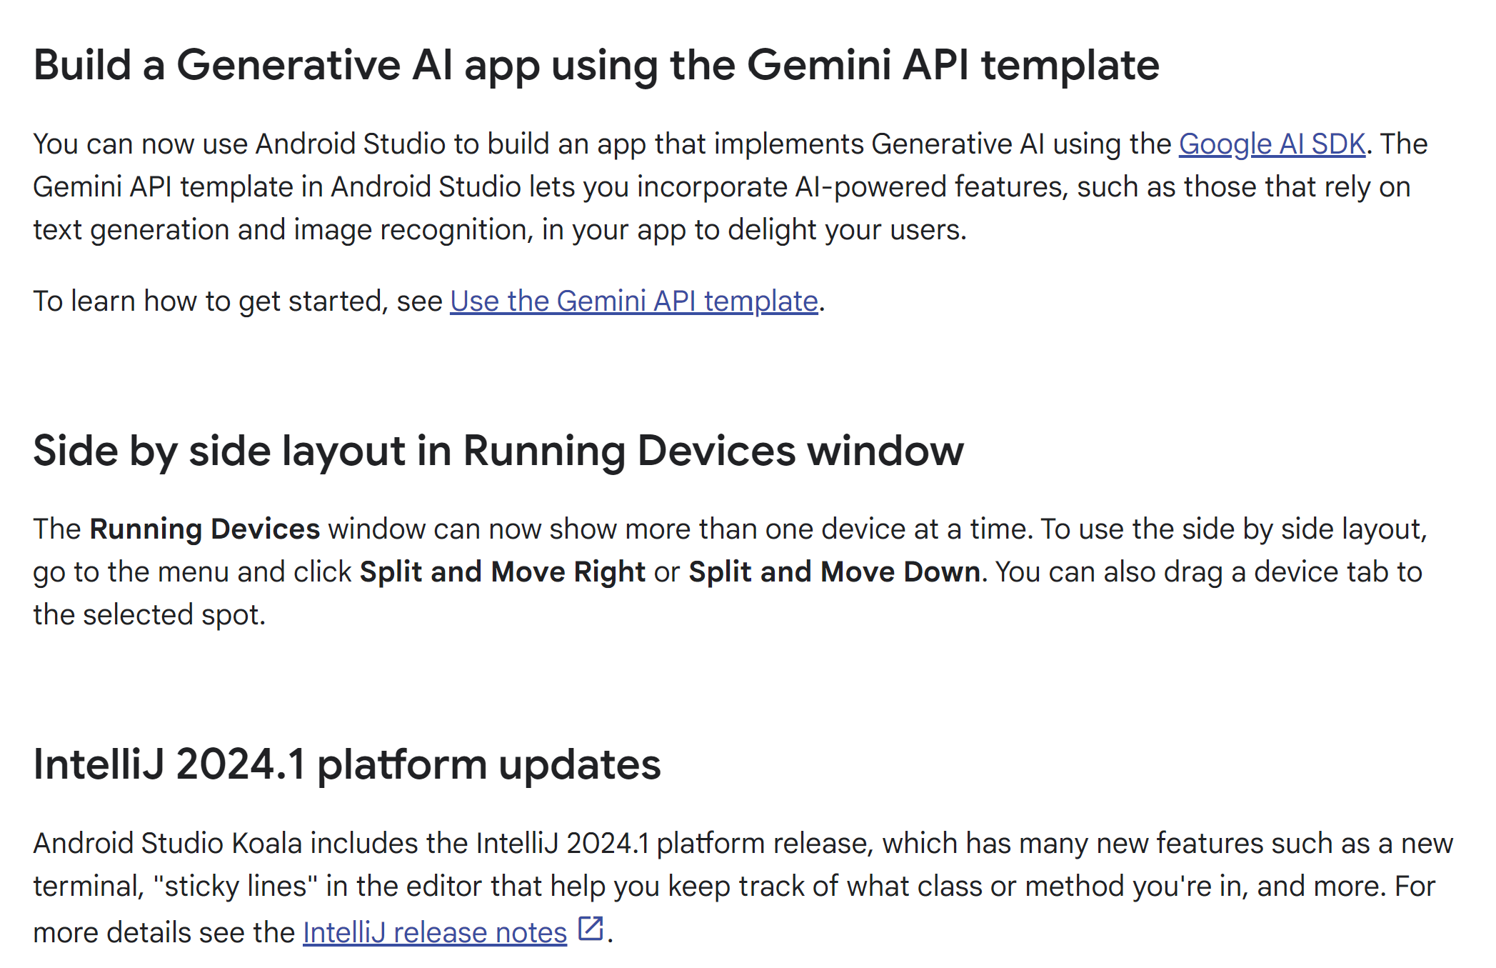
Android Studio Development Kit (SDK)
Android Studio Koala | 2024.1.1 (June 2024)
Android Studio release notes | Android Developers

Slide 11
Types of Applications
Top types of applications:
Games;
Lifestyle;
Shopping;
Travel & Local;
Sports;
Healthcare

Slide 12
Android Terminology
Activity – Single screen (supporting Java code, derived from the Activity class)
Layout Resource – An XML file that describes the layout of an Activity screen
Intent – Message to activate a component
Manifest – Describes app, its permissions
View – Something drawn on the screen
Includes layouts, controls, dialogs, etc.
Widget – Mini-view
Gradle – A build system running on Android Studio.

Slide 13
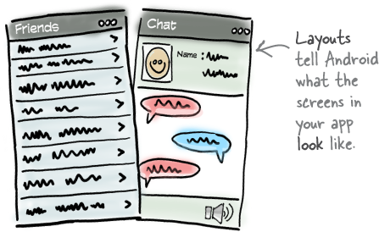
What makes up a typical Android app?
Layouts define what each screen looks like
A typical Android app is composed of one or more screens
You define what each screen looks like using a layout to define its appearance
Layouts are usually defined using a UI editor or XML, and can include components such as buttons, text fields, and labels

Slide 14
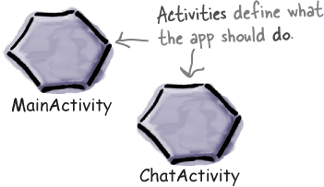
What makes up a typical Android app?
Activities define what the app does
Layouts only define the appearance of the app
You define what the app does using one or more activities
An activity is a special class that decides which layout to use and tells the app how to respond to the user
Activities are usually written in Java or Kotlin

Slide 15
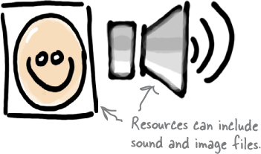
What makes up a typical Android app?
Extra resources may be needed too
In addition to activities and layouts, Android apps often need extra resources such as image files and application data.
You can add any extra files you need to the app.

Slide 16
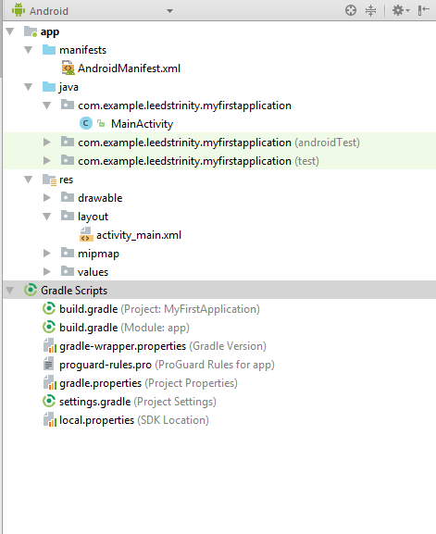
Android Project Structure
Notes:
Android apps are really just a bunch of files in particular directories. When you build your app, all of these files get bundled together, giving you an app you can run on your device.

Slide 17
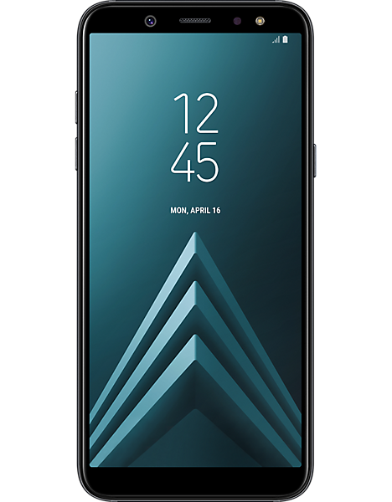
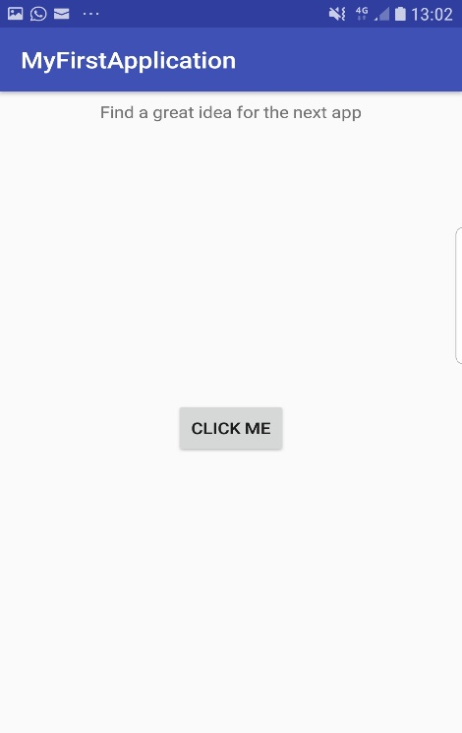



Activity_main.xml
MainActivity.java
<?xml version="1.0" encoding="utf-8"?> <android.support.constraint.ConstraintLayout xmlns:android="http://schemas.android.com/apk/res/android" xmlns:app="http://schemas.android.com/apk/res-auto" xmlns:tools="http://schemas.android.com/tools" android:layout_width="match_parent" android:layout_height="match_parent" tools:context="com.example.leedstrinity.myfirstapplication.MainActivity"> <TextView android:id="@+id/textView" android:layout_width="wrap_content" android:layout_height="wrap_content" android:layout_marginEnd="8dp" android:layout_marginStart="8dp" android:layout_marginTop="8dp" android:text="Change me" app:layout_constraintEnd_toEndOf="parent" app:layout_constraintStart_toStartOf="parent" app:layout_constraintTop_toTopOf="parent" /> <Button android:id="@+id/firstButton" android:layout_width="wrap_content" android:layout_height="wrap_content" android:layout_marginBottom="8dp" android:layout_marginEnd="8dp" android:layout_marginStart="8dp" android:layout_marginTop="8dp" android:onClick="pressMeButton" android:text="Click me" app:layout_constraintBottom_toBottomOf="parent" app:layout_constraintEnd_toEndOf="parent" app:layout_constraintStart_toStartOf="parent" app:layout_constraintTop_toBottomOf="@+id/textView" /> </android.support.constraint.ConstraintLayout>
package com.example.leedstrinity.myfirstapplication; import android.support.v7.app.AppCompatActivity; import android.os.Bundle; import android.view.View; import android.widget.Button; import android.widget.TextView; public class MainActivity extends AppCompatActivity { TextView NewText; Button ChangeText; @Override protected void onCreate(Bundle savedInstanceState) { super.onCreate(savedInstanceState); setContentView(R.layout.activity_main); NewText = (TextView)findViewById(R.id.textView); ChangeText = (Button)findViewById(R.id.firstButton); } public void pressMeButton(View view) { NewText.setText(" Find a great idea for the next app "); } }
➃
➀
➂
➁
➀
Click me!
EVENT!
Remember
➃
➁
➂
Notes:
Layouts and activities work together to define your app’s user interface. The layouts tell Android how the different screen elements should be arranged, and the activities control the app’s behavior. If your app features a button, for example, the layout specifies its position, and the activity controls what happens when the user presses it.
Here’s how activities and layouts work together when you run an app on your device:
Android starts the app’s main activity.
The activity tells Android to use a specific layout.
The layout is displayed on the device.
The user interacts with the layout.
The activity responds to these interactions, and updates the display...
...which the user sees on the device.

Slide 18
Deployment Target
Android Virtual Devices (AVDs)
Android Device

Slide 19

Creating an Android App
There are just a few things we need to do:
Set up a development environment: install Android Studio, which includes all the tools you need to develop Android apps.
Build a basic app: you’ll build a simple app using Android Studio that will display some sample text on the screen.
Run the app: you’ll run the app on a physical device and a virtual one to see it up and running.
Change the app: you’ll tweak the app to add a button and insert the required code to show the sample text up based on clicking the button and run it again.

Slide 20

Any questions

