Slide 1

Fake and Real news Detection
22AIE213 – Machine Learning
K.Rupa Rasagna – BL.EN.U4AIE23114
Tera Bhavitha – BL.EN.U4AIE23148
Y. Pranavi Teja – BL.EN.U4AIE23114
Dr. Debanjali Bhattacharya
Dept. of CSE

Slide 2
Problem Statement
The spread of fake news through digital platforms poses a serious threat to public trust and societal stability. Manual fact-checking is slow and not scalable.
This project aims to automate fake and real news detection using NLP techniques by analyzing article text and classifying it as fake or real.

Slide 3
Introduction :
The exponential rise of misinformation and fake news on the internet has led to serious social, political, and economic consequences. This project presents a machine learning approach for detecting fake news using Natural Language Processing (NLP) techniques.
The core objective is to classify news articles as either fake or real based on their textual content. Initially, classical NLP techniques like TF-IDF are used to convert raw text into numerical features.
Subsequently, deep learning models such as Long Short-Term Memory (LSTM) networks and Transformer-based architectures are employed to capture contextual and sequential dependencies within the text.
The models are trained and evaluated using a labeled dataset of real and fake news articles. The results demonstrate that deep learning techniques, especially Transformer models, offer high accuracy.

Slide 4
Data Set Description :
Dataset: fake_and_real_news.csv
9900 records
Fields: Title, Text, Subject, Label
Label: Classification as either:
Fake – 5000 articles
Real – 4900 articles
Label: Fake = 0, Real = 1
Balanced dataset
Preprocessing includes cleaning, tokenization, and TF-IDF

Slide 5
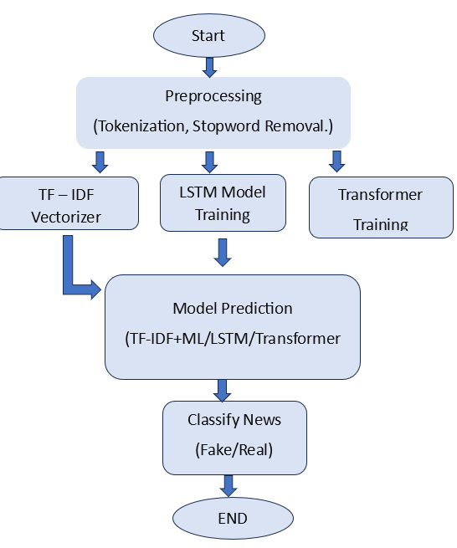
Flow Chart

Slide 6
Methodology
End-to-end pipeline for fake news detection using NLP.
Key stages:
Data Collection & Preprocessing
Feature Extraction
Model Development
Training & Validation
Evaluation

Slide 7
Data Collection & Preprocessing
Dataset includes labeled news articles (Real or Fake).
Preprocessing steps:
Convert text to lowercase
Remove punctuation, stopwords & special characters
Tokenization
Optional stemming or lemmatization

Slide 8
Feature Extraction
1) TF-IDF Vectorization
Converts text into numerical vectors.
Highlights important words across documents.
2) Token Embeddings
LSTM: Word sequences → integer indices → embedding layer.
Transformers: Pretrained tokenizer (e.g., BERT) → input IDs & attention masks.

Slide 9
Model Development
Implemented Models:
SVM: Classical ML model using TF-IDF vectors.
LSTM: RNN that captures sequential/temporal text dependencies.
Transformer-based (BERT): Fine-tuned for high contextual understanding.

Slide 10
Model Training & Validation
SVM: Trained using Scikit-learn.
LSTM & BERT: Trained using TensorFlow/Keras & HuggingFace Transformers.
Train-validation split applied.
Performed cross-validation & hyperparameter tuning.

Slide 11
Evaluation Metrics
Accuracy: Correct predictions over all predictions.
Precision: Fraction of predicted fake news that is actually fake.
Recall: Fraction of actual fake news correctly identified.
F1-Score: Harmonic mean of Precision & Recall.

Slide 12
Confusion Matrix Breakdown
True Positive (TP): Fake → correctly identified as fake.
True Negative (TN): Real → correctly identified as real.
False Positive (FP): Real → incorrectly labeled fake.
False Negative (FN): Fake → incorrectly labeled re

Slide 13
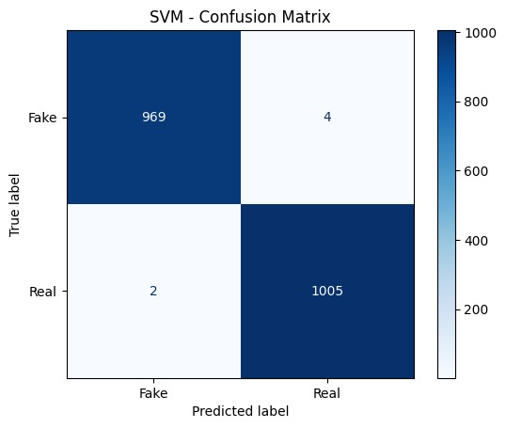
RESULTS

Slide 14
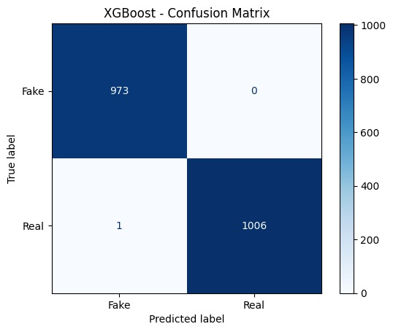
RESULTS

Slide 15


Slide 16


Slide 17


Slide 18


Slide 19
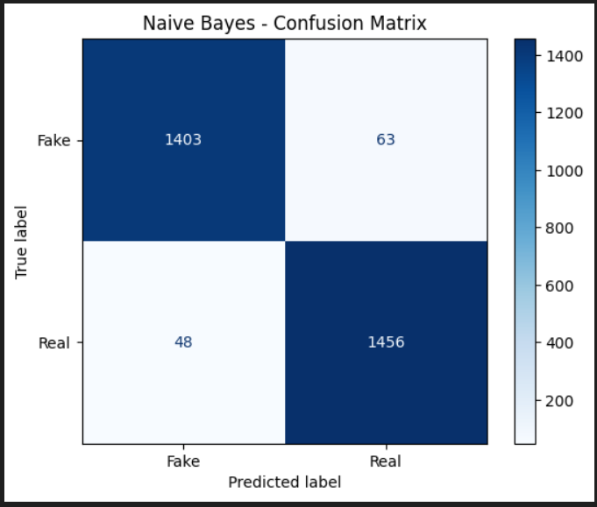

Slide 20
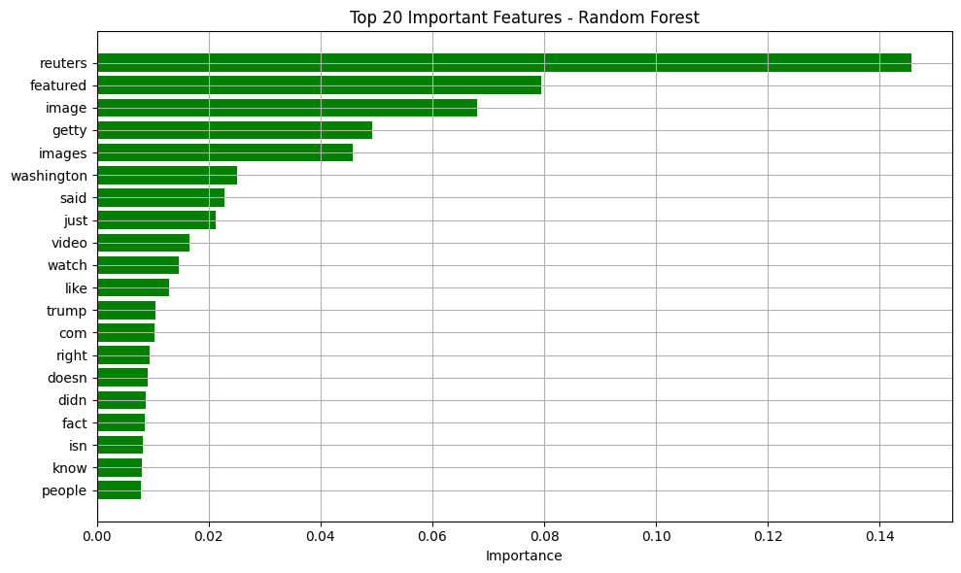

Slide 21
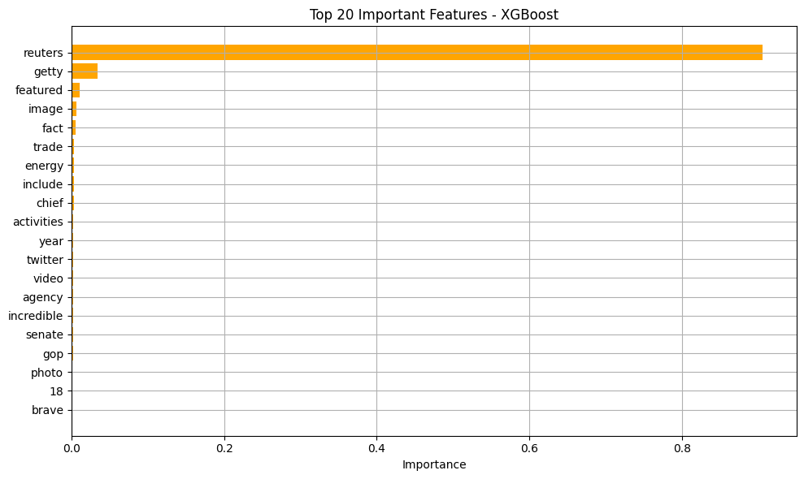

Slide 22
Results:
Model | Accuracy | F1 Score 0 1 |  | Recall |  | Precision
Naive Bayes | 0.9636 | 0.96 | 0.96 | 0.96 | 0.97 | 0.97 | 0.96
SVM | 0.9970 | 1 | 1 | 1 | 1 | 1 | 1
Decision Tree | 0.9980 | 1 | 1 | 1 | 1 | 1 | 1
Random Forest | 0.9995 | 1 | 1 | 1 | 1 | 1 | 1
AdaBoost | 0.9995 | 1 | 1 | 1 | 1 | 1 | 1
XGBoost | 0.9995 | 1 | 1 | 1 | 1 | 1 | 1
MLP | 0.9949 | 0.99 | 0.99 | 0.99 | 0.99 | 0.99 | 0.99

Slide 23
Conclusion :
This project demonstrates the effectiveness of machine learning and NLP techniques in detecting fake news. By combining traditional methods like TF-IDF with advanced models such as LSTM and Transformers (e.g., BERT), the system achieves high accuracy in classifying news as real or fake.
Future Scope :
Future work can focus on incorporating multimodal data (e.g., images or user comments), continual learning, and bias mitigation to further enhance the robustness of the system in dynamic and adversarial information environments.

Slide 24
Novelty
Hybrid NLP Strategy
Integrates TF-IDF (for keyword-based understanding) with LSTM (for sequential pattern recognition).
Context-Aware Fake News Detection
LSTM captures sequence and context of words, making it effective in identifying manipulative or emotionally loaded content.
DistilBERT provides rich sentence-level semantics, enhancing model understanding of nuanced misinformation.

