Slide 1


THEORY OF COMPUTATION
BY BATCH:-01 SEC-2L
1. 231FA04776
2. 231FA04815
3. 231FA04858
4. 231FA04875

Slide 2
QUESTION:-
Construct the following languages:
The residue (remainder) mod 3 for each binary string treated as a binary integer.
All strings where the number of "1"s is divisible by 3
Design a Moore for the above language
Convert Moore machine to Mealy machine
Convert the above Mealy into Moore machine

Slide 3

Moore machine:- A Moore machine is a finite-state machine whose current output values are determined only by its current state.
There are 6 Tuples in Moore machine:-(Q,$δ$,$Δ$,$∑$,$⋋$,$q_{0}$)
Q:-Finite no of states
$∑$:-Input symbols
$q_{0}$:-Initial States
$Δ$:-output Symbols
$δ$:- ‘Q x $∑$ -> Q’
$⋋$:-Q -> $Δ$

Slide 4

Mealy machine:- a Mealy machine is a finite-state machine whose output values are determined both by its current state and the current inputs.
There are 6 Tuples in Mealy machine:-(Q,$δ$,$Δ$,$∑$,$⋋$,$q_{0}$)
Q:-Finite no of states
$∑$:-Input symbols
$q_{0}$:-Initial States
$Δ$:-output Symbols
$δ$:- ‘Q x $∑$ -> Q’
$⋋$:-Q x $∑$ -> $Δ$

Slide 5

The residue (remainder) mod 3 for each binary string treated as a binary integer.
Design a Moore for the above language
Convert Moore machine to Mealy machine
Convert the above Mealy into Moore machine
Moore machine:-
Q:-{$q_{0},q_{1},q_{2},q_{3}$}
$∑$:-{ 0,1 }
$q_{0}$:-{$q_{0} \}$
$Δ$:-{ 0 ,1 }
$δ$:- ‘Q x $∑$ -> Q’
$⋋$:-Q -> $Δ$
There are 5 steps to do the moore machine
1) $∑$ , 2) language ,3) State Diagram ,4) Transition Table ,5)Verification

Slide 6




Step :- 1
$∑$ = {0,1}
Step :- 2
Language = { 110 , 0110, 11110 ---------}
Step :- 3
State Diagram =
0
1
$$q_{0}/0$$
1
$q_{1}$/1
0
$q_{2}$/2
1
0

Slide 7

Step :- 4
Transition table =
$δ$ 0 1 $△$
-> $q_{0}$ * $q_{0} { q}_{1}$ 0
${ q}_{1}$ * $q_{2}$ $q_{0}$ 1
$q_{2}$ * $q_{1}$ $q_{2}$ 2
1
Step :- 5
Verification = 1 1 0
0 1 0 0
1 0 0 1

Slide 8



B) Convert the above Moore machine into its equivalent Mealy machine.
Sol:- To convert the Moore to Mealy machine we have 2 methods
State diagram - State diagram
Transition table - Transition table
Here we are using State diagram - State diagram method
0/0
1/2
$$q_{0}$$
$$q_{1}$$
$$q_{2}$$
1/1
0/2
1/0
0/1

Slide 9


$δ$ 0 1
N.S $∆$ N.S $∆$
$q_{0}$ $q_{0}, 0 { q}_{1}, 1$
${ q}_{1}$ $q_{2}$, 2 $q_{0},$ 0
$q_{2}$ $q_{1}$, 1 $q_{2}$, 2
C)Convert the above Mealy into Moore machine:
Transition table =
$δ$ 0 1 $△$
$q_{0}$0 $q_{0} { q}_{1}$ 0
${ q}_{1}$1 $q_{2}$ $q_{0}$ 1
$q_{2}$ 2 $q_{1}$ $q_{2}$ 2

Slide 10



State Diagram =
1
0
$$q_{00}/0$$
1
$q_{11}$/1
0
$q_{22}$/2
1
0
ii) All strings where the number of "1"s is divisible by 3
Design a Moore for the above language
Convert Moore machine to Mealy machine
Convert the above Mealy into Moore machine

Slide 11
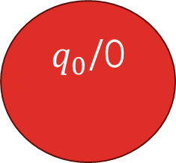
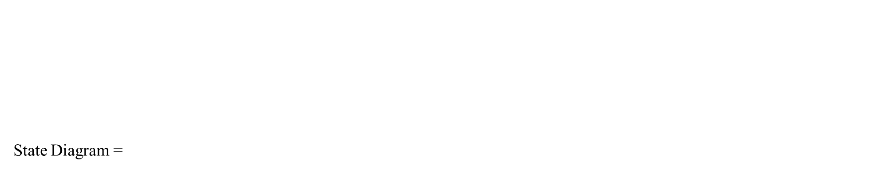

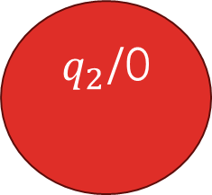
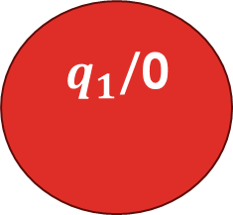
Step :- 1
$∑$ = {0,1}
Step :- 2
Language = { 111,0111,01011111 ---------}
Step :- 3
State Diagram =
0
0
0
0
1
1
$q_{0}$/0
1
$q_{1}$/0
$q_{2}$/0
$q_{3}$/1
1

Slide 12

Step :- 4
Transition table =
$δ$ 0 1 $△$
-> $q_{0}$ $q_{0} { q}_{1}$ 0
${ q}_{1}$ $q_{1}$ $q_{2}$ 0
$q_{2}$ $q_{2}$ $q_{3}$ 0
$q_{3}$ * $q_{3}$ $q_{1}$ 1
Step :- 5
Verification = 1 0 1 1
${ q}_{o} q_{1} q_{1} q_{2}$ $q_{3}$
0 0 0 0 1

Slide 13
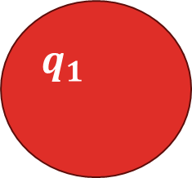



B) Convert the above Moore machine into its equivalent Mealy machine.
Sol:- To convert the Moore to Mealy machine we have 2 methods
State diagram - State diagram
Transition table - Transition table
Here we are using State diagram - State diagram method
0/0
0/0
0/0
0/1
$$q_{0}$$
1/0
$$q_{1}$$
1/0
$$q_{2}$$
1/1
$$q_{3}$$
1/0

Slide 14


C)Convert the above Mealy into Moore machine:
Transition table =
$δ$ 0 1
N.S $∆$ N.S $∆$
-> $q_{0}$ $q_{0}, 0 { q}_{1},0$
${ q}_{1}$ $q_{1}$, 0 $q_{2},0$
$q_{2}$ $q_{2}$, 0 $q_{3}$,1
* $q_{3}$ $q_{3 ,} 1 q_{1}$,0
$δ$ 0 1 $△$
-> $q_{0}0$ $q_{0} { q}_{1}$ 0
${ q}_{1}0$ $q_{1}$ $q_{2}$ 0
$q_{2}0$ $q_{2}$ $q_{3}$ 0
$q_{3}1$* $q_{3}$ $q_{1}$ 1

Slide 15
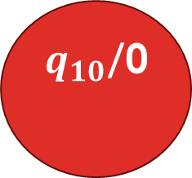
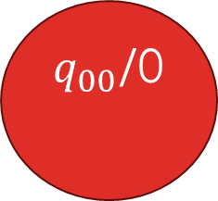
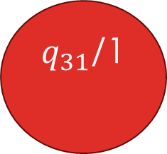
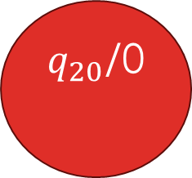
0
0
0
0
$q_{00}$/0
$q_{10}$/0
1
$q_{20}$/0
1
$q_{31}$/1
1
1
Conclusion:-
We have defined the states and transitions for both Moore machines, one for detecting the pattern of mod 3 remainders and the other for checking divisibility by 3 for the number of 1’s.
We then converted these Moore machines into equivalent Mealy machines by associating the outputs with transitions

