Slide 1
Data Storytelling & Statistical Validation Sales Data Analysis Project ApexPlanet Software Pvt. Ltd. 60-Day Data Analytics Internship
Presented by: Roshani Singh

Slide 2
Project Overview
Objective
The objective of this project was to analyze a retail sales dataset to uncover meaningful business insights, identify customer purchasing patterns, and support data-driven decision-making.
The project covered the complete data analytics workflow
Data Cleaning & Wrangling
Exploratory Data Analysis (EDA)
SQL-Based Business Analysis
Interactive Power BI Dashboard
Statistical Validation
Business Recommendations

Slide 3
Dataset Overview
Dataset Name: Sales Dataset | Key Attributes
Order Details | Order ID
Customer Information | Customer Name
Product Categories | Age
Sales Transactions | Gender
Quantity Purchased | City
Unit Price | Product
Total Sales | Category
Customer Demographics | Quantity , Age Group, Month
Monthly Sales | Unit Price , Total Sales

Slide 4
Data Preparation
Data Cleaning & Wrangling
The dataset was cleaned to improve data quality before analysis.
Tasks Performed
Removed duplicate records
Handled missing values
Standardized column formats
Converted data into proper data types
Created new features such as Age Group
Prepared an analysis-ready dataset
Outcome
A clean and structured dataset suitable for analysis and visualization.

Slide 5
Exploratory Data Analysis
Key Insights from EDA
Several visualizations were created to understand the dataset.
Analysis Performed
Age Distribution
Gender Distribution
Category-wise Sales
Monthly Sales Trend
Product Performance
Sales Distribution
Correlation Analysis
Major Findings
Some product categories generated significantly higher revenue.
Sales varied across different months.
Customer purchasing behavior differed by gender and age group.
A small number of products contributed to a large share of sales.

Slide 6
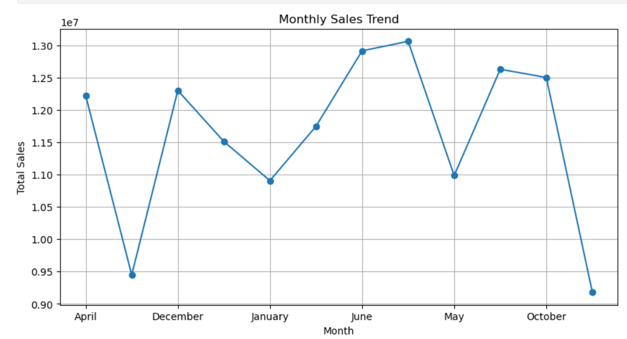
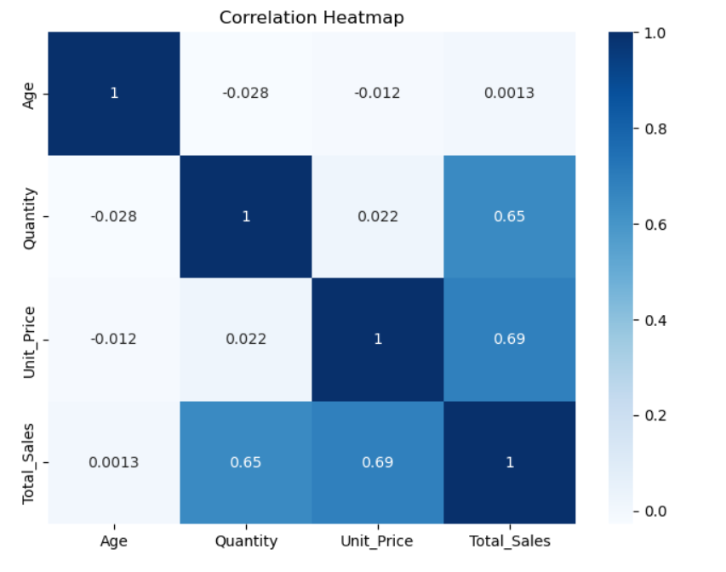
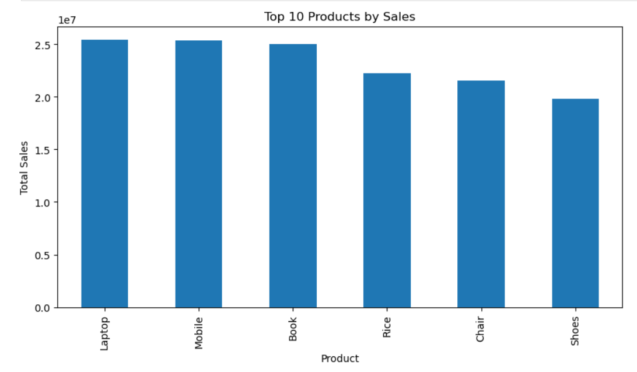
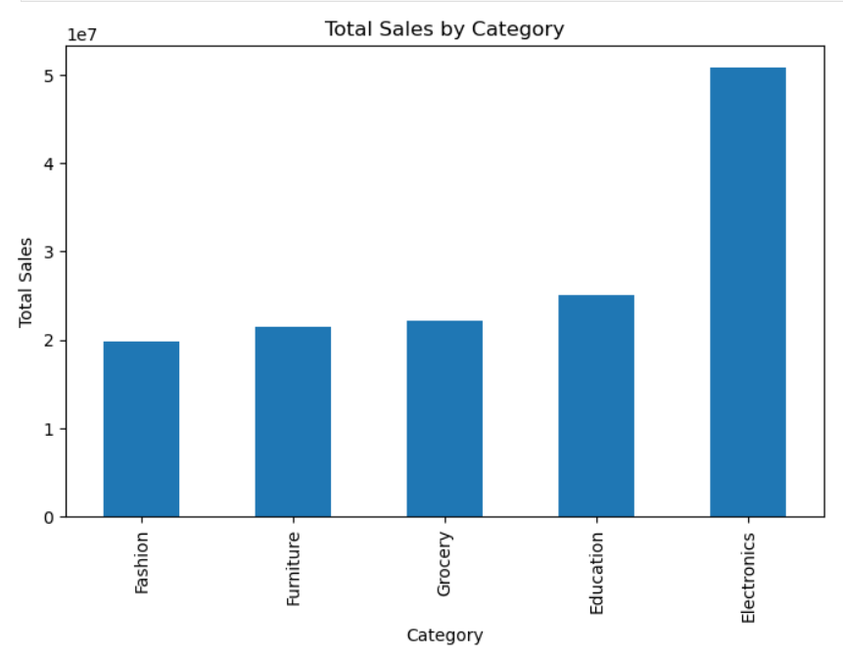

Slide 7
: SQL Business Analysis
Business Questions Answered
SQL was used to answer important business questions.
Queries Included
Total Sales by Category
Top 10 Products
Sales by City
Sales by Gender
Monthly Sales Trend
Average Sales by Age Group
Top Customers by Spending
Business Value
SQL helped extract actionable insights efficiently and supported decision-making through structured data analysis.

Slide 8
Interactive Dashboard
Power BI Dashboard
An interactive dashboard was created to monitor sales performance.
Dashboard Features
Total Sales KPI
Total Orders KPI
Average Sales KPI
Total Quantity KPI
Sales by Category
Sales by City
Monthly Sales Trend
Top Products
Interactive Filters

Slide 9
Hypothesis Testing
Business Hypothesis
Null Hypothesis (H₀)
There is no significant difference in average sales between male and female customers.
Alternative Hypothesis (H₁)
There is a significant difference in average sales between male and female customers.
Statistical Test
Independent Two-Sample T-Test

Slide 10
Statistical Results
Results
The hypothesis test produced:
Test Statistic
P-value
Interpretation
If P-value < 0.05
✔ Reject the Null Hypothesis
There is a statistically significant difference in average sales between male and female customers.
OR
If P-value ≥ 0.05
✔ Fail to Reject the Null Hypothesis
No statistically significant difference exists.
(Add your actual Python output here.)

Slide 11
Business Recommendations
Based on the analysis:
Focus marketing campaigns on high-performing product categories.
Increase inventory for frequently purchased products.
Improve promotions during low-sales months.
Develop targeted marketing strategies for different customer segments.
Monitor KPIs regularly using the Power BI dashboard.

Slide 12
Skills & Technologies
Tools
Programming
Libraries
Pandas
NumPy
Matplotlib
Seaborn
SciPy
Too
Python
SQL
Jupyter Notebook
Power BI
GitHub
Microsoft Excel

Slide 13
Conclusion
This project demonstrated the complete data analytics workflow from raw data preparation to business storytelling.
Key achievements include:
Cleaned and prepared the dataset.
Performed Exploratory Data Analysis.
Solved business problems using SQL.
Developed an interactive Power BI dashboard.
Validated findings using statistical testing.
Presented actionable business recommendations.

Slide 14
thank you

