Slide 1
Indian Sign Language Recognition System for Deaf and Dumb People
By
R.Srikar – AM.EN.U4AIE19051
Guide: Dr. Geetha M

Slide 2
1
Problem Statement
Create a chatbot which interacts with deaf and dumb people.
Assist them in filling forms and giving input to the computer.
This way, then can atleast have a way of interacting with the computer.
This is addressed by using ISL(Indian Sign Language) as the common medium.

Slide 3
2
Motivation
Deaf and dumb people cannot interact with the computer since they cannot see the screen nor hear what it says via speakers.
We aim at creating a chatbot which interacts with these people using ISL(Indian Sign Language) and understanding what they say via ISL hand signs in the webcam feed.
This assists them in basic interaction with computer like inputing text and filling forms.

Slide 4
3
Literature Review
Sign Language Recognition for Static and Dynamic Gestures by Jay Suthar
Zero-Shot Sign Language Recognition: Can Textual Data Uncover Sign Languages? by Yunus Can Bilge
A Review Paper on Sign Language Recognition of Engineering System For Deaf And Research & Dumb People using Image Technology Processing by Manisha U. Kakde
Attention-Based Sign Language Recognition Network Utilizing Key frame Sampling and Skeletal Features by Wei Pan

Slide 5
4
Research Gap/ the need for your work
Most of the models used to detect ISL hand signs in an image are really slow, inaccurate or do not detect all characters(26 alphabets + 10 numbers).
Also since the models are really slow in terms of predictions, it becomes really tough for those models to be used in a chatbot since the response needs to be as fast as possible.
The third concern is the scalability part wherein we have to make the chatbot to work for multiple users at a time.
Our work addresses all these problems and provides a robust solution for detecting ISL hand signs using a chatbot.

Slide 6
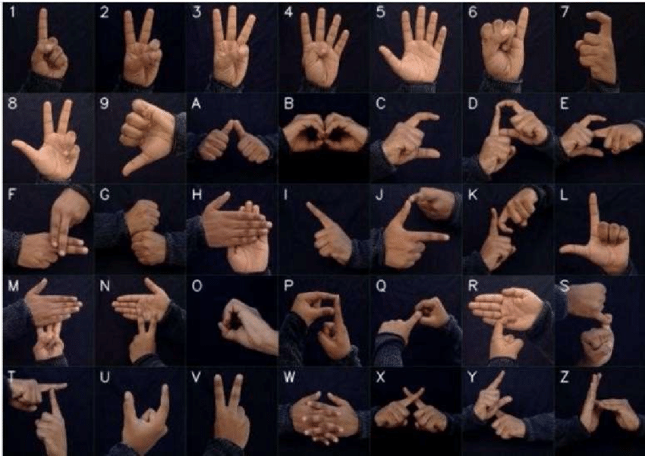
5
Indian Sign Language
Indian Sign Language(ISL) is a method of representing alphabets and numbers using hand signs.
This can be used as a medium between deaf and dumb people for communicating with each other.
We use this as a communication medium in our approach with out chatbot and the user.

Slide 7
6
Proposed Methodology
User shows ISL hand signs which are captured using a webcam.
We get the coordinates of hands from the image using mediapipe framework.
Transformation functions were applied to the hand coordinates to make all hands similar and in same position.
The transformed coordinates are used to train a neural network which will later predict hand signs according to the coordinates.
Basic NLP is applied to the model output for removing unwanted characters, applying spellchecking and word segmentation if required.

Slide 8
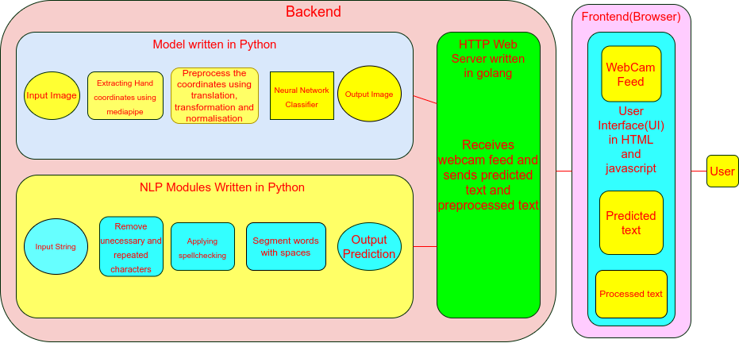
7
Final Architecture and Block Diagram

Slide 9
8
Results and Discussion
The model with the new dataset gave an incredible boosted the training accuracy.
The transformation function gave a great boost to the accuracy since it made all the hands look a bit similar.
The model is now able to detect all the 36 characters very easily from the live feed.

Slide 10
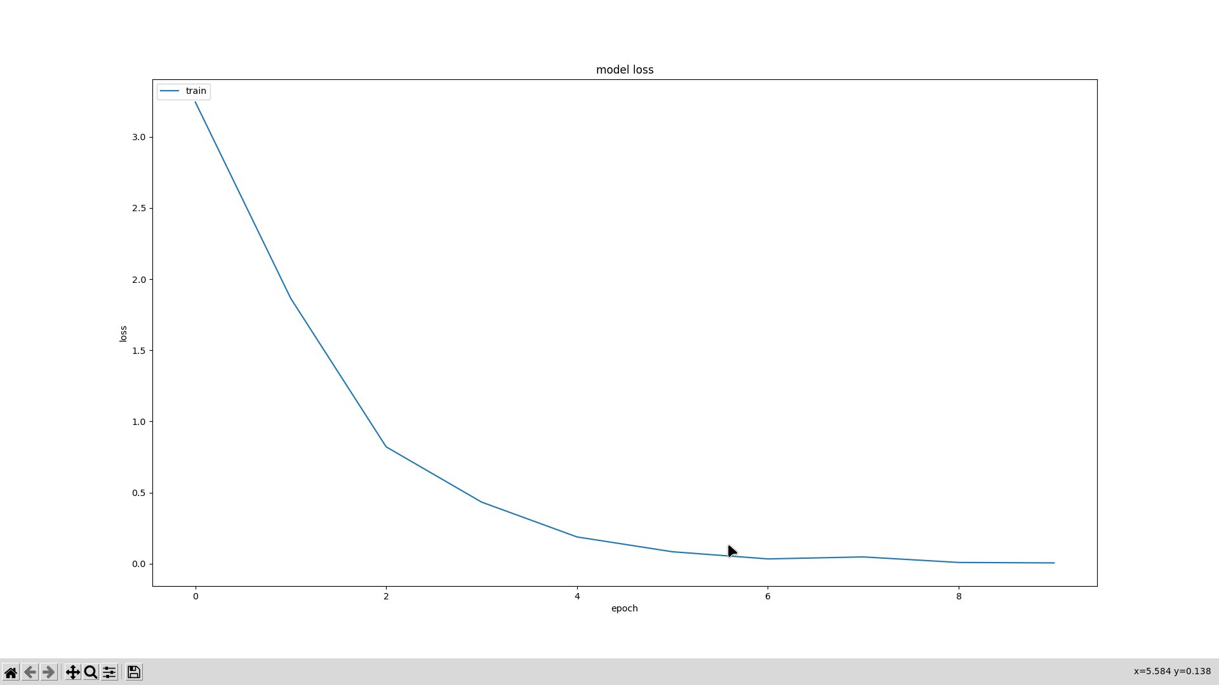
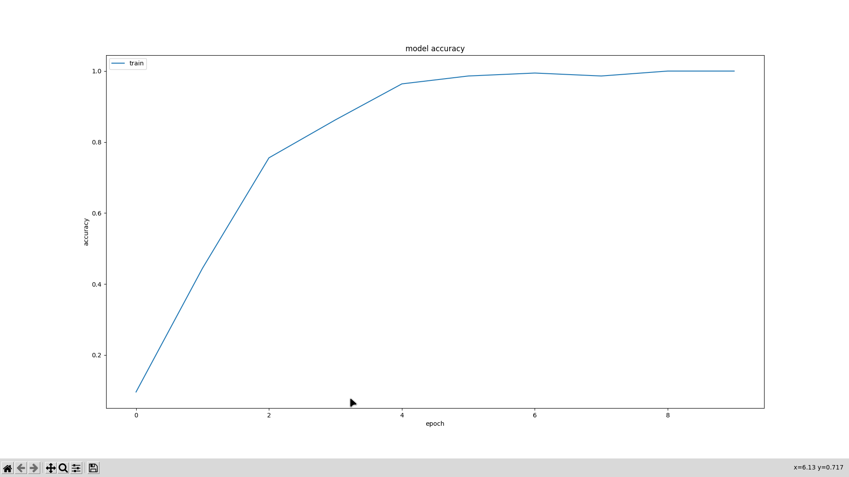
9
Results
Loss per Epoch graph
Accuracy per Epoch graph

Slide 11
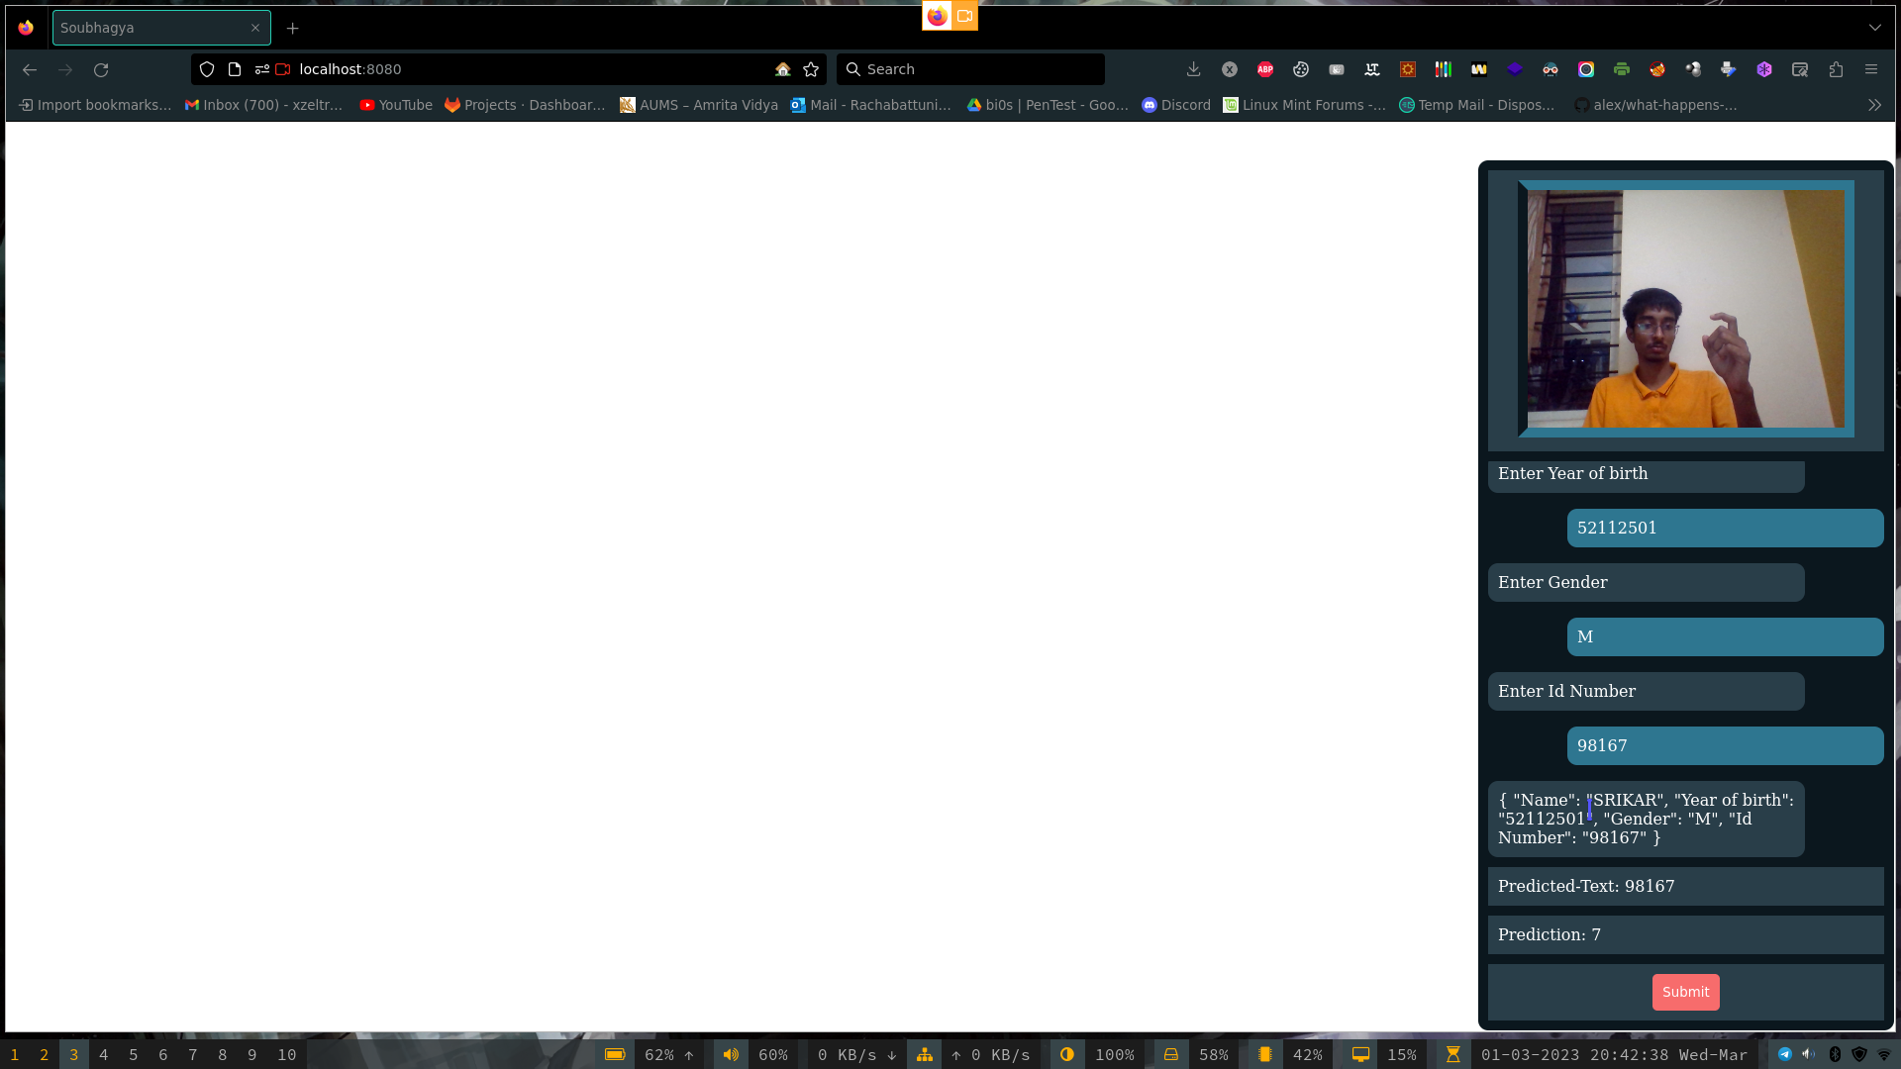
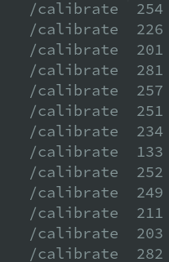
10
Chatbot UI Results(Continued)

Slide 12
11
Conclusion and Future Scope
Model detects all the ISL hand signs really good but it should work on hands of people whose hands are really big.
Since our dataset is not very large and only consists of 20 images per character totaling to 720 images for 36 characters, increasing the size of the dataset might give even better accuracy for predictions for all kinds of hands.
The dataset could also consist of left handed coordinate samples for left handed predictions. Currently there are no left handed coordinate samples.
Working on the dataset can increase the model prediction accuracy by a great extent in realtime.

Slide 13
12
Target publication & Publication status
Target publication

Slide 14
13
References
https://indiansignlanguage.org

Slide 15
The End
THANK YOU

