Slide 1

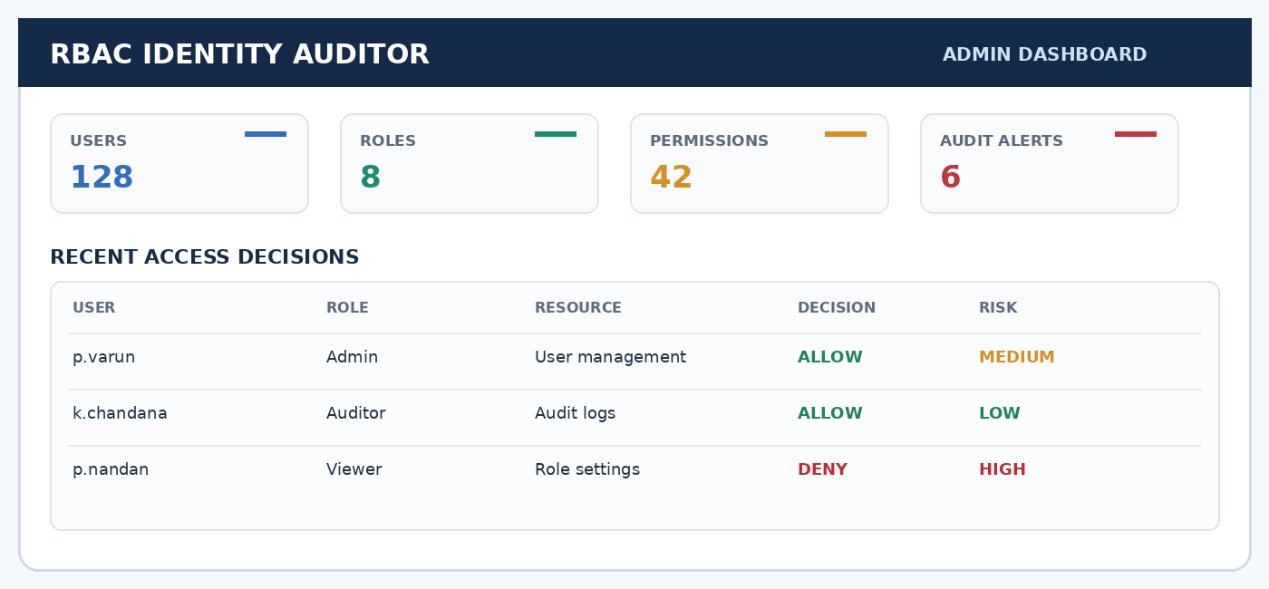
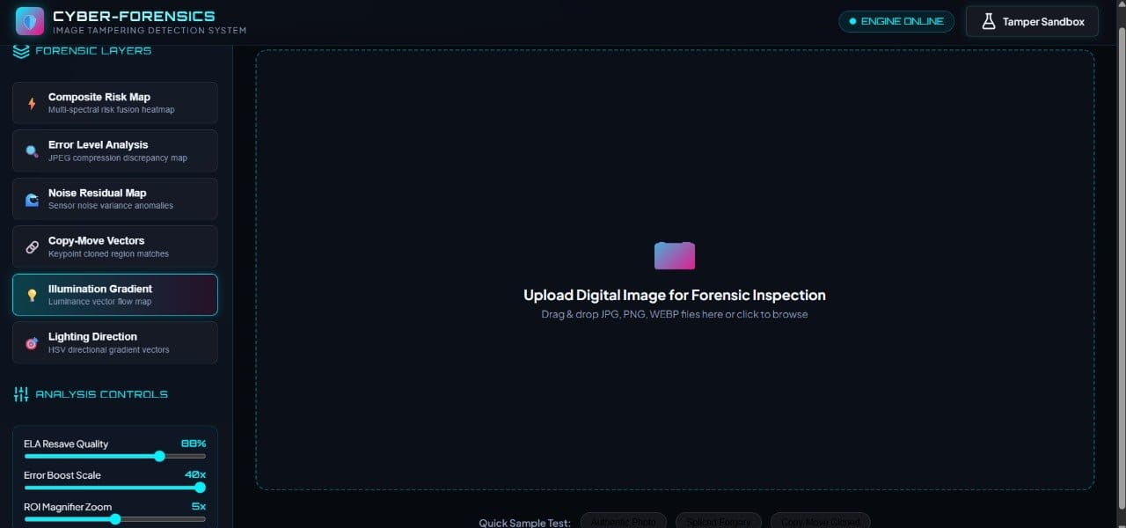
Enterprise Role-Based Access Control (RBAC) & Identity Auditor
An Explainable Risk-Based Framework for Privilege Auditing
STUDENTS
INNOVATION
RESEARCH
IMPACT
B.Tech Project • KLH CSE
Guide: Dr. K. Swanthana
Explainable • Risk-Based
Identity & Privilege Auditing
RBAC Enforcement
Audit Logging • Risk Scoring
Least Privilege • Accountability
Suspicious Access Monitoring
Abstract
Proposed Methodology
Enterprise organizations need a reliable way to ensure users have only the permissions required for their roles. This project presents an explainable Role-Based Access Control (RBAC) and Identity Auditor that combines role/permission enforcement with risk-based monitoring and auditable access decisions.
User / Admin Request
Login • Token
Authenticate Identity
BCrypt • JWT validation
RBAC & Identity Audit Pipeline
User & Role Management
Assign users to roles
Permission Evaluation
Role-to-permission mapping
Context Signals
IP • Device • Time
Objectives
1
Create and manage users, roles and permissions using a role-based access model
Access Decision
ALLOW / DENY
Audit Logging
Record event details
Risk Assessment
Explainable risk factors
2
Authenticate users securely with BCrypt password hashing and JWT-based sessions
3
Evaluate each access request against assigned roles and permissions to return ALLOW or DENY
4
Record access and security events to support traceability and audit review
Aggregate Context + Privilege Signals
5
Calculate contextual risk indicators to help identify excessive or suspicious privilege use
Risk Score & Review Priority
Key Innovations
LOW
MEDIUM
HIGH
CRITICAL
Explainable Access Decisions | Permission checks provide a clear ALLOW/DENY outcome based on role and permission assignments.
Review high-risk access, investigate unusual events and remediate unnecessary privileges.
Risk-Aware Identity Auditing | Contextual signals can highlight unusual access patterns and potentially risky privilege combinations.
Stack:
Java
Spring Boot
MySQL
JWT
React
Auditable Event Trail | Security-relevant actions are recorded to support investigation and accountability.
Experimental Results
Privilege-Creep Awareness | Review excessive, unused or elevated permissions to support least-privilege practice.
Prototype focus: role/permission enforcement, authentication, audit events and risk classification. Quantitative performance metrics are not stated in the supplied project materials; avoid presenting unverified accuracy or latency values.
Integrated Web Stack | Java, Spring Boot, Spring Security, JWT, MySQL and a React-based interface (as documented in project materials).
Evaluation Area | Current Evidence | Precision | Recall | F1
Authentication | BCrypt + JWT flow | TBD | TBD | TBD
Authorization | Role / permission checks | TBD | TBD | TBD
Auditing | Access-event logging | TBD | TBD | TBD
Risk analysis | Rule-based contextual review | TBD | TBD | TBD
Illumination + lighting only | TBD | TBD | TBD | TBD
Proposed fused score | TBD | TBD | TBD | TBD
Prototype Interface
Illustrative workflow only. No unverified benchmark values are reported.
Limitations & Future Scope
• Risk scores depend on configured rules and available context; they support review rather than prove malicious intent.
• Future work: validate against realistic enterprise scenarios, tune risk thresholds, add notifications and dashboards, and evaluate audit coverage and performance.
Illustrative RBAC dashboard mock-up for the poster. Replace with a verified screenshot of the running project before final submission if available.
References
Team Details
[1] Enterprise RBAC & Identity Auditor research paper draft. | [2] Project review materials (PRC-I and PRC-III). | [3] Spring Security documentation. | [4] JSON Web Token (JWT) specification and implementation references.
Guide: Dr. K. Swanthana, Assistant Professor, CSE
Team 16
2320030047 – P. Varun Reddy
2320030410 – K. Chandana
2320030446 – Pardhava Nandan
Department of Computer Science and Engineering

