Slide 1
FINAL YEAR PROJECT · HKBU COMPUTER SCIENCE
RadAssist AI
An AI-assisted Online System for X-Ray Report Generation
Clinician-in-the-loop chest X-ray reporting inside a hospital CMS-style workspace — AI drafts, the radiologist decides.
PANG Ho Yiu
Student ID 23226609
Demonstration system · not a clinical product
Notes:
Introduce yourself and the project title. One-line pitch: RadAssist AI takes a research chest X-ray model (CURV) out of the lab and wraps it in a complete, role-based hospital web system — the AI writes the first draft, and a radiologist always reviews and signs it.

Slide 2
Agenda
1
Problem & objectives
Why a research model is not yet a usable tool
5
Clinical modules
Patient chart, Azure findings, Sepsis Monitor, Care Notes
2
Solution & architecture
Roles, components, technology stack
6
Admin, data & security
Users, audit, data model, access control
3
End-to-end workflow
Booking → film → AI draft → review → endorse
7
Testing, limitations, future work
How it was verified and what comes next
4
AI pipeline
CURV report generation + Azure OpenAI assistance
8
Live demo & Q&A
RadAssist AI · An AI-assisted Online System for X-Ray Report Generation
2
Notes:
Walk through the structure: problem, solution, workflow, AI, clinical modules, admin/data/security, testing, then a live demo.

Slide 3
PROBLEM
Background: the deployment gap
Vision-language models such as CURV can now write chest X-ray reports — but they stay in scripts and notebooks, out of reach of the clinicians who need them.
1 Time-consuming reporting
2 AI is not accessible
3 Static, opaque output
Radiology reports are professional work product. Writing similar reports from a blank page occupies valuable radiologist hours.
Research models have no standard web interface. Running them needs Python, a GPU/Apple Silicon box and a command line.
Image-in, text-out tools are not interactive. Clinicians cannot see where a finding is, edit it, or tell AI text from human text.
Goal: AI drafts automatically when the film is saved; the radiologist reviews instead of typing from scratch.
Goal: browser login, worklist and one review screen — no notebook, no command line.
Goal: film + boxes beside an editable report, an AI-vs-manual log while drafting, and a clean signed report.
RadAssist AI · An AI-assisted Online System for X-Ray Report Generation
3
Notes:
The project statement names three bottlenecks. Emphasise that this is an information-systems project: we do not retrain CURV — we make it usable, safe and auditable in a real workflow.

Slide 4
PROBLEM
Project objectives
1. Online prototype
2. Interactive interface
Use the pretrained CURV model to assist radiologists by generating chest X-ray reports.
Film with editable boxes and measurements beside an editable report; Word / PDF export.
3. Complete web information system
4. Radiologist in the loop
Sessions, roles, asynchronous inference, persistence, audit and document generation.
AI output is always a draft until a radiologist endorses it. Doctors read endorsed reports only.
5. Clinical context
6. Run locally, deploy later
Patient Master chart with vitals, labs, care notes and a teaching sepsis screen beside imaging.
Semester 1 on a local Mac (CURV on Apple Silicon); optional hosted deployment in Semester 2.
RadAssist AI · An AI-assisted Online System for X-Ray Report Generation
4
Notes:
Objectives 1–4 come from the project statement and supervisor briefing. Objective 5 (clinical context) was added during development so the imaging workflow sits inside a realistic inpatient CMS.

Slide 5
SOLUTION
Solution overview: four roles, one workflow
Role-separated, clinician-in-the-loop web application presented in a hospital CMS-style shell (beige title bar, MODULES column, RIS-style worklist).
Referring doctor
Technician
Radiologist
Administrator
Books a chest X-ray on a calendar
Reads endorsed reports only
Orders labs on the chart
Exports Word / PDF
Sees the requested-case queue
Registers (uploads) the film
CURV starts automatically
Never sees the film or report afterwards
Works the X-ray worklist
Edits report, boxes, measurements
Endorses (signs) the report
Shares an endorsed report
Everything a radiologist can do
Adds / disables users
Reads the audit log
Bulk-deletes test data
Control principle: AI drafts → the radiologist edits and endorses → only then does the referring doctor see the report. AI never signs, and the issued report carries no AI / manual markings.
RadAssist AI · An AI-assisted Online System for X-Ray Report Generation
5
Notes:
Explain each role in one sentence. Stress the control principle — it drives every design decision: role checks on the server, locking after endorse, clean reports for doctors.

Slide 6
SOLUTION
System architecture
Cosmos DB
MongoDB API + GridFS
patients, cases, users, audit
Express API
Node :5002
JWT · role checks · audit
GridFS images
Browser SPA
Vite :5173 · Vanilla JS
Tailwind CSS
FastAPI middleware
Python :8001
CURV
mlx_vlm :8080
Apple Silicon
/api (proxied)
film → report
report text (+ film)
Azure OpenAI (optional)
Film boxes · worklist label · patient-chart findings
Asynchronous AI — the API stores the film and returns immediately; CURV runs in the background and the worklist moves Generating → Pending approve.
Graceful degradation — if CURV or Azure is down, the case is still saved and the radiologist can write the report by hand.
Separation of concerns — CURV writes the report; Azure only assists (boxes, labels, chart findings) and never edits report text.
RadAssist AI · An AI-assisted Online System for X-Ray Report Generation
6
Notes:
Trace a request: the browser calls the Express API through the Vite proxy. Express owns authentication, roles, persistence and the audit log. Images live in GridFS inside Cosmos DB. When a film is saved, Express calls the FastAPI middleware, which talks to the CURV model served by mlx_vlm on the Mac. Azure OpenAI is optional and only assists.

Slide 7
SOLUTION
Technology stack
Layer | Technology | Why
Frontend | Vanilla JavaScript SPA, Vite 8, Tailwind CSS 3 | Lightweight; tiny DOM helper + pub/sub store; fast dev reload
Backend API | Node.js, Express 4, Mongoose 8, JWT, bcrypt, Helmet | REST gateway, role middleware, audit writer, document streams
Database | Azure Cosmos DB (MongoDB API) + GridFS | Managed, cloud-hosted persistence for charts, cases and films
Report model | CURV (vision-language) served by mlx_vlm on Apple Silicon | Pretrained chest X-ray report generator, runs locally
Model gateway | FastAPI middleware (Python 3.12, uvicorn) | Official CURV prompt, image resizing, DICOM rendering
AI assistance | Azure OpenAI (gpt-4.1-mini, JSON mode) | Film boxes, worklist labels, patient-chart findings
Documents | docx (Word) and browser PDF | Clean endorsed report with film, measurements, signature
Testing | Node test scripts with linkedom (DOM), e2e API script | 193 automated UI tests across 19 suites
RadAssist AI · An AI-assisted Online System for X-Ray Report Generation
7
Notes:
The project statement suggested React or Vue as examples; a lightweight vanilla SPA met the same interaction goals with less overhead. CURV runs locally on Apple Silicon via mlx_vlm, which avoids GPU cloud cost.

Slide 8
WORKFLOW
End-to-end workflow
Doctor
Technician
CURV (auto)
Azure
Radiologist
Radiologist
Azure
Doctor
Books chest X-ray on a calendar
Registers the film (PNG/JPG/DICOM)
Writes Findings · Thinking · Impression
Places boxes on the film
Edits report, boxes, measures
Endorses (signs) the report
Writes patient-chart findings
Reads, exports, shares
requested
pending
generating
pending approve
draft
endorsed
chart updated
read-only
Automatic first draft
Human sign-off
Clean issued report
There is no “Use AI” button. Saving the film starts CURV in the background; the API returns at once and the worklist updates itself when the draft is ready.
Endorse is refused while AI is still running. After endorsement the report, boxes and measurements are locked; remarks and the urgent flag can still change.
The doctor’s view, Word and PDF contain Findings, Impression, measurements and the signature — no hidden Thinking and no AI / manual tags.
RadAssist AI · An AI-assisted Online System for X-Ray Report Generation
8
Notes:
This is the happy path you will demonstrate live. Point out the automatic draft, the mandatory human sign-off, and that Azure has two touch points: boxes after the draft and chart findings after endorsement.

Slide 9
WORKFLOW
Role-based access control
Action | Technician | Radiologist | Doctor | Admin
Browse Patient Master, Sepsis Monitor, Care Notes | yes | yes | yes | yes
Book (request) a chest X-ray | no | no | yes | yes
Register the film on a request | yes | no | no | yes
See drafts, films and AI boxes | no | yes | no | yes
Edit report, boxes, measurements · re-run AI · endorse | no | yes | no | yes
Read an endorsed report · export Word / PDF | no | yes | yes | yes
See Azure findings on the patient chart | no | yes | yes | yes
Order labs on the chart | no | no | yes | yes
Share an endorsed report (public link) | no | yes | no | yes
Users, audit log, bulk delete | no | no | no | yes
Enforced on the server (route middleware + response stripping), not just hidden in the UI. Technician responses never contain the film, report, findings or chart findings.
RadAssist AI · An AI-assisted Online System for X-Ray Report Generation
9
Notes:
Highlight that permissions are enforced by the API: for example a technician calling the case endpoint gets the film and report stripped. The UI hiding is only convenience.

Slide 10
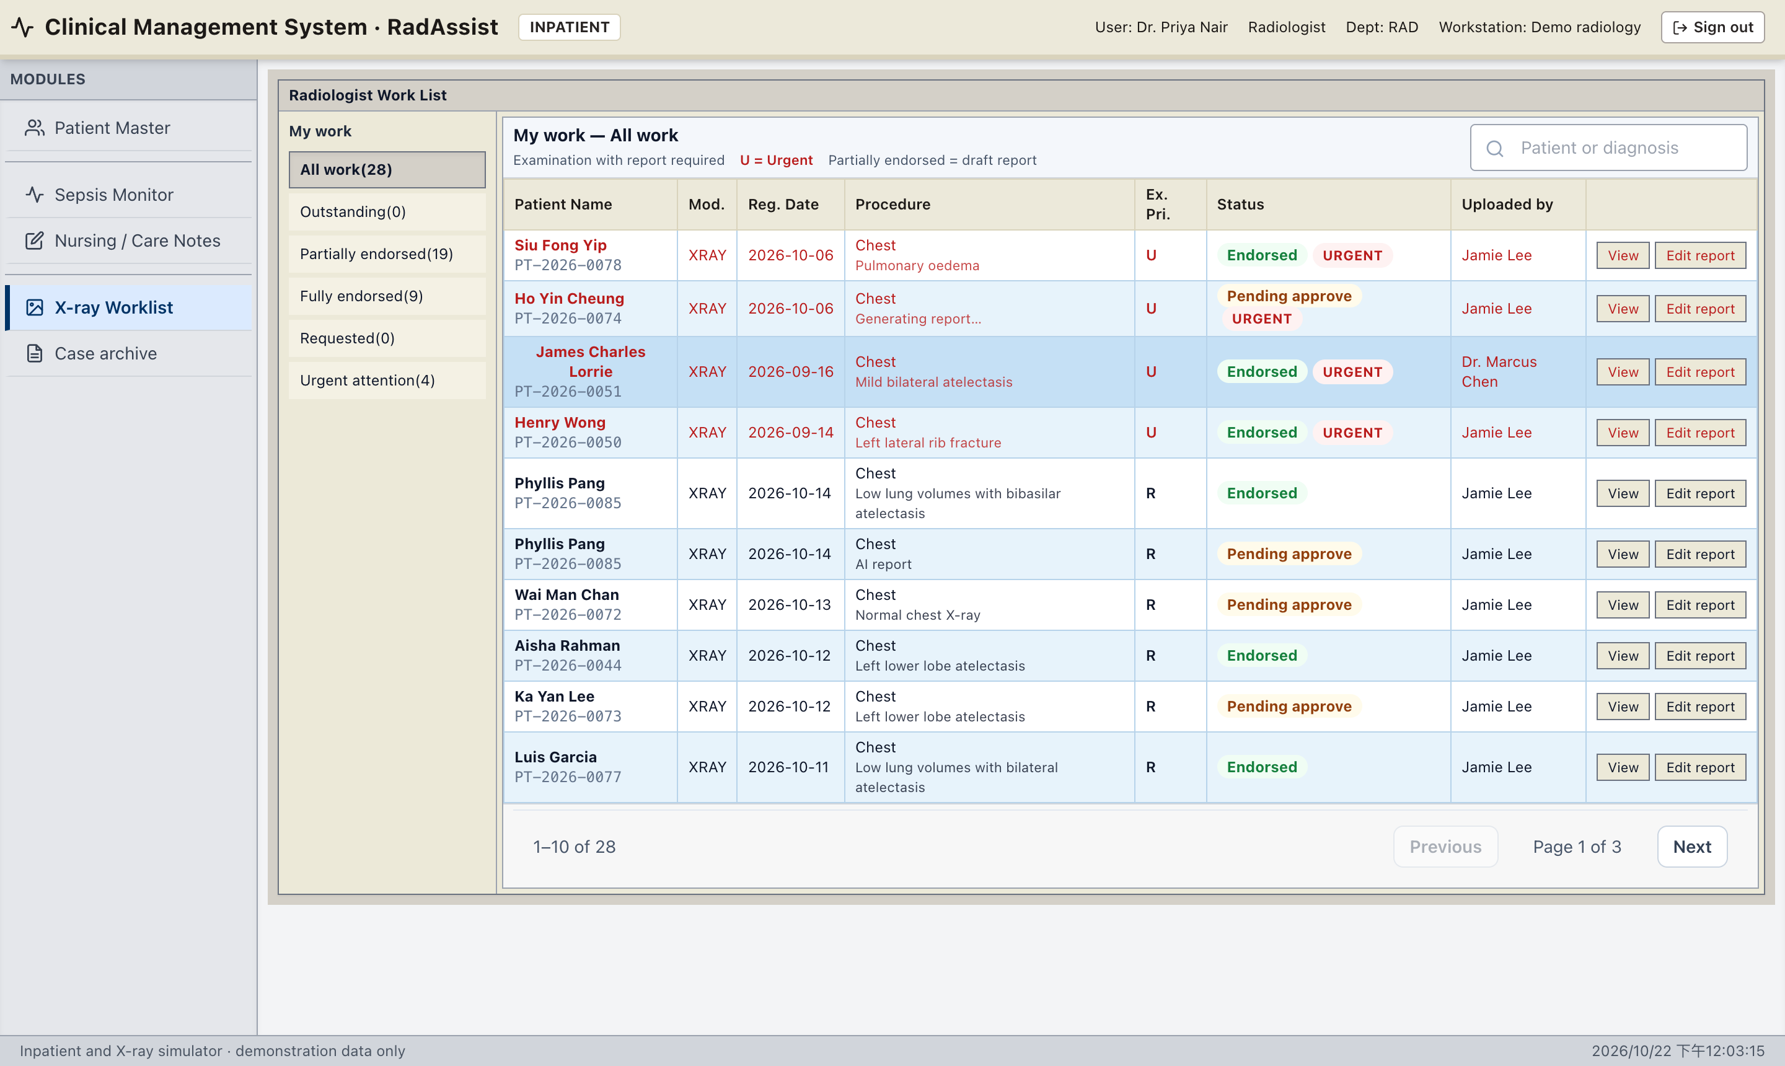
SCREENS
Radiologist X-ray worklist
1
My work queues: All, Outstanding, Partially endorsed (draft), Fully endorsed, Requested, Urgent.
2
Dense RIS-style grid modelled on the COMP4126 lecture worklist. Urgent rows (U) sort first.
3
Live status: Generating → Pending approve → Endorsed, updated without a reload.
4
Short diagnosis under “Chest”: picked locally from CURV’s text; Azure refines it only after the radiologist edits.
5
Referring doctors use the same grid as “Examination enquiry” — requested and endorsed rows only.
RadAssist AI · An AI-assisted Online System for X-Ray Report Generation
10
Notes:
This is the radiologist's home screen. Mention the queue counts, urgency sorting, and that the list polls while a draft is generating.

Slide 11
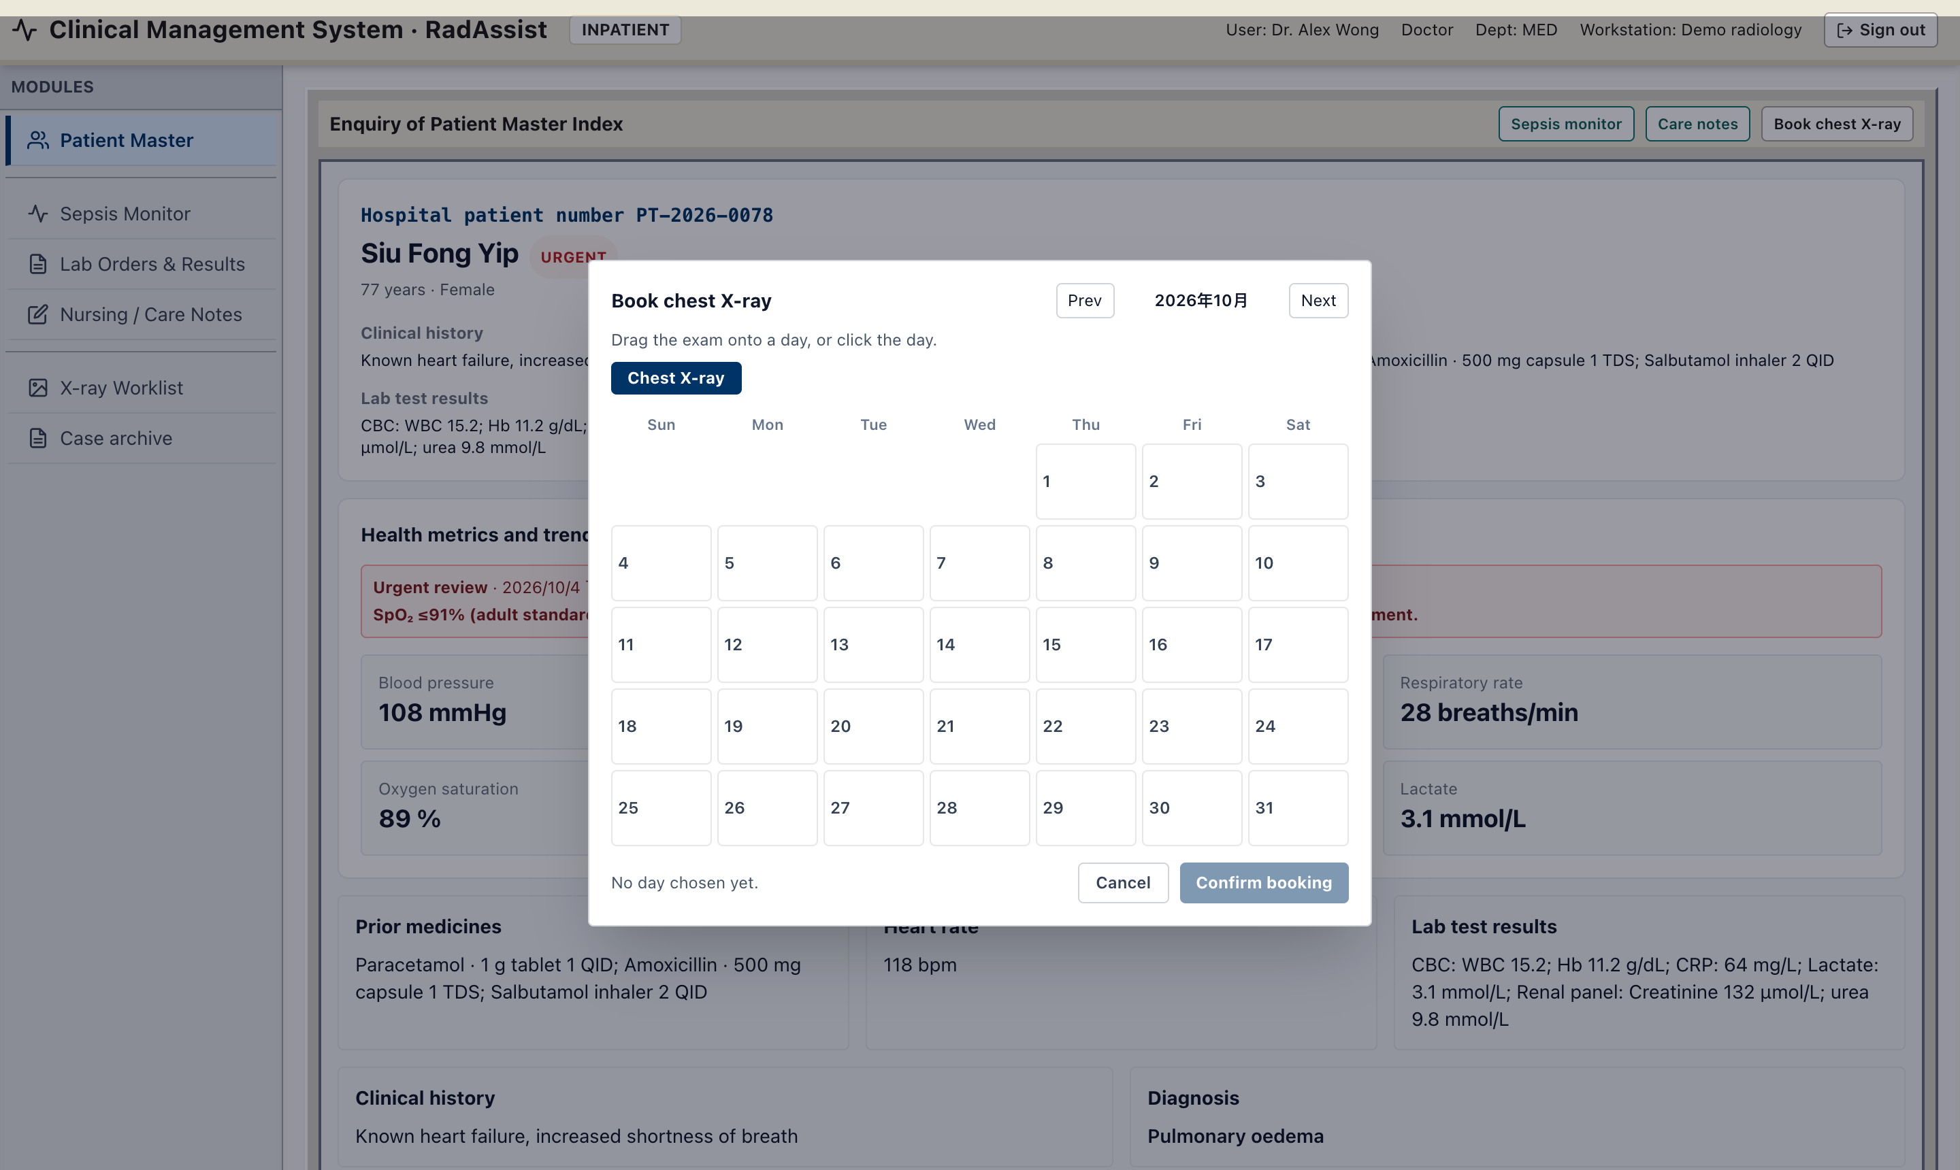
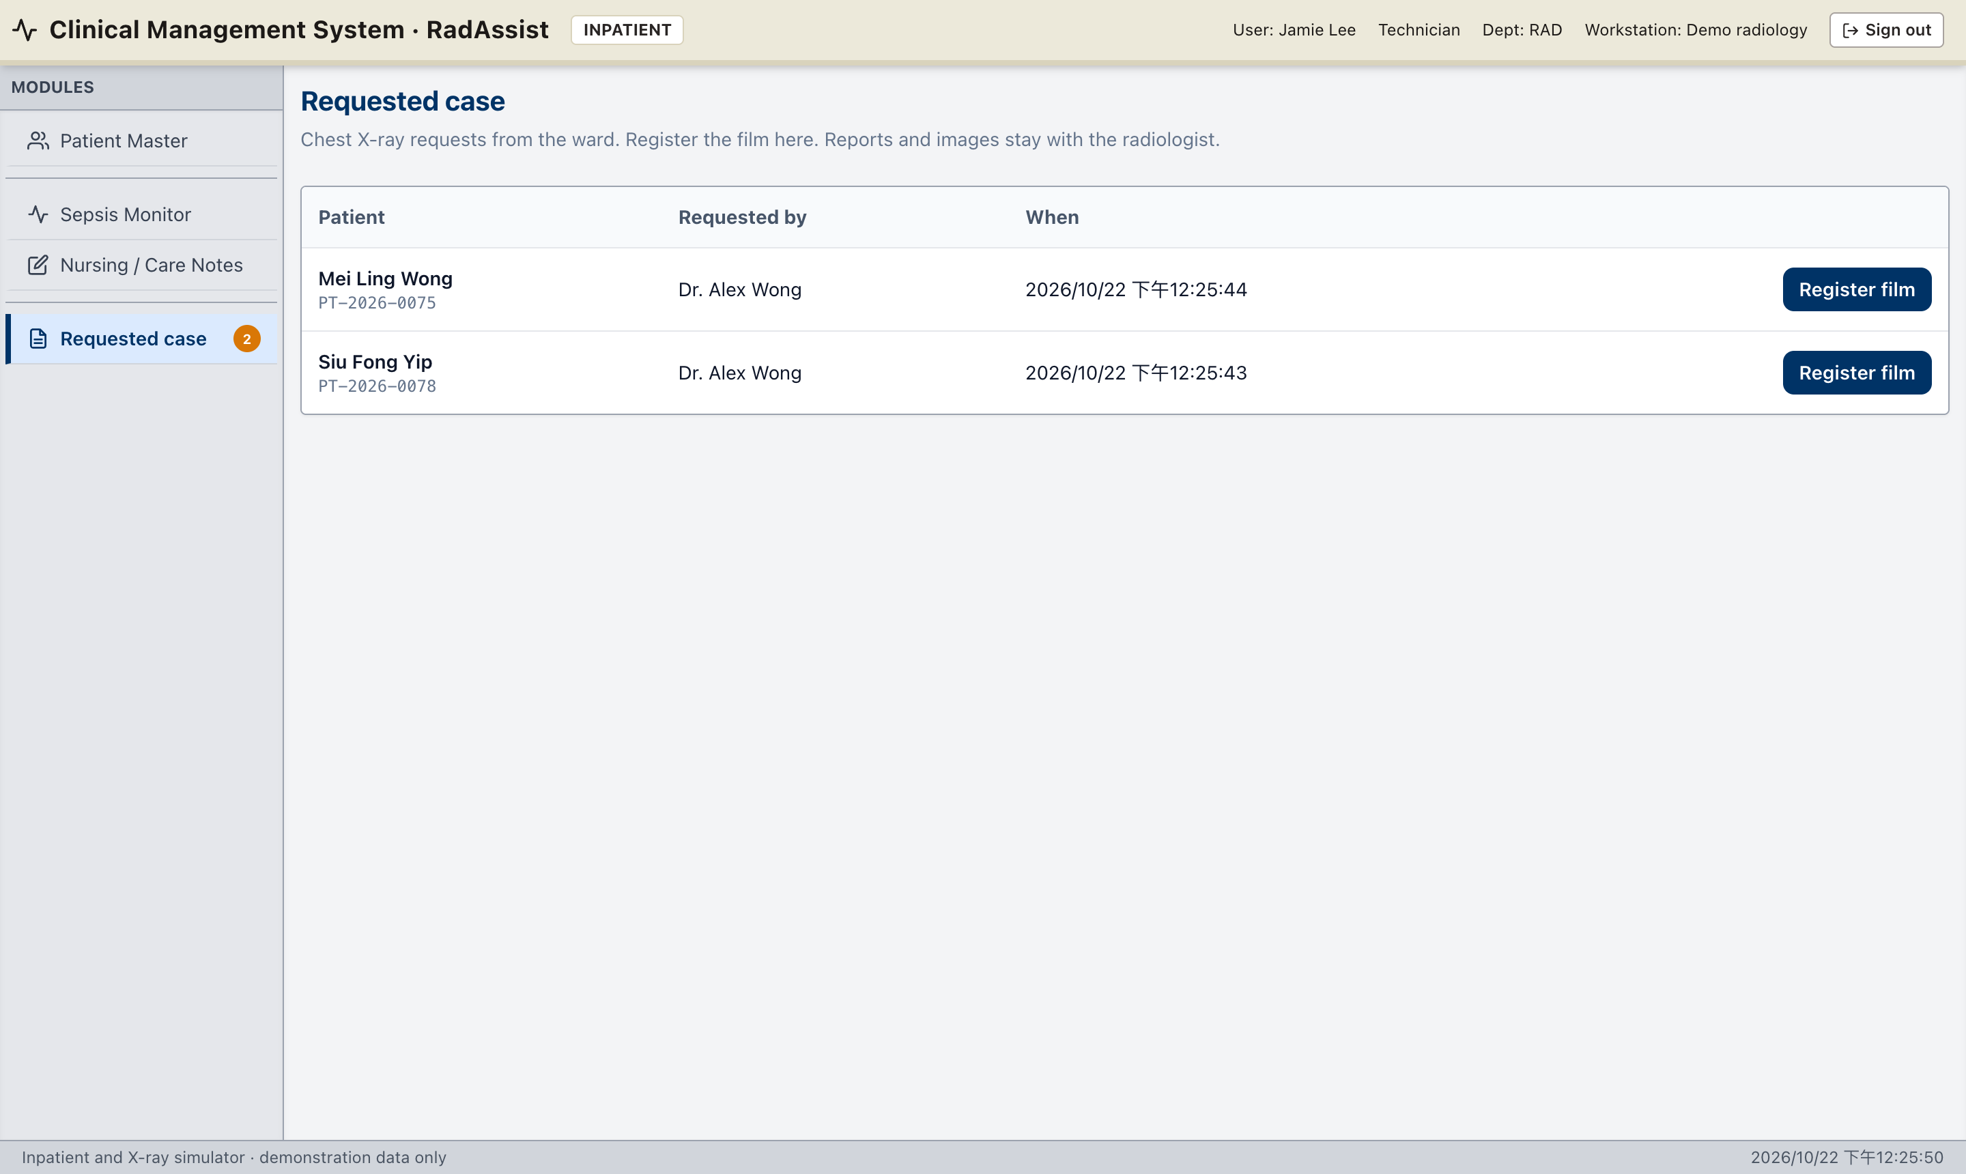
SCREENS
Ordering the exam and registering the film
Doctor: drag the Chest X-ray chip onto a day (or click it) → Confirm booking
Technician: Requested case queue → Register film
One open request per patient; the chart button reads “Requested” until the film is saved.
DICOM films are rendered to PNG; pixel spacing is kept so measurements can be shown in centimetres.
RadAssist AI · An AI-assisted Online System for X-Ray Report Generation
11
Notes:
Booking calls POST /api/cases/request and creates a case with status requested and no film. The technician only sees requested rows — patient, who asked, when. Saving the film attaches it to the request and queues CURV.

Slide 12
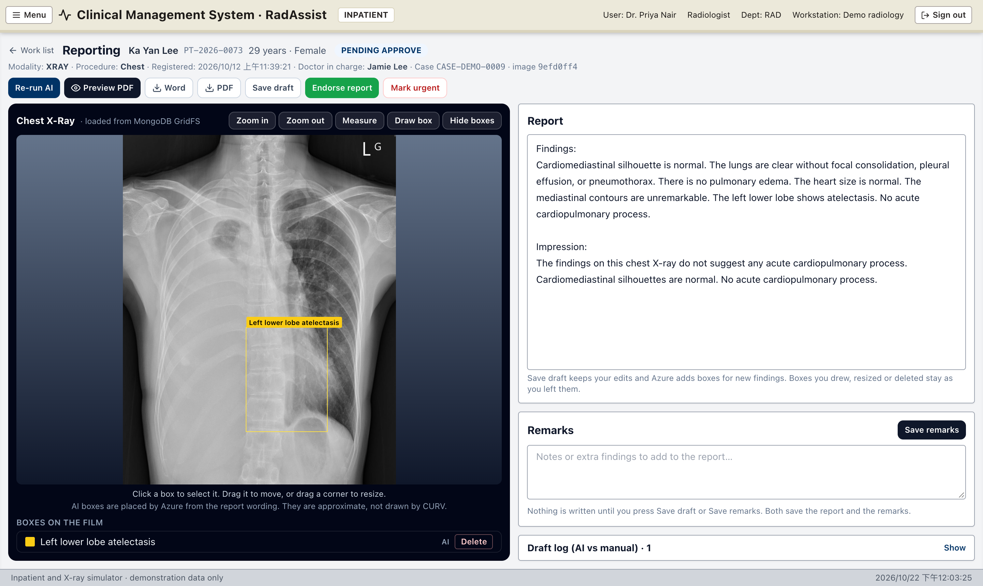
SCREENS
Report review: film beside an editable draft
1
Toolbar: Re-run AI, Preview PDF, Word, PDF, Save draft, Endorse report, Mark urgent.
2
Film tools: zoom, Measure (cm from DICOM spacing), Draw box, hide boxes / lines.
3
AI boxes placed by Azure from the report wording — select, move, resize, delete or draw your own.
4
Report box is directly editable (Findings + Impression). CURV’s hidden Thinking is preserved but never shown.
5
Draft log (AI vs manual) shows exactly which lines, boxes and measurements a human changed.
RadAssist AI · An AI-assisted Online System for X-Ray Report Generation
12
Notes:
This is the main clinical screen and matches the supervisor's briefing slide: film on the left, grounded findings and report on the right. Demonstrate moving a box and editing a sentence, then show the draft log.

Slide 13
AI
AI pipeline: CURV writes, Azure assists
CURV — report generation (local)
Azure OpenAI — assistance (optional)
Called with the official CURV conversation: system prompt prompt_cxr.txt + “Please analyze this chest X-ray image…”
Whole frame resized to the model budget (~224 × 224, max_pixels 50176); the review screen keeps the original film.
Greedy decoding, repetition penalty 1.05, up to 1536 tokens.
Output tags <findings>, <thinking>, <impression> are saved verbatim — no rewording.
Thinking is stored with the draft but hidden on every page and in every export.
If CURV is unavailable the case is still stored and the radiologist writes the report by hand.
Film boxes — after the draft and after a wording change; report + film → boxes with severity (normal ones not drawn). Falls back to anatomical zones.
Worklist label — short diagnosis, only after the radiologist has edited the draft.
Patient-chart findings — after endorsement; text-only, Thinking removed, ≤ 6 grouped findings with a severity.
Guard-rails — JSON mode, low temperature, server-side validation; Azure never writes reportText.
RadAssist AI · An AI-assisted Online System for X-Ray Report Generation
13
Notes:
Make the split crystal clear: the clinical text is CURV's alone, as trained, with no extra prompt engineering. Azure is an optional helper for localisation and summarisation, and its output is validated before it is stored.

Slide 14
AI
Keeping the human in the loop
Draft provenance
Box merge respects edits
Honest confidence
Every save appends an editLog row (kind: ai | manual) with added / removed / edited lines, boxes and measurements.
When Azure re-places boxes after a wording change, boxes the radiologist drew, moved, resized or deleted are kept exactly as left.
Confidence blends report language (hedges vs definite statements) with image support, instead of showing the model’s self-reported 100%.
Locking after endorse
Clean issued report
Full audit trail
Report text, boxes and measurements become read-only; Endorse is refused while AI is running. Remarks and urgency remain editable.
Doctors, shared links, Word and PDF never receive the draft log, source tags or the Thinking section.
Logins, case and patient changes, AI runs, endorsements, deletions, share links and user changes are logged for the admin.
RadAssist AI · An AI-assisted Online System for X-Ray Report Generation
14
Notes:
This slide answers the key examiner question: how do you make sure AI does not silently become the decision-maker? Provenance, merge rules, honest confidence, locking, clean output and audit.

Slide 15
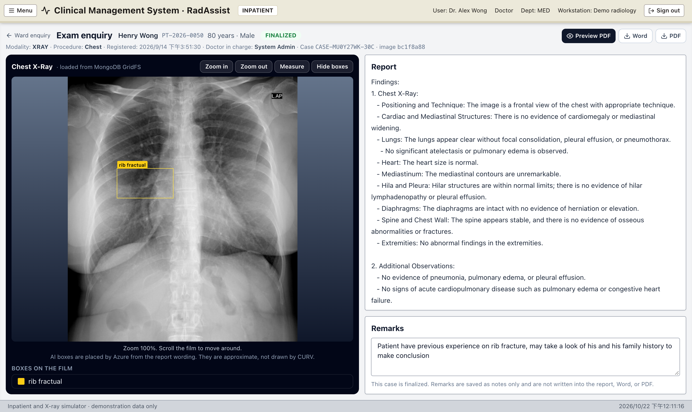
SCREENS
Endorsed report for the referring doctor
Read-only — no re-run, no draft log, no save, no endorse.
Clean text — Findings, Impression, measurements and signature; no Thinking.
Film with boxes — Measure works for reading but is never saved.
Export — Preview PDF, Word (.docx) and PDF include the film, measurement lines, date, reporting doctor and signature.
Share link — a radiologist can create a public token (#/share/<token>) for one endorsed case, and revoke it.
RadAssist AI · An AI-assisted Online System for X-Ray Report Generation
15
Notes:
Log in as the doctor during the demo to show the same case without any draft provenance. Download the PDF to show the signature and measurements.

Slide 16
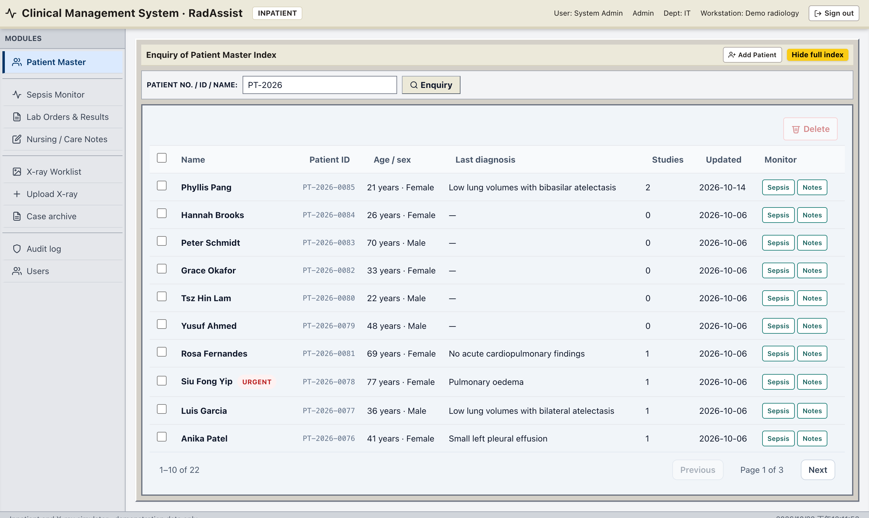
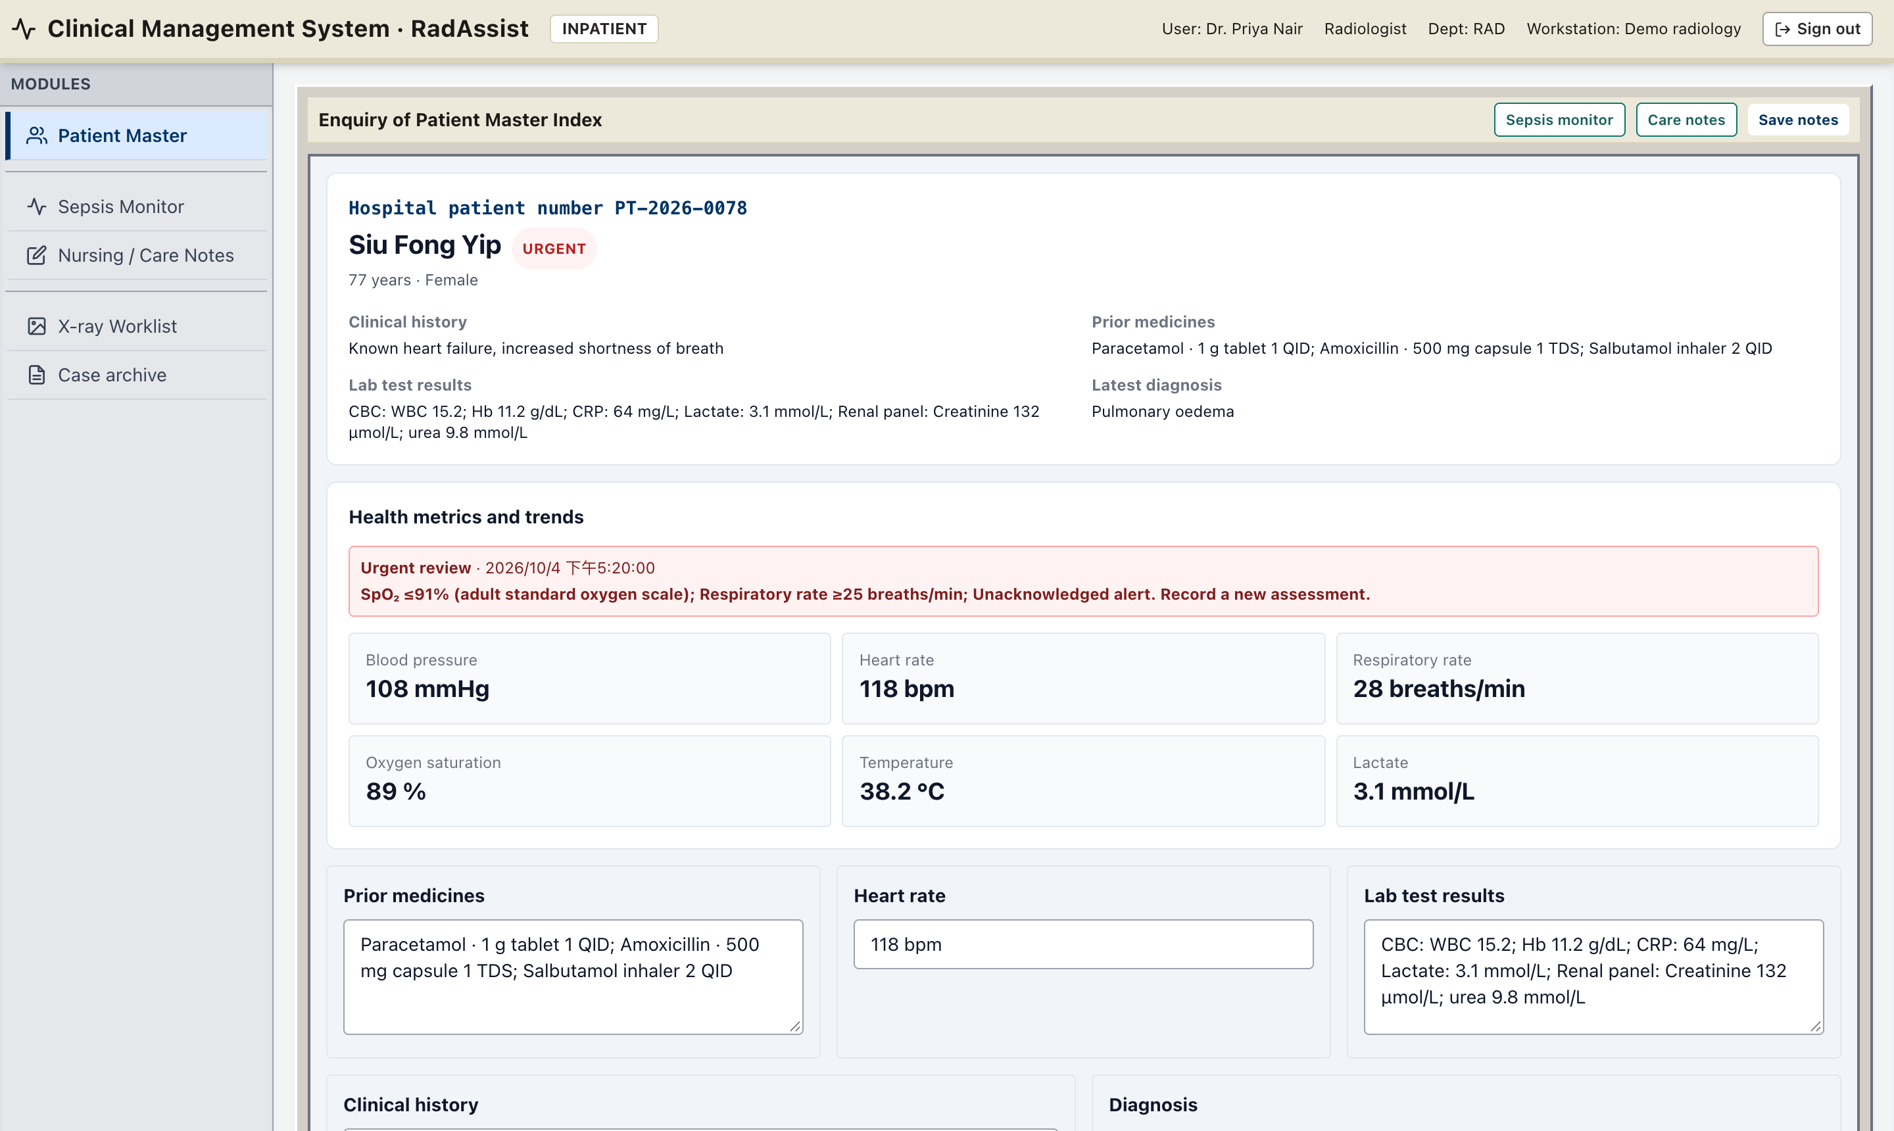
CLINICAL
Patient Master Index and patient chart
Enquiry of Patient Master Index — search, Sepsis / Notes buttons per row
Chart: history, medicines, labs, latest vitals and review state
A patient can exist before any X-ray; studies, X-ray requests, diagnosis, remarks and care notes all live on one chart.
The health-metrics banner flags Urgent / Abnormal review from the latest observations (e.g. SpO₂ ≤ 91 %, RR ≥ 25).
RadAssist AI · An AI-assisted Online System for X-Ray Report Generation
16
Notes:
The imaging workflow sits inside a CMS-style inpatient chart. Point out the urgent tag, the health-metrics banner and the header buttons for Sepsis monitor and Care notes.

Slide 17
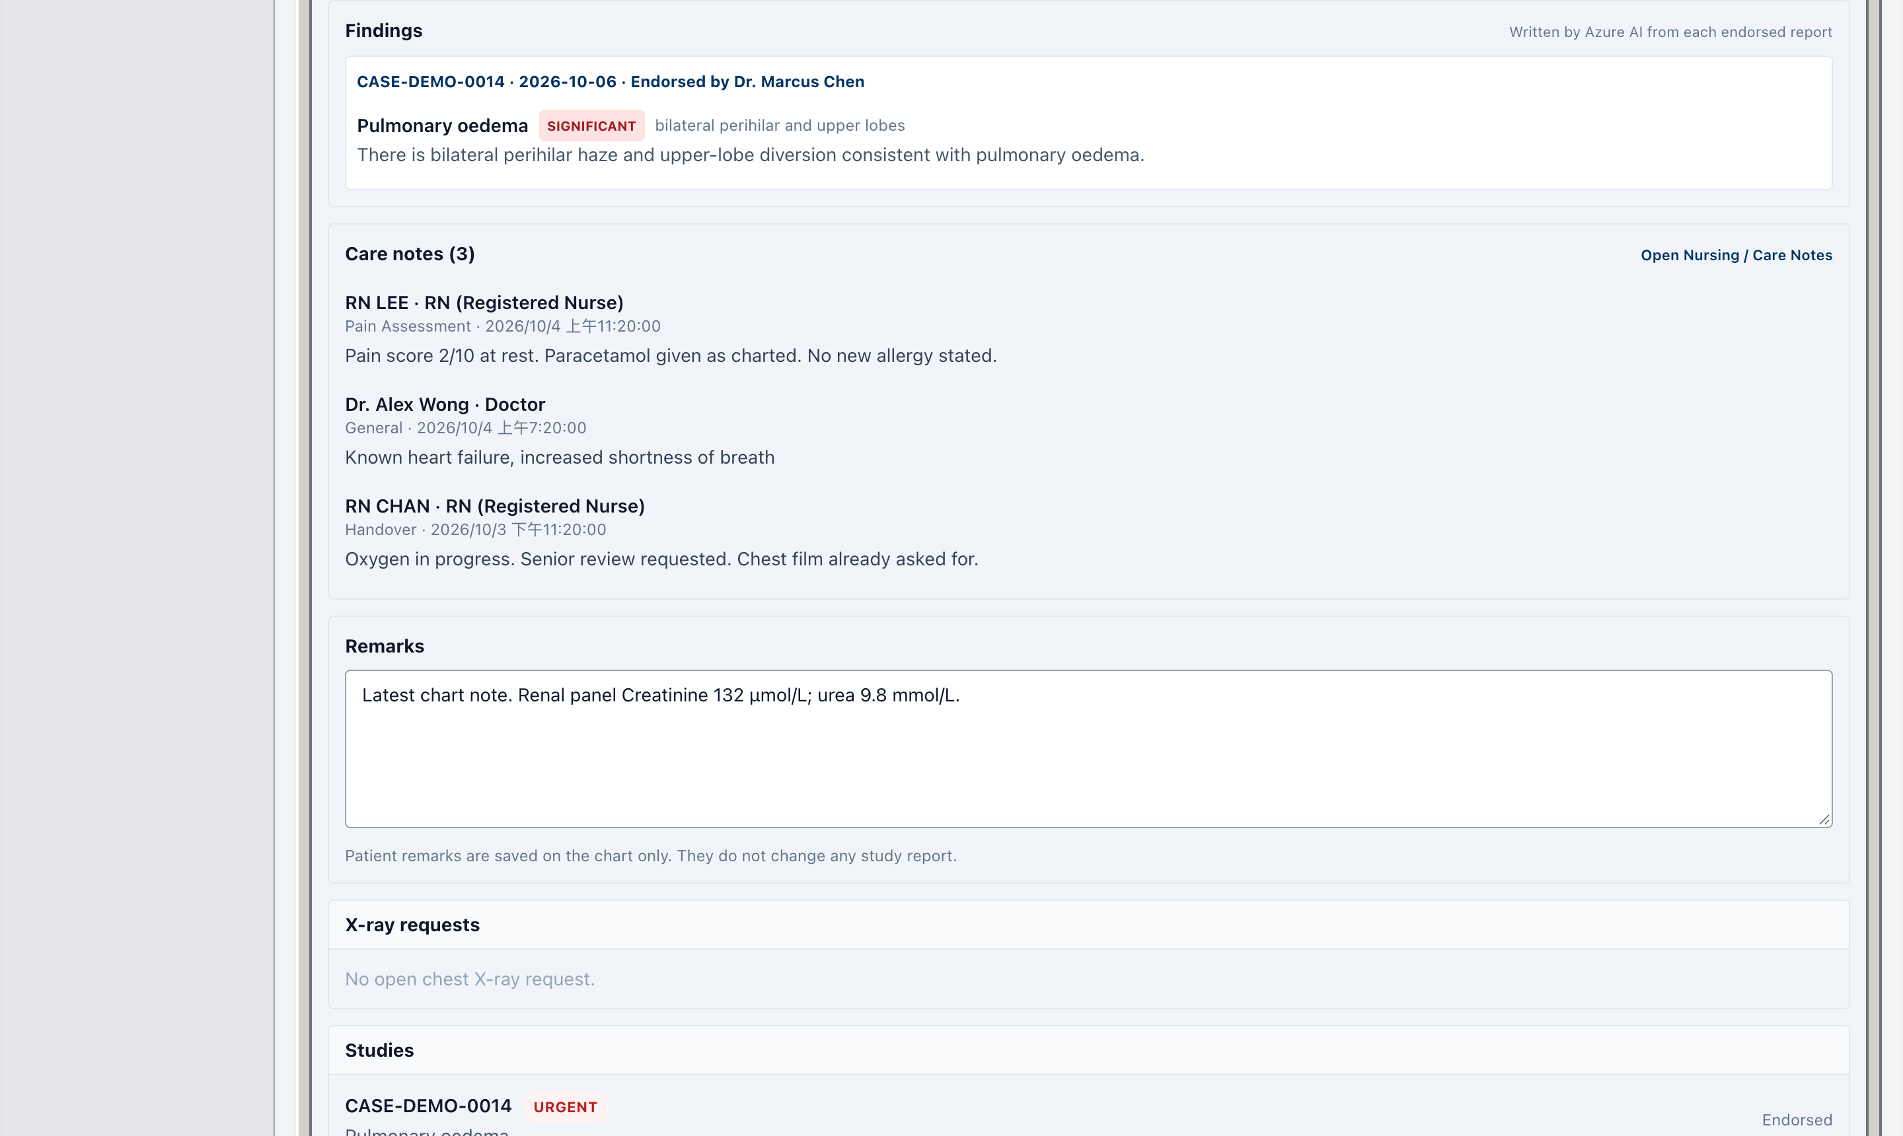
CLINICAL
Patient-chart findings written by Azure after endorsement
Radiologist presses Endorse
Case claimed atomically (no duplicate Azure calls)
Azure reads the clean endorsed report (no Thinking)
≤ 6 grouped findings + severity saved on the case
Chart polls every 4 s and shows them
Draft reports never appear under Findings — only endorsed studies, each tagged Significant / Minor / Normal with “Endorsed by …”.
Older endorsed reports are back-filled the first time the chart opens; a lost run (> 3 min) or an Azure failure shows Retry Azure AI to radiologists.
Hidden from technicians; if Azure is not configured the chart says so instead of guessing.
RadAssist AI · An AI-assisted Online System for X-Ray Report Generation
17
Notes:
This feature closes the loop back to the ward: once the radiologist signs, ward staff see concise structured findings on the patient chart. A database-level atomic claim means two people opening the chart at the same moment trigger only one Azure call.

Slide 18
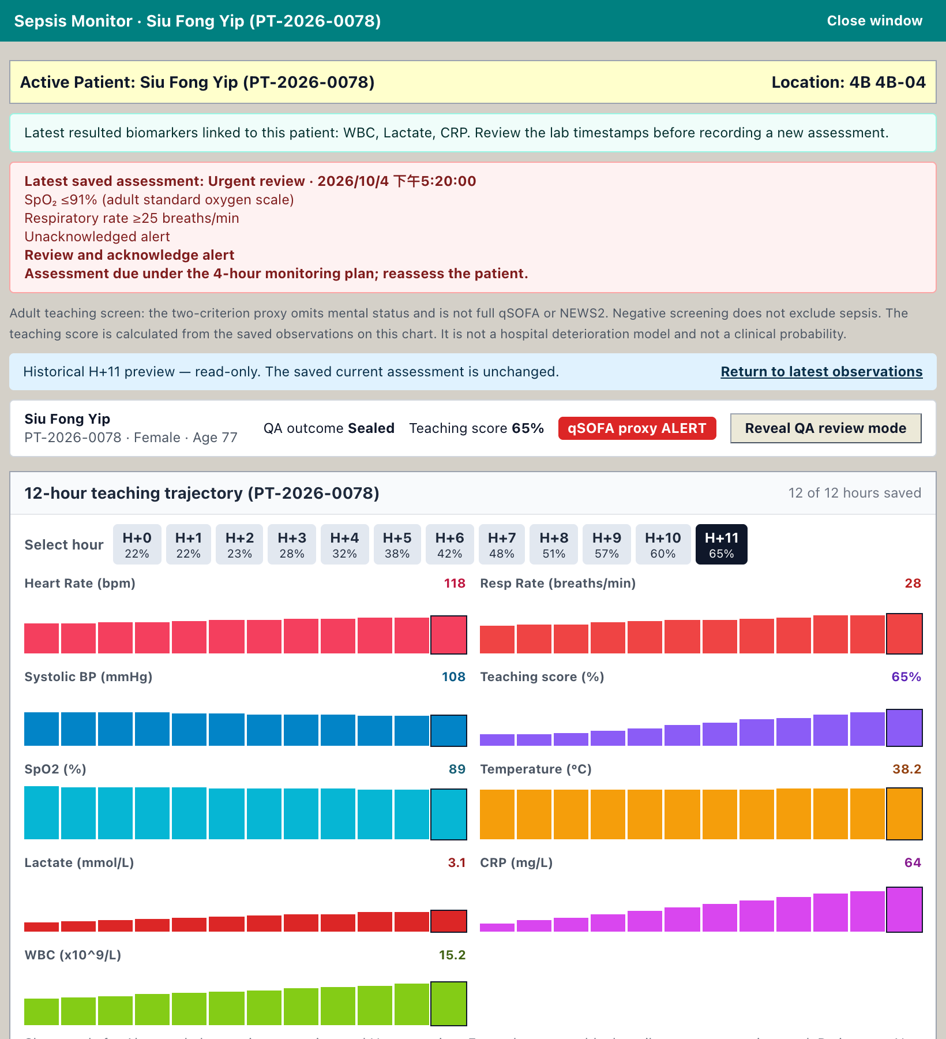
CLINICAL
Inpatient observations & sepsis screening (teaching)
Review states from the CMS sepsis screen
Urgent review: SpO₂ ≤ 91 %, RR ≥ 25, or the two-criterion proxy RR ≥ 22 and systolic BP ≤ 100.
Abnormal: outside adult teaching ranges (HR, RR, BP, SpO₂, temperature, lactate, WBC, CRP).
Otherwise: no configured trigger.
12-hour trajectory — per-hour bars for HR, RR, BP, SpO₂, temperature, lactate, CRP, WBC and a teaching score.
Hour preview — step through H+0 … H+11 read-only; the saved assessment is unchanged.
Record vitals — new observations append to the flowsheet and alert audit log.
Honest labelling — the teaching score is not a hospital deterioration model or a clinical probability.
RadAssist AI · An AI-assisted Online System for X-Ray Report Generation
18
Notes:
The Sepsis Monitor gives the imaging workflow inpatient context. Be explicit that it is a teaching screen: the two-criterion proxy omits mental status and is not full qSOFA or NEWS2.

Slide 19
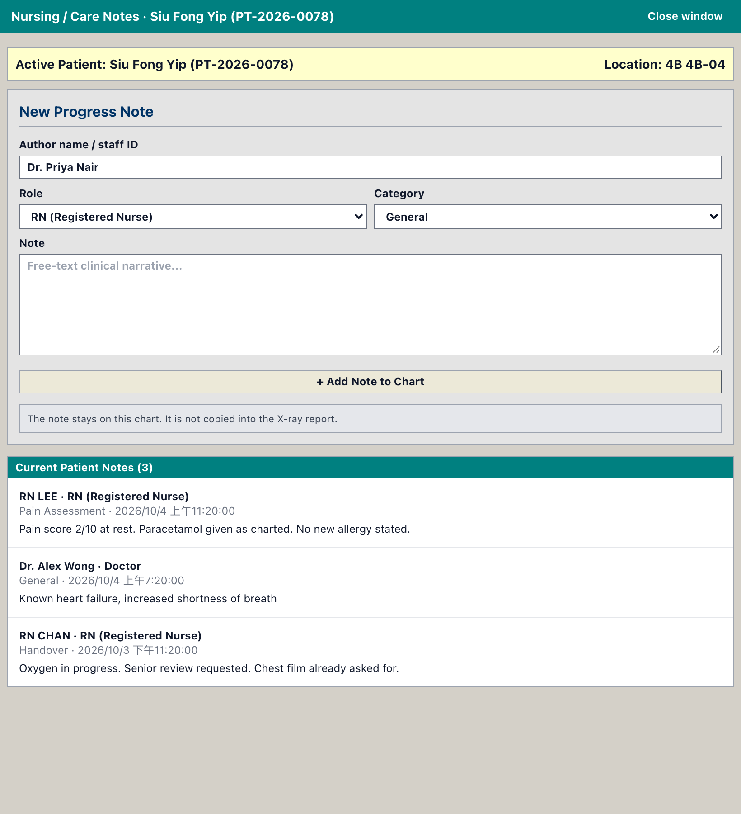
CLINICAL
Sepsis Monitor and Care Notes in their own windows
Read side by side — Sepsis monitor and Care notes open the patient in a separate browser window — beside the chart or on a second screen.
One patient only — no ward worklist or patient picker, so nothing is recorded against the wrong patient.
Live sync — vitals or notes saved in a window are posted back (same-origin postMessage) and the chart updates without a reload.
Window reuse — each view has its own named window; opening another patient reuses it.
Pop-up blocked? — the same view opens as a draggable, resizable floating panel instead.
?view=sepsis&patientId=… · ?view=notes&patientId=…
RadAssist AI · An AI-assisted Online System for X-Ray Report Generation
19
Notes:
This was requested by clinical-style usage: users want to read the Patient Master and the monitor at the same time without being redirected. Demonstrate recording a vital in the window and the chart updating behind it.

Slide 20
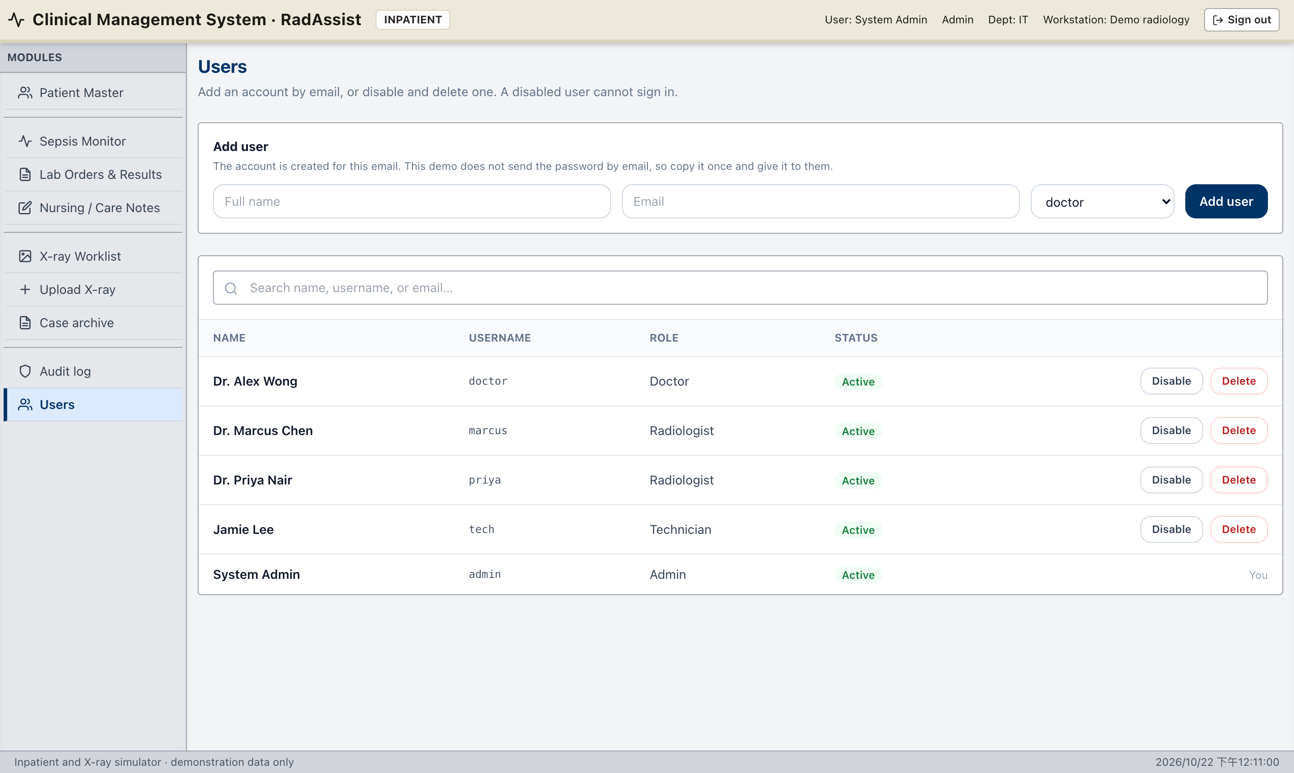
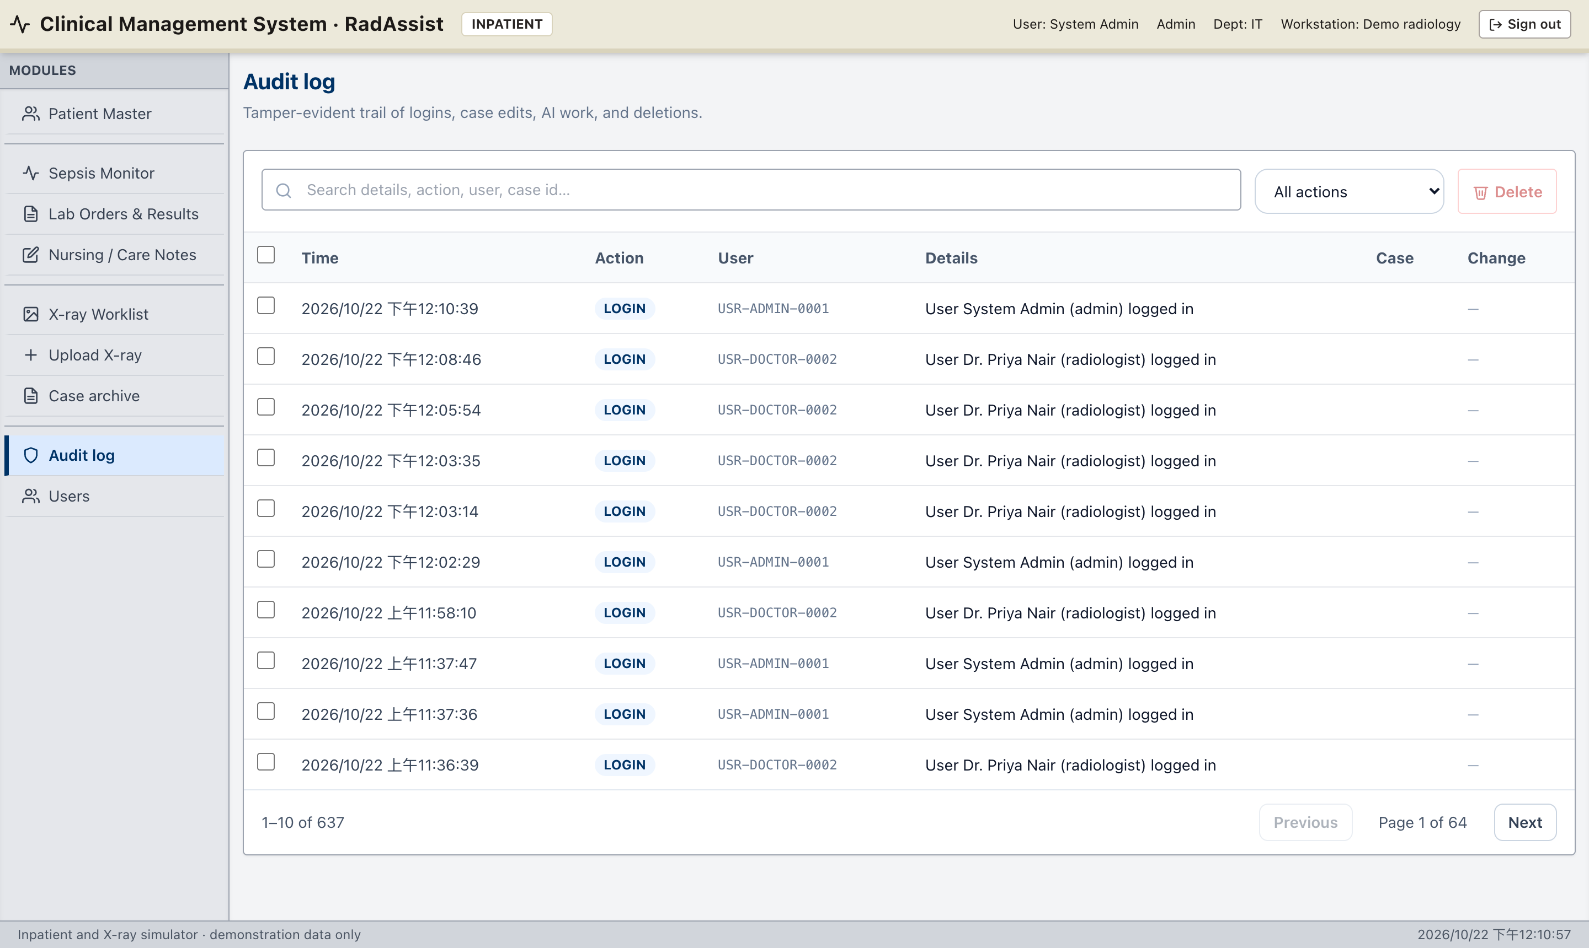
ADMIN
Administration: users and audit trail
Users: add by email, one-time temporary password, enable / disable / delete
Audit log: filter by action, user, case; admin-only
Safeguards: an admin cannot disable or delete their own account or remove the last active administrator.
Bulk delete (cases, patients, audit rows) removes related studies and GridFS images; a patient delete keeps nothing orphaned.
RadAssist AI · An AI-assisted Online System for X-Ray Report Generation
20
Notes:
Show the users page and the audit trail. The audit log is the traceability evidence for the human-in-the-loop claim.

Slide 21
DATA
Data model
Patient
Case (one study / film)
User
patientId · first / middle / last name
age · sex · history · remarks
medicines · heartRate · labResults
ward · bed · admissionStatus
observations[] · labOrders[] · careNotes[]
caseId · patientId · status · urgent
reportText · remarks · diagnosis(+Source)
findings[] = film boxes · measurements[]
analysisState · boxesState · editLog[]
chartFindings[] · chartFindingsState
imageId (GridFS) · pixelSpacingMm
requestedBy · createdBy · finalizedBy/At · shareToken
username · email · name
role: technician | radiologist |
doctor | admin
bcrypt password · isActive
1 : N
AuditLog
userId · action · details
affectedCaseId · before / after
timestamp
Case status | requested | pending | pending_approve | finalized
Shown as | Requested | Outstanding / Generating | Pending approve (draft) | Endorsed (locked)
Images are streamed from the GridFS bucket “images” and require a valid JWT (except a share link’s single film).
RadAssist AI · An AI-assisted Online System for X-Ray Report Generation
21
Notes:
Two main collections: patients and cases. Note the difference between findings (boxes on the film) and chartFindings (Azure's structured findings for the chart, written only after endorsement and never part of the report).

Slide 22
DATA
Security and privacy
In place
Known gaps (demo scope)
JWT authentication; every route checks the role on the server.
Response stripping per role (technicians never receive film, report or findings; doctors never receive draft logs or source tags).
bcrypt password hashing; temporary passwords shown once.
Helmet security headers; GridFS images require a JWT.
Share links are random 24-byte tokens for one endorsed case, revocable.
Chart windows accept updates only from the same origin.
Secrets in backend/.env (never committed); no HKID or address collected.
CORS is intentionally loose for local Vite ports.
Public demo sign-up (POST /api/auth/register) should be disabled for real use.
JWT is stored in localStorage; httpOnly cookies would resist XSS better.
Seed passwords are public in the repository and must be rotated on shared databases.
Patient ID allocation (max + 1) can collide under concurrent creates.
Synthetic chart data only — MIMIC-IV vitals and labs are not loaded.
RadAssist AI · An AI-assisted Online System for X-Ray Report Generation
22
Notes:
Be upfront about the gaps — examiners appreciate it. All of them are listed in the README as engineering recommendations for Semester 2 hardening.

Slide 23
EVALUATION
Testing and verification
193
19
35
~14.7k
automated UI tests
test suites, all passing
REST route handlers
lines of JavaScript
UI behaviour tests — linkedom DOM + mocked API: every review-page control (edit, boxes, measurements, endorse, share, Word / PDF), role restrictions, worklist, pagination, DICOM, audit, users, share page.
Patient chart tests — Azure findings only for endorsed reports, running / failed / Retry states, hidden from technicians, Care notes, separate windows, sync back to the chart, blocked pop-up fallback.
Backend logic checks — atomic claim of chart findings against a throw-away MongoDB: two simultaneous loads → one Azure call; lost runs restart; Retry forces a re-run.
End-to-end — test-e2e-case.mjs logs in against the running API and checks every case, its report text, findings and image.
Live checks — Azure prompts verified on sample reports (Thinking removed, grouped findings); screens verified in headless Chrome per role.
RadAssist AI · An AI-assisted Online System for X-Ray Report Generation
23
Notes:
Mention npm test runs the whole frontend suite in about 10 seconds. Acknowledge that Express/Mongo do not yet have a full automated backend test suite — that is listed as future work.

Slide 24
EVALUATION
Limitations
Not a clinical device
Model input resolution
Decision support only — not a PACS, not CE / FDA cleared, not a substitute for a radiologist.
CURV sees a ~224 px film; fine detail is lost. The original is kept for human review.
Approximate boxes
Measurement accuracy
Azure boxes come from the report wording and the film, not from CURV’s attention; they can be imprecise.
Centimetres depend on DICOM pixel spacing; other films measure in pixels.
Synthetic chart data
Single-machine AI
Vitals, labs, medicines and the sepsis score are teaching data, not MIMIC-IV.
CURV runs on one Apple Silicon Mac — the critical dependency for any live demo.
RadAssist AI · An AI-assisted Online System for X-Ray Report Generation
24
Notes:
Frame limitations as deliberate scope decisions for an FYP rather than oversights.

Slide 25
EVALUATION
Future work (Semester 2 and beyond)
Hardening — tighten CORS, remove public sign-up, httpOnly cookie sessions, rotate secrets, structured logs with request IDs.
Backend test suite — API black-box tests for Express + MongoDB, plus upload-to-draft latency measurements.
Deployment — static frontend + Node API in a container, Cosmos secrets in a key vault, CURV on a dedicated Apple Silicon / GPU host, Azure via private endpoint.
Richer imaging — full DICOM / PACS viewer with compressed transfer syntaxes and windowing.
Bidirectional binding — hover a sentence to highlight its box and vice versa; global confidence threshold slider.
Evaluation with clinicians — time-to-report and edit-distance study comparing AI-drafted vs blank-page reports; usability feedback from radiologists.
Real clinical data — link MIMIC-IV vitals and labs under an ethics plan to replace synthetic chart data.
RadAssist AI · An AI-assisted Online System for X-Ray Report Generation
25
Notes:
Pick two or three items to emphasise depending on time — evaluation with clinicians is the strongest research follow-up.

Slide 26
DEMO
Live demo plan (≈ 10 minutes)
1
Doctor Book a chest X-ray on the calendar
6
Radiologist Endorse → open chart → Azure writes Findings
2
Technician Requested case → register the film
7
Any role Open Sepsis monitor + Care notes windows; record a vital and a note
3
Radiologist Worklist: Generating → Pending approve
8
Doctor Read the clean endorsed report; export Word / PDF
4
Radiologist Review: Azure boxes, edit text, resize/draw a box, measure
9
Admin Users, audit trail, share link
5
Radiologist Save draft → show draft log → download PDF
Before the session: start backend, Vite and start_server.sh; check /api/health (mongo up) and :8001/health; wait for the model to load.
RadAssist AI · An AI-assisted Online System for X-Ray Report Generation
26
Notes:
Demo accounts: doctor/doctor123, tech/tech123, priya/priya123, admin/admin123. Keep an already-endorsed case open in another tab in case CURV is slow.

Slide 27
Thank you
Questions & discussion
RadAssist AI
AI drafts. The radiologist decides. The ward sees only what was signed.
PANG Ho Yiu · 23226609 · HKBU Computer Science
Notes:
Invite questions. Likely questions: why not retrain CURV; how is safety enforced; what does Azure cost; how would you deploy it; how accurate are the boxes.

