Slide 1
Environment Diagrams
Slides adapted from Berkeley CS61a

Slide 2
What are Environment Diagrams?
A visual tool to keep track of bindings & state of a computer program
In this class, we use Python as our primary language
The diagrams we teach can be applied to similar languages

Slide 3
Why do we use Environment Diagrams?
Environment Diagrams are conceptual
understand why programs work the way they do
confidently predict how a program will behave
Environment Diagrams are helpful for debugging
When you're really stuck,
diagramming code > staring at lines of code
Environment Diagrams will be used in future courses
CS 61C (Machine Structures)
CS 164 (Programming Languages and Compilers)
Notes:
Conceptual
They help you understand why programs work the way they do and allow you to definitively predict what a function will do.
Visual
When you are stuck, having a framework for visualizing functions is often more helpful than staring at lines of code.
Future Courses
If you continue taking additional CS classes, you will see them again, particularly in CS 61C (Machine Structures) and CS 164 (Programming Languages and Compilers).

Slide 4


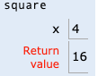

What do we've seen so far
Assignment Statements
x = 1
x = x + x + x
Def Statements
def square(x):
return x * x
Call Expressions
square(4)
Frame

Slide 5
Terminology: Frames
A frame keeps track of variable-to-value bindings.
Every call expression has a corresponding frame.
Global, a.k.a. the global frame, is the starting frame.
It doesn't correspond to a specific call expression.
Parent frames
The parent of a function is the frame in which it was defined.
If you can't find a variable in the current frame, you check it's parent, and so on. If you can't find the variable, NameError
Demo
Notes:
Try a new example! http://tinyurl.com/broken-square
y = 10
def broken_square(x):
return x * y
broken_square(4)

Slide 6
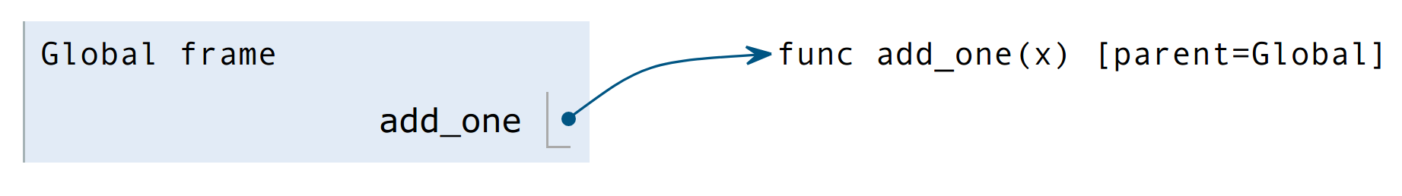
How to draw an Environment Diagram
When a function is defined:
Create a function value:
func <name>(<formal parameters>) [parent=<label>]
Bind <name> to the function value in the current frame
Its parent is the current frame.
def add_one(x): y = x + 1 return y
Bind the name to the function value
Create a function value

Slide 7
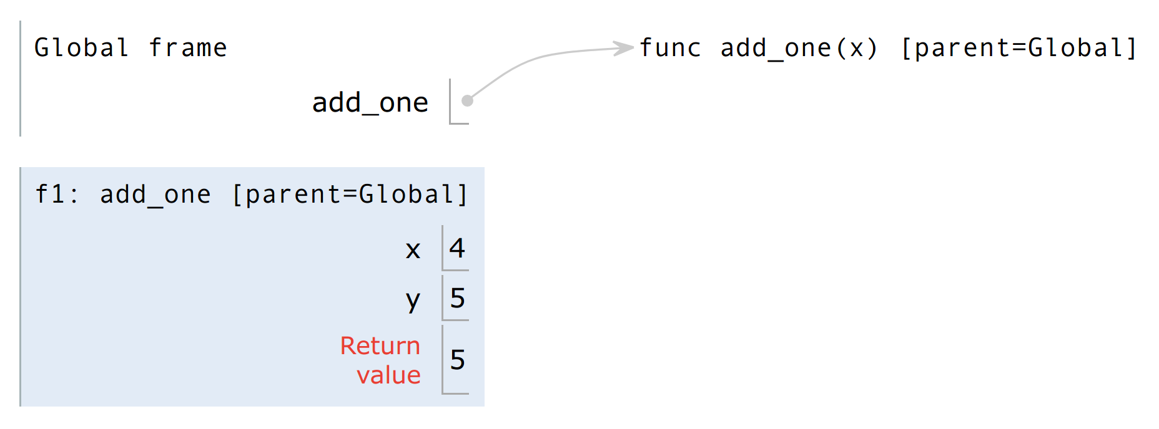
How to draw an Environment Diagram
Demo
When a function is applied:
Add a local frame, titled with the <name> of the function being applied.
Copy the parent of the function (not always the current frame) to the local frame: [parent=<label>]
Bind the <formal parameters> to the arguments in the local frame.
Execute the body of the function in the environment that starts with the local frame
Create a new frame with name and parent
def add_one(x): y = x + 1 return y add_one(4)
Bind the formal parameters
Execute the body of the function
Notes:
Run through diagram
Link: https://goo.gl/xaRv3T

Slide 8
Check Your Understanding
Draw the environment diagram
def square(x):
return x * x
def sum_of_squares(x, y):
return square(x) + square(y)
sum_of_squares(3, 4)
Notes:
http://pythontutor.com/visualize.html#code=def%20square%28x%29%3A%0A%20%20%20%20return%20x%20*%20x%0A%0Adef%20sum_of_squares%28x,%20y%29%3A%0A%20%20%20%20return%20square%28x%29%20%2B%20square%28y%29%0A%20%20%20%20%0Asum_of_squares%283,%204%29&cumulative=true&curInstr=0&heapPrimitives=nevernest&mode=display&origin=opt-frontend.js&py=3&rawInputLstJSON=%5B%5D&textReferences=false

Slide 9
Review: Evaluation Order
Demo
Remember to evaluate the operator, then the operand(s), then apply the operator onto the operand(s).
def add_one(x): y = x + 1 return y def square(x): return x * x
Evaluate the operator. A function value is returned
Evaluate the operand..
square(add_one(9))
Returns 10
Returns 100
Evaluate the operator. A function value is returned
Evaluate the operand. Now we have evaluate another expression.
What will the environment diagram look like? (When are frames created?)
The environment diagram should reflect Python’s evaluation.
Notes:
Run through diagram
Link: https://goo.gl/9YqDf4

Slide 10
Variable Lookup
Notes:
Now that we have multiple frames, what if the same name ("X") exists in two different frames?
If I type "x" in my program, how does python know which "x" I am referring to?

Slide 11
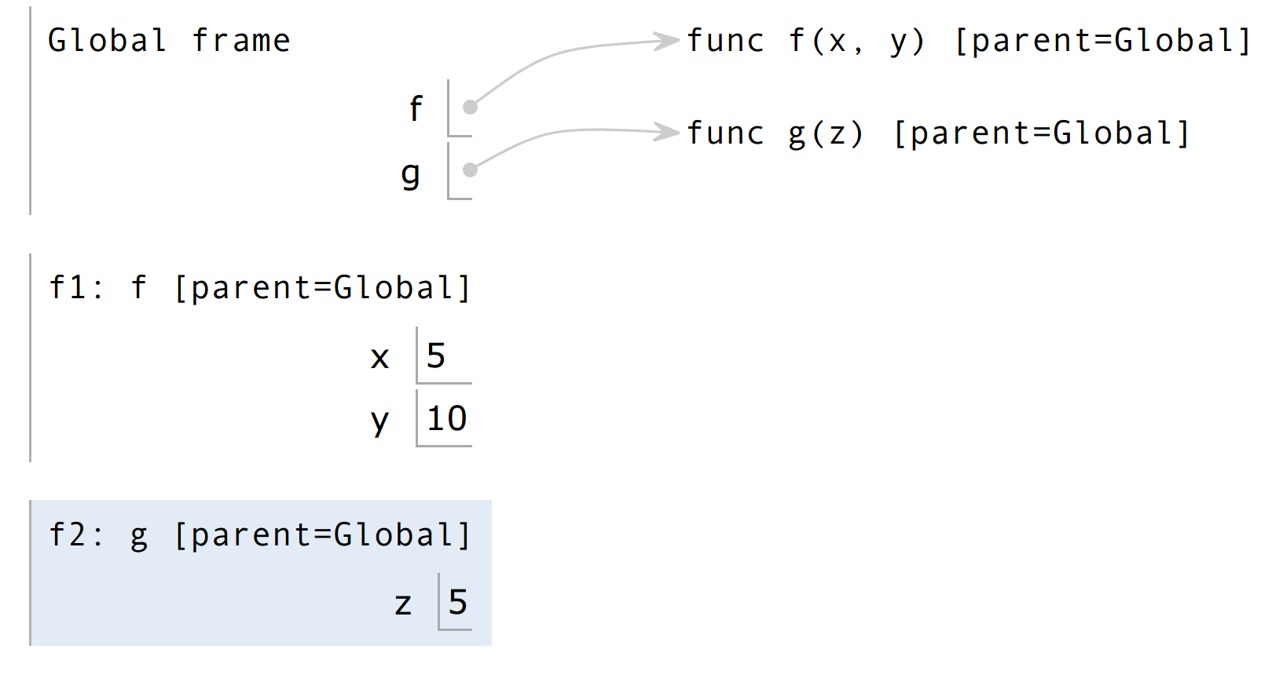
Local Names
Variable Lookup:
Lookup name in the current frame
Lookup name in parent frame, its parent frame, etc..
Stop at the global frame
If not found, an error is thrown
An error is thrown
def f(x, y): return g(x) def g(z): return z + x result = f(5, 10)
Name “x” is not found, again
Where do we look next?
Name “x” is not found
Important: There was no lookup done in f1 since the parent of f2 was Global
What happens here?
Notes:
Link: https://goo.gl/qapMyY

Slide 12
Evaluation vs Apply
Demo
def a_plus_bc(a, b, c): """ >>> a_plus_bc(2, 3, 4) # 2 + 3 * 4 14 """ bc = b * c return a + bc
Apply operator a_plus_bc function to operand 4, 3, 81.
How many frames are created? In what order?
a_plus_bc(square(2), 3, square(square(3)))
Apply operator square function to operand 2.
Apply operator square function to operand 9.
Apply operator square function to operand 3.
Notes:
Demo: go through ED
Link: https://goo.gl/4EgiDe

Slide 13
Break/Q&A

Slide 14
Lambda Expressions

Slide 15
Lambda Expressions
Expressions that evaluate to functions!
A function
with parameter x
that returns the value of x * x
>>> square = lambda x: x * x
>>> square
<function <lambda> ... >
>>> square(4)
16
>>> x = square(5)
>>> x
25

Slide 16
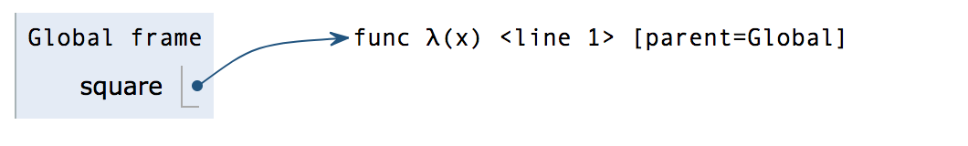
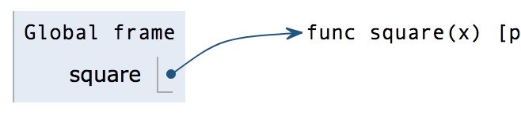
Lambda Expressions vs def Statements
square = lambda x: x * x
def square(x):
return x * x
Both create a function with the same behavior
The parent frame of each function is the frame in which they were defined
Both bind the function to the same name
Only the def statement gives the function an intrinsic name

Slide 17
Environment Diagram
times = 2
def repeated(f, n, x):
while n > 0:
x = f(x)
n -= 1
return x
repeated(lambda x: x*x, times, 3)
times = 2
def repeated(f, n, x):
while n > 0:
x = f(x)
n -= 1
return x
def square(x):
return x * x
repeated(square, times, 3)

Slide 18
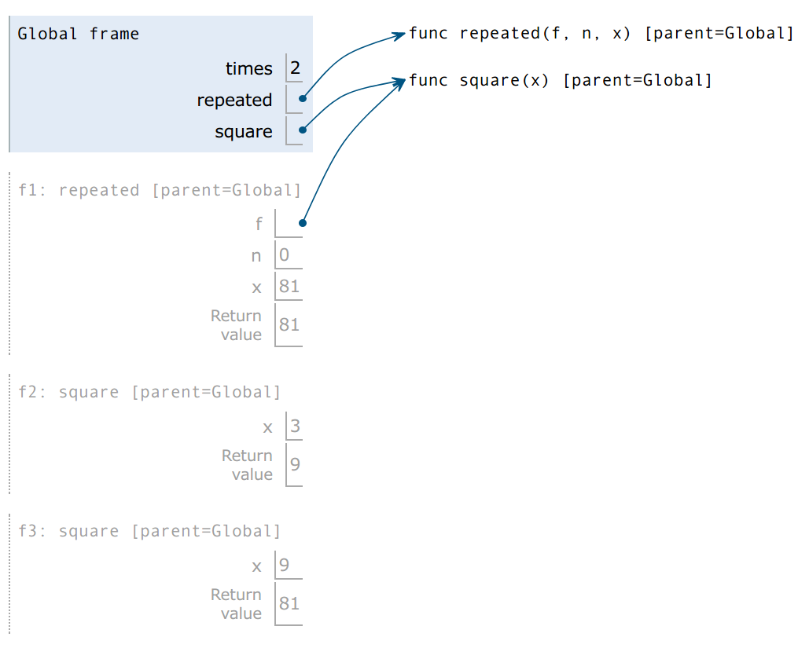
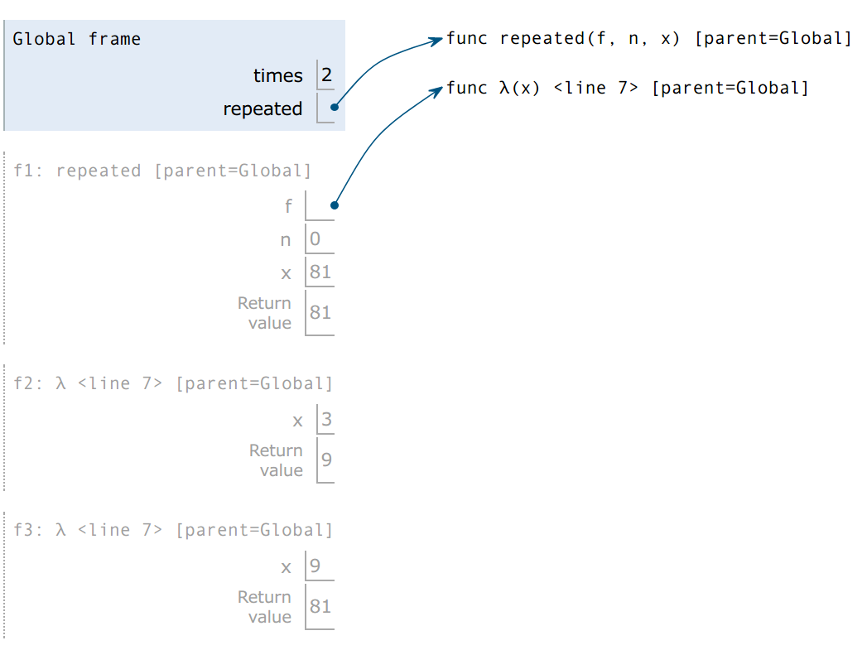
Comparisons
times = 2 def repeated(f, n, x): while n > 0: x = f(x) n -= 1 return x def square(x): return x * x repeated(square, times, 3)
Bounded to name in global frame
Parent is the global frame
Intrinsic name is “square”
times = 2 def repeated(f, n, x): while n > 0: x = f(x) n -= 1 return x repeated(lambda x: x * x, times, 3)
Not bounded to name in global frame
Parent is the global frame
Intrinsic name is “λ”

Slide 19
Higher Order Functions

Slide 20
Higher Order Functions
A function that ...
takes a function as an argument value, and/or
returns a function as a return value
You just saw this in
the previous example!
times = 2
def repeated(f, n, x):
while n > 0:
x = f(x)
n -= 1
return x
repeated(lambda x: x*x, times, 3)

Slide 21
Locally Defined Functions
>>> def make_greeter(name):
… return lambda greeting: print(greeting, name)
>>> greeter_function = make_greeter("Tiffany")
>>> greeter_function("Hey what's up, ")
Currying
>>> make_greeter("Tiffany")("Where's the party at, ")
Notes:
Check your understanding

Slide 22
Summary
Environment Diagrams formalize the evaluation procedure for Python
Understanding them will help you think deeply about how the code that you are writing actually works
Lambda functions are similar to functions defined with def, but are nameless
A Higher Order Function is a function that either takes in functions as an argument (shown earlier) and/or returns a function as a return value (will see soon)

