Slide 1

Weather and Air Quality Dashboard
WEB APPLICATION PROGRAMMING (CB2001105-062)
AICH SATYABRATA
Pusan National University
202014337 Jung Junhyuk
Department of Atmospheric Science

Slide 2

1
Used Things
2
Explanation
3
Things to do

Slide 3





1
Used Things

Slide 4
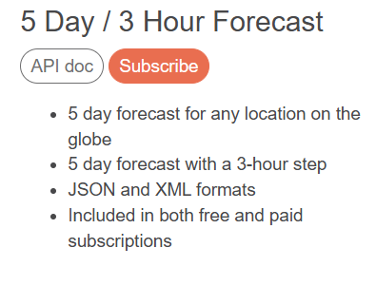
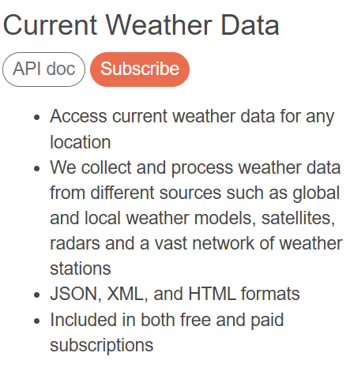

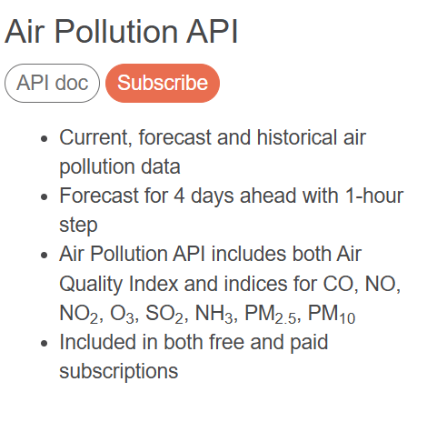
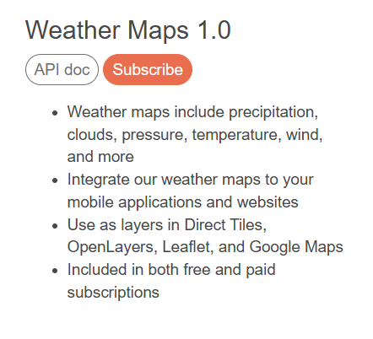
1
Used Things

Slide 5
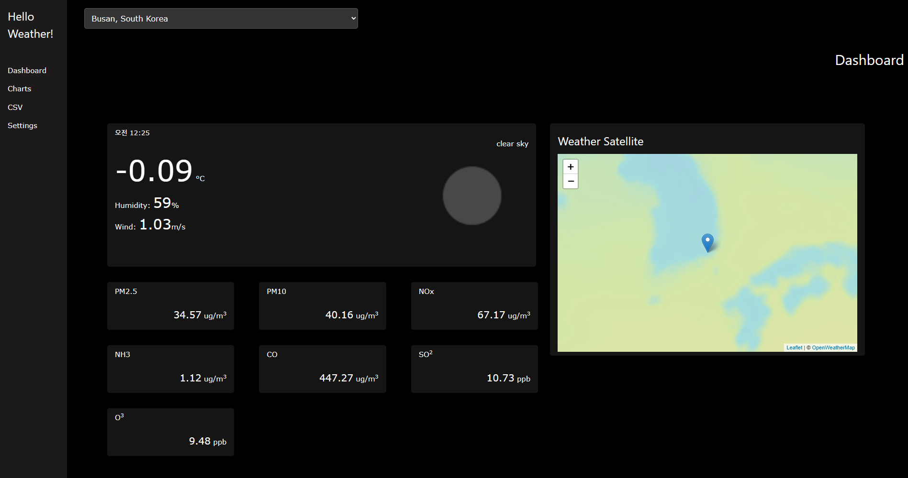
2
Explaination

Slide 6
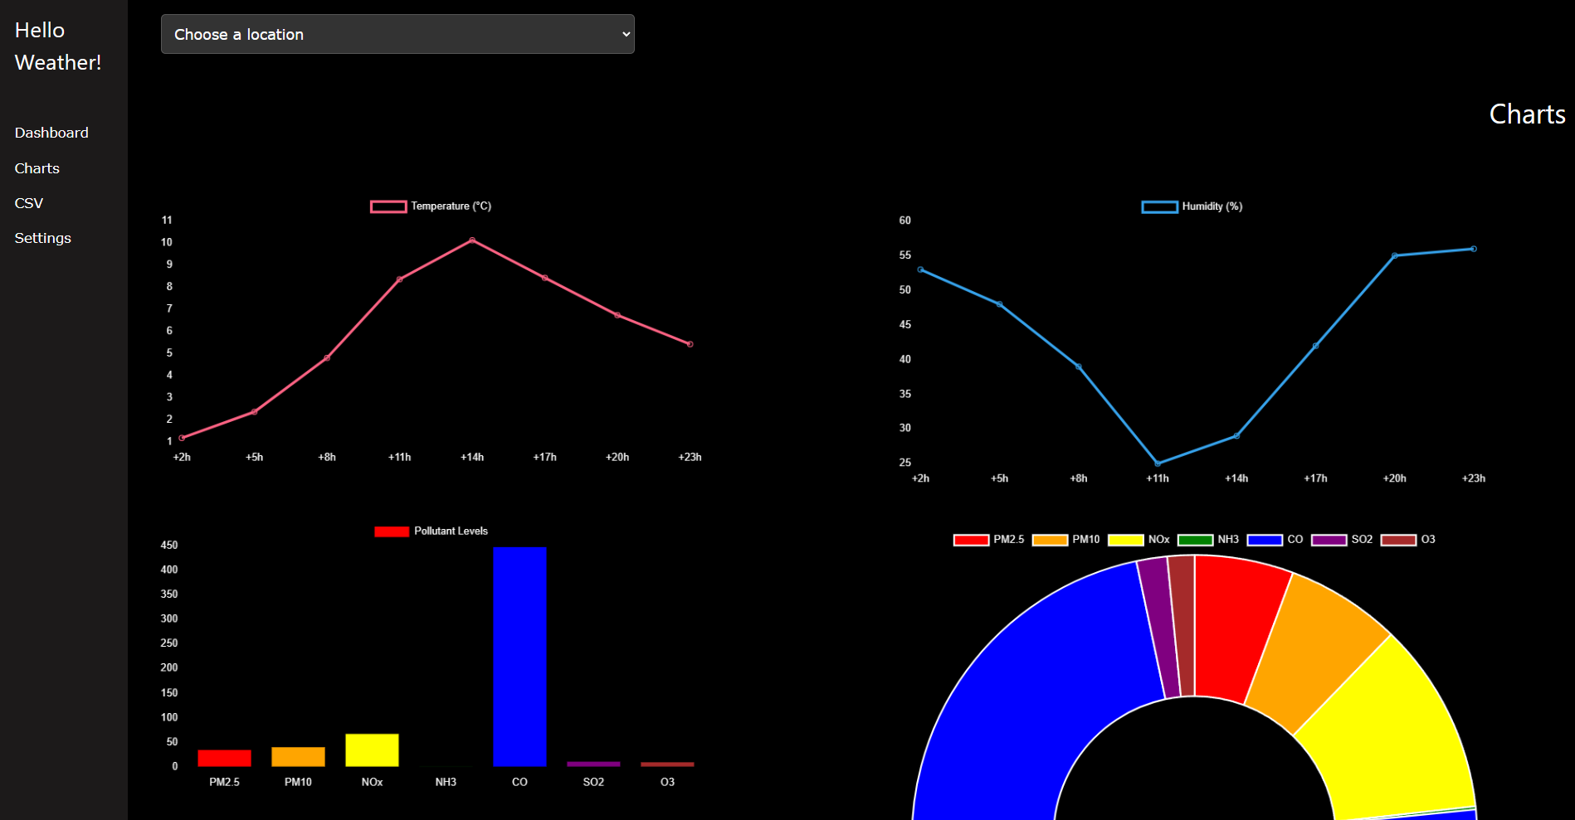
2
Explaination

Slide 7

2
Explaination
The SideBar
Dashboard
This section is likely the main interface where users can view an overview of weather data, including current conditions, other key insights.
Charts
This section contains visual representations of weather data, such as temperature trends, helping users understand patterns and changes over time.
CSV
This feature could allow users to upload weather-related data in CSV format, making it useful for watching to data in Dashboard

Slide 8
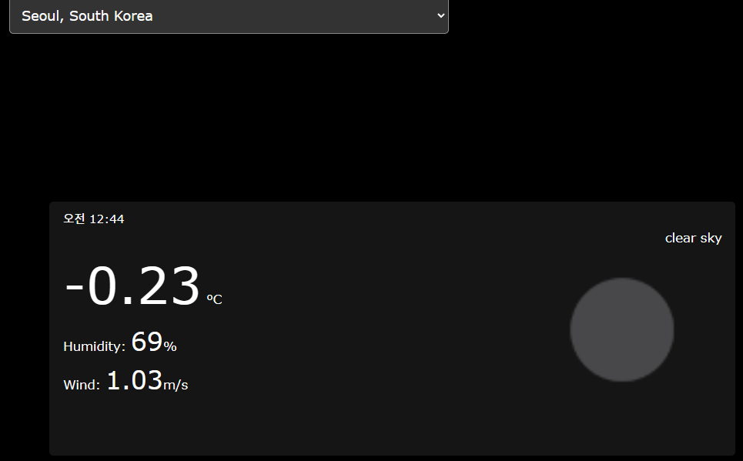
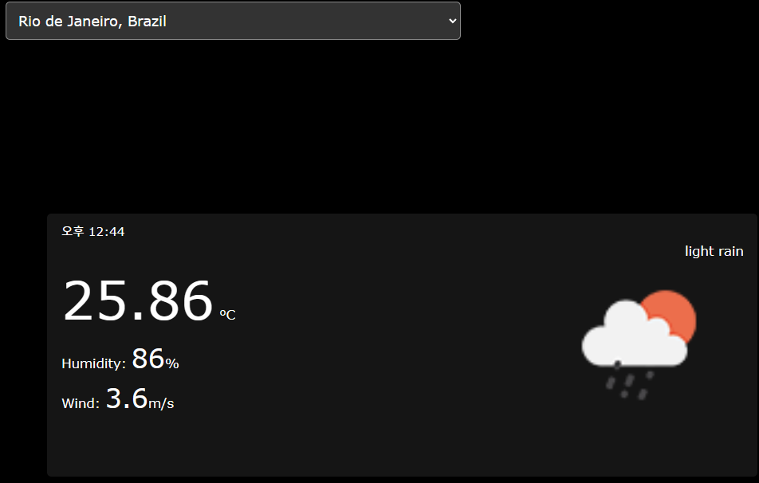
2
Explaination
allows users to select a specific region from a dropdown menu, as shown in the images. Based on the selected location, the app provides detailed weather information, including:
Temperature: Displays the current temperature in degrees Celsius.
Humidity: Indicates the percentage of humidity in the atmosphere.
Wind Speed: Shows the current wind speed in meters per second.
Weather Conditions: Describes the overall weather state, such as "clear sky" or "light rain," often accompanied by an icon for visual clarity.
Timeline

Slide 9
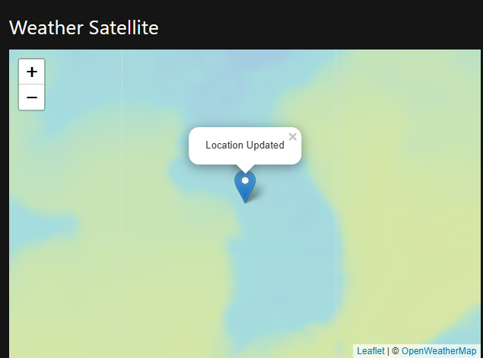
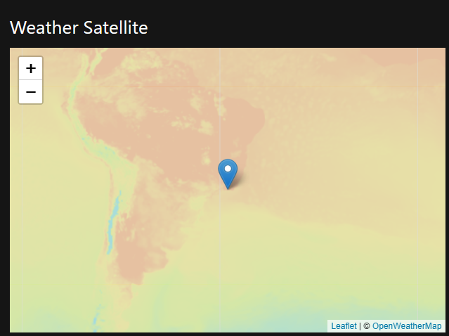
2
Explaination
also includes a Weather Satellite feature that displays the temperature distribution of the selected region and its surrounding areas, as shown in the images.
Interactive Map: Users can navigate and zoom in/out to explore detailed satellite imagery.
Location Marker: The selected location is marked with a pin, providing a clear reference point.
Temperature Distribution: The map visualizes temperature variations using a gradient of colors, offering insights into regional weather patterns.

Slide 10
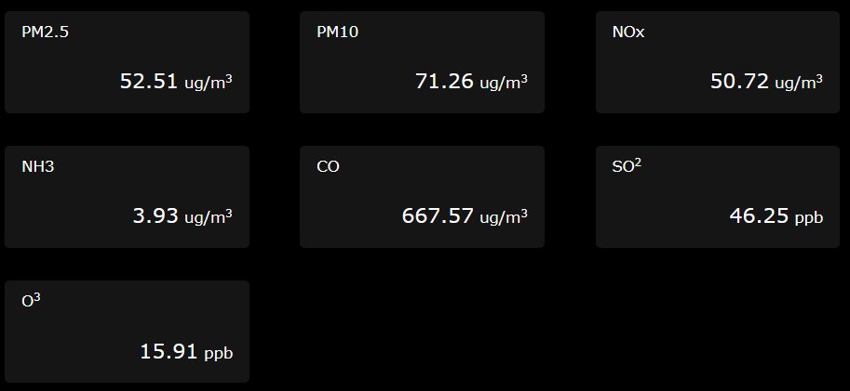
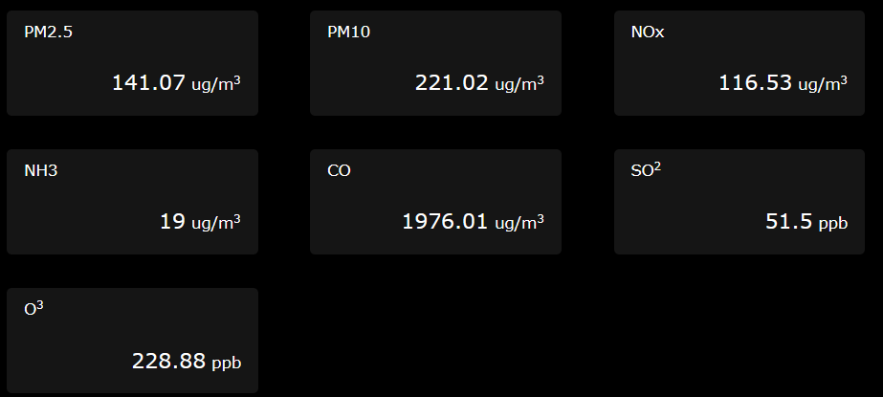
2
Explaination
Seoul
Rio de Janeiro
The values of various pollutants vary depending on the location, offering users insights into the air quality.
PM2.5 and PM10: Fine and coarse particulate matter concentrations (measured in µg/m³).
NOx: Nitrogen oxides levels, which contribute to smog and acid rain.
NH3: Ammonia concentrations.
CO: Carbon monoxide levels, indicating combustion-related pollution.
SO₂: Sulfur dioxide concentrations (measured in ppb), often linked to industrial emissions.
O₃: Ozone levels, a key factor in assessing photochemical smog.

Slide 11
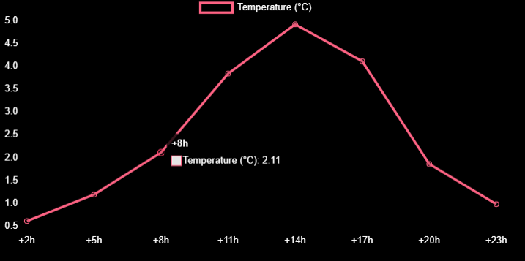
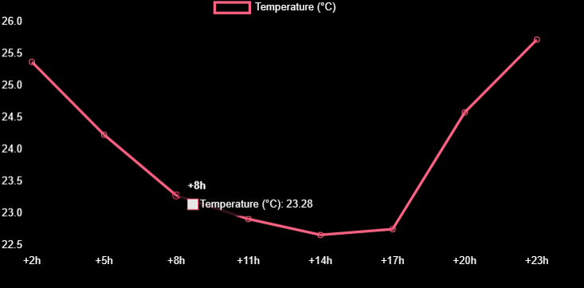
2
Explaination
Seoul
Rio de Janeiro
Interactive Visualization:
When hovering over a specific data point, detailed information, such as the exact temperature value and time, is displayed.
The data point and connected line slightly enlarge to visually capture the user's attention.

Slide 12
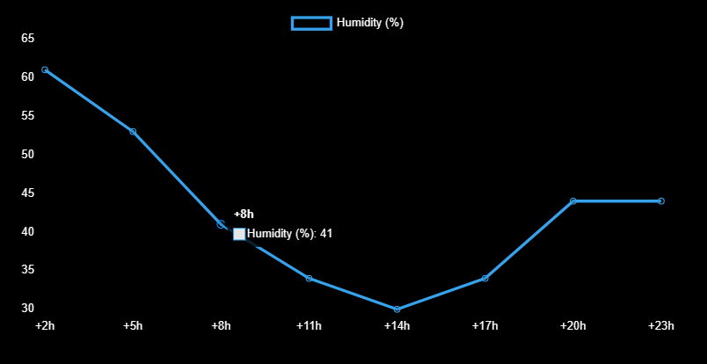
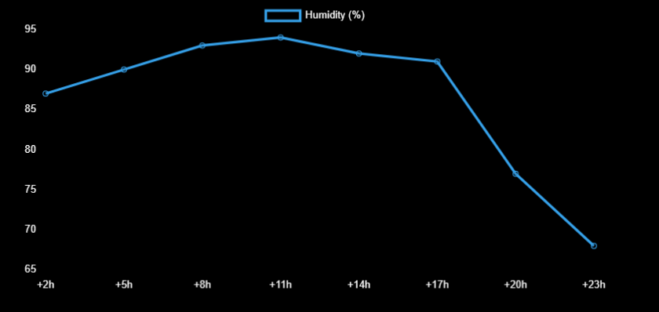
2
Explaination
Seoul
Rio de Janeiro
Interactive Visualization:
When hovering over a specific data point, detailed information, such as the exact temperature value and time, is displayed.
The data point and connected line slightly enlarge or emphasize to visually capture the user's attention.

Slide 13
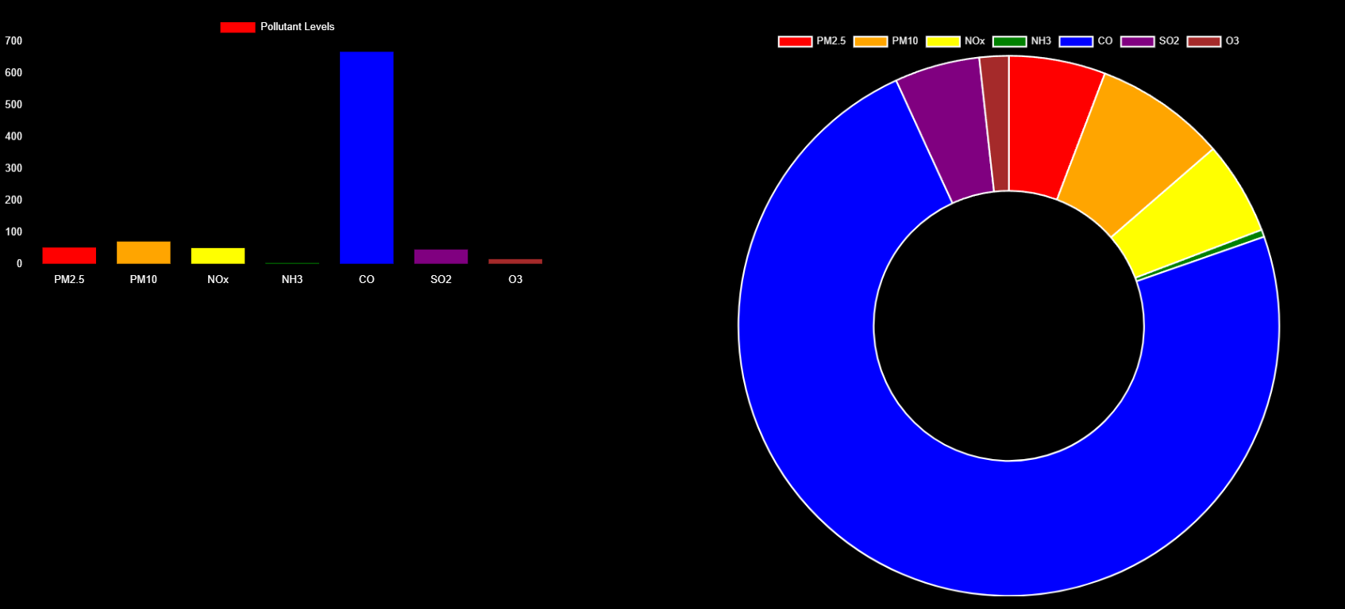
2
Explaination
▪ Bar Charts: Show levels of PM2.5, PM10, NOx, NH3, CO2, SO2, and VOC.
▪ Doughnut Chart: Represent the distribution of various pollutants.
This charts also change by the location

Slide 14
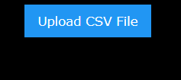
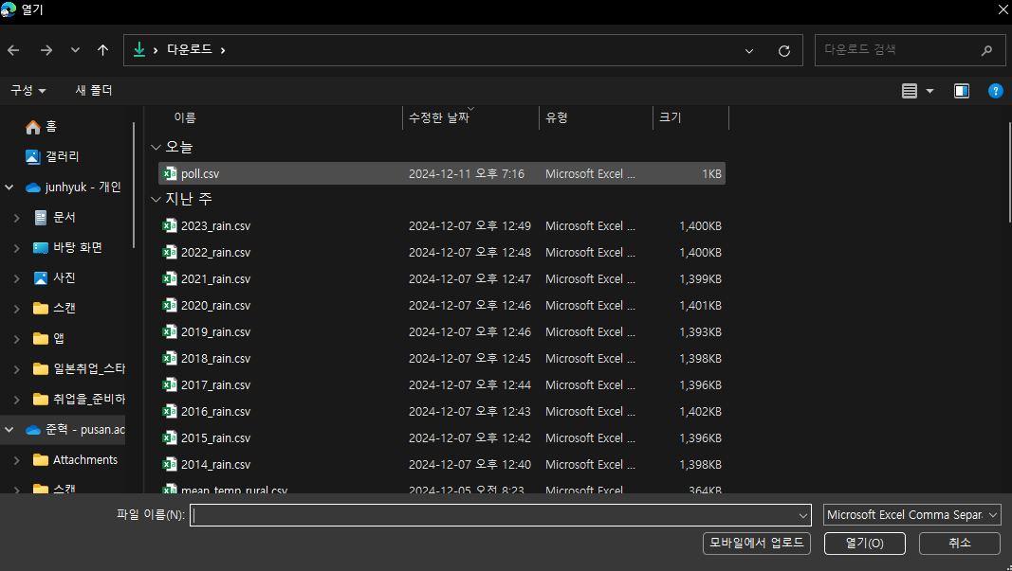
2
Explaination
In the CSV file sidebar, users can upload their CSV files to dynamically update the values in the displayed boxes. Each box's value will change depending on the corresponding data points from the uploaded CSV file.

Slide 15
3
Things to do
1. I attempted to create a button that switches between dark mode and light mode,
allowing users to view the application in light mode as well. However, it did not work as intended.
2. Although an attempt was made to represent the bar chart and doughnut chart on the same scale
despite their differing units, a suitable method to effectively align them was not found.

