Slide 1

Weather and Air Quality Dashboard
WEB APPLICATION PROGRAMMING (CB2001105-062)
AICH SATYABRATA
Pusan National University
202014337 Jung Junhyuk
Department of Atmospheric Science

Slide 2

1
Used Things
2
Explanation
3
Things to do

Slide 3





1
Used Things

Slide 4
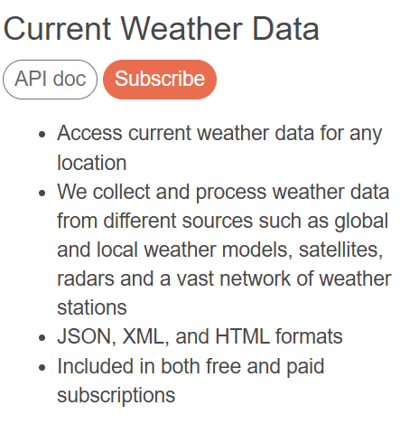
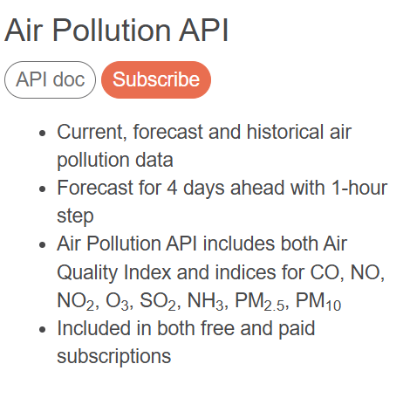

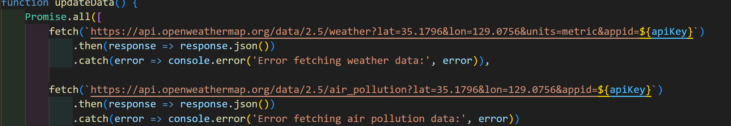
1
Used Things

Slide 5
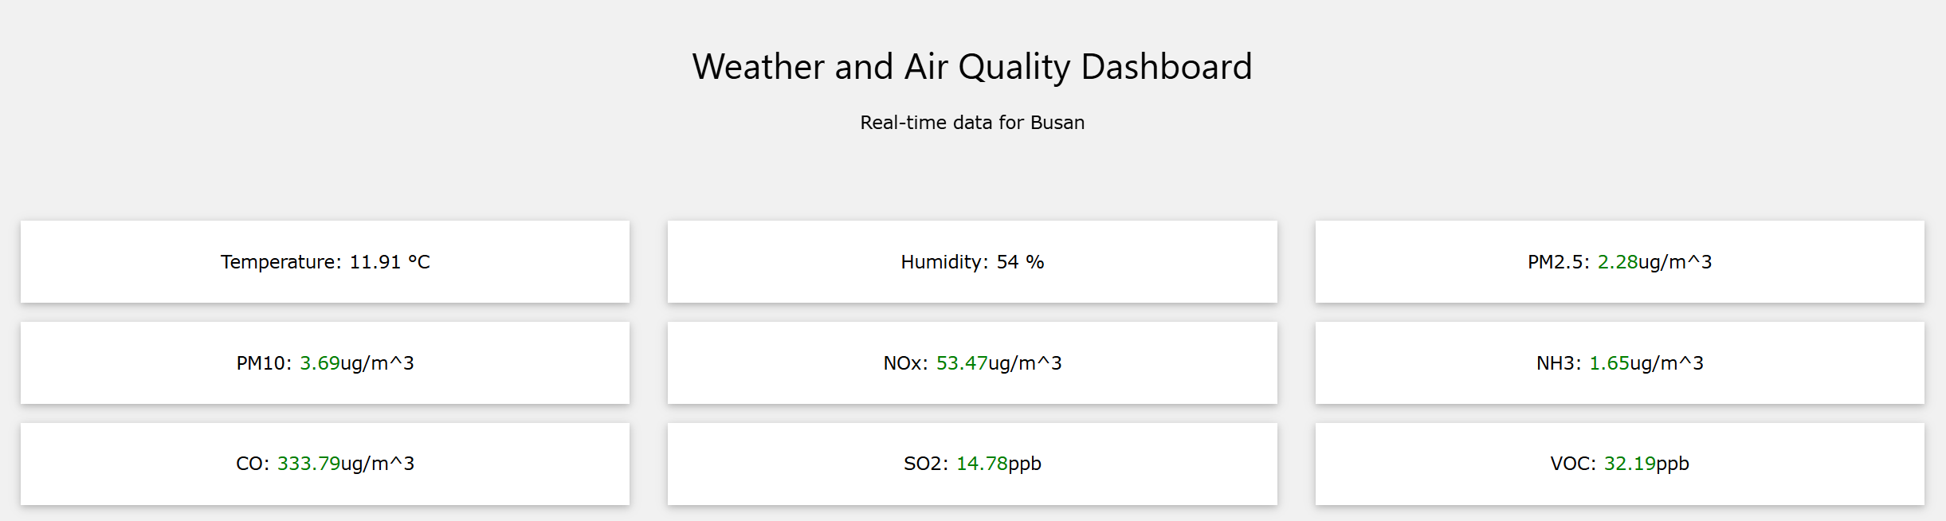
2
Explaination
Feature 1. Real Time DashBoard
Header
Main DashBoard

Slide 6



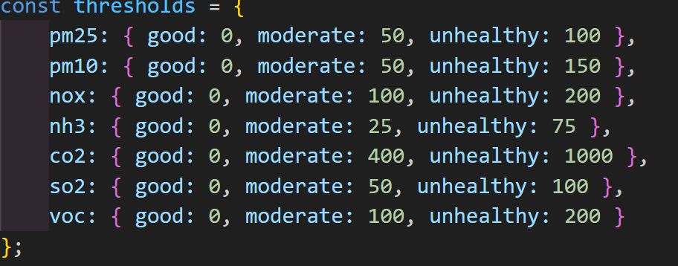
2
Explaination
Feature3. Styling

Slide 7
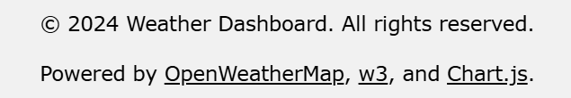
2
Explaination
Feauret 2. Footer

Slide 8
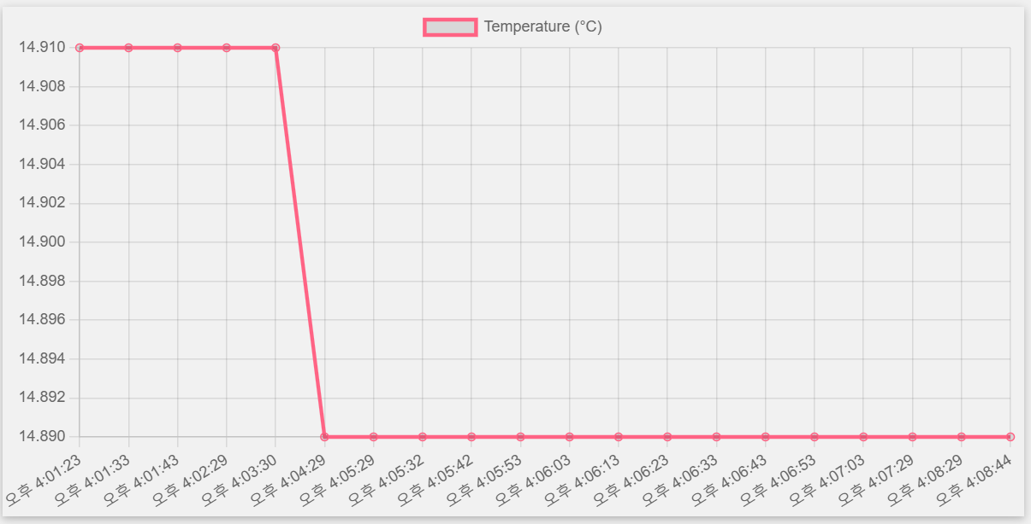
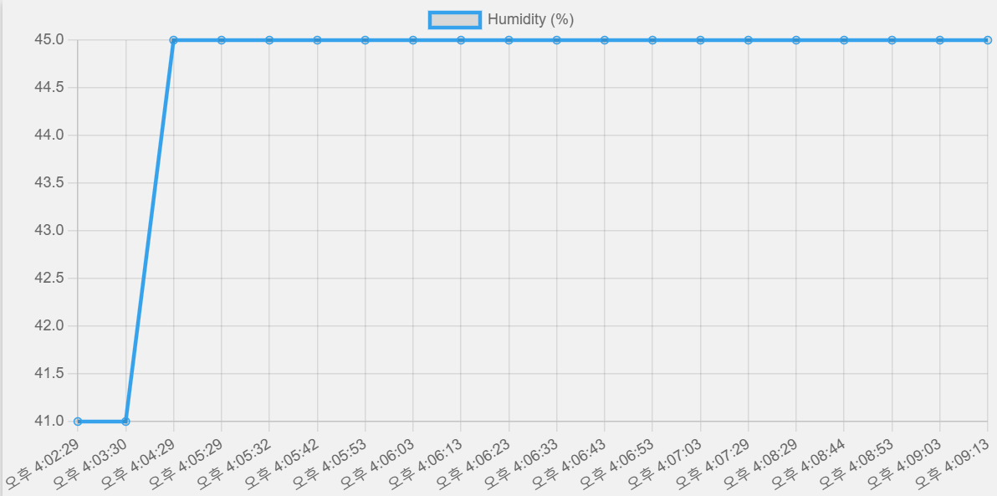

2
Explaination
Feature4. Line Graph
Updates Every 10 Seconds!

Slide 9
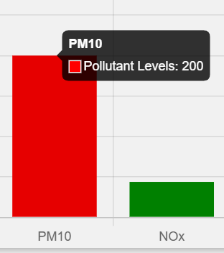
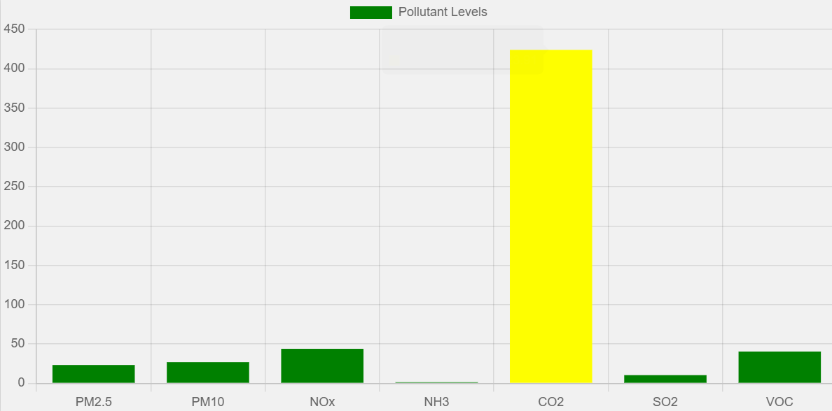
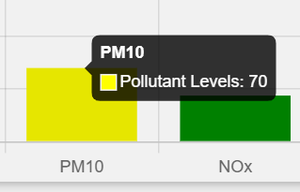
2
Explaination
Feature5. Bar Charts

Slide 10
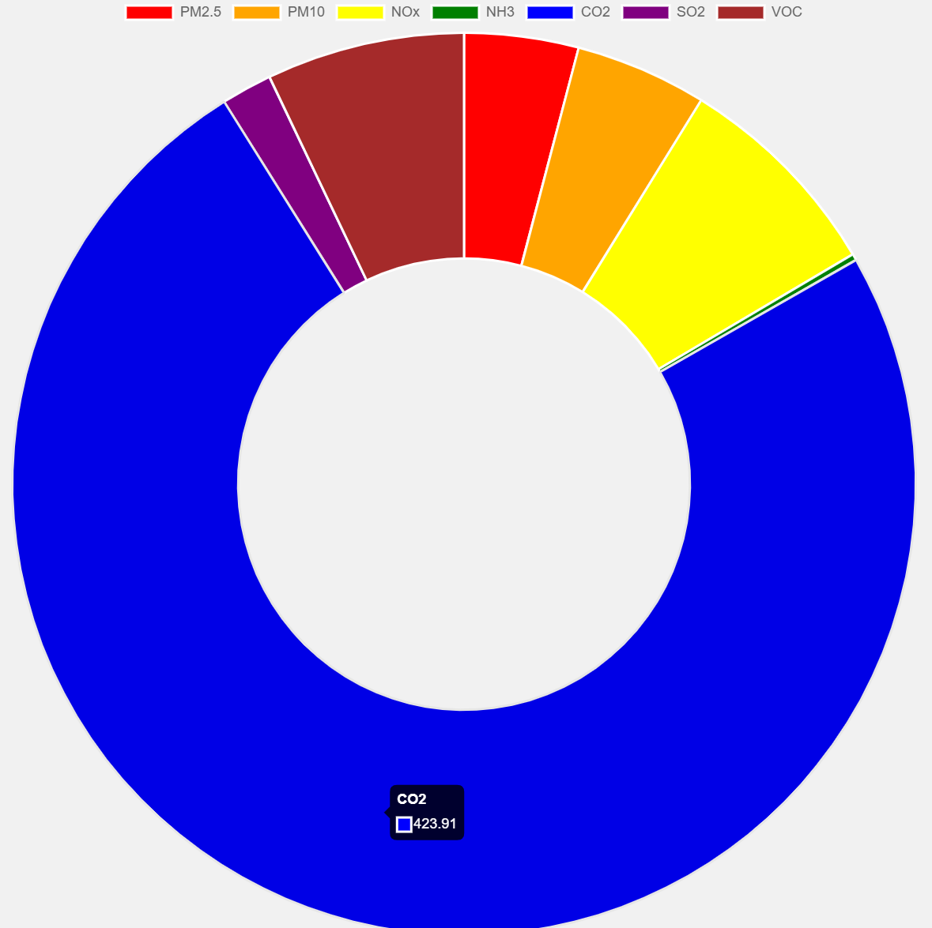
2
Explaination
Feature6. Doughnut Chart

Slide 11


3
Things to do
Navigation Bar: Links to sections like Home, Data, and About.
2. Change the display format of the unit
3. Draw the line chart with a longer interval than 10 seconds. Like 3 hours…
4. When drawing bar charts or doughnut charts, ensure that differences in the units of pollutants are accounted for in the representation. CO2: ppm, SO2: ppb
5. Consider web design elements to favor visibillity
6. create an interactive website where users can actively engage with the content through features

