Slide 1

User Personas: Billy Bob– Student
General Description:
Billy is a 20 year old student for Computing Science and Stats in Glasgow University. Billy spends every day studying and working hard to maintain good grades everyday, however she does need a little extra help sometimes with assessments. He spends most of her time on the computer and doesn’t go out much.
Frustrations:
Billy suffers from social anxiety, he feels like everyone else is smarter and more capable than him. As a result, he has no friends and struggles asking people for help with homework and assessments. Billy does not like sending emails to lecturers for help because he feels as if he's wasting their time on trivial issues.
Goals:
He wants to achieve good grades
He wants to make some friends
Needs:
Billy wants to be able to ask questions casually to other students and lecturers without the embarrassment and pressure of real life interaction.
He also has no friends, so he needs a way to find some outside of class.

Slide 2
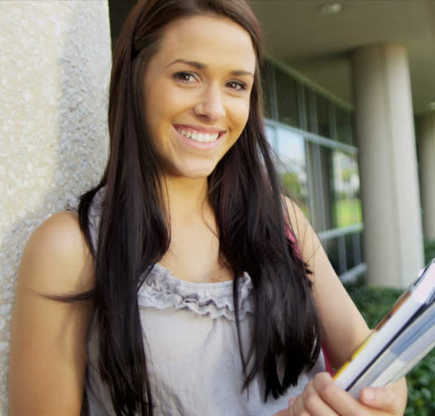
User Personas: Montana Brown– Student
General Description:
Montana is a 18 year old student for Physics in Glasgow University. Montana travels on the train for two hours to Glasgow University every day. She only spends a few hours in university, and then goes to work at her part time job after university during the week. The only time she has to do university work/assessments is on the weekends.
Frustrations:
Because her time is limited to the weekends, lecturers and other resources become unavailable, and her friends always have plans because they complete their university work during the week. So nobody is around to help him when she needs it.
Goals:
She wants to achieve good grades
Needs:
Montana needs to be able to seek help from other students and lecturers on the weekend.

