Slide 1

User Persona 1: Billy Bob – Student
General Description:
Billy is a 20 year old student studying Computing Science and Stats in Glasgow University. Billy spends every day studying and working hard to maintain good grades everyday, however he does need a little extra help sometimes with assessments. He spends most of his time on the computer and doesn’t go out much.
Frustrations:
Billy suffers from social anxiety, he feels like everyone else is smarter and more capable than him. As a result, he has no friends and struggles asking people for help with homework and assessments. Billy does not like sending emails to lecturers for help because he feels he's wasting their time on trivial issues.
Goals:
He wants to achieve good grades
He wants to make some friends
Needs:
Billy wants to be able to ask questions casually to other students and lecturers without the embarrassment and pressure of real life interaction.
He also has no friends, so he needs a way to find some outside of class.

Slide 2

User Persona 2: Montana Brown – Student
General Description:
Montana is a 18 year old student studying Physics in Glasgow University. Montana travels on the train for two hours to University every day. She only spends a few hours in university, and then goes to work at her part time job after university during the week. The only time she has to do university work/assessments is on the weekends.
Frustrations:
Because her time is limited to the weekends, lecturers and other resources become unavailable, and her friends always have plans because they complete their university work during the week. So nobody is around to help her when she needs it.
Goals:
She wants to achieve good grades
Needs:
Montana needs to be able to seek help from other students and lecturers on the weekend.

Slide 3

User Persona 3: Naomi Masu – Student
General Description:
Naomi is a 18 year old student who is studying Statistics at Glasgow University. She originally lived in Japan and has moved to Glasgow for education. She is a very outgoing and family oriented person, who has enjoyed a very socially active lifestyle.
Frustrations:
Academically Naomi excels, but she has found moving away from her family and friends to be difficult and is nervous that the difference of culture between her home and the UK will make finding new friends and settling in properly difficult. But she wishes to restore her social lifestyle despite the move.
Goals:
She wants to achieve good grades
She wants to make new friends.
She wants to integrate into her new surroundings.
Needs:
Naomi needs the ability to connect and meet with new people.

Slide 4
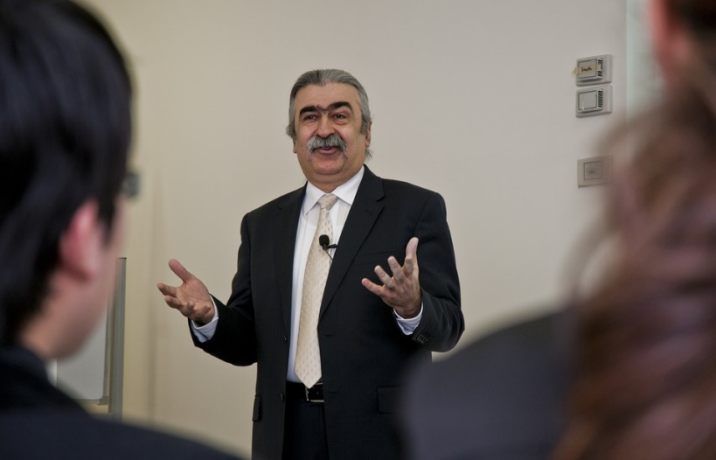
User Persona 4: Doctor David Kanas – Lecturer
General Description:
David is a 45 year old Mathematics lecturer, who has been working at Glasgow University for 8 years. He lives in the outskirts of Glasgow and drives into work each day, and spends the weekends at home with his family. He is also rather old school, and prefers to use pen and paper over technology as much as possible, and as such he has only limited IT experience.
Frustrations:
Among all his work commitments, David does not find enough time during the week to answer all of the questions students have during his limited office hours, and lecture times. He wishes there was a more convenient way than emails to assist his students outside class times, especially weekends.
Despite his limited understanding of technology, he is willing to try to use an online system to solve his problem, but fears it will be too complex for him.
Goals:
To help his students understand course content.
To ensure students understand what is expected of them during the course.
Needs:
David needs to be able to find and answer questions from his students as quickly and easily as possible.
He also needs a system that is easy to understand and use.

