Slide 1
Ask Students
Lab 3 Team B
Mohammad Majid – 2324127
Euan John Ferguson – 2323460
Matthew Wilson – 2251532
Jasmine Naowarat Casey – 2325421
James Bradford - 2324024

Slide 2
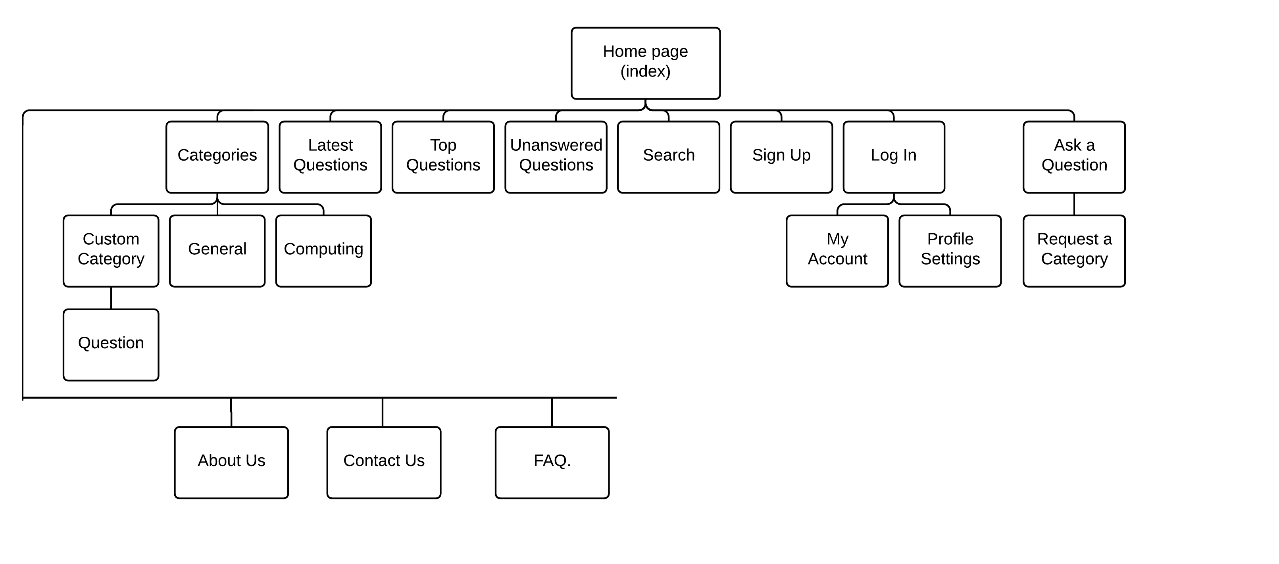
Site Map

Slide 3
Site URLs
/home | /account/signup
/about-us | /account/login
/contact-us | /account/myaccount
/faq
/category
/category/general
/category/custom-category-here
/category/question-id
/latest-questions
/top-questions
/unanswered-questions

Slide 4
Notes
/account/myaccount
Change password, university, student status, profile pic etc on myaccount page
How do we create categories? Maybe we should let anyone create one and an administrator’s approval is required before its public? i.e. unapproved categories will be hidden from regular users and admin users can see them on a restricted page, open them then choose to approve or decline. Approve makes them a public category and decline deletes them from database. We would only need one extra view and a Boolean in a category to implement this.
A form that allows admin users to ban regular users from creating users. Admins can create categories without approval. Easy to implement something like, you must be a member with x amount of likes or a member for over 14 days before u can create a category.
Complexity increases when we think about deleting categories, what happens to questions, etc.
If we decide on this, we only need to add an “approve category” page that is accessible by admins and a “create category” page accessible by all (except regular users who don’t meet the requirements)
Discuss on Thurs, might get too complex, alternatives?
MAKE SURE WE WILL HAVE EVERYTHING FROM THE IMPLEMENTATION MARK SCHEME

