Slide 1

Completing my MLSA Internship on Full-Stack Web Development
I recently completed my internship at MLSA, focusing on full-stack web development. I gained valuable experience and knowledge in building dynamic and interactive web applications.
By Ansh Kumar Kaushal

Slide 2
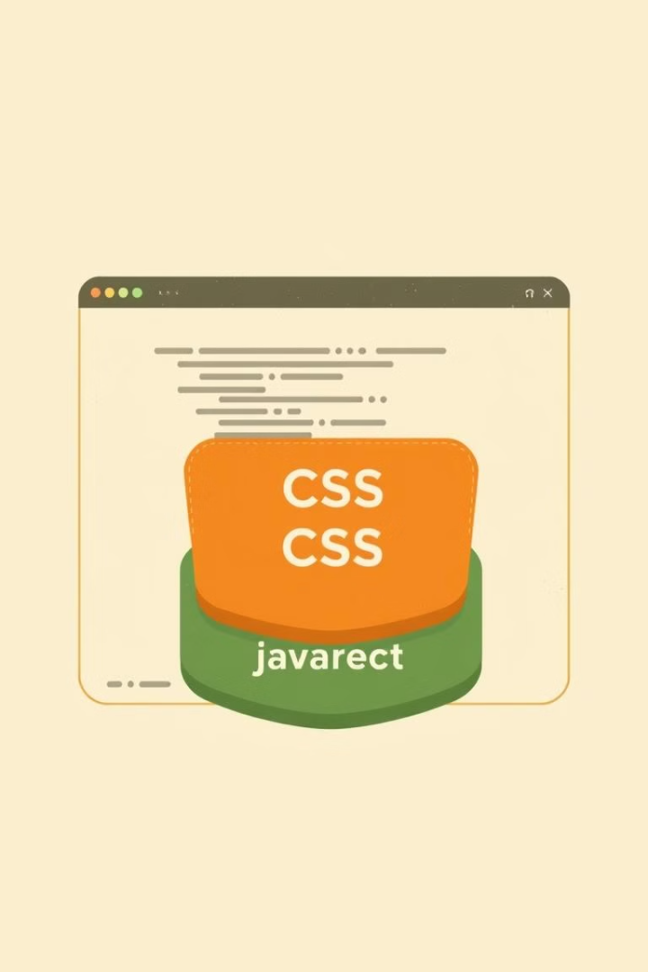
HTML, CSS, and JavaScript: My Journey
1
HTML
I learned to build the structure of webpages, including elements like headings, paragraphs, and lists. I was able to organize content and define its layout.
2
CSS
Next, I learned how to style those pages, adding colors, fonts, and layout. I was able to control the visual appearance and responsiveness of my web pages.
3
JavaScript
Finally, I learned how to add interactivity to my websites. I used JavaScript to implement dynamic behavior like user interactions and data manipulation.

Slide 3
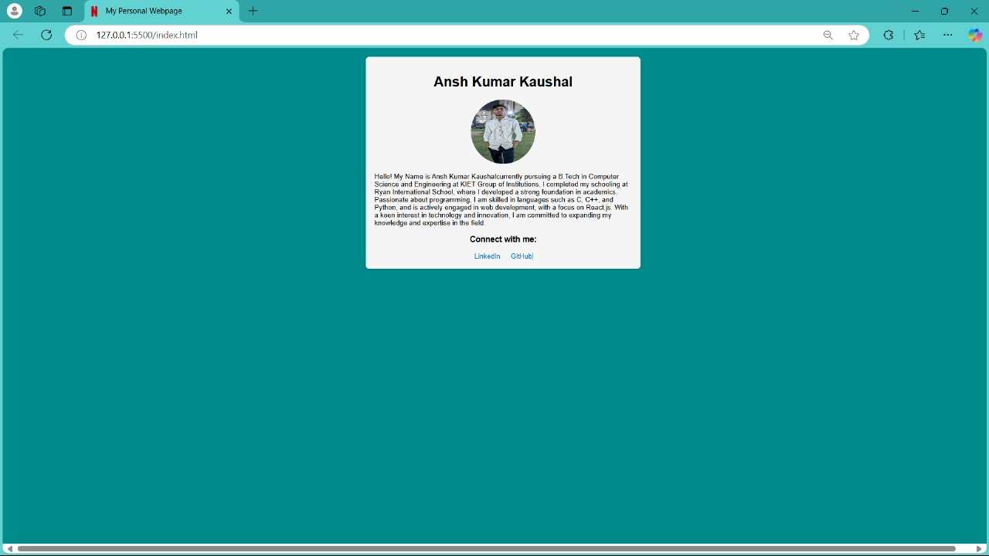
Project 1: Personal Webpage/Portfolio
HTML Structure
CSS Styling
I designed a layout for my portfolio, with sections for my skills, projects, and contact information. I used HTML elements to create a user-friendly and easy-to-navigate structure.
Using CSS, I styled the page to reflect my personality and interests. I chose color schemes and fonts that were visually appealing and reflected my personal brand.

Slide 4
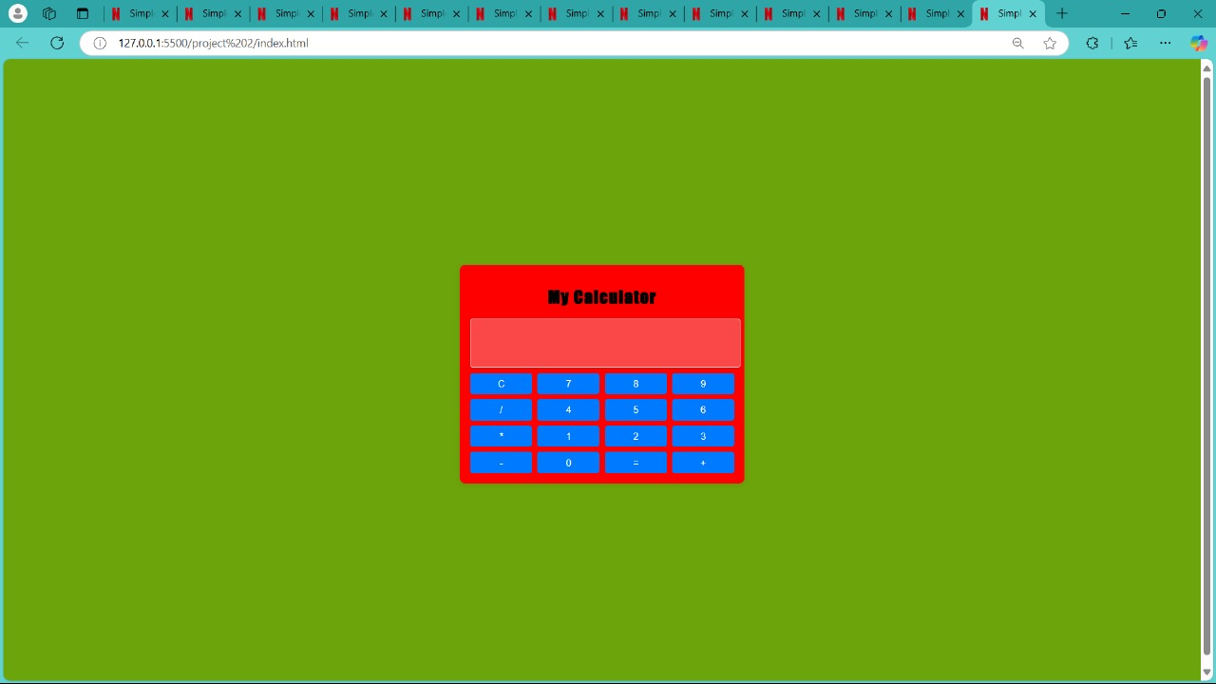



Project 2: Building a Calculator App
HTML Structure
I created the basic structure of the calculator using HTML, setting up the display area, buttons for numbers and operations.
CSS Styling
With CSS, I styled the calculator's appearance, choosing colors, fonts, and layout to make it visually appealing and easy to use.
JavaScript Logic
I implemented the logic behind the calculator using JavaScript. I handled button clicks, calculated results, and ensured that the calculator functioned as expected.

Slide 5

Key Takeaways and Lessons Learned
1
Problem-Solving
2
Collaboration
I learned to approach challenges creatively and strategically. Debugging and troubleshooting became essential skills.
Working on projects with my friends improved my communication and teamwork skills.
3
Continuous Learning
I understood the importance of staying up-to-date with the latest web development trends and technologies.

Slide 6
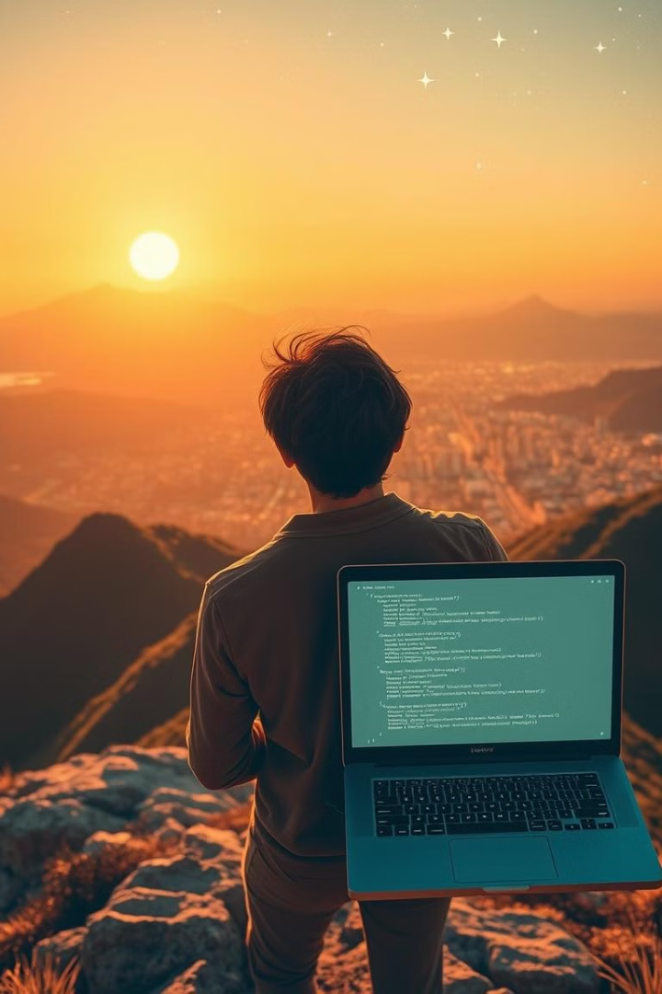
Conclusion
The MLSA internship has been an amazing experience for me. It helped me learn new skills and discover my passion for web development. I am excited to use what I learned to create more projects in the future. With the knowledge I gained, I look forward to exploring new opportunities in web development and making my mark in this field.

