Slide 1
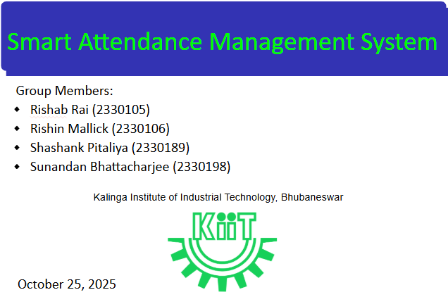

Slide 2
Problem
Traditional manual attendance tracking methods require significant manual effort and are prone to errors.
There is a lack of transparency for students regarding their real-time attendance status.
Educational institutions need a digital, automated method to track attendance and enforce institutional rules efficiently

Slide 3
Solution
System Overview: The Student Attendance Management System (SAMS) is a web-based platform designed to digitize attendance tracking.
Centralization: It provides a centralized hub for attendance management, detailed reporting, and automated notification capabilities.
Modernization: SAMS entirely replaces traditional manual attendance registers with a secure, easily accessible online system.
Student → View Attendance
Teacher → Mark Attendance
Admin → Approve Requests

Slide 4
Objectives
Reduce manual effort and eliminate human errors in recording attendance.
Allow teachers to seamlessly mark daily attendance for their assigned classes online.
Provide students with transparent, real-time access to their overall and subject-wise attendance percentages.
Enable administrators to efficiently manage users, subjects, and classes from a single dashboard.
Generate comprehensive reports and dispatch low-attendance notifications via email or SMS.

Slide 5
System Architecture Design
The system is built on a modular Layered Architecture:
Presentation Layer (Web UI): Delivers role-based dashboards to interact with the system via web browsers.
Application Layer (Controllers/APIs): Acts as the communication bridge, receiving requests and routing them to the correct service.
Business Layer (Services): Houses core logic, including authentication, attendance processing, and Role-Based Access Control (RBAC) rules.
Data Layer: Manages all persistent data retrieval and storage within the Attendance Database.
Integration Layer: Securely connects to third-party Email and SMS gateways for external communication.

Slide 6
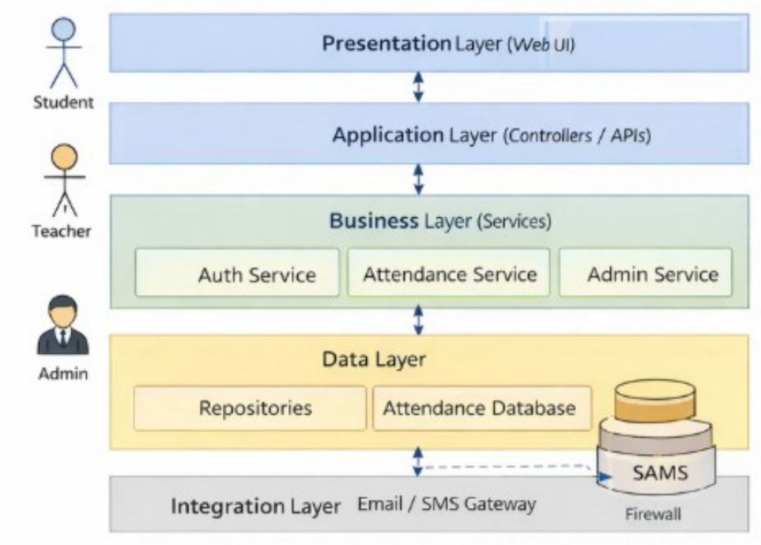
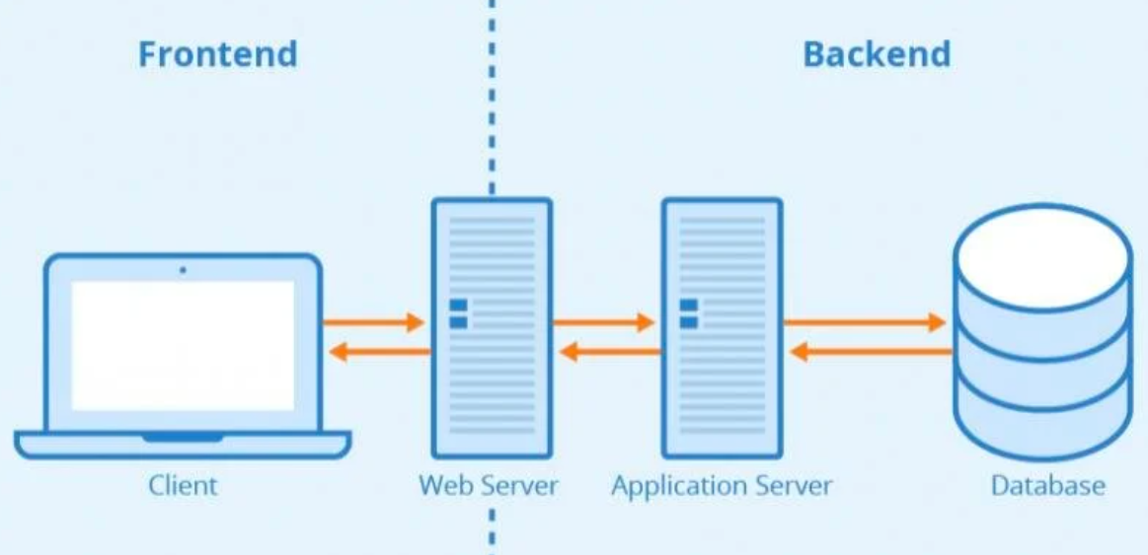
System Architecture Design

Slide 7
Student End Display Module
Access & Transparency: Allows enrolled students to log in and securely access their own data.
Dashboard View: Features attendance summary cards that display overall percentages and subject-wise breakdowns for a quick overview.
Filtering Options: Includes dropdown menus to filter attendance records based on specific subjects or semesters.
Notifications Panel: Displays system alerts, important updates, and low attendance warnings directly to the student.

Slide 8
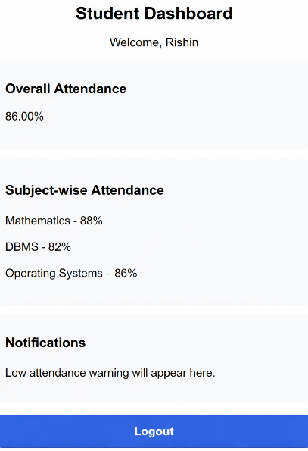
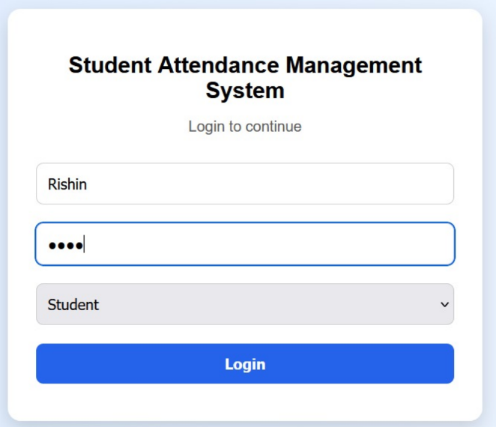
Student End Display Module

Slide 9
Teacher End Entry Module
Efficient Entry: Instructors are provided a streamlined interface to manage class attendance.
Marking Interface: Teachers utilize dropdown menus to select the specific class, subject, and date.
Toggle System: The module displays a list of enrolled students with simple Present/Absent toggle switches for rapid marking.
Correction Workflows: Teachers can officially request edits or corrections to past attendance records if an error was made.
Report Generation: Instructors can easily generate attendance reports for their assigned classes.

Slide 10
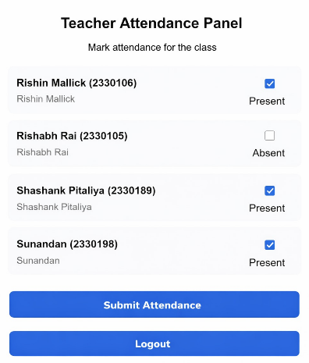
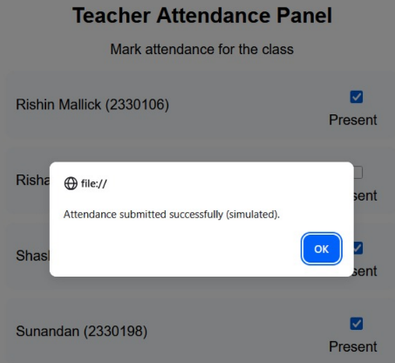
Teacher End Entry Module

Slide 11
Admin End Management Module
System Oversight: Designed specifically for system administrators and managers to govern the platform.
Data Management: Administrators can create, update, and manage user accounts, classes, and subjects.
Approval Authority: Admins have the ability to review, approve, or reject attendance edit requests submitted by teachers.
Reporting & Auditing: Admins can generate broad academic reports and view critical system audit logs (such as login attempts and data changes).

Slide 12
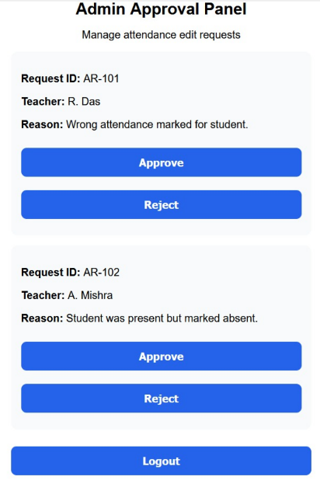
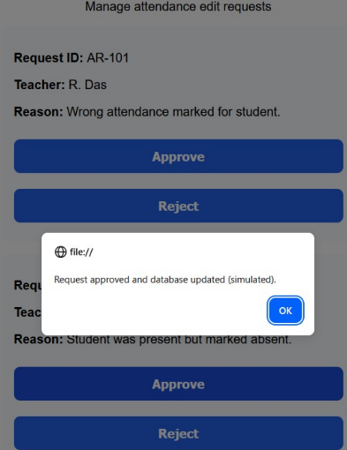
Admin End Management Module

Slide 13
Workflow of System
Authentication: Users log in, and Role-Based Access Control (RBAC) safely routes them to their designated dashboard (Student, Teacher, or Admin).
Record Creation: Teachers mark daily attendance via the Web UI, which is then securely processed and stored in the Data Layer.
Data Consumption: Students view these newly updated records in real-time on their summary dashboards.
Edits & Approvals: If a teacher submits an attendance correction, the request is paused in the system until the Administrator approves it.
Alert Generation: The system checks attendance against institutional rules and triggers warning notifications through the integration layer if criteria are not met.

Slide 14
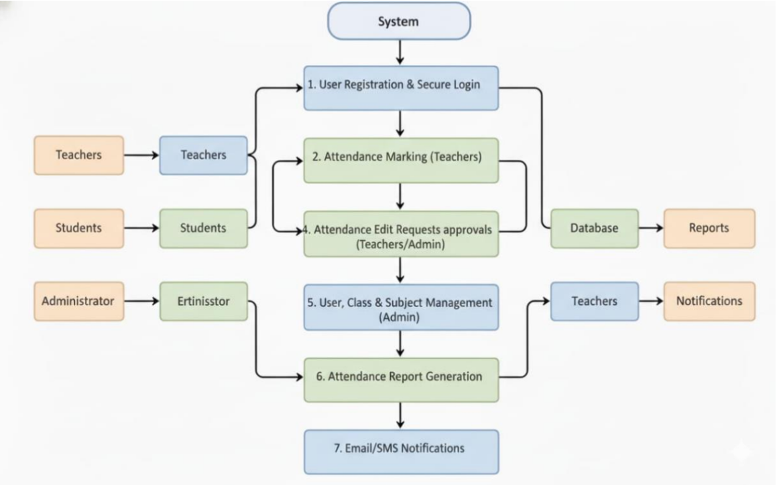
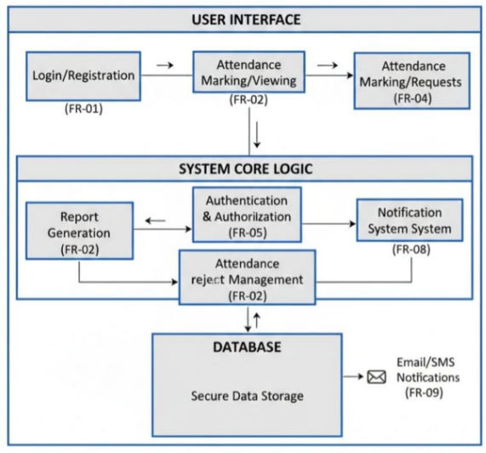
Workflow of System

Slide 15
Individual roles of Members
Rishab Rai - Testing and Debugging,Screenshot Collection and Validation
Rishin Mallik -Frontend Development (HTML, CSS, JavaScript),UI Design and System Integration
Shashank Pitaliya -Documentation and Report Preparation,PPT Design and Content Organization
Sunandan Bhattacharjee -System Design and Architecture Planning,Workflow Design (SRS & ACDD contribution)

Slide 16
Technologies Used
Deployment: Functions as a standalone web-based platform accessed through standard client web browsers.
Network Security: Mandates HTTPS protocol for all system communications to ensure data privacy.
Application Logic: Utilizes a robust Web/App Server to host controllers, APIs, and business services.
Database Management: Relies on a dedicated Database Server (DBMS) for secure, scalable record storage.
Access Control: Employs RBAC middleware, secure session/token management, and encrypted passwords.

Slide 17
Conclusion
SAMS modernizes educational administration by completely replacing error-prone manual registers with a fast, transparent digital platform.
The system empowers students with real-time visibility into their academic standing and drastically reduces administrative burdens on teachers.
Its strict, secure layered architecture ensures complete compliance with institutional attendance policies.
The modular design paves the way for future scalability and full integration with broader university databases.

Slide 18
Thank You

