Slide 1
UNIT-3

Slide 2
Defining Package
Creating and Accessing a Package
Types of packages
Understanding CLASSPATH
importing packages
Introduction to I/O Programming:
DataInputStream
DataOutputStream
FileInputStream
FileOutputStream
BufferedReader
Collections:
Interfaces,implementation classes,and Algorithms(such as sorting and searching)

Slide 3
Packages
( Putting Classes Together )

Slide 4
Introduction
The main feature of OOP is its ability to support the reuse of code:
  Using the classes ( directly )
  Extending the classes (via inheritance)
  Extending interfaces
The features in basic form limited to reusing the classes within a program.
What if we need to use classes from other programs without physically copying them into the program under development ?
In Java, this is achieved by using what is known as “packages”, a concept similar to “class libraries” in other languages.

Slide 5
Defining Packages
Packages are Java’s way of grouping a number of related classes and/or interfaces together into a single unit. That means, packages act as “containers” for classes.
The benefits of organising classes into packages are:
  The classes contained in the packages of other programs/applications can be reused.
  In packages classes can be unique compared with classes in other packages, i.e, two classes in two different packages can have the same name. If there is a naming clash, then classes can be accessed with their fully qualified name.
  Classes in packages can be hidden if we don’t want other packages to access them ( using access specifier ).

Slide 6
Contd..
In general, a Java source file can contain any (or all) of the following four internal parts:
  A single package statement (optional).
  Any number of import statements (optional).
  A single public class declaration (required).
  Any number of classes private to the package (optional).

Slide 7
Java Foundation Packages
Java provides a large number of classes grouped into different packages based on their functionality.
The six foundation Java packages are:
  java.lang
    Contains classes for primitive types, strings, math functions, threads, and exception
  java.util
    Contains classes such as vectors, hash tables, date etc.
  java.io
    Stream classes for I/O
  java.awt
    Classes for implementing GUI – windows, buttons, menus etc.
  java.net
    Classes for networking
  java.applet
    Classes for creating and implementing applets

Slide 8
Creating Packages
To create a package is quite easy: simply include a package command as the first
statement in a Java source file.
Any classes declared within that file will belong to the specified package.
The package statement defines a name space in which classes are stored.
If you omit the package statement, the class names are put into the default
package, which has no name.
This is the general form of the package statement:
Syntax: package pkgname;
Example: package MyPackage;
Java uses file system directories to store packages.

Slide 9
  package myPackage;
  public class ClassA {
    // class body
  }
  class ClassB {
  // class body
  }
More than one file can include the same package statement.
You can create a hierarchy of packages.
To do so, simply separate each package name from the one above it by use of a
period.
The general form of a multileveled package statement is shown here:
package pkg1[.pkg2[.pkg3]];
A package hierarchy must be reflected in the file system of your Java development
system.

Slide 10
Creating Sub Packages
As packages in Java are organised hierarchically, sub-packages can be created as follows:
  package myPackage.Math
  package myPackage.secondPakage.thirdPackage
A package hierarchy must be reflected in the file system.
Store “thirdPackage” in a subdirectory named myPackage\secondPackage”. Store “secondPackage” and “Math” class in a subdirectory “myPackage”.

Slide 11
Exercise Creating Packages
mypackage
S1,S2,S3
mypackageA
S4,S5,S6
mypackageB
ABC
DEG
IJK
XYZ
A,B,C
D,E,F
A,B,C,I,J,K
X,Y,Z
Package ABC and IJK have classes with same name.
A class in ABC has name mypackage.mypackageA.ABC.A
A class in IJK has name mypackage.mypackageB.IJK.A

Slide 12
How to make a class Belong to a Package
Include a proper package statement as first line in source file
Make class S1 belongs to mypackageA
package mypackage.mypackageA;
public class S1
{
public S1( )
{
System.out.println("This is Class S1");
}
}
Name the source file as S1.java and compile it and store the S1.class file in mypackageA directory

Slide 13
Make class S2 belongs to mypackageA
package mypackage.mypackageA;
public class S2
{
public S2( )
{
System.out.println("This is Class S2");
}
}
Name the source file as S2.java and compile it and store the S2.class file in mypackageA directory

Slide 14
Make class A belongs to IJK
package mypackage.mypackageB.IJK;
public class A
{
public A( )
{
System.out.println("This is Class A in IJK");
}
}
Name the source file as A.java and compile it and store the A.class file in IJK directory
<< Same Procedure For all classes>>

Slide 15
Accessing Classes from Packages
There are two ways of accessing the classes stored in packages:
  Using fully qualified class name
    java.lang.Math.sqrt(x);
  Import package and use class name directly.
    import java.lang.Math
    Math.sqrt(x);
Selected or all classes in packages can be imported:
Implicit in all programs: import java.lang.*;
package statement(s) must appear first
import package.class;
import package.*;

Slide 16
Finding Packages and CLASSPATH
How does the Java run-time system know where to look for packages that you
create?
The answer has two parts:
First, by default, the Java run-time system uses the current working directory as its
starting point. Thus, if your package is in the current directory, or a subdirectory of
the current directory, it will be found.
Second, you can specify a directory path or paths by setting the CLASSPATH
environmental variable.
For example, consider the following package specification.
package MyPack;
In order for a program to find MyPack, one of two things must be true.
Either the program is executed from a directory immediately above MyPack, or
CLASSPATH must be set to include the path to MyPack.

Slide 17
// A simple package
package MyPack;
class Balance {
String name;
double bal;
Balance(String n, double b){
name = n;
bal = b;
}
void show() {
if(bal<0)
System.out.print("--> ");
System.out.println(name + ": $" + bal);
}
}
//AccountBalance.java
class AccountBalance {
public static void main(String args[]) {
Balance current[] = new Balance[3];
current[0] = new Balance("K. J. Fielding", 123.23);
current[1] = new Balance("Will Tell", 157.02);
current[2] = new Balance("Tom Jackson", -12.33);
for(int i=0; i<3; i++)
current[i].show();
}
}
//To compile
javac –d . AccountBalance.java
//To run
java MyPack.AccountBalance
//java AccountBalance invalid

Slide 18
Access Control
Java addresses four categories of visibility for class members:
  Subclasses in the same package.
  Non-subclasses in the same package.
  Subclasses in different packages.
  Classes that are neither in the same package nor subclasses.
A class has only two possible access levels: default and public.

Slide 19
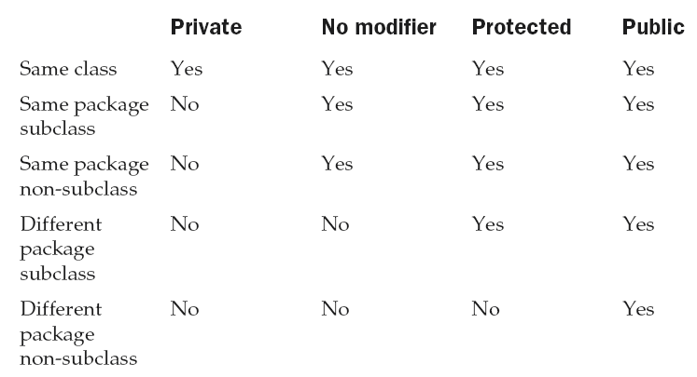
Class Member Access

Slide 20
//VarProtection.java
package pack1;
public class VarProtection {
int n = 1;
private int pri = 2;
protected int pro = 3;
public int pub = 4;
public VarProtection() {
System.out.println("Individual class constructor");
System.out.println("default value is: " + n);
System.out.println("private value is: " + pri);
System.out.println("protected value is: " + pro);
System.out.println("public value is: " + pub);
}
}
To Compile:
d:\>javac –d . VarProtection.java

Slide 21
//SameSub .java:
package pack1;
class SameSub extends VarProtection{
SameSub(){
System.out.println("subclass constructor");
System.out.println("default value is: " + n);
// System.out.println("private value is: " + pri);
System.out.println("protected value is: " + pro);
System.out.println("public value is: " + pub);
}
}
To Compile:
d:\>javac –d . SameSub.java

Slide 22
// SameDiff.java
package pack1;
class SameDiff{
SameDiff(){
VarProtection v1 = new VarProtection();
System.out.println("Delegationclass constructor");
System.out.println("default value is: " +v1. n);
// System.out.println("private value is: " +v1. pri);
System.out.println("protected value is: " +v1. pro);
System.out.println("public value is: " + v1.pub);
}
}
To Compile:
d:\>javac –d . SameDiff.java

Slide 23
//OtherSub.java
package pack2;
import pack1.*;
class OtherSub extends VarProtection{
OtherSub(){
System.out.println("Different Package subclass constructor");
//System.out.println("default value is: " + n);
// System.out.println("private value is: " + pri);
System.out.println("protected value is: " + pro);
System.out.println("public value is: " + pub);
}
}
To Compile:
d:\>javac –d . OtherSub.java

Slide 24
// OtherDiff.java
package pack2;
import pack1.*;
class OtherDiff{
OtherDiff(){
VarProtection v2=new VarProtection();
System.out.println("Different Package non-subclass constructor");
// System.out.println("default value is: " +v2. n);
// System.out.println("private value is: " + v2.pri);
// System.out.println("protected value is: " + v2.pro);
System.out.println("public value is: " + v2.pub);
}
}
To Compile:
d:\>javac –d . OtherDiff.java

Slide 25
// Demo package p1.
package pack1;
class MainTest{
public static void main(String args[]){
VarProtection v=new VarProtection();
SameDiff s2=new SameDiff();
SameSub s1=new SameSub();
}
}
To Compile:
d:\>javac –d . MainTest.java
To Run:
d:\>java pack1.MainTest
package pack2;
import pack1.*;
class OtherMainTest{
public static void main(String args[]){
OtherSub os=new OtherSub();
OtherDiff od=new OtherDiff();
}
}
To Compile:
d:\>javac –d . OtherMainTest.java
To Run:
d:\>java pack2.OtherMainTest

Slide 26
5.Define a package with name “sortapp” in which declare an interface “SortInterface” with method sort () whose return type and parameter type should be void and empty.
Define “subsortapp” as sub package of “sortapp” package in which define class “SortImpl” implementing “SortInterface” in which sort() method should print a message Linear sort is used.
Define a package “searchingapp” in which declare an interface “SearchInterface” with search () method whose return type and parameter list should be void and empty respectively.
Define “serachingimpl” package in which define a “SearchImpl” class implementing “SearchInterface” defined in “searchingapp” package in which define a search() method which should print a message linear search is used.
Define a class ExecutePackage with main method using the above packages (classes and it’s methods).

Slide 27
package sortapp;
public interface SortInterface{
void sort();
}
//Save file with SortInterface.java
complile:
javac –d . SortInterface.java

Slide 28
package sortapp.subsortapp;
import sortapp.*;
public class SortImpl implements SortInterface{
public void sort(){
System.out.println("linear sort is used");
}
}
//Save file with SortImpl.java
complile:
javac –d . SortImpl.java

Slide 29
package searchingapp;
public interface SearchInterface{
void search();
}
//Save file with SearchInterface.java
complile:
javac –d . SearchInterface.java

Slide 30
package searchingimpl;
import searchingapp.*;
public class SearchImpl implements SearchInterface{
public void search(){
System.out.println("lenear search is used");
}
}
//Save file with SearchImpl.java
complile:
javac –d . SearchImpl.java

Slide 31
import sortapp.subsortapp.SortImpl;
import searchingimpl.SearchImpl;
public class ExecutePackage
{
public static void main(String a[]){
SortImpl s1=new SortImpl();
s1.sort();
SearchImpl s2=new SearchImpl();
s2.search();
}
}
//Save file with ExecutePackage.java
complile: javac ExecutePackage.java
Execution: java ExecutePackage

Slide 32
Introduction to i/o programming
  DataInputStream,
  DataOutputStream,
  FileInputStream,
  FileOutputStream,
  BufferReader

Slide 33
Exploring java.io
File
The Stream Classes

Slide 34
File class
It deals directly with files and the file system
A File object is used to obtain or manipulate the information associated with a disk file, such as the permissions, time, date, and directory path, and to navigate subdirectory hierarchies
The following constructors can be used to create File objects:
File(String directoryPath)
File(String directoryPath, String filename)
File(File dirObj, String filename)
File(URI uriObj)
ex:
File f1 = new File("/");
File f2 = new File("/","autoexec.bat");
File f3 = new File(f1,"autoexec.bat");

Slide 35
methods
String getName()
String getPath()
String getParent()
boolean exists()
boolean canWrite()
boolean canRead()
boolean isDirectory()
boolean isFile()
boolean isAbsolute()
length()
boolean renameTo(File newName)
boolean delete( )
String[ ] list( )

Slide 36
import java.io.File;
class FileDemo {
public static void main(String args[]) {
File f1 = new File("/ita12/FileDemo.java");
System.out.println("File Name: " + f1.getName());
System.out.println("Path: " + f1.getPath());
System.out.println("Abs Path: " + f1.getAbsolutePath());
System.out.println("Parent: " + f1.getParent());
System.out.println(f1.exists() ? "exists" : "does not exist");
System.out.println(f1.canWrite() ? "is writeable" : "is not writeable");
System.out.println(f1.canRead() ? "is readable" : "is not readable");
System.out.println("is " + (f1.isDirectory() ? "" : "not" + " a directory"));
System.out.println(f1.isFile() ? "is normal file" : "might be a named pipe");
System.out.println(f1.isAbsolute() ? "is absolute" : "is not absolute");
System.out.println("File last modified: " + f1.lastModified());
System.out.println("File size: " + f1.length() + " Bytes");
}
}

Slide 37
import java.io.File;
class DirList {
public static void main(String args[]) {
String dirname = "/itb";
File f1 = new File(dirname);
if (f1.isDirectory()) {
System.out.println("Directory of " + dirname);
String s[] = f1.list();
for (int i=0; i < s.length; i++)
{
File f = new File(dirname + "/" + s[i]);
if (f.isDirectory()) {
System.out.println(s[i] + " is a directory");
} else {
System.out.println(s[i] + " is a file");
}
}
} else {
System.out.println(dirname + " is not a directory");
}}}

Slide 38

Using FileNameFilter

Slide 39
import java.io.*;
class OnlyExt implements FilenameFilter {
String ext;
public OnlyExt(String ext) {
this.ext = "." + ext;
}
public boolean accept(File dir, String name) {
return name.endsWith(ext);
}
}
class DirListOnly {
public static void main(String args[]) {
String dirname = "/ita12";
File f1 = new File(dirname);
FilenameFilter only = new OnlyExt("class");
String s[] = f1.list(only);
for (int i=0; i < s.length; i++) {
System.out.println(s[i]);
}
}
}

Slide 40


The Stream Classes
Stream
A stream is a sequence of data.
In Java a stream is composed of bytes. It's called a stream because it's like a stream of water that continues to flow.
Three streams are created for us automatically:
1) System.out: standard output stream
2) System.in: standard input stream
3) System.err: standard error

Slide 41
The Stream Classes
InputStream,
OutputStream,
Reader,
and Writer
byte stream classes
character stream classes

Slide 42
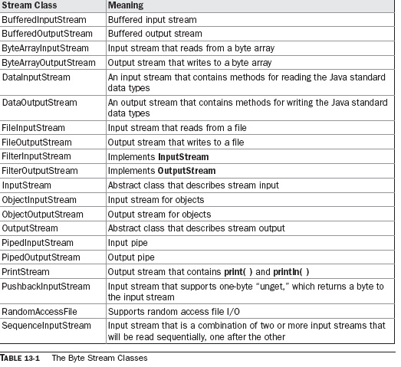

Slide 43
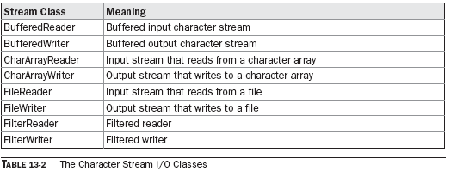

Slide 44
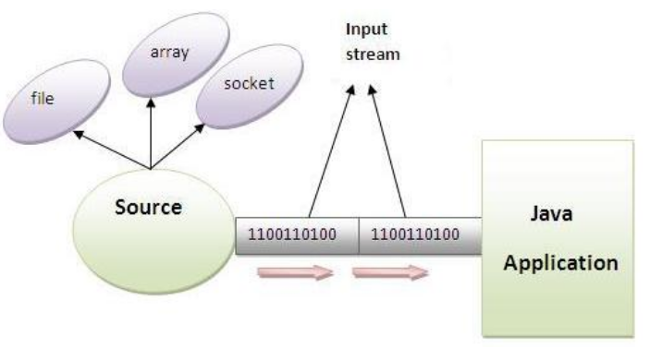
The Byte Streams
InputStream
Java application uses an input stream to read data from a source, it may be a file, an array, peripheral device or socket.

Slide 45
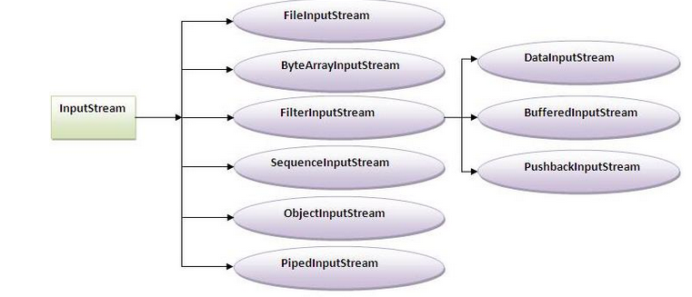
InputStream class is an abstract class. It is the super class of all classes representing an input stream of bytes.

Slide 46
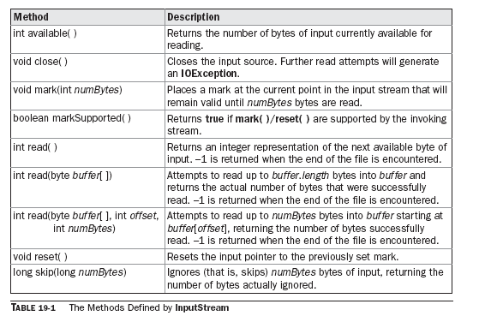
InputStream class methods

Slide 47
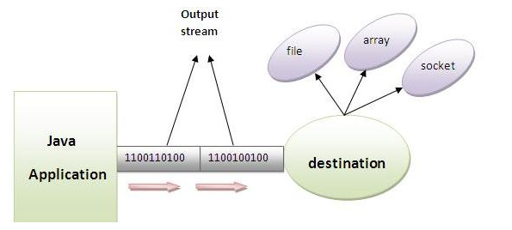
OutputStream
Java application uses an output stream to write data to a destination, it may be a file, an array, peripheral device or socket.

Slide 48
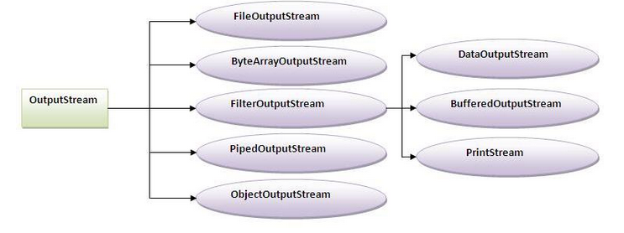
OutputStream class
OutputStream class is an abstract class. It is the superclass of all classes representing an output stream of bytes. An output stream accepts output bytes and sends them to some sink.

Slide 49
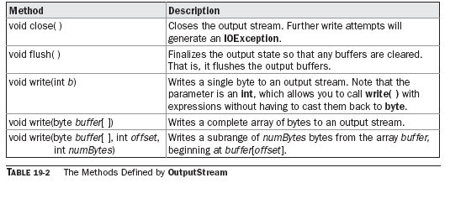
OutputStream class methods

Slide 50
FileInputStream
It can use to read bytes from a file.
Constructors
FileInputStream(String filepath)
FileInputStream(File fileObj)
Ex:
1.FileInputStream f0 = new FileInputStream("/autoexec.bat");
2.File f = new File("/autoexec.bat");
FileInputStream f1 = new FileInputStream(f);

Slide 51
methods
int available( )
void close( )
int read( )
long skip(long nBytes)

Slide 52
import java.io.*;
class SimpleRead{
public static void main(String args[]){
try{
FileInputStream fin=new FileInputStream("/ece/abc.txt");
int i;
while((i=fin.read())!=-1){
//System.out.println((char)i);
System.out.println((char)i);
}
fin.close();
}catch(Exception e){
System.out.println(e);
}
}
}

Slide 53
FileOutputStream
A FileOutputStream is an output stream for writing data to a file.
If you have to write primitive values then use FileOutputStream.Instead, for character-oriented data, prefer FileWriter.But you can write byte-oriented as well as character-oriented data.
most commonly used constructors are shown here:
FileOutputStream(String filePath)
FileOutputStream(File fileObj)
FileOutputStream(String filePath, boolean append)
FileOutputStream(File fileObj, boolean append)
Methods:
void close();
void write();

Slide 54
import java.io.*;
class Test2{
public static void main(String args[]){
try{
FileOutputStream fout=new FileOutputStream("/ece/xyz.txt");
String s="Sachin Tendulkar is my favourite player";
byte b[]=s.getBytes();
fout.write(b);
fout.close();
System.out.println("success...");
}catch(Exception e){System.out.println(e);}
}
}

Slide 55
Example of Reading the data of current java file and writing it into another file
import java.io.*;
class C2{
public static void main(String args[])throws Exception{
FileInputStream fin=new FileInputStream("Test2.java");
FileOutputStream fout=new FileOutputStream("M.java");
int i=0;
while((i=fin.read())!=-1){
fout.write((byte)i);
}
fin.close();
}
}

Slide 56


DataInputStream&DataOutputStream
These enables you to write or read primitive data to or from a stream
They implement the DataOutput and DataInput interface,respectively
These interfaces define methods that convert primtive values to or from a sequence of bytes
DataOutputStream:
Methods:

Slide 57
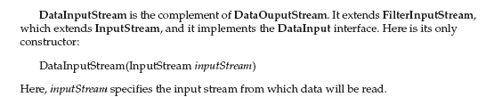

DataInputStream:
Methods:

Slide 58
import java.io.*;
class DataIODemo {
public static void main(String args[])
throws IOException {
FileOutputStream fout = new FileOutputStream("Test.dat");
DataOutputStream out = new DataOutputStream(fout);
out.writeDouble(98.6);
out.writeInt(1000);
out.writeBoolean(true);
out.close();
FileInputStream fin = new FileInputStream("Test.dat");
DataInputStream in = new DataInputStream(fin);
double d = in.readDouble();
int i = in.readInt();
boolean b = in.readBoolean();
System.out.println("Here are the values: " + d + " " + i + " " + b);
in.close();
}
}

Slide 59
character stream classes

Slide 60
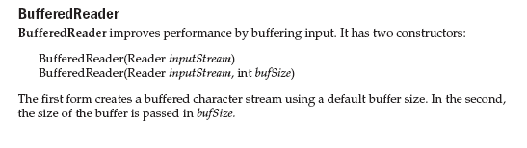

Slide 61
Q)Write a program to count number of words in a given text
import java.io.*;
import java.util.*;
import java.lang.*;
public class WordsCount
{
public static void main(String arg[]) throws IOException
{
long nl=0,nw=0,nc=0;
String line;
BufferedReader br = new BufferedReader(new FileReader(arg[0]));
while((line = br.readLine())!= null)
{
nl++;
nc = nc +line.length();
StringTokenizer st = new StringTokenizer(line);
nw += st.countTokens();
}
System.out.println("Number of Characters: "+nc);
System.out.println("Number of Words: "+nw);
System.out.println("Number of Lines: "+nl);
}
}

Slide 62
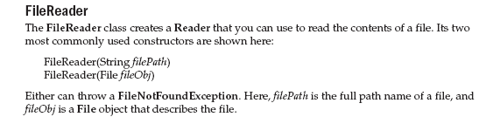
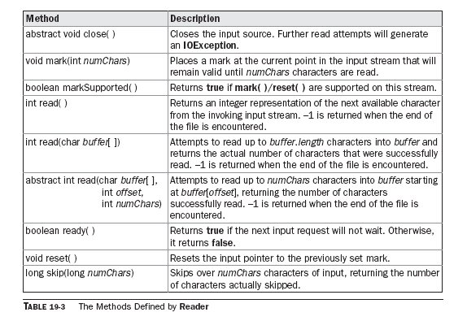

Slide 63
// Demonstrate FileReader.
import java.io.*;
class FileReaderDemo {
public static void main(String args[]) throws IOException {
FileReader fr = new FileReader("FileReaderDemo.java");
BufferedReader br = new BufferedReader(fr);
String s;
while((s = br.readLine()) != null) {
System.out.println(s);
}
fr.close();
}
}

Slide 64
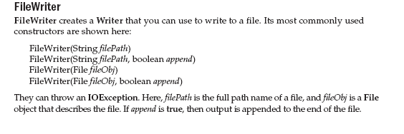
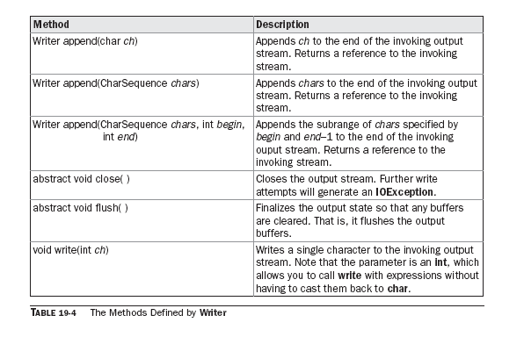

Slide 65
// Demonstrate FileWriter.
import java.io.*;
class FileWriterDemo {
public static void main(String args[]) throws IOException {
String source = "Now is the time for all good men\n"
+ " to come to the aid of their country\n"
+ " and pay their due taxes.";
char buffer[] = new char[source.length()];
source.getChars(0, source.length(), buffer, 0);
FileWriter f0 = new FileWriter("file1.txt");
for (int i=0; i < buffer.length; i += 2) {
f0.write(buffer[i]);
}
f0.close();
FileWriter f1 = new FileWriter("file2.txt");
f1.write(buffer);
f1.close();
FileWriter f2 = new FileWriter("file3.txt");
f2.write(buffer,0,buffer.length/4);
f2.close();
}
}

Slide 66
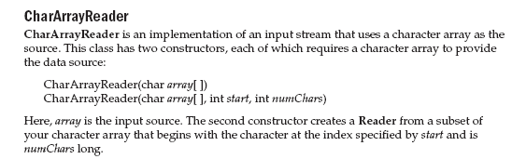

Slide 67
// Demonstrate CharArrayReader.
import java.io.*;
public class CharArrayReaderDemo {
public static void main(String args[]) throws IOException {
String tmp = "abcdefghijklmnopqrstuvwxyz";
int length = tmp.length();
char c[] = new char[length];
tmp.getChars(0, length, c, 0);
CharArrayReader input1 = new CharArrayReader(c);
CharArrayReader input2 = new CharArrayReader(c, 0, 5);
int i;
System.out.println("input1 is:");
while((i = input1.read()) != -1) {
System.out.print((char)i);
}
System.out.println();
System.out.println("input2 is:");
while((i = input2.read()) != -1) {
System.out.print((char)i);
}
System.out.println();
}

Slide 68



Slide 69
// Demonstrate CharArrayWriter.
import java.io.*;
class CharArrayWriterDemo {
public static void main(String args[]) throws
IOException {
CharArrayWriter f = new CharArrayWriter();
String s = "This should end up in the array";
char buf[] = new char[s.length()];
s.getChars(0, s.length(), buf, 0);
f.write(buf);
System.out.println("Buffer as a string");
System.out.println(f.toString());
FileWriter f2 = new FileWriter("test.txt");
f.writeTo(f2);
f2.close();
}
}

Slide 70
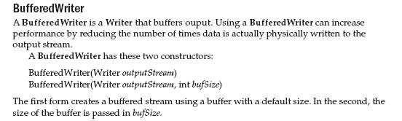

Slide 71
import java.io.*;
public class WriteToFileExample {
public static void main(String[] args) {
try {
String content = "This is the content to write into file";
File file = new File("/itb16/t1.txt");
FileWriter fw = new FileWriter(file);
BufferedWriter bw = new BufferedWriter(fw);
bw.write(content);
bw.close();
System.out.println("Done");
} catch (IOException e) {
e.printStackTrace();
}
}
}

Slide 72
Collections in Java
Collections in java is a framework that provides an architecture to store and manipulate the group of objects.
All the operations that you perform on a data such as searching, sorting, insertion, manipulation, deletion etc. can be performed by Java Collections.
Java Collection simply means a single unit of objects. Java Collection framework provides many interfaces (Set, List, Queue, Deque etc.) and classes (ArrayList, Vector, LinkedList, PriorityQueue, HashSet, LinkedHashSet, TreeSet etc).

Slide 73
What is Collection in java
Collection represents a single unit of objects i.e. a group.
What is framework in java
  provides readymade architecture.
  represents set of classes and interface.
  is optional.
What is Collection framework
Collection framework represents a unified architecture for storing and manipulating group of objects. It has:
  Interfaces and its implementations i.e. classes
  Algorithm

Slide 74
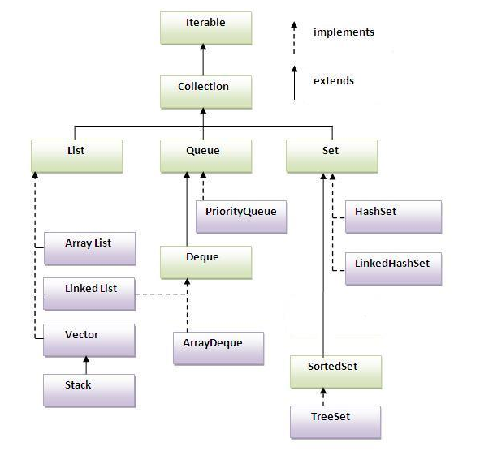
Hierarchy of Collection Framework
The java.util package contains all the classes and interfaces for Collection framework.

Slide 75
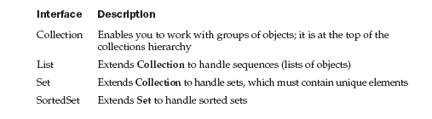

Slide 76
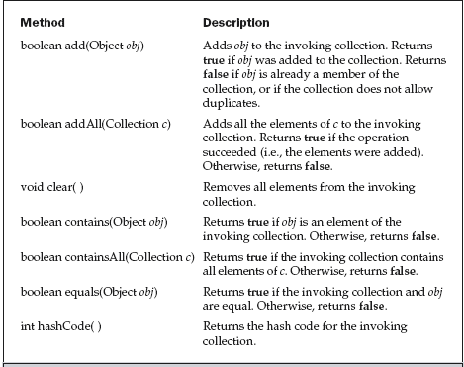
The Collection Interfaces Methods

Slide 77
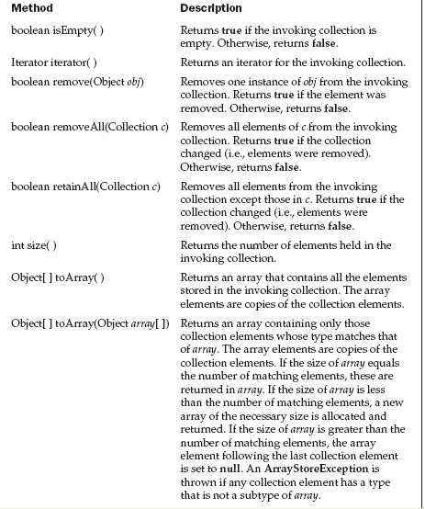

Slide 78
The List Interface
The List interface extends Collection and declares the behavior of a collection that stores a sequence of elements.
Elements can be inserted or accessed by their position in the list, using a zero-based index.
A list may contain duplicate elements.
In addition to the methods defined by Collection, List defines some of its own.

Slide 79
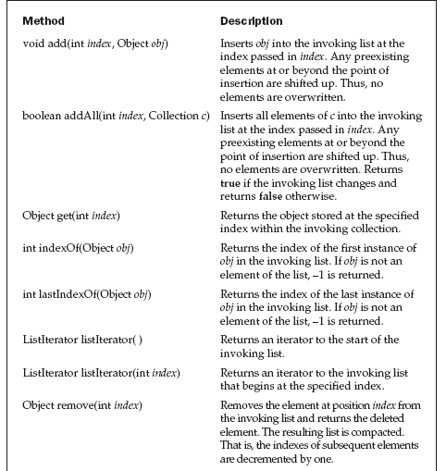

Slide 80
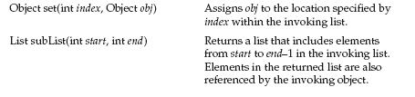

Slide 81
The Set Interface
  The Set interface defines a set. It extends Collection and declares the behavior of a
collection that does not allow duplicate elements.
The SortedSet Interface
  The SortedSet interface extends Set and declares the behavior of a set sorted in ascending order.
  In addition to those methods defined by Set,

Slide 82
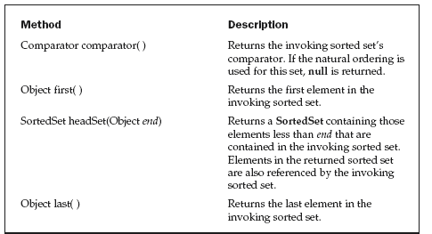
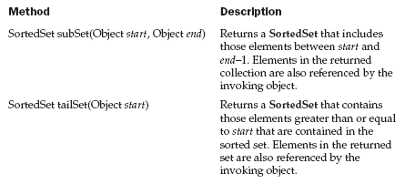

Slide 83
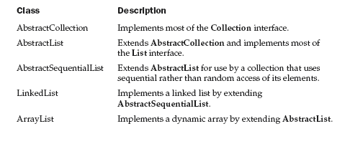
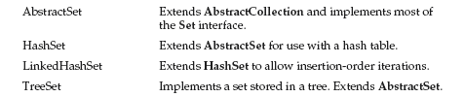
The Collection Classes

Slide 84
The ArrayList Class
The ArrayList class extends AbstractList and implements the List interface.
ArrayList supports dynamic arrays that can grow as needed.
In Java, standard arrays are of a fixed length. After arrays are created, they cannot grow or shrink,
Constructors:
  ArrayList( )
  ArrayList(Collection c)
  ArrayList(int capacity)

Slide 85
// Demonstrate ArrayList.
import java.util.*;
class ArrayListDemo {
public static void main(String args[]) {
// create an array list
ArrayList al = new ArrayList();
System.out.println("Initial size of al: " +al.size());
// add elements to the array list
al.add("C");
al.add("A");
al.add("E");
al.add("B");
al.add("D");
al.add("F");
al.add(1, "A2");
System.out.println("Size of al after additions: " +al.size());
// display the array list
System.out.println("Contents of al: " + al);
// Remove elements from the array list
al.remove("F");
al.remove(2);
System.out.println("Size of al after deletions: " +al.size());
System.out.println("Contents of al: " + al);
}
}

Slide 86
Obtaining an Array from an ArrayList
// Convert an ArrayList into an array.
import java.util.*;
class ArrayListToArray {
public static void main(String args[]) {
// Create an array list
ArrayList al = new ArrayList();
// Add elements to the array list
al.add(new Integer(10));
al.add(new Integer(20));
al.add(new Integer(30));
al.add(new Integer(40));
System.out.println("Contents of al: " + al);
// get array
Object ia[] = al.toArray();
int sum = 0;
// sum the array
for(int i=0; i<ia.length; i++)
sum += ((Integer) ia[i]).intValue();
System.out.println("Sum is: " + sum);
}
}

Slide 87
/* An example of list using ArrayList */
import java.util.*;
public class ListExample
{
public static void main(String args[])
{
List list = new ArrayList();
list.add("Bernadine");
list.add("Elizabeth");
list.add("Gene");
list.add("Elizabeth");
list.add("Clara");
System.out.println(list);
System.out.println("2: " + list.get(2));
System.out.println("0: " + list.get(0));
}
}

Slide 88
The LinkedList Class
The LinkedList class extends AbstractSequentialList and implements the List interface.
It provides a linked-list data structure.
constructors:
  LinkedList( )
  LinkedList(Collection c)
Methods:
  void addFirst(Object obj)
  void addLast(Object obj)
  Object getFirst( )
  Object getLast( )
  Object removeFirst( )
  Object removeLast( )

Slide 89
// Demonstrate LinkedList.
import java.util.*;
class LinkedListDemo {
public static void main(String args[]) {
// create a linked list
LinkedList ll = new LinkedList();
// add elements to the linked list
ll.add("F");
ll.add("B");
ll.add("D");
ll.add("E");
ll.add("C");
ll.addLast("Z");
ll.addFirst("A");
ll.add(1, "A2");
System.out.println("Original contents of ll: " + ll);
// remove elements from the linked list
ll.remove("F");
ll.remove(2);
System.out.println("Contents of ll after deletion: "+ ll);
// remove first and last elements
ll.removeFirst();
ll.removeLast();
System.out.println("ll after deleting first and last: "+ ll);
// get and set a value
Object val = ll.get(2);
ll.set(2, (String) val + " Changed");
System.out.println("ll after change: " + ll);
}
}

Slide 90
The HashSet Class:
HashSet extends AbstractSet and implements the Set interface. It creates a collection that uses a hash table for storage.
The following constructors are defined:
  HashSet( )
  HashSet(Collection c)
  HashSet(int capacity)
basic operations, such as add( ),contains( ), remove( ), and size( )

Slide 91
// Demonstrate HashSet.
import java.util.*;
class HashSetDemo {
public static void main(String args[]) {
// create a hash set
HashSet hs = new HashSet();
// add elements to the hash set
hs.add("B");
hs.add("A");
hs.add("D");
hs.add("E");
hs.add("C");
hs.add("F");
System.out.println(hs);
}
}

Slide 92
The LinkedHashSet Class
This class extends HashSet, but adds no members of its own.
LinkedHashSet maintains a linked list of the entries in the set,in the order in which they were inserted.
// Demonstrate HashSet.
import java.util.*;
class HashSetDemo {
public static void main(String args[]) {
// create a hash set
LinkedHashSet hs = new LinkedHashSet();
// add elements to the hash set
hs.add("B");
hs.add("A");
hs.add("D");
hs.add("E");
hs.add("C");
hs.add("F");
System.out.println(hs);
}
}

Slide 93
The TreeSet Class
TreeSet provides an implementation of the Set interface that uses a tree for storage.
Objects are stored in sorted, ascending order. Access and retrieval times are quite fast,which makes TreeSet an excellent choice when storing large amounts of sorted information that must be found quickly.
The following constructors are defined:
  TreeSet( )
  TreeSet(Collection c)
  TreeSet(Comparator comp)
  TreeSet(SortedSet ss)

Slide 94
// Demonstrate TreeSet.
import java.util.*;
class TreeSetDemo {
public static void main(String args[]) {
// Create a tree set
TreeSet ts = new TreeSet();
// Add elements to the tree set
ts.add("C");
ts.add("A");
ts.add("B");
ts.add("E");
ts.add("F");
ts.add("D");
System.out.println(ts);
}
}

Slide 95
Accessing a Collection via an Iterator
Iterator enables you to cycle through a collection, obtaining or removing elements.
ListIterator extends Iterator to allow bidirectional traversal of a list, and the modification of elements.
Each of the collection classes provides an iterator( ) method that returns an iterator to the start of the collection.
By using this iterator object, you can access each element in the collection, one element at a time.
In general, to use an iterator to cycle through the contents of a collection, follow these steps:
1. Obtain an iterator to the start of the collection by calling the collection’s
iterator( ) method.
2. Set up a loop that makes a call to hasNext( ). Have the loop iterate as long as
hasNext( ) returns true.
3. Within the loop, obtain each element by calling next( ).

Slide 96
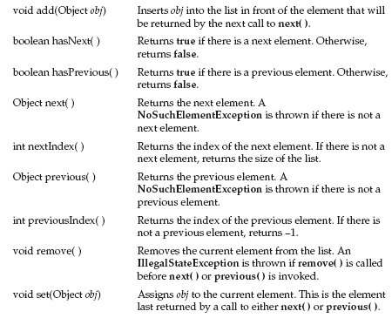

Slide 97
// Demonstrate iterators.
import java.util.*;
class IteratorDemo {
public static void main(String args[]) {
// create an array list
ArrayList al = new ArrayList();
// add elements to the array list
al.add("C");
al.add("A");
al.add("E");
al.add("B");
al.add("D");
al.add("F");
// use iterator to display contents of al
System.out.print("Original contents of al: ");
Iterator itr = al.iterator();
while(itr.hasNext()) {
Object element = itr.next();
System.out.print(element + " ");
}
System.out.println();
// modify objects being iterated
ListIterator litr = al.listIterator();
while(litr.hasNext()) {
Object element = litr.next();
litr.set(element + "+");
}
System.out.print("Modified contents of al: ");
itr = al.iterator();
while(itr.hasNext()) {
Object element = itr.next();
System.out.print(element + " ");
}
System.out.println();
// now, display the list backwards
System.out.print("Modified list backwards: ");
while(litr.hasPrevious()) {
Object element = litr.previous();
System.out.print(element + " ");
}
System.out.println();
}
}

Slide 98
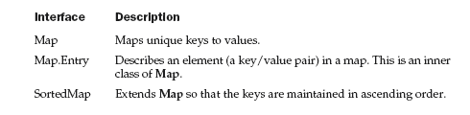
Working with Maps
A map is an object that stores associations between keys and values, or key/value pairs.
Given a key, you can find its value. Both keys and values are objects.
The keys must be unique, but the values may be duplicated. Some maps can accept a null key and null values, others cannot.

