Slide 1
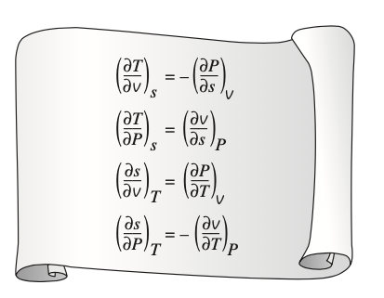
Chemical Engineering Thermodynamics Lecture 4 Thermodynamic Properties Xiaofei Xu

Slide 2

Internal Energy and Free Energy
$U=U(S,V,N)$
Free energy: useful work

Slide 3
Fundamental Equation
Temperature
Pressure
Chemical Potential

Slide 4
Fundamental Equation
This fundamental equation is not popular for experimenters. WHY???
S,V,N are extensive parameters.
T,P,mu are intensive parameters.
Could we use intensive parameters, rather than extensive ones, as the independent variables?

Slide 5
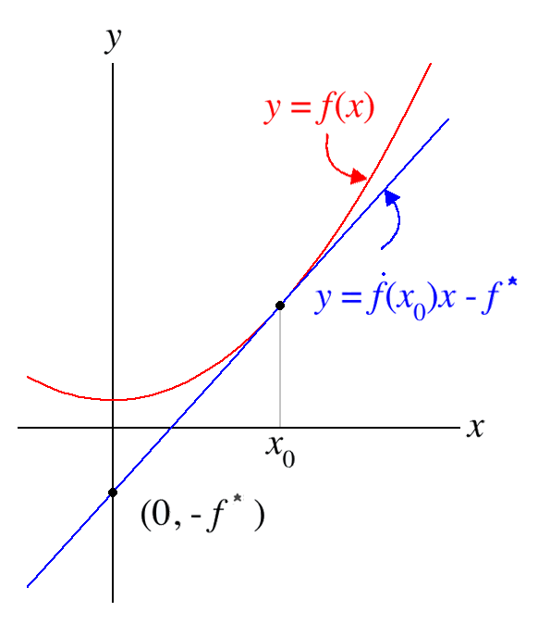
Legendre Transformation

Slide 6


Example
$$y=f(x)$$
$$y=f^{∗}\left(p\right)$$

Slide 7
Thermodynamic Potential
The Legendre transformation of the internal energy.

Slide 8
Helmholtz Free Energy
It measures the useful work obtainable from a closed system at a constant temperature.

Slide 9
Enthalpy
Enthalpy change is a measure of heat transfer during phase transition or chemical reaction.

Slide 10
Gibbs Free Energy
It measures the useful work obtainable from a closed system at a constant temperature and pressure.

Slide 11
Grand Canonical Potential

Slide 12
Some Formulas

Slide 13
Ideal Gas

Slide 14
van der Waals Fluid

Slide 15
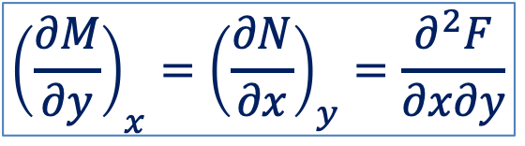
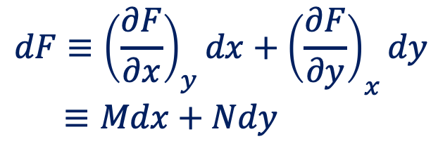
Maxwell’s Relation
$$dF≡{\left(\frac{∂F}{∂x}\right)}_{y}dx+{\left(\frac{∂F}{∂y}\right)}_{x}dy$$
$$≡Mdx+Ndy$$
$${\left(\frac{∂M}{∂y}\right)}_{x}={\left(\frac{∂N}{∂x}\right)}_{y}=\frac{∂^{2}F}{∂x∂y}$$

Slide 16
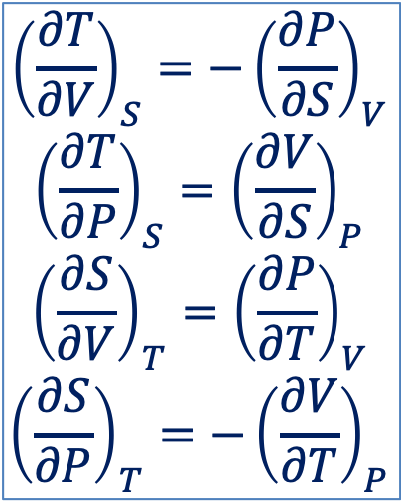
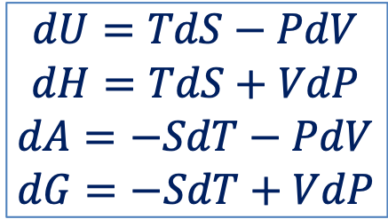
Maxwell’s Relation
$$dU=TdS−PdV$$
$$dH=TdS+VdP$$
$$dA=−SdT−PdV$$
$$dG=−SdT+VdP$$
$${\left(\frac{∂T}{∂V}\right)}_{S}=−{\left(\frac{∂P}{∂S}\right)}_{V}$$
$${\left(\frac{∂T}{∂P}\right)}_{S}={\left(\frac{∂V}{∂S}\right)}_{P}$$
$${\left(\frac{∂S}{∂V}\right)}_{T}={\left(\frac{∂P}{∂T}\right)}_{V}$$
$${\left(\frac{∂S}{∂P}\right)}_{T}={−\left(\frac{∂V}{∂T}\right)}_{P}$$

Slide 17
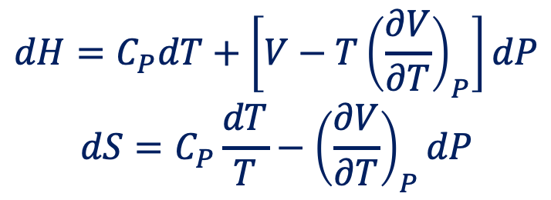
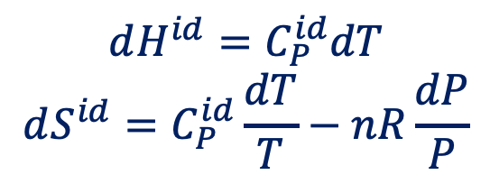
Evaluation of Entropy and Enthalpy
$$dH=C_{P}dT+\left[V−T{\left(\frac{∂V}{∂T}\right)}_{P}\right]dP$$
$$dS=C_{P}\frac{dT}{T}−{\left(\frac{∂V}{∂T}\right)}_{P}dP$$
Ideal gas state
$$dH^{id}=C_{P}^{id}dT$$
$$dS^{id}=C_{P}^{id}\frac{dT}{T}−nR\frac{dP}{P}$$

Slide 18

Evaluation of Internal Energy
As a function of pressure:
$${\left(\frac{∂U}{∂P}\right)}_{T}=\left(−βT+κP\right)V$$
As a function of temperature and volume
$$dU=C_{v}dT+\left[T{\left(\frac{∂P}{∂T}\right)}_{V}−P\right]dV$$

Slide 19
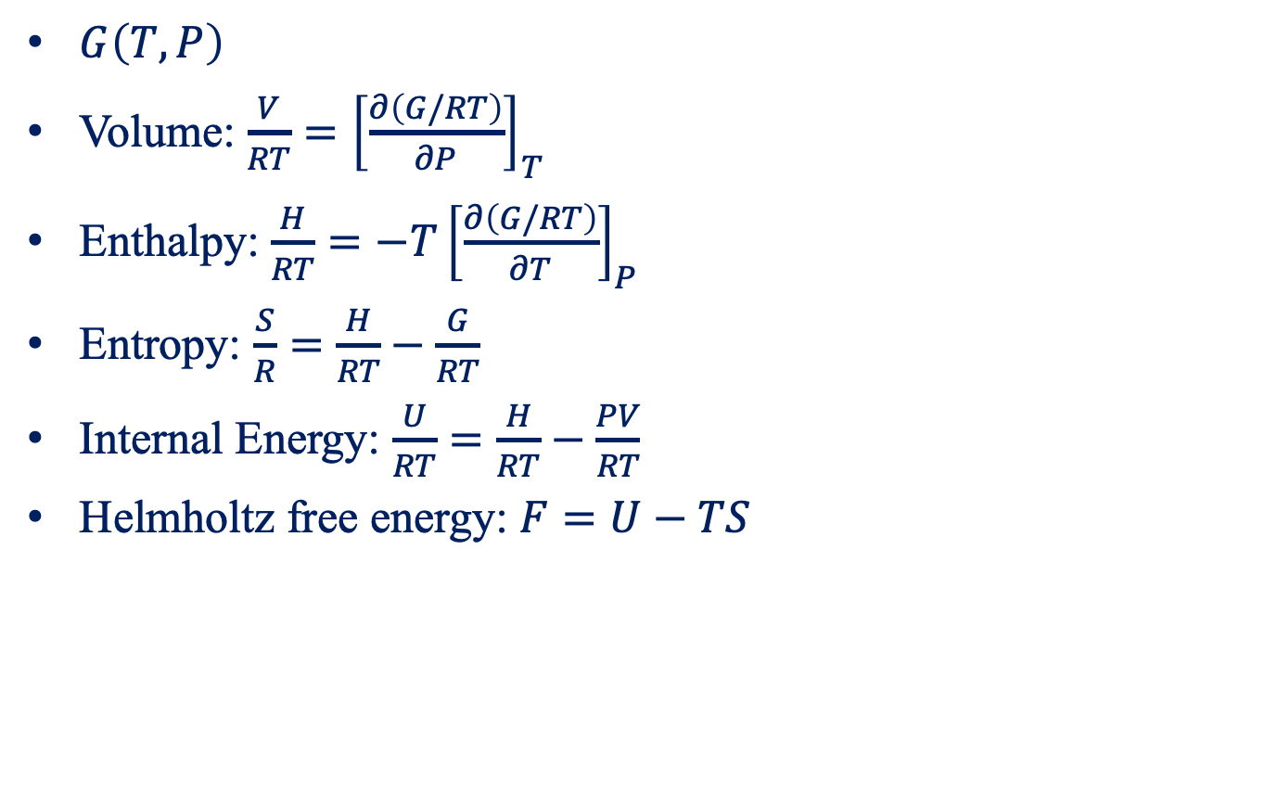
Gibbs Free Energy as a Generating Function
$G\left(T,P\right)$
Volume: $\frac{V}{RT}={\left[\frac{∂\left(G/RT\right)}{∂P}\right]}_{T}$
Enthalpy: $\frac{H}{RT}=−T{\left[\frac{∂\left(G/RT\right)}{∂T}\right]}_{P}$
Entropy: $\frac{S}{R}=\frac{H}{RT}−\frac{G}{RT}$
Internal Energy: $\frac{U}{RT}=\frac{H}{RT}−\frac{PV}{RT}$
Helmholtz free energy: $F=U−TS$

Slide 20
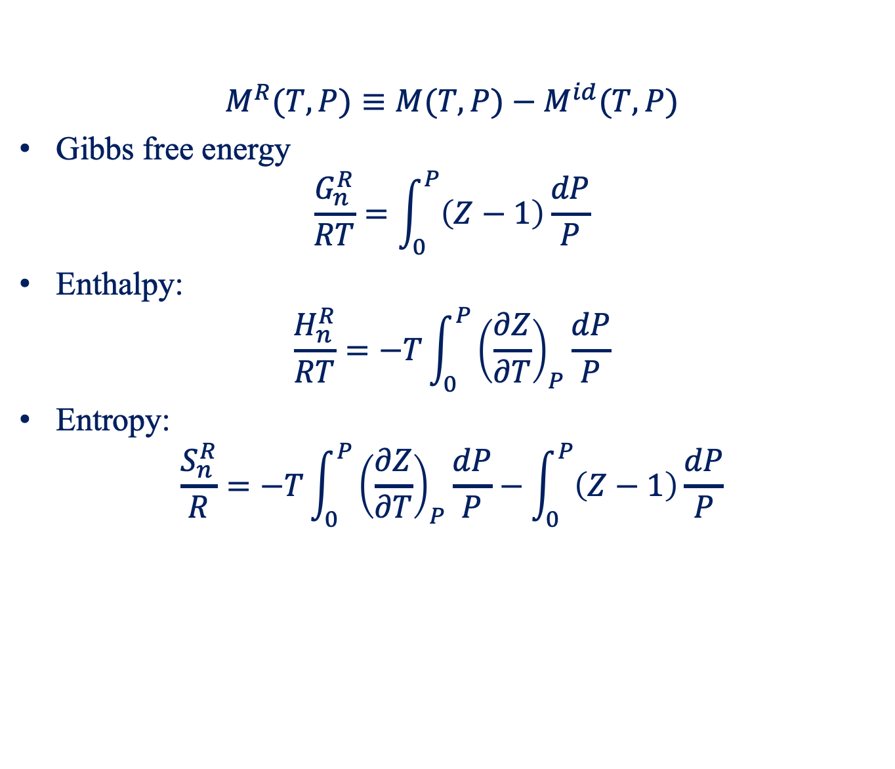
Residual Properties
$$M^{R}(T,P)≡M(T,P)−M^{id}(T,P)$$
Gibbs free energy
$$\frac{G_{n}^{R}}{RT}=\int_{0}^{P}{\left(Z−1\right)\frac{dP}{P}}$$
Enthalpy:
$$\frac{H_{n}^{R}}{RT}=−T\int_{0}^{P}{{\left(\frac{∂Z}{∂T}\right)}_{P}\frac{dP}{P}}$$
Entropy:
$$\frac{S_{n}^{R}}{R}=−T\int_{0}^{P}{{\left(\frac{∂Z}{∂T}\right)}_{P}\frac{dP}{P}−\int_{0}^{P}{\left(Z−1\right)\frac{dP}{P}}}$$

Slide 21

Residual Properties
Viral equation: $Z−1=BP/RT$
Gibbs free energy: $\frac{G_{n}^{R}}{RT}=\frac{BP}{RT}$
Enthalpy: $\frac{H_{n}^{R}}{RT}=\frac{P}{R}\left(\frac{B}{T}−\frac{dB}{dT}\right)$
Entropy: $\frac{S_{n}^{R}}{R}=−\frac{P}{R}\frac{dB}{dT}$

Slide 22
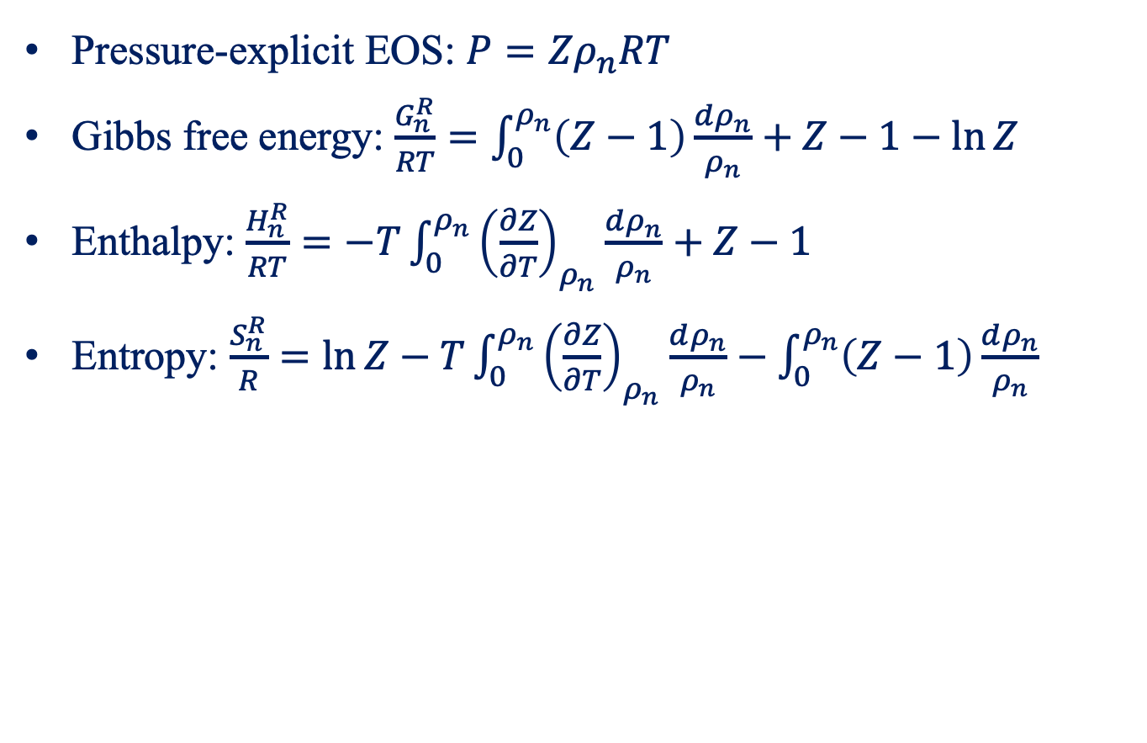
Residual Properties
Pressure-explicit EOS: $P=Zρ_{n}RT$
Gibbs free energy: $\frac{G_{n}^{R}}{RT}=\int_{0}^{ρ_{n}}{\left(Z−1\right)\frac{dρ_{n}}{ρ_{n}}}+Z−1−\ln{Z}$
Enthalpy: $\frac{H_{n}^{R}}{RT}=−T\int_{0}^{ρ_{n}}{{\left(\frac{∂Z}{∂T}\right)}_{ρ_{n}}\frac{dρ_{n}}{ρ_{n}}}+Z−1$
Entropy: $\frac{S_{n}^{R}}{R}=\ln{Z}−T\int_{0}^{ρ_{n}}{{\left(\frac{∂Z}{∂T}\right)}_{ρ_{n}}\frac{dρ_{n}}{ρ_{n}}−\int_{0}^{ρ_{n}}{\left(Z−1\right)\frac{dρ_{n}}{ρ_{n}}}}$

Slide 23

Residual Properties in the Zero-Pressure Limit
Volume: $\lim_{P→0}V_{n}^{R}=RT\lim_{P→0}{\left(\frac{∂Z}{∂P}\right)}_{T}$
Internal energy: $\lim_{P→0}U_{n}^{R}=0$
Enthalpy: $\lim_{P→0}H_{n}^{R}=0$

Slide 24
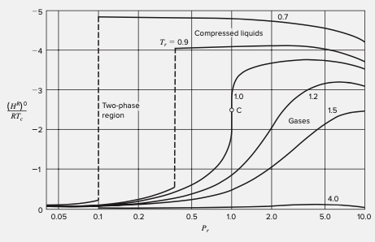
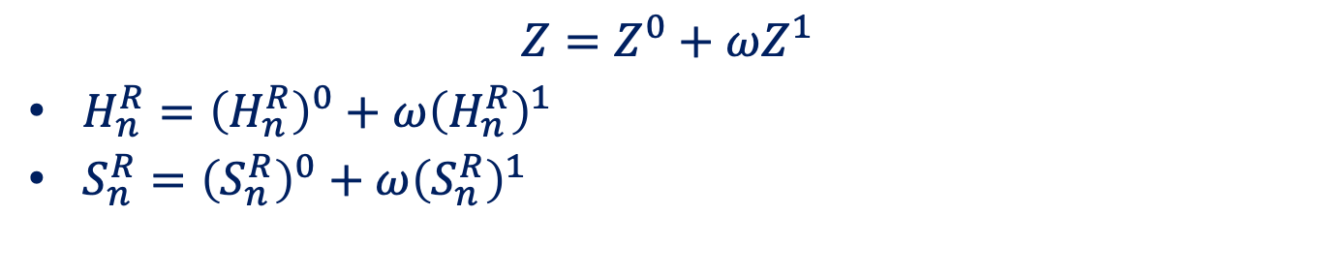
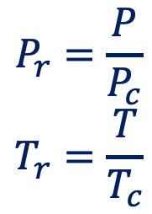
Generalized Property Correlations for Gases
$$Z=Z^{0}+ωZ^{1}$$
$H_{n}^{R}={\left(H_{n}^{R}\right)}^{0}+ω{\left(H_{n}^{R}\right)}^{1}$
$S_{n}^{R}={\left(S_{n}^{R}\right)}^{0}+ω{\left(S_{n}^{R}\right)}^{1}$
$$P_{r}=\frac{P}{P_{c}}$$
$$T_{r}=\frac{T}{T_{c}}$$

Slide 25
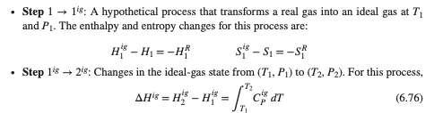
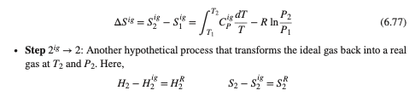
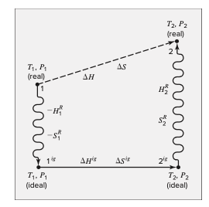
Evaluation of Entropy and Enthalpy for Gases

Slide 26
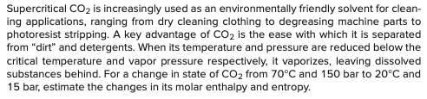
Example

Slide 27
The Claperyron Equation
At saturation
At low saturated pressure
The Clapeyron-Clausius Equation

Slide 28
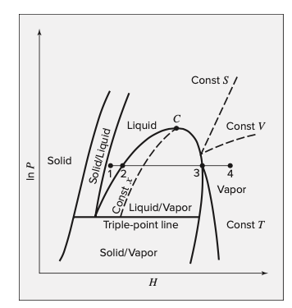
PH Diagram

Slide 29
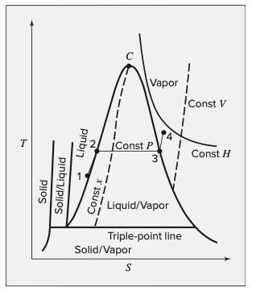
TS Diagram

Slide 30
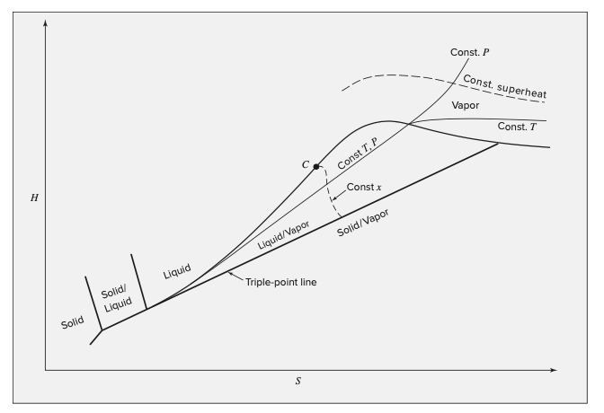
HS Diagram

Slide 31

Tables of Thermodynamic Properties
The interpolation is required to evaluate thermodynamic properties.

