Slide 1
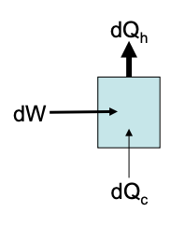
Chemical Engineering Thermodynamics Lecture 7 Refrigeration and Liquefaction Xiaofei Xu

Slide 2
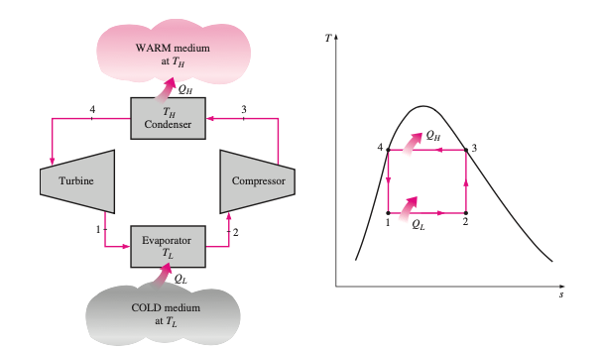
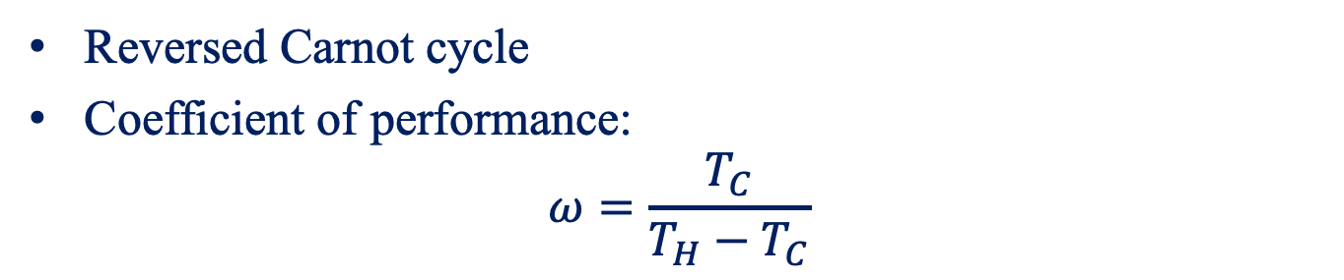
The Carnot Refrigerator
Reversed Carnot cycle
Coefficient of performance:
$$ω=\frac{T_{C}}{T_{H}−T_{C}}$$

Slide 3
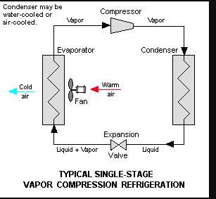
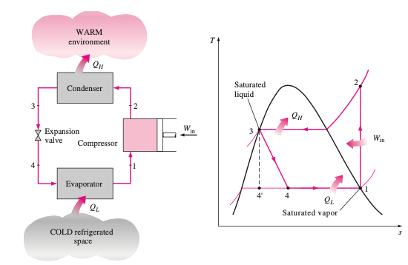
The Ideal Vapor-Compression Refrigeration Cycle
The most widely used cycle for refrigerators and air-conditioning systems

Slide 4
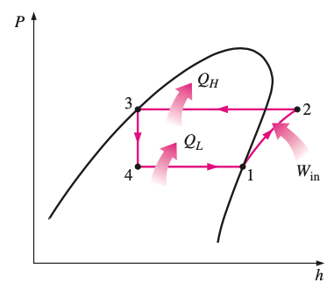
The Ideal Vapor-Compression Refrigeration Cycle
1-2: Isentropic compression
2-3: Constant-pressure heat rejection in a condenser
3-4: Throttling in an expansion device
4-1: Constant-pressure heat absorption in an evaporator

Slide 5
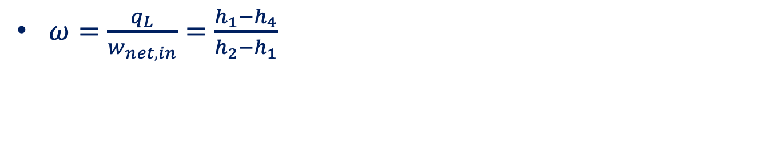
The Ideal Vapor-Compression Refrigeration Cycle
$ω=\frac{q_{L}}{w_{net,in}}=\frac{h_{1}−h_{4}}{h_{2}−h_{1}}$

Slide 6
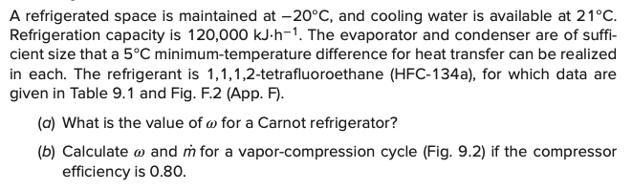
Example

Slide 7
The Choice of Refrigerant
The COP of Carnot refrigerator is independent of the refrigerant
Irreversibility
Toxicity, flammability, cost, corrosion properties, vapor pressure, environmental concerns

Slide 8
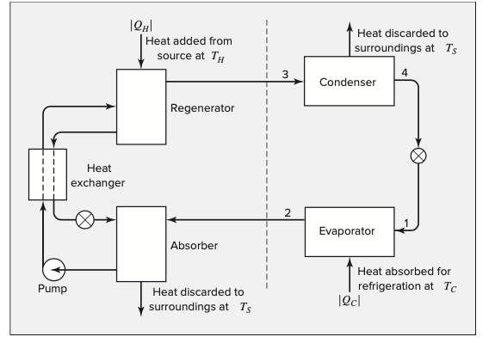
Absorption Refrigerator
Use a heat source to provide energy needed to drive the cooling process

Slide 9
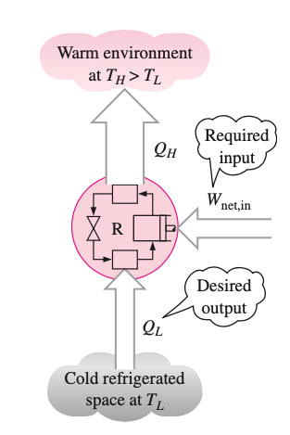
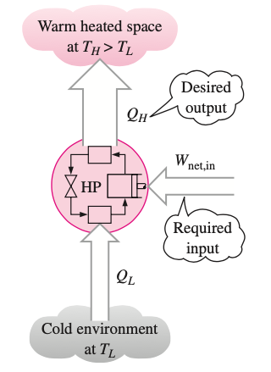
The Heat Pump
Move thermal energy in the opposite direction of spontaneous heat transfer.
Refrigerator
Heat Pump

Slide 10
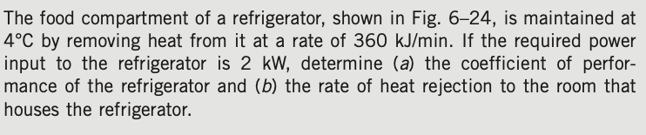
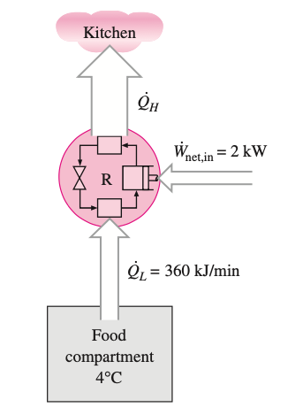
Example

Slide 11
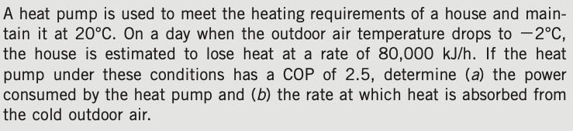
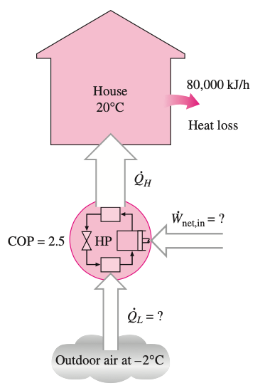
Example

Slide 12
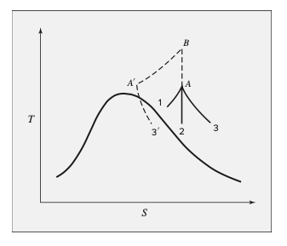
Liquefaction Processes
1: By heat exchange at constant pressure
2: By an expansion process from which work is obtained
3: By a throttling process

Slide 13
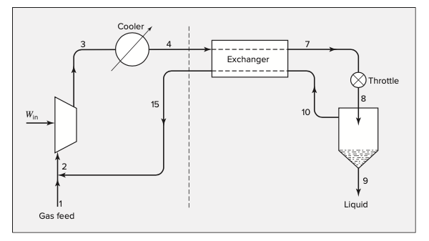
Linde Liquefaction Process

Slide 14
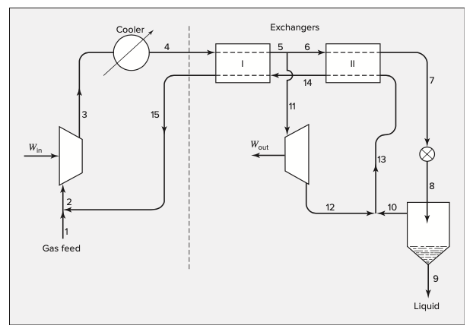
Claude Liquefaction Process

