Slide 1
Q & A
Q1. What is the Elementary Reaction？
A: (1)Products are formed by only one single step, no intermediates can be detected by macroscopic experimental methods
(2) The Mass Action Law is only applicable to elementary reactions, that the reaction rate is proportional to the power product of concentrations of various reactants
Unimolecular Reactions
Bimolecular Reactions
Trimolecular Reactions

Slide 2
Q & A
Q2. What is the relationship among the reaction rate, the rate of consumption, and the rate of formation?
Reaction Rate
Rate of
Consumption
Rate of
Formation
(V constant)
(V constant)
(V constant)

Slide 3
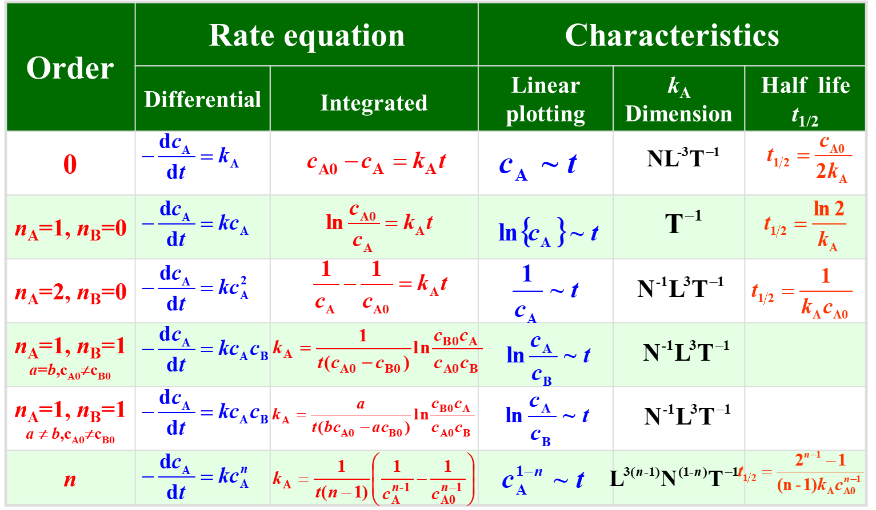
Q & A
Q3. What are rate equations and the characteristics of the zeroth, first and second order reaction rate law, respectively?

