Slide 1
2
拉格朗日插值

Slide 2
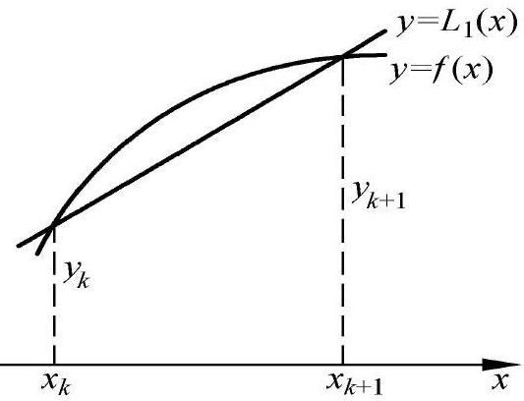




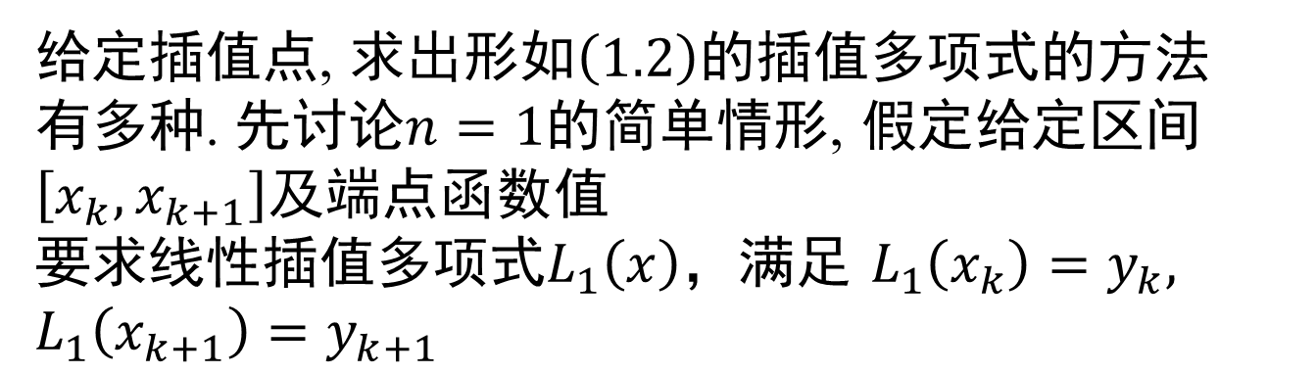

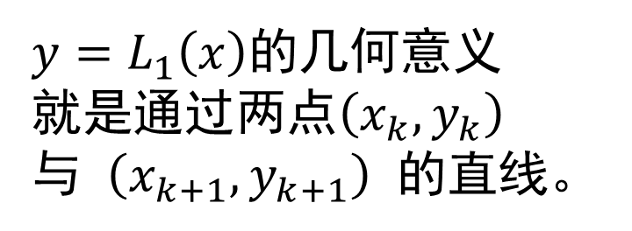

1
线性插值与抛物线插值
给定插值点, 求出形如$\left(1.2\right)$的插值多项式的方法
有多种. 先讨论$n=1$的简单情形, 假定给定区间
$\left[x_{k},x_{k+1}\right]$及端点函数值
要求线性插值多项式$L_{1}\left(x\right)$，满足 $L_{1}\left(x_{k}\right)=y_{k}, L_{1}\left(x_{k+1}\right)=y_{k+1}$
$$y_{k}$$
$$=$$
$$f\left(x_{k}\right),$$
$$y_{k+1}$$
$$=$$
$$f\left(x_{k+1}\right),$$
$y=L_{1}\left(x\right)$的几何意义就是通过两点$\left(x_{k},y_{k}\right)$与$\left(x_{k+1},y_{k+1}\right)$的直线。

Slide 3
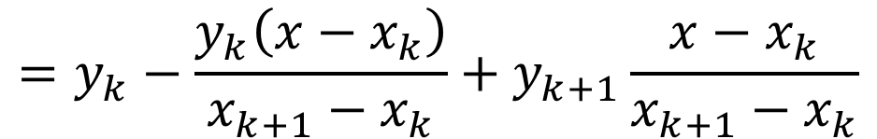
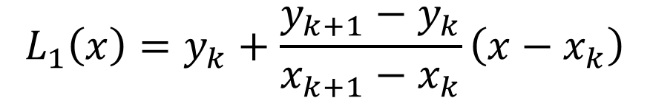
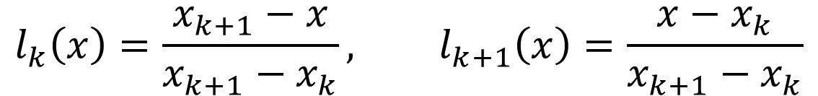
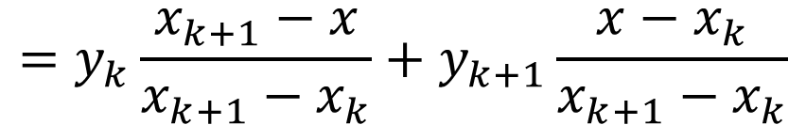
1
线性插值与抛物线插值
点斜式方程：
$$L_{1}\left(x\right)=y_{k}+\frac{y_{k+1}−y_{k}}{x_{k+1}−x_{k}}\left(x−x_{k}\right)$$
$$=y_{k}−\frac{y_{k}\left(x−x_{k}\right)}{x_{k+1}−x_{k}}+y_{k+1}\frac{x−x_{k}}{x_{k+1}−x_{k}}$$
$$=y_{k}\frac{x_{k+1}−x}{x_{k+1}−x_{k}}+y_{k+1}\frac{x−x_{k}}{x_{k+1}−x_{k}}$$
令
$$l_{k}\left(x\right)=\frac{x_{k+1}−x}{x_{k+1}−x_{k}}, l_{k+1}\left(x\right)=\frac{x−x_{k}}{x_{k+1}−x_{k}}$$
$$L_{1}\left(x\right)=y_{k}l_{k}\left(x\right)+y_{k+1}l_{k+1}\left(x\right)$$

Slide 4
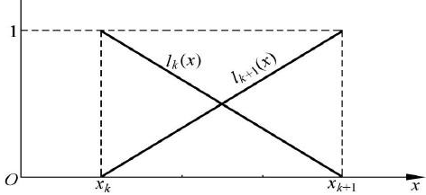
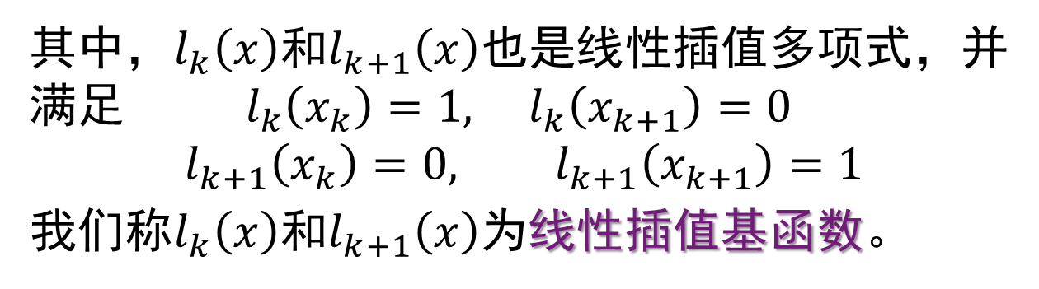
1
线性插值与抛物线插值
其中，$l_{k}\left(x\right)$和$l_{k+1}\left(x\right)$也是线性插值多项式，并满足 $l_{k}\left(x_{k}\right)=1, l_{k}\left(x_{k+1}\right)=0$
$$l_{k+1}\left(x_{k}\right)=0, l_{k+1}\left(x_{k+1}\right)=1$$
我们称$l_{k}\left(x\right)$和$l_{k+1}\left(x\right)$为线性插值基函数。

Slide 5




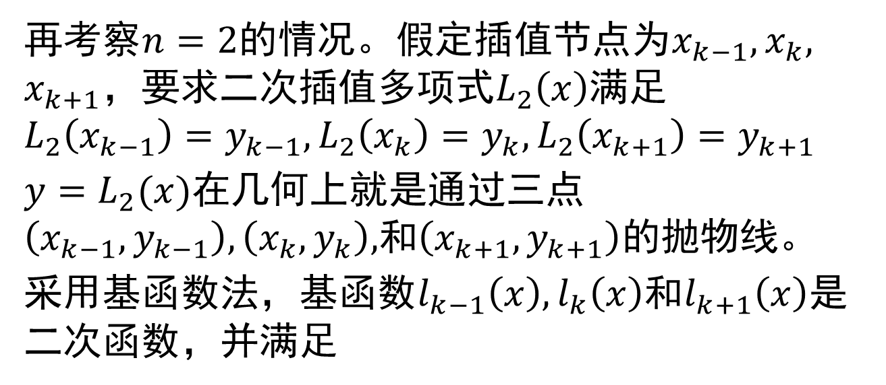







1
线性插值与抛物线插值
再考察$n=2$的情况。假定插值节点为$x_{k−1},x_{k},$
$x_{k+1}$，要求二次插值多项式$L_{2}\left(x\right)$满足
$$L_{2}\left(x_{k−1}\right)=y_{k−1}, L_{2}\left(x_{k}\right)=y_{k}, L_{2}\left(x_{k+1}\right)=y_{k+1}$$
$y=L_{2}(x)$在几何上就是通过三点$\left(x_{k−1},y_{k−1}\right), \left(x_{k},y_{k}\right),$和$\left(x_{k+1},y_{k+1}\right)$的抛物线。
采用基函数法，基函数$l_{k−1}\left(x\right), l_{k}\left(x\right)$和$l_{k+1}\left(x\right)$是二次函数，并满足
$$l_{k−1}\left(x_{k−1}\right)=1, l_{k−1}\left(x_{k}\right)=0, l_{k−1}\left(x_{k+1}\right)=0$$
$$l_{k}\left(x_{k−1}\right)=0, l_{k}\left(x_{k}\right)=1, l_{k}\left(x_{k+1}\right)=0$$
$$1$$
$$=$$
$$=$$
$$0$$
$$,$$
$$l_{k+1}\left(x_{k}\right)$$
$$l_{k+1}\left(x_{k+1}\right)$$
$$=$$
$$,$$
$$l_{k+1}\left(x_{k−1}\right)$$
$$0$$

Slide 6
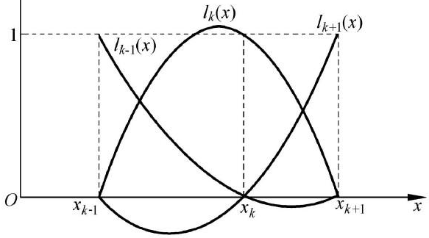
1
线性插值与抛物线插值

Slide 7






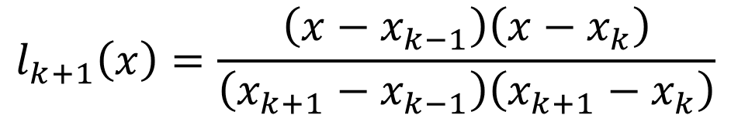

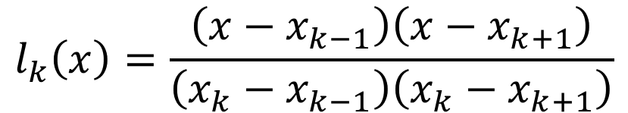

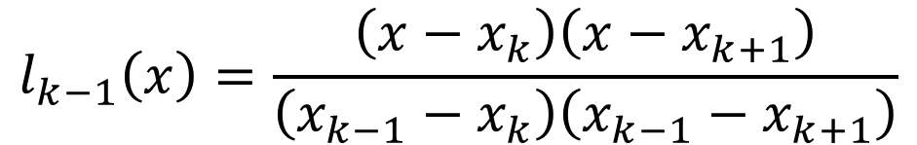
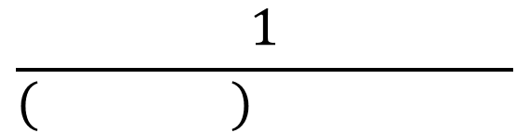

1
线性插值与抛物线插值
因为$l_{k−1}\left(x\right)$有两个零点$x_{k}$和$x_{k+1}$，所以
$$l_{k−1}\left(x\right)=A\left(x−x_{k}\right)\left(x−x_{k+1}\right)$$
$$\frac{1}{\left( \right) }$$
由$l_{k−1}\left(x_{k−1}\right)=1$可得
$$=$$
$$A$$
$$x_{k−1}$$
$$−x_{k}$$
$$x_{k−1}$$
$$−x_{k+1}$$
$$l_{k−1}\left(x\right)=\frac{\left(x−x_{k}\right)\left(x−x_{k+1}\right)}{\left(x_{k−1}−x_{k}\right)\left(x_{k−1}−x_{k+1}\right)}$$
$$l_{k}\left(x\right)=\frac{\left(x−x_{k−1}\right)\left(x−x_{k+1}\right)}{\left(x_{k}−x_{k−1}\right)\left(x_{k}−x_{k+1}\right)}$$
$$l_{k+1}\left(x\right)=\frac{\left(x−x_{k−1}\right)\left(x−x_{k}\right)}{\left(x_{k+1}−x_{k−1}\right)\left(x_{k+1}−x_{k}\right)}$$

Slide 8
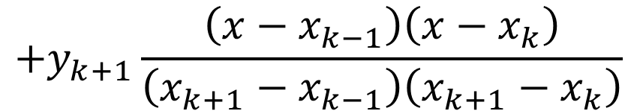
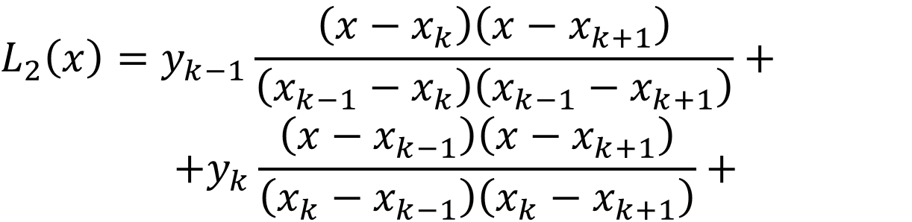
1
线性插值与抛物线插值
$$L_{2}\left(x\right)=y_{k−1}l_{k−1}\left(x\right)+y_{k}l_{k}\left(x\right)+y_{k+1}l_{k+1}\left(x\right)$$
$$L_{2}\left(x_{k−1}\right)=y_{k−1}⋅1+y_{k}⋅0+y_{k+1}⋅0=y_{k−1}$$
$$L_{2}\left(x_{k}\right)=y_{k−1}⋅0+y_{k}⋅1+y_{k+1}⋅0=y_{k}$$
$$L_{2}\left(x_{k+1}\right)=y_{k−1}⋅0+y_{k}⋅0+y_{k+1}⋅1=y_{k+1}$$
$$L_{2}\left(x\right)=y_{k−1}\frac{\left(x−x_{k}\right)\left(x−x_{k+1}\right)}{\left(x_{k−1}−x_{k}\right)\left(x_{k−1}−x_{k+1}\right)}+$$
$$+y_{k}\frac{\left(x−x_{k−1}\right)\left(x−x_{k+1}\right)}{\left(x_{k}−x_{k−1}\right)\left(x_{k}−x_{k+1}\right)}+$$
$$+y_{k+1}\frac{\left(x−x_{k−1}\right)\left(x−x_{k}\right)}{\left(x_{k+1}−x_{k−1}\right)\left(x_{k+1}−x_{k}\right)}$$

Slide 9




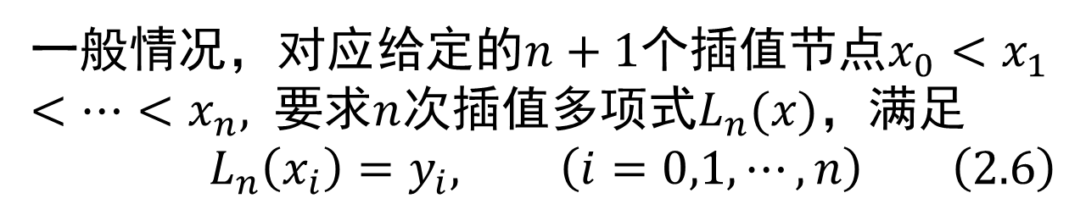






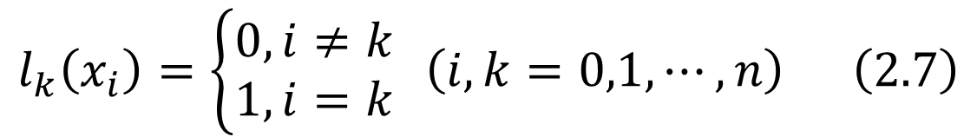







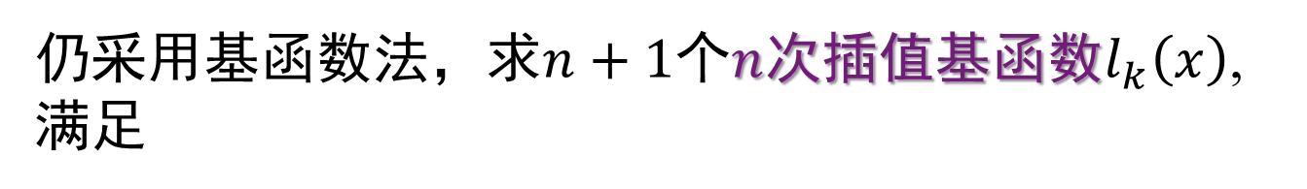



2
拉格朗日插值多项式
一般情况，对应给定的$n+1$个插值节点$x_{0}<x_{1}$
$<⋯<x_{n},$ 要求$n$次插值多项式$L_{n}(x)$，满足
$$L_{n}\left(x_{i}\right)=y_{i}, \left(i=0,1,⋯,n\right) \left(2.6\right)$$
仍采用基函数法，求$n+1$个$n$次插值基函数$l_{k}\left(x\right)$,满足
$$l_{k}\left(x_{i}\right)=\left\{\begin{aligned}0, i≠k \\ 1, i=k\end{aligned}\right. \left(i,k=0,1,⋯,n\right) \left(2.7\right)$$
$$l_{k}\left(x\right)$$
$$=$$
$$A_{k}$$
$$x$$
$$−x_{0}$$
$$⋯$$
$$x$$
$$−x_{k−1}$$
$$x$$
$$−x_{k+1}$$
$$⋯$$
$$x$$
$$−x_{n}$$
$$l_{k}\left(x_{k}\right)=1,$$
$$\frac{1}{\left(x_{k}−x_{0}\right)⋯\left(x_{k}−x_{k−1}\right)\left(x_{k}−x_{k+1}\right)⋯\left(x_{k}−x_{n}\right)}$$
$$A_{k}$$
$$=$$

Slide 10



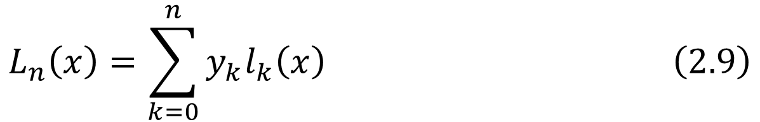














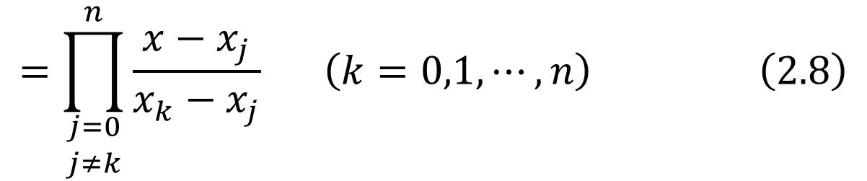







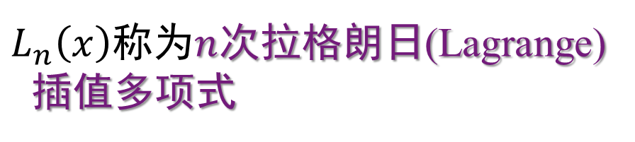






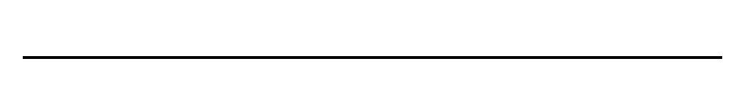
2
拉格朗日插值多项式
对于$k=0,1,⋯,n，$有
$$x$$
$$−x_{0}$$
$$⋯$$
$$x$$
$$−x_{k−1}$$
$$x$$
$$−x_{k+1}$$
$$⋯$$
$$x$$
$$−x_{n}$$
$$l_{k}\left(x\right)$$
$$=$$
$$x_{k}$$
$$−x_{0}$$
$$⋯$$
$$x_{k}$$
$$−x_{k−1}$$
$$x_{k}$$
$$−x_{k+1}$$
$$⋯$$
$$x_{k}$$
$$−x_{n}$$
$$=\prod_{\begin{aligned}j=0 \\ j≠k\end{aligned}}^{n}{\frac{x−x_{j}}{x_{k}−x_{j}}} \left(k=0,1,⋯,n\right) \left(2.8\right)$$
$$L_{n}\left(x\right)=\sum_{k=0}^{n}{y_{k}l_{k}\left(x\right)} \left(2.9\right)$$
$L_{n}\left(x\right)$称为$n$次拉格朗日(Lagrange)
插值多项式

Slide 11










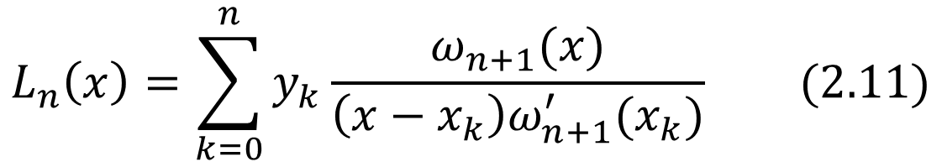







2
拉格朗日插值多项式
引入记号
$$ω_{n+1}\left(x\right)$$
$$=$$
$$x$$
$$−x_{0}$$
$$x$$
$$−x_{1}$$
$$⋯$$
$$x$$
$$−x_{n}$$
$$\left(2.10\right)$$
$$ω_{n+1}^{′}\left(x_{k}\right)$$
$$=$$
$$x_{k}$$
$$−x_{0}$$
$$⋯$$
$$x_{k}$$
$$−x_{k−1}$$
$$x_{k}$$
$$−x_{k+1}$$
$$⋯$$
$$x_{k}$$
$$−x_{n}$$
$$L_{n}\left(x\right)=\sum_{k=0}^{n}{y_{k}\frac{ω_{n+1}(x)}{\left(x−x_{k}\right)ω_{n+1}^{′}(x_{k})}} (2.11)$$
于是
$n$次插值多项式$L_{n}\left(x\right)$通常是次数为$n$的多项式，特殊情况下次数可能小于$n$。
例如，如果$\left(x_{0},y_{0}\right), \left(x_{1},y_{1}\right), \left(x_{2},y_{2}\right)$三点共线，那么插值多项式$L_{2}\left(x\right)$是一次多项式。

Slide 12


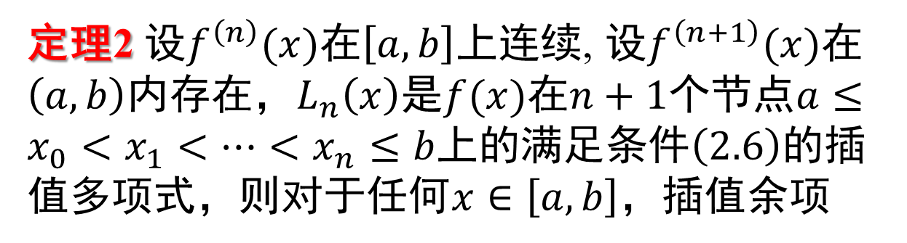










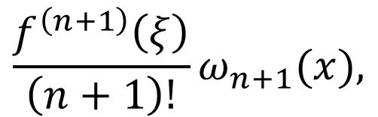
3
插值余项与误差估计
若在$\left[a,b\right]$上用$L_{n}\left(x\right)$近似$f\left(x\right)$,则其截断误差为
也称为插值多项式的余项.
$$R_{n}\left(x\right)$$
$$f\left(x\right)$$
$$−L_{n}\left(x\right)$$
$$=$$
定理2 设$f^{\left(n\right)}(x)$在$\left[a,b\right]$上连续, 设$f^{\left(n+1\right)}(x)$在$\left(a,b\right)$内存在，$L_{n}\left(x\right)$是$f(x)$在$n+1$个节点$a≤x_{0}<x_{1}<⋯<x_{n}≤b$上的满足条件$\left(2.6\right)$的插值多项式，则对于任何$x∈\left[a,b\right]$，插值余项
$$\frac{f^{\left(n+1\right)}\left(ξ\right)}{\left(n+1\right)!}ω_{n+1}(x),$$
$$f\left(x\right)$$
$$=$$
$$\left(2.12\right)$$
$$R_{n}\left(x\right)$$
$$=$$
$$−L_{n}\left(x\right)$$
其中$ξ∈(a,b)$且依赖于$x$, $ω_{n+1}(x)$由$(2.10)$式
所定义。

Slide 13


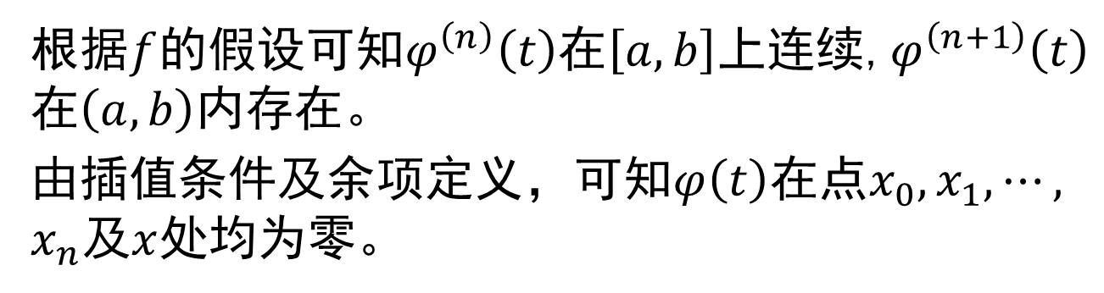




















3
插值余项与误差估计
证明
$$R_{n}\left(x_{k}\right)=0, k=0,1,⋯,n$$
$$R_{n}\left(x\right)$$
$$=$$
$$K\left(x\right)$$
$$x$$
$$−x_{0}$$
$$x$$
$$−x_{1}$$
$$⋯$$
$$x$$
$$−x_{n}$$
$$=$$
$$K\left(x\right)$$
$$ω_{n+1}(x)$$
其中$K\left(x\right)$是关于$x$的待定函数。
现把$x$看成是$\left[a,b\right]$上的一个固定的点，构造函数
$$−L_{n}\left(t\right)$$
$$−K\left(x\right)$$
$$t$$
$$−x_{0}$$
$$t$$
$$−x_{1}$$
$$⋯$$
$$t$$
$$φ\left(t\right)$$
$$f\left(t\right)$$
$$−x_{n}$$
$$=$$
根据$f$的假设可知$φ^{\left(n\right)}\left(t\right)$在$\left[a,b\right]$上连续,$φ^{\left(n+1\right)}\left(t\right)$在$\left(a,b\right)$内存在。
由插值条件及余项定义，可知$φ\left(t\right)$在点$x_{0},x_{1},⋯,$
$x_{n}$及$x$处均为零。

Slide 14



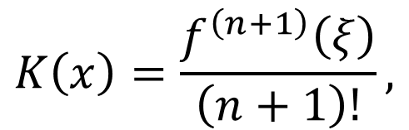


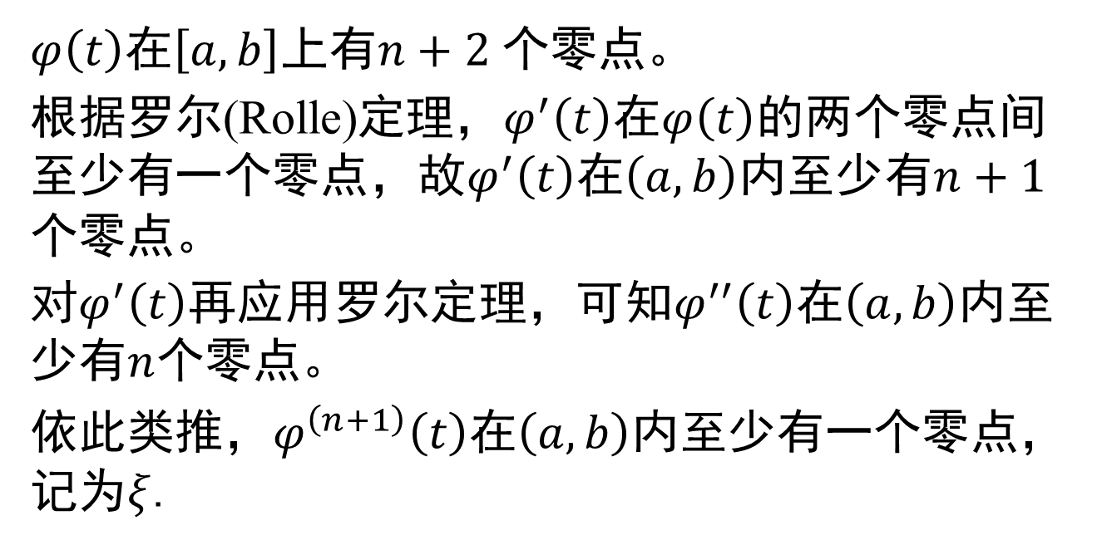










3
插值余项与误差估计
$φ\left(t\right)$在$\left[a,b\right]$上有$n+2$个零点。
根据罗尔(Rolle)定理，$φ^{′}\left(t\right)$在$φ\left(t\right)$的两个零点间至少有一个零点，故$φ^{′}\left(t\right)$在$\left(a,b\right)$内至少有$n+1$个零点。
对$φ^{′}\left(t\right)$再应用罗尔定理，可知$φ^{′′}\left(t\right)$在$\left(a,b\right)$内至少有$n$个零点。
依此类推，$φ^{\left(n+1\right)}\left(t\right)$在$\left(a,b\right)$内至少有一个零点，记为$ξ$.
$$φ^{\left(n+1\right)}\left(ξ\right)$$
$$f^{\left(n+1\right)}\left(ξ\right)$$
$$=$$
$$−\left( \right)!$$
$$+1$$
$$K\left(x\right)$$
$$=$$
$$n$$
$$0$$
$$K\left(x\right)=\frac{f^{\left(n+1\right)}\left(ξ\right)}{\left(n+1\right)!},$$
$$ξ$$
$$a$$
且依赖于$x$
$$∈$$
$$,$$
$$b$$

Slide 15
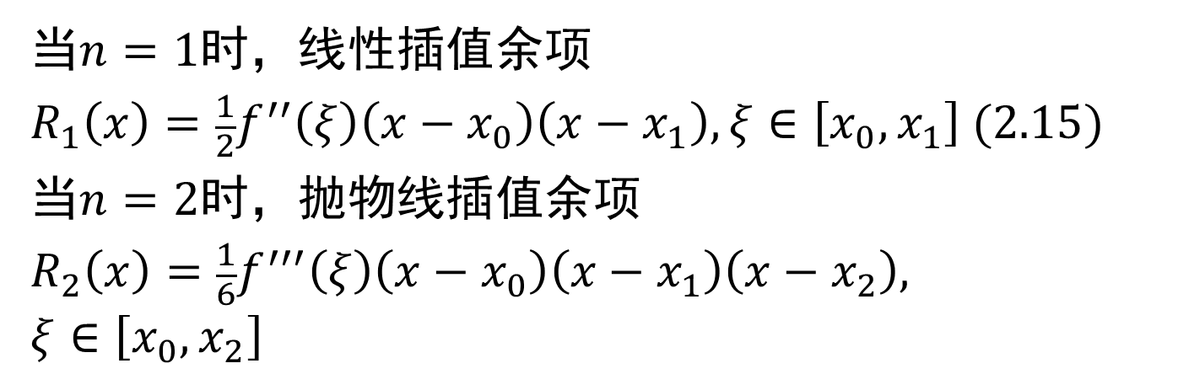
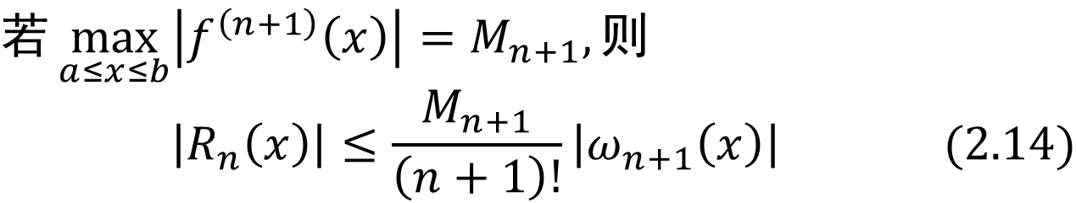
3
插值余项与误差估计
$$若\max_{a≤x≤b}\left|f^{\left(n+1\right)}\left(x\right)\right|=M_{n+1}, 则$$
$$\left|R_{n}\left(x\right)\right|≤\frac{M_{n+1}}{\left(n+1\right)!}\left|ω_{n+1}\left(x\right)\right| (2.14)$$
当$n=1$时，线性插值余项
$$R_{1}\left(x\right)=\frac{1}{2}f^{′′}\left(ξ\right)\left(x−x_{0}\right)\left(x−x_{1}\right), ξ∈\left[x_{0},x_{1}\right] (2.15)$$
当$n=2$时，抛物线插值余项
$$R_{2}\left(x\right)=\frac{1}{6}f^{′′′}\left(ξ\right)\left(x−x_{0}\right)\left(x−x_{1}\right)\left(x−x_{2}\right),$$
$$ξ∈\left[x_{0},x_{2}\right]$$

Slide 16
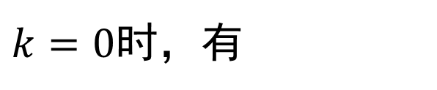
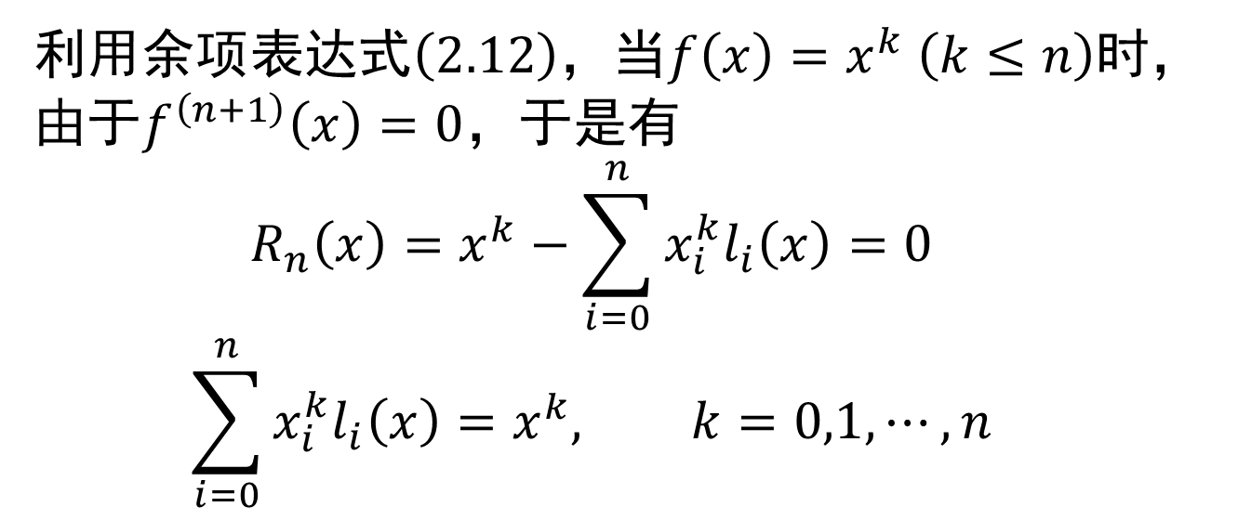
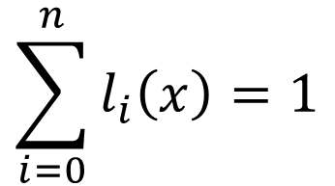
3
插值余项与误差估计
利用余项表达式$\left(2.12\right)$，当$f\left(x\right)=x^{k} \left(k≤n\right)$时，由于$f^{\left(n+1\right)}\left(x\right)=0$，于是有
$$R_{n}\left(x\right)=x^{k}−\sum_{i=0}^{n}{x_{i}^{k}l_{i}\left(x\right)}=0$$
$$\sum_{i=0}^{n}{x_{i}^{k}l_{i}\left(x\right)}=x^{k}, k=0,1,⋯,n$$
$$\sum_{i=0}^{n}{l_{i}\left(x\right)}=1$$
$k=0$时，有

