Slide 1
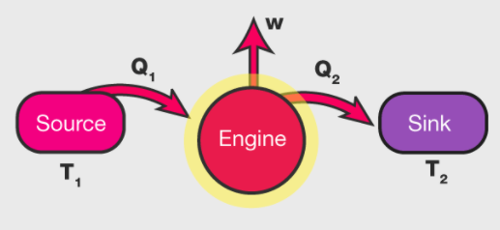
Chemical Engineering Thermodynamics Lecture 6 Heat Engine Xiaofei Xu

Slide 2
Power Cycles
Heat Engines: The devices or systems used to produce a net power output
Power cycles: Thermodynamic cycles of heat engines
Refrigerators / heat pumps: The devices or systems used to produce a refrigeration effect; refrigeration cycles
Gas cycles: working fluid is the gas phase
Vapor cycles: working fluid is vapor/liquid

Slide 3
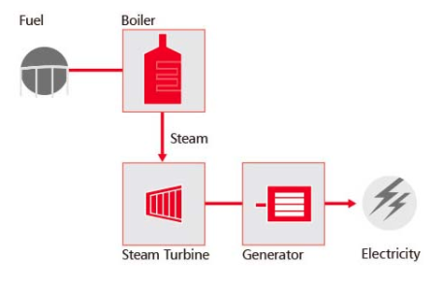
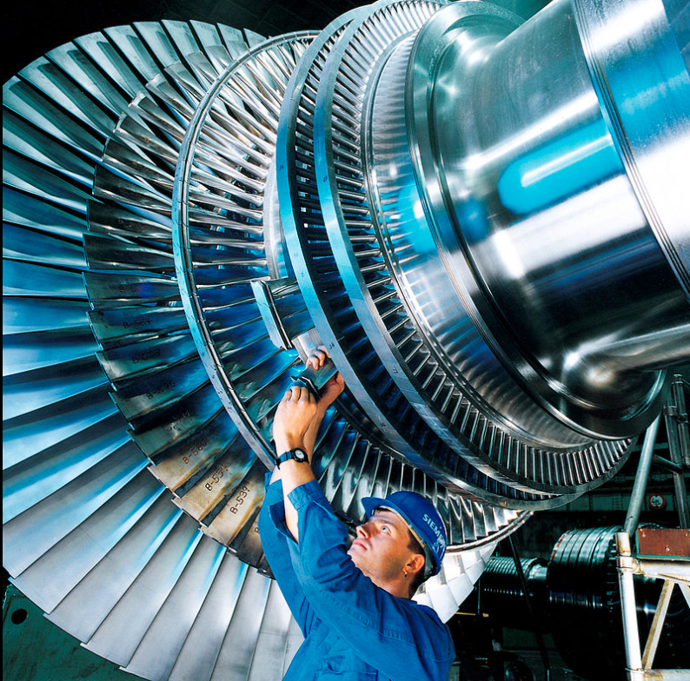
Steam Power Plant

Slide 4
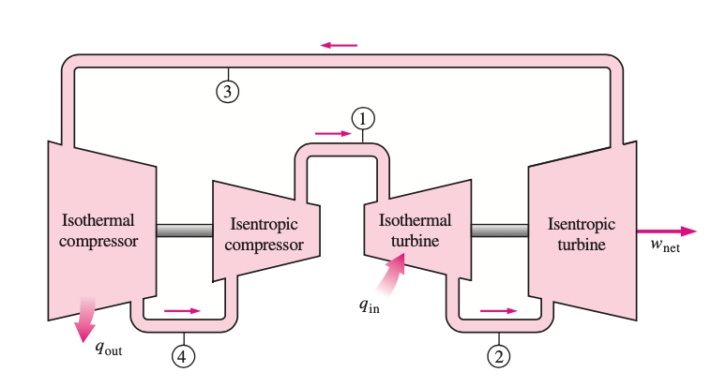
Steam Turbine
A steady flow Carnot engine

Slide 5
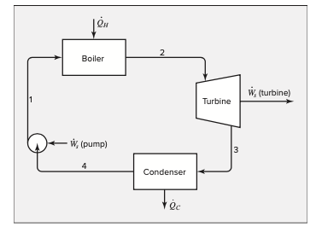
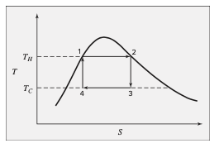
Steam Power Plant
Steady-state steady-flow cyclic process

Slide 6
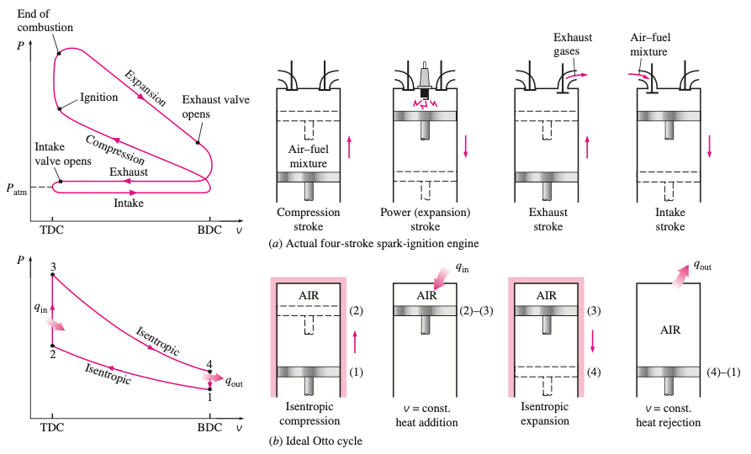
The Otto Cycle
The ideal cycle for spark-ignition engines
Four-stroke internal combustion engines

Slide 7
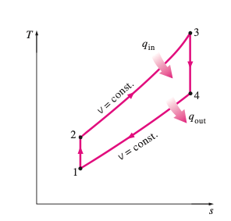
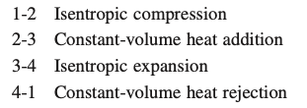
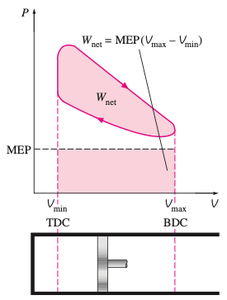
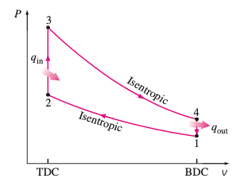
The Ideal Otto Cycle

Slide 8
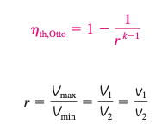
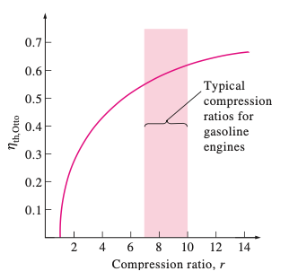
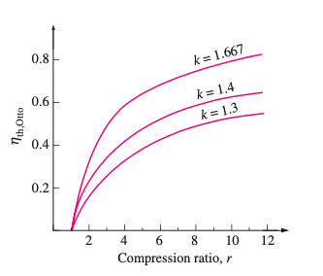
The Ideal Otto Cycle

Slide 9
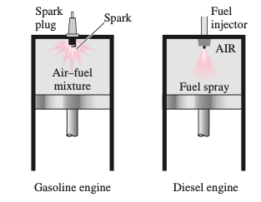
The Diesel Cycle
In Diesel engines, the spark plug is replaced by a fuel injector, and only air is compressed during the compression process.
T< autoignition
T> autoignition

Slide 10
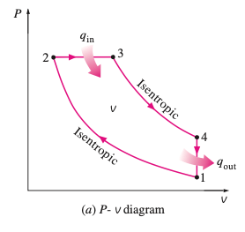
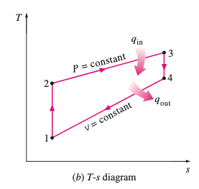
The Ideal Diesel Cycle

Slide 11
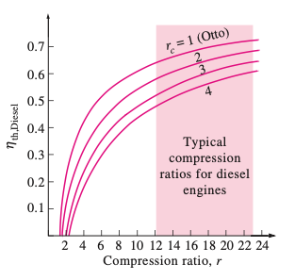
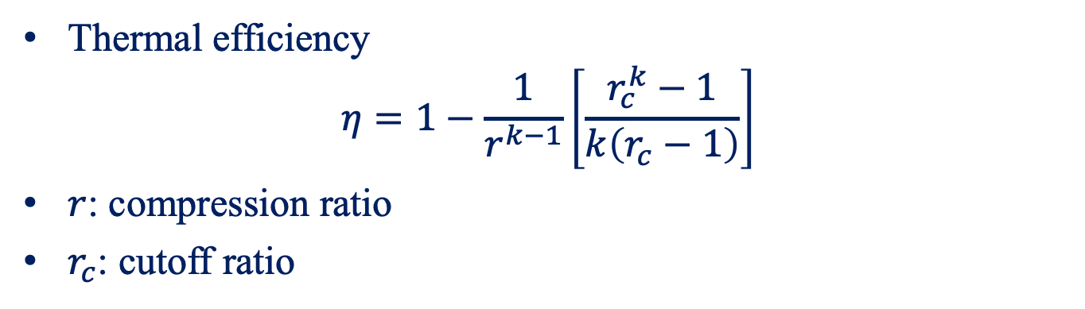
The Ideal Diesel Cycle of Ideal Gas
Thermal efficiency
$$η=1−\frac{1}{r^{k−1}}\left[\frac{r_{c}^{k}−1}{k\left(r_{c}−1\right)}\right]$$
$r$: compression ratio
$r_{c}$: cutoff ratio

Slide 12
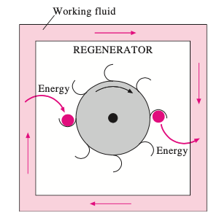
Regenerator
Borrows energy from the working fluid during one part of the cycle and pays it back during another part.

Slide 13
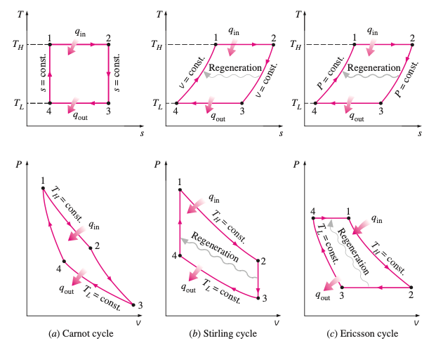

Stirling and Ericsson Cycles

Slide 14
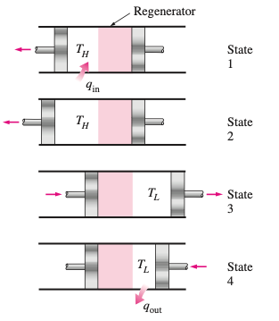
Stirling Cycle

Slide 15
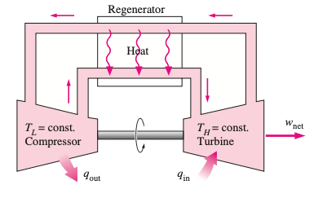
Ericsson Engine

Slide 16


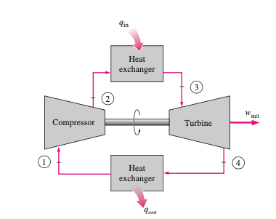
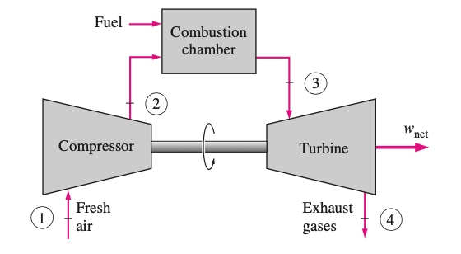
Ideal Brayton Cycle
The ideal cycle for gas-turbine engines
open-cycle
closed-cycle

Slide 17
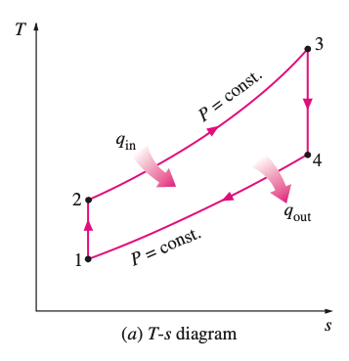
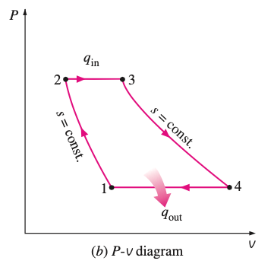
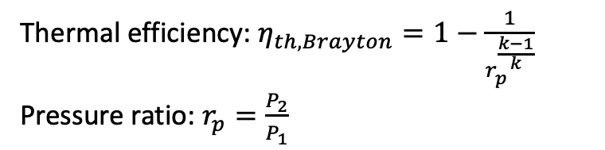
Ideal Brayton Cycle
Thermal efficiency: $η_{th,Brayton}=1−\frac{1}{r_{p}^{\frac{k−1}{k}}}$
Pressure ratio: $r_{p}=\frac{P_{2}}{P_{1}}$

Slide 18
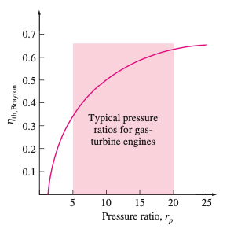
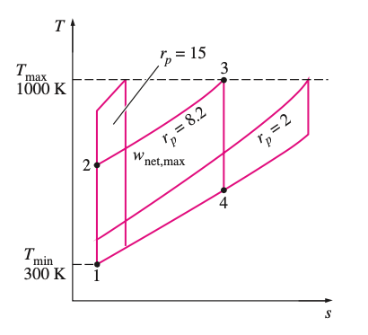
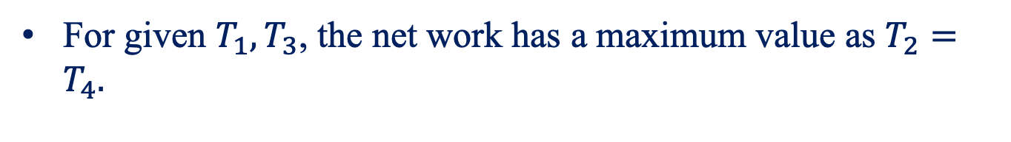
Ideal Brayton Cycle
For given $T_{1},T_{3}$, the net work has a maximum value as $T_{2}=T_{4}.$

Slide 19
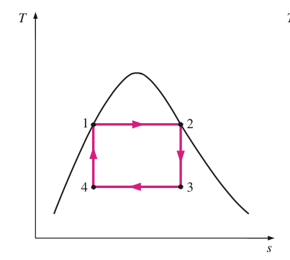
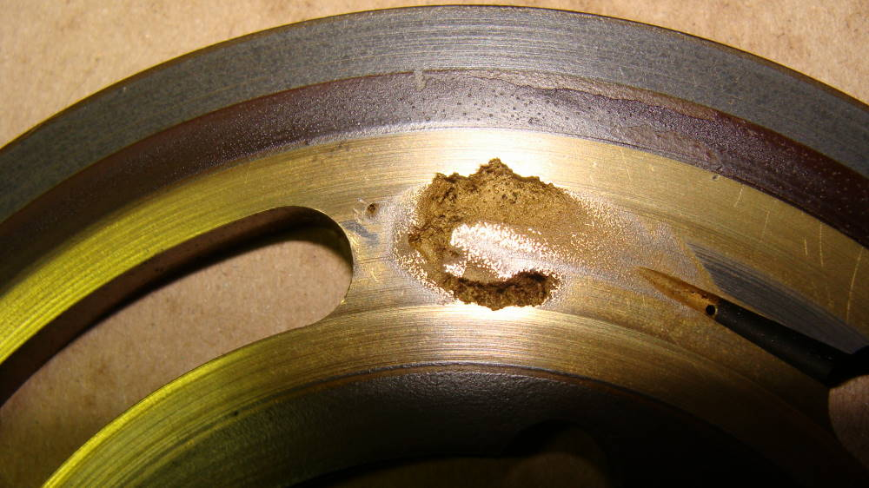
Motivation of Vapor Cycle
Low thermal efficiency
Nucleation of liquid bubble
Handle with two phases.
Cavitation Damage

Slide 20
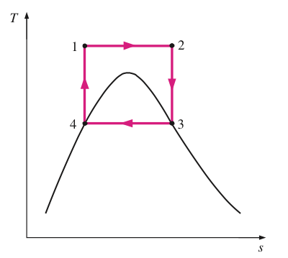
Motivation of Vapor Cycle
Working pressure is too high
Isothermal process of 1 to 2 is not isobaric

Slide 21
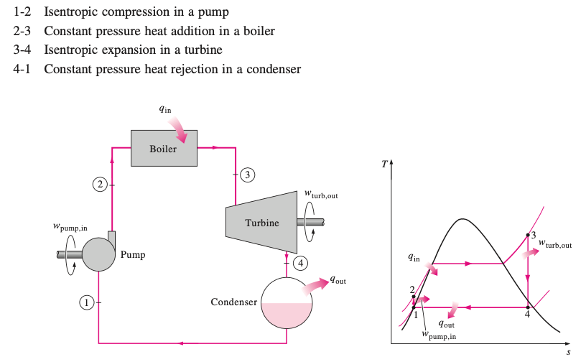
The Rankine Cycle

Slide 22
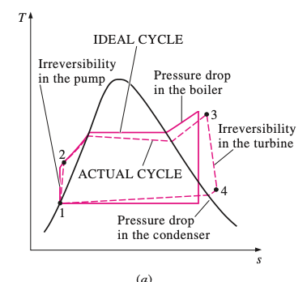
Actual Vapor Power Cycle

Slide 23
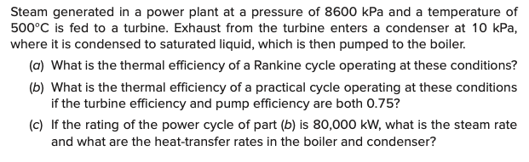
Example

Slide 24
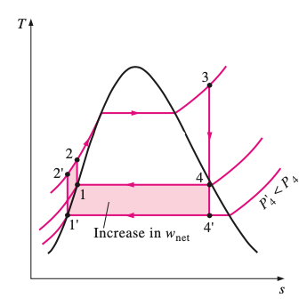
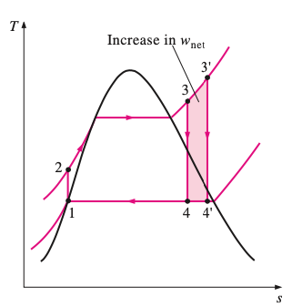
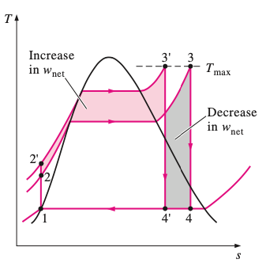
Increasing the Efficiency of the Rankine Cycle
Lowering the condenser pressure
Superheating the steam to high temperatures
Increasing the boiler pressure

