Slide 1
Chemical Engineering Thermodynamics Lecture 9 Mixing Processes Xiaofei Xu

Slide 2
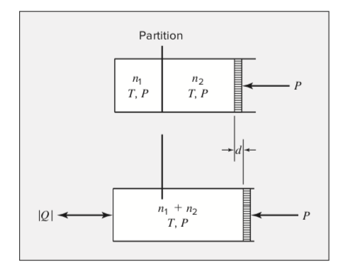
Mixing Processes
Standard mixing process: mixing at constant T and P.

Slide 3

Property Changes of mixing
$ΔV=V^{E}$
$ΔH=H^{E}$
$ΔS=S^{E}−R\sum_{i}{x_{i}\ln{x_{i}}}$
$ΔG=G^{E}+RT\sum_{i}{x_{i}\ln{x_{i}}}$

Slide 4

Mixing of ideal solution
$ΔV^{id}=0$
$ΔH^{id}=0$
$ΔS^{id}=−R\sum_{i}{x_{i}\ln{x_{i}}}$
$ΔG^{id}=RT\sum_{i}{x_{i}\ln{x_{i}}}$

Slide 5
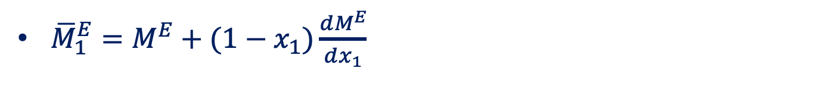
Binary Mixing
${\overline{M}}_{1}^{E}=M^{E}+(1−x_{1})\frac{dM^{E}}{dx_{1}}$

Slide 6
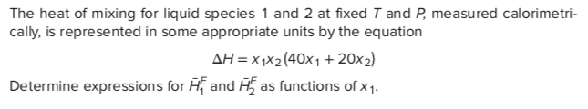
Example

Slide 7
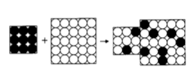
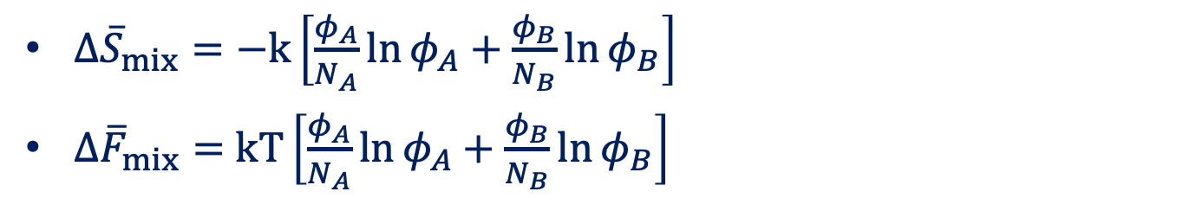
Entropy of Binary Mixing
$Δ{\overline{S}}_{mix}=−k\left[\frac{φ_{A}}{N_{A}}\ln{φ_{A}}+\frac{φ_{B}}{N_{B}}\ln{φ_{B}}\right]$
$Δ{\overline{F}}_{mix}=$ $kT\left[\frac{φ_{A}}{N_{A}}\ln{φ_{A}}+\frac{φ_{B}}{N_{B}}\ln{φ_{B}}\right]$

Slide 8

Energy of Binary Mixing
Flory interaction parameter:
$$χ≡\frac{z}{2kT}\left(2u_{AB}−u_{AA}−u_{BB}\right)$$
Free energy of mixing
$$Δ{\overline{F}}_{mix}=kT\left[\frac{φ}{N_{A}}\ln{φ}+\frac{1−φ}{N_{B}}\ln\left(1−φ\right)+χφ\left(1−φ\right)\right]$$

Slide 9
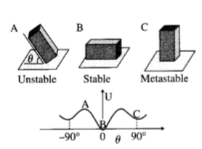
Stability
Unstable, stable, metastable

Slide 10
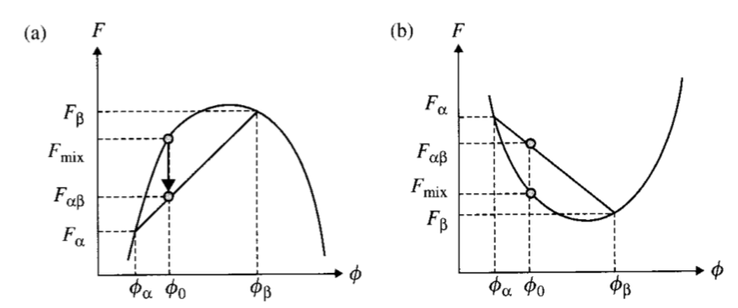
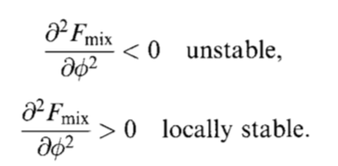
Stability

Slide 11
Ideal mixture
Ideal mixture are stable always
Entropy always acts to promote mixing
Principle of entropy increase

Slide 12
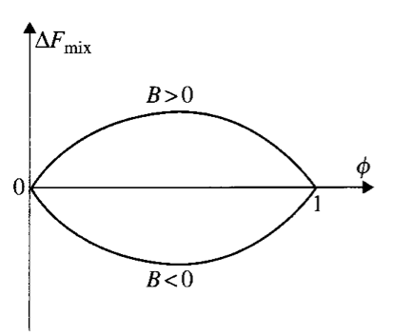
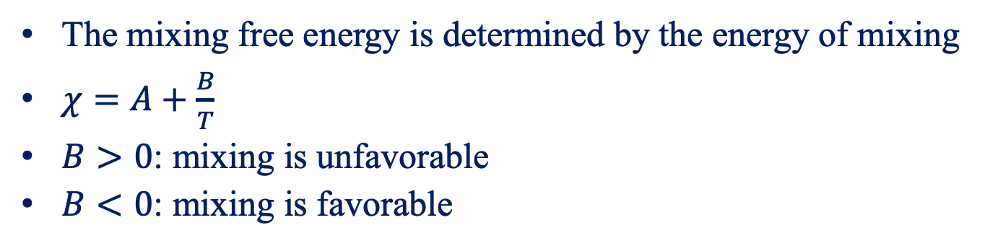
Mixing at T=0 K
The mixing free energy is determined by the energy of mixing
$χ=A+\frac{B}{T}$
$B>0$: mixing is unfavorable
$B<0$: mixing is favorable

Slide 13
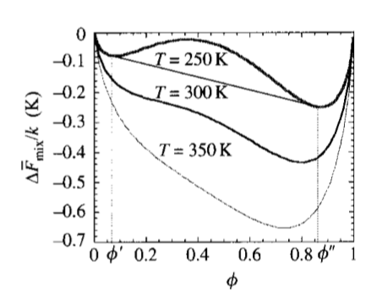
Real Mixture
Common tangent rule
Chemical potentials are balanced at equilibrium

Slide 14
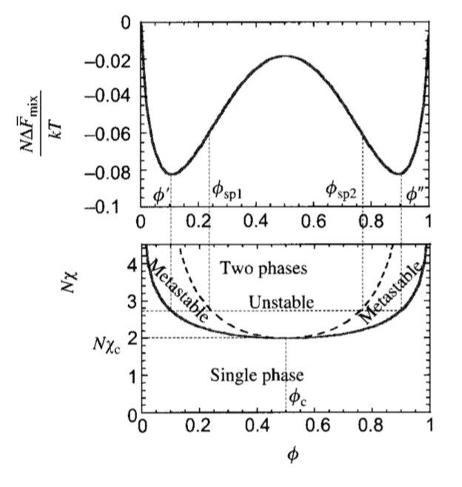
Phase diagram
Binodal
Spinodal
Critical point

Slide 15
Nucleation and Spinodal Decomposition
1111

Slide 16
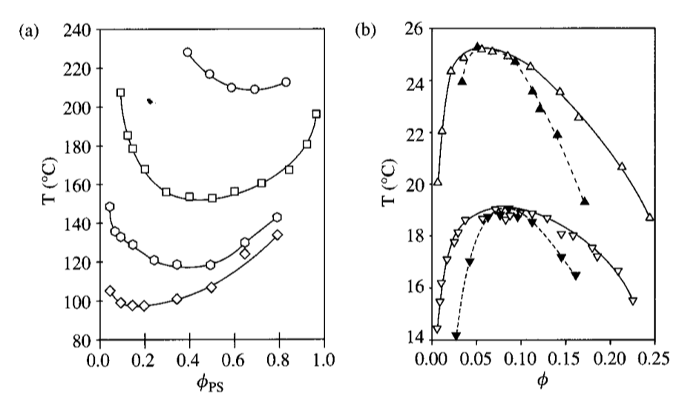
UCST and LCST

Slide 17
UCSP and LCSP

Slide 18
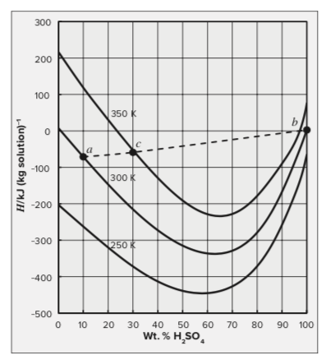
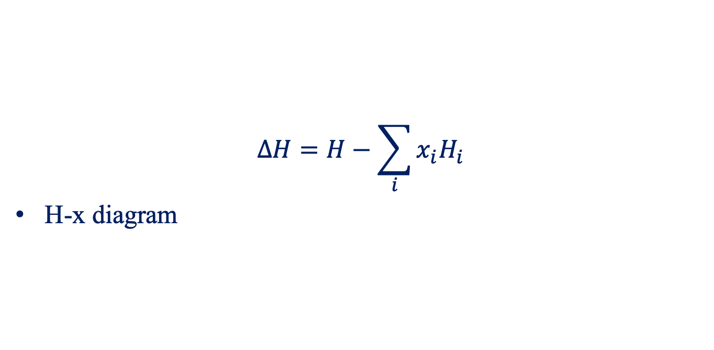
Heat of Mixing
$$ΔH=H−\sum_{i}{x_{i}H_{i}}$$
H-x diagram

