Slide 1
Language in use
1 Form new words with the following words
2 Answer the questions with the words you formed
3 Rewrite the sentences
4 Complete the sentences with suitable expressions
5 Translate the paragraph into Chinese
6 Translate the paragraph into English

Slide 2


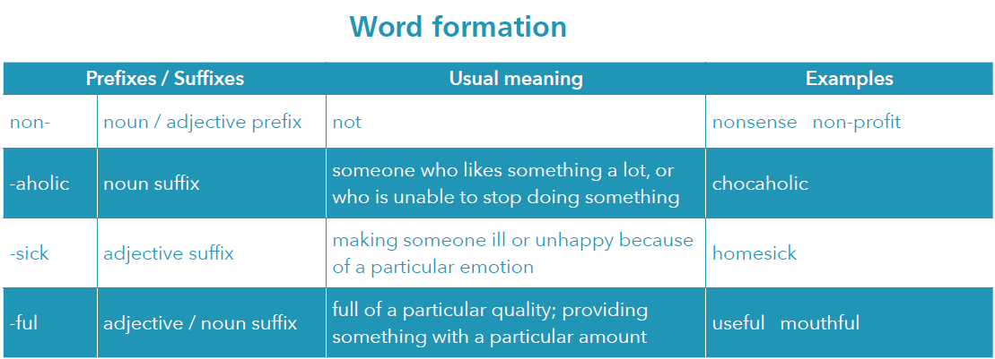

Language in use
1 Form new words with the following words and the prefixes / suffixes in the table.
air car fiction help sea shop smoker spoon stop work

Slide 3

Language in use
1 Form new words with the following words and the prefixes / suffixes in the table.
air shop
car smoker
fiction spoon
help stop
sea work
airsick
shopaholic
carsick
non-smoker
non-fiction
spoonful
helpful
non-stop
seasick
workaholic

Slide 4
Language in use
2
Answer the questions with the words you formed in Activity 1.
What’s the word for:
1 how you feel if the sea makes you ill?
2 someone who likes shopping a lot?
3 what something is if it is useful and providing help?
4 what a flight is if it goes directly from one place to another?
5 someone who doesn’t smoke?
6 writing which is about real people and events, not imaginary ones?
seasick
shopaholic
helpful
non-stop
non-smoker
non-fiction

Slide 5
Language in use
Leaving out words
In defining relative clauses, we can leave out which + present / past tense, and replace it with a present participle. We can leave out which + be in passive sentences and keep the past participle.
3 Look at the sentence.
It is also known that chocolate helps release hormones in the brain which are called endorphins.
You can rewrite it like this:
It is also known that chocolate helps release hormones in the brain called endorphins.

Slide 6
Language in use
Now rewrite the sentences.
1 ... and the waiter had already brought an enormous portion of seafood, crabs, prawns, lobsters and all sorts of shellfish which were clinging onto each other ...
… and the waiter had already brought an enormous portion of seafood, crabs, prawns, lobsters and all sorts of shellfish clinging onto each other …
2 On his plate was a pile of discarded lobster claws, and alongside was a battery of implements which were used to crack the shells ...
On his plate was a pile of discarded lobster claws, and alongside was a battery of implements used to crack the shells …

Slide 7
Language in use
3 The next development was learning how to get cocoa butter from the beans, a process which was first tried in 1825.
The next development was learning how to get cocoa butter from the beans, a process first tried in 1825.
4 Condensed milk is a thick, sweet milk which is sold in cans.
Condensed milk is a thick, sweet milk sold in cans.
5 Hormones are a chemical substance which is produced by your body.
Hormones are a chemical substance produced by your body.

Slide 8
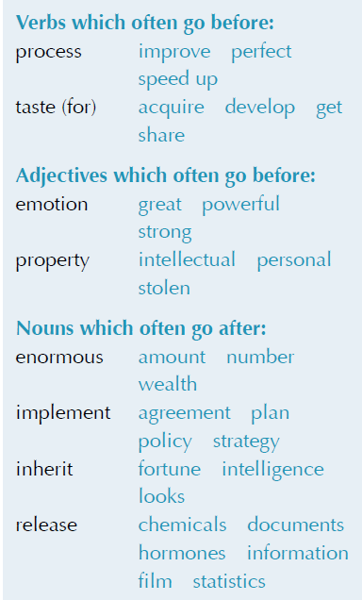
Language in use
Collocations
4 Complete the sentences with suitable expressions from the collocation box. Sometimes more than one collocation is possible.
1 Some chefs claim that their recipes are part of their _________ _______, and cannot be used in other chefs’ recipe books.
2 When I lived in Rome, I _____________ a(n) ________ ____ Italian food.
intellectual property
developed / got taste for

Slide 9
Language in use
released film
3 Hollywood has just _________ a(n) ______ about life in a typical French restaurant.
4 Chocolate isn’t just something to eat. It’s something which fills you with ____________ ________.
5 As a successful restaurant owner, he became very rich, and when he died he left his _________________ _______________ to his staff.
great / strong emotion
personal property / enormous wealth

Slide 10
Language in use
6 They agreed they needed something to attract customers, so they ___________ a(n) ___________ _______ of introducing new dishes every week.
7 She is just like her father; she ________ her father’s ________.
8 Cooking good food takes a lot of time. You can’t ______ ____ the ________.
implemented plan / policy / strategy
inherited looks
speed up process

Slide 11
Language in use
Translation
5 Translate the paragraph into Chinese.
Table manners are the rules of etiquette that should be observed by diners. In the UK, the host or hostess takes the first bite after all food is served and everyone is seated. Food should always be tasted before salt and pepper are added. It is acceptable to take some butter from the butter dish with a butter knife and put it onto a side plate. This prevents the butter in the dish from gathering bread crumbs as it is passed around. It is impolite to reach over someone to pick up food or other items. Diners should always ask for items to be passed along the table to them. Food should always be chewed with the mouth closed. It is rude to eat noisily. Talking with food in one’s mouth is also seen as very impolite. When someone has finished eating, they should place the knife and fork together on the plate and place the napkin unfolded on the table.

Slide 12
Language in use
餐桌礼仪是就餐者必须遵守的礼仪规范。在英国，要等到所有的饭菜端上桌、所有的就餐者都就座后，男主人或女主人才带头开始吃。应该在尝过饭菜之后再加盐和胡椒。可以用黄油刀从黄油盘中取一些黄油放在小寸盘中，这样可以防止黄油在盘子传递的过程中粘上面包屑。不要探起身子隔着人去拿食物或其他东西，这样做不礼貌。就餐者应请同桌的人把需要的物品递过来。嚼饭菜的时候一定要闭着嘴, 吃饭吧唧嘴不礼貌。而且，边吃东西边说话也是很不礼貌的行为。吃完后，应该把刀叉放在盘子上，把用过的餐巾展开放在餐桌上。

Slide 13
Language in use
6 Translate the paragraph into English.
中国药膳（Chinese medicated diet）源远流长，是中国宝贵的文化遗产，也是中医养生学的重要内容。药膳对预防疾病和强身健体有着显著的功效。比如，把冰糖和梨放在一起蒸是很好的药膳，可以起到润肺（moisten lung）、化痰（dissolve phlegm）、止咳（arrest cough）的作用。药膳不仅具有药物的疗效，还具有食物的美味。药膳是中国人日常饮食的重要组成部分，现在就连外国人也开始喜爱、接受中国药膳。

Slide 14
Language in use
Chinese medicated diets have a long history. They are part of the valuable cultural heritage of China and an important part of Chinese health study. Medicated diets have a notable effect on the prevention of diseases and improvement of physical fitness. For example, pear steamed with rock sugar is a medicated diet, good for moistening the lung, dissolving phlegm and arresting cough. Chinese medicated diets have not only the efficiency of medicine, but also the delicacy of food. They are an important part of Chinese people’s daily meals. Even people from other countries have come to love and consume Chinese medicated diets.

