Slide 1
Language in use
1 Replace the underlined words with compounds
2 Replace the underlined words with phrasal verbs
3 Rewrite the sentences using So + inversion + that
4 Complete the sentences with suitable expressions
5 Translate the paragraph into Chinese
6 Translate the paragraph into English

Slide 2



Language in use
Word formation:
down in compound words and phrasal verbs
Downsize is a compound made from down + size. It means “to make (an organization) smaller”.
Close down is a phrasal verb. It means “to close (a business) permanently”.
1 Look at the sentences from the passage The death of the newspaper.
… The New York Times Company has downsized hundreds of jobs …
The Baltimore Sun has closed down its foreign news bureaux.

Slide 3
Language in use
Now replace the underlined words with compounds made from down and the words in brackets.
1 I’m going to the centre of town tonight. (town)
downtown
2 I need to transfer this data onto my computer. (load)
download
3 I’m afraid they’re going to move me to a job which is less important. (grade)
downgrade

Slide 4

Language in use
4 The editor’s office is on the floor below this one. (stairs)
downstairs
5 Why have you bought such a cheap and popular tabloid? (market)
downmarket
6 There has been a sharp fall in demand in recent months. (turn)
downturn

Slide 5
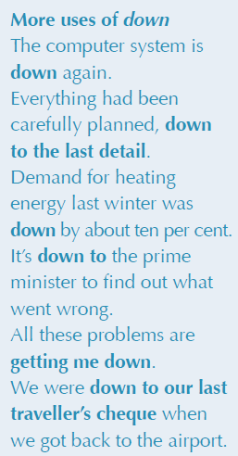
Language in use
2 Replace the underlined words with phrasal verbs made from the verbs in brackets and down.
1 House prices began to fall a few months ago. (go)
go down
2 I applied for a job with the local paper, but they didn’t offer it to me. (turn)
turned me down
3 You are expected to leave the position after three years as president. (stand)
stand down

Slide 6
Language in use
4 It’s time we all started to work. (get)
got down
5 For centuries these stories have been transmitted from one generation to the next. (hand)
handed down
6 The government lowered interest rates in order to tackle inflation. (bring)
brought down
7 She started crying when she heard the news. (break)
broke down

Slide 7
Language in use
So + inversion + that
When adjectives or adverbial phrases starting with so, the subject and the auxiliary verb are inverted. We often do this for emphasis and to express the extreme degree of what is being described.
3 Look at the sentence.
The news was so striking that years after the event, many people can still remember exactly what they were doing when they first heard it.
You can rewrite it like this:
So striking was the news that, years after the event, many people can still remember exactly what they were doing when they first heard it.

Slide 8
Language in use
Now rewrite the sentences using So + inversion + that.
1 The newsreader’s accent was so odd that I couldn’t understand what she was saying.
So odd was the newsreader’s accent that I couldn’t understand what she was saying.
2 The language on that programme was so incredibly bad that I switched off the TV.
So incredibly bad was the language on that programme that I switched off the TV.

Slide 9
Language in use
3 The story was so exaggerated that it had to be completely rewritten.
So exaggerated was the story that it had to be completely rewritten.
4 Frank’s reactions were so slow that he wasn’t able to avoid hitting the car in front.
So slow were Frank’s reactions that he wasn’t able to avoid hitting the car in front.

Slide 10
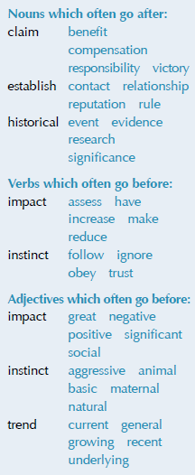
Language in use
Collocations
4 Complete the sentences with suitable expressions from the collocation box. Sometimes more than one collocation is possible.
1 There’s a(n) _____________________ _______ for older people to read their newspapers online.
2 Don’t ask me; ___________ your ______ and do what you think is right.
3 No organization has ______ ___________ for the bombing, so it must have been carried out by an individual terrorist.
general / growing / recent
trend
follow / obey instinct
claimed responsibility

Slide 11
Language in use
4 Our _____________ ________ when attacked is to defend ourselves, but the media doesn’t always allow us to do so.
5 John F. Kennedy ___________ a(n) _________ for courage and honesty among voters during his presidency.
6 When deciding if a story is important enough to publish, journalists have to ________ the _______ on their readers.
basic / natural instinct
established
reputation
assess impact

Slide 12
Language in use
7 The _______________ _______ of 9/11 was that most people remember what they were doing when they heard the news.
8 ________ _________________ over the past 200 years suggests that traditional print media has always had a significant role to play in forming people’s opinions.
great / significant impact
Historical evidence / research

Slide 13
Language in use
Translation
5 Translate the paragraph into Chinese.
Social networking sites are an important part of life in the US. About two-thirds of American adults online use social media platforms such as Facebook, Twitter, MySpace or LinkedIn. Connecting with family members and friends is a primary consideration in their adoption of social media tools. Some media users go to these sites in order to stay in touch with current friends and family members, while others try to connect with old friends they’ve lost touch with. Sharing hobbies or interests, making new friends, reading comments by public figures and finding potential romantic partners are also among the reasons for using social networking sites. Social networking sites can also serve as information networks where people share information with other users. Instead of searching through a news source such as the website of The New York Times or ESPN that caters to all people, a person can check their Twitter account and find out about their favourite team’s scores and news.

Slide 14
Language in use
社交网站是美国人生活的重要组成部分。有大约三分之二的美国成年网民使用像脸书、推特、我的空间或领英这样的社交媒体平台。与家人和朋友联系是他们使用社交媒体工具的首要因素。一些社交媒体用户到这些网站上去是为了与现在的朋友和家人保持联系，有的人则是为了联系已失去联系的故友。分享共同的兴趣爱好、结交新朋友、阅读公众人物的评论、寻找潜在的浪漫情缘也是人们使用社交网站的原因。社交网站也可以用作信息网站，人们可以在社交网站上与网友分享信息。要想了解自己喜爱的球队的比赛得分和消息，人们可以登录他们的推特账户去查看，而不用搜索面向大众群体的信息网，如《纽约时报》的官网或娱乐与体育节目电视网。

Slide 15
Language in use
6 Translate the paragraph into English.
最近的调查显示，中国手机网民的数量超过电脑网民，网民的手机上网率高达85.8％。手机已成为继电视、广播、报纸、杂志之后的第五大媒体。中国人通过手机上网，享受微博、微信、播客（podcast）等新媒体所带来的便利与好处。新媒体生动、实时、互动的特点吸引了大批的年轻人。微信朋友圈让人们能够经常与朋友互动交流，而播客则满足了人们表达自我、张扬个性的需要。

Slide 16
Language in use
A recent survey indicated that the number of people accessing the Internet by mobile phone has overtaken the number of Internet users on computers. Online access on mobile phones has risen to 85.8%. The mobile phone has become the fifth mass medium after the traditional four media: television, radio, newspapers and magazines. With online access by mobile phone, Chinese people are enjoying the convenience and benefits of all kinds of new media like MicroBlog, WeChat and podcasts. The vividness, real-timeness and interactivity of such media have attracted many young people. While WeChat’s circle of friends enables people to communicate and interact frequently with friends, podcasts meet people’s need for self-expression and displaying individuality.

