Slide 1
Language in use
1 Rewrite the sentences using inversion
2 Rewrite the sentences using imperative + …
3 Complete the sentences with suitable binomials
4 Complete the sentences with suitable expressions
5 Translate the paragraph into Chinese
6 Translate the paragraph into English

Slide 2



Language in use
Inversion
When we use an adverbial expression of place or direction at the beginning of a clause, and the verb is intransitive, we can put the verb before the subject. This is called “inversion”.
High up in the topmost bough of one of the apple trees rested the boy, reading his favourite book.
The structure is common in literary and descriptive writing. In speech it’s common with here and there.
Note: We can’t use an inversion with adverbial expressions of time.

Slide 3
Language in use
1 Look at the sentence.
A city of spires is in the distance, silent except on days when the bells peal.
You can rewrite it like this:
In the distance is a city of spires, silent except on days
when the bells peal.
Now rewrite the sentences using inversion.

Slide 4

Language in use
1 The sound of children playing came from around the house.
From around the house came the sound of children playing.
2 More houses stood on top of the hill.
On top of the hill stood more houses.
3 Horseless carriages passed in front of the house.
In front of the house passed horseless carriages.
4 Two middle-aged women lived here.
Here lived two middle-aged women.
5 A lorry stops at the front of the house.
At the front of the house stops a lorry.
6 A large crane comes round the bend.
Round the bend comes a large crane.

Slide 5
Language in use
Imperative + and + simple sentence
2 Look at the sentence.
If you ask any frequent flyer in their forties or fifties …
they’ll probably sigh …
You can rewrite it like this:
Ask any frequent flyer in their forties or fifties … and
they’ll probably sigh …
Now rewrite the sentences using imperative + and +
simple sentence.

Slide 6
Language in use
1 If you contact your parents too often when you get to university, you’re more likely to miss home.
Contact your parents too often when you go to university and you’re more likely to miss home.
2 If you say you’re homesick, people might think you’re immature.
Say you’re homesick and people might think you’re immature.

Slide 7
Language in use
3 If you travel a great deal, you’re likely to become homesick.
Travel a great deal and you’re likely to become homesick.
4 If you offer them the choice between a comfortable hotel room and a walk in the park with their children, they’ll choose the walk in the park.
Offer them the choice between a comfortable hotel room and a walk in the park with their children and they’ll choose the walk in the park.
5 If you acknowledge you’re homesick, it’s possible to avoid anxiety and depression.
Acknowledge you’re homesick and it’s possible to avoid anxiety and depression.

Slide 8
Language in use
Binomials
Binomials are expressions where two words are joined by a conjunction (usually and). The order of the two words is usually fixed. Often the two words mean more or less the same, but they can also be opposite in meaning.
… which gave each and every one of us our first experience of homesickness.
Here are some more binomials with and:
black and white
The film was in black and white, not in colour.
here and there The park is mostly grass, but here and there are some trees.

Slide 9
Language in use
out and about
She’s recovered from her illness, and she’s now out and about.
prim and proper
She was dressed in a neat suit with a hat and gloves and
behaved extremely politely – very prim and proper.
pick and choose
You have a wide choice, you can pick and choose. peace and quiet
Before the traffic grew, it was peace and quiet in the garden. up and down I was looking for you up and down the street.

Slide 10
Language in use
Here are some binomials linked by words other than and.
back to front
You’re wearing your sweater back to front.
sooner or later
Sooner or later, we’ll have to find a bigger house.
all or nothing
She didn’t want to be just friends. It was all or nothing.
take it or leave it
It’s all I can offer you. Take it or leave it.

Slide 11
Language in use
black and white
here and there
out and about
prim and proper
pick and choose
peace and quiet
up and down
back to front
sooner or later
all or nothing
take it or leave it
3 Complete the sentences with suitable binomials.
1 There are lots of good things to eat. You can_______________.
2 His secretary looked very ____________ and the whole meeting was very formal.
3 When I write a story, I write the ending first, and then work backwards. I write _____________.
pick and choose
prim and proper
back to front

Slide 12
Language in use
black and white
here and there
out and about
prim and proper
pick and choose
peace and quiet
up and down
back to front
sooner or later
all or nothing
take it or leave it
4 When I go on holiday, I don’t want to do much. I just need some ____________.
5 Don’t worry, we’ll find your wallet _____________.
6 This is the best I can do for this activity. ________________.
peace and quiet
sooner or later
Take it or leave it

Slide 13
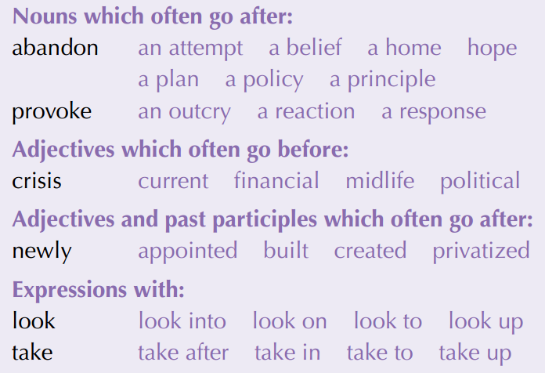
Language in use
Collocations
4 Complete the sentences with suitable expressions from the collocation box. Sometimes more than one collocation is possible.
1 The results led him to ________ his _______ that the climate was not changing.
abandon
belief
newly built
2 A __________ house is one which is no more than a year old.
3 It has taken several years for the economy to recover from the ______________ of 2008.
financial crisis

Slide 14
Language in use
provoke
4 Sometimes he exaggerates the risks in order to _______ a(n) _______ from his team of experts.
5 The minister has set up a working party to _________ the problem of homelessness.
6 If you have a spare room, you could ________ a student and make a little extra money.
outcry
look into
take in

Slide 15
Language in use
Translation
5 Translate the paragraph into Chinese.
Over recent decades in Europe, the family is one of the domains where the greatest changes have taken place. The traditional European nuclear family consisted of a married father and mother with several children, but today this is only one option among many. Declining marriage rates, an increased number of divorces, the wide acceptance of co-habitation, the legalization of same-sex marriage and dropping fertility rates have caused the size of the average household within the European Union to drop to 2.4 people. Yet family remains of the utmost importance to people. Eighty-four percent of Europeans say that family is very important, almost twice as many as those who find friends very important. Perhaps the most significant changes relate to childbearing, since these result in important demographic changes over time. Throughout Europe, having children is no longer considered a duty towards society, but rather just one of life’s options. The choice to stay childless is well accepted in many countries. The driving force behind these changes appears to be individualization. Values oriented towards autonomy, privacy, self-actualization and personal happiness have become more important, and have ousted values that point at collective goals.

Slide 16
Language in use
在欧洲，家庭是近几十年来发生变化最大的领域之一。传统的欧洲核心家庭由一对已婚父母和几个孩子构成，但现在这种家庭只是诸多选择中的一个。日益下降的结婚率、离婚人数的增加、人们对同居的普遍接受、同性婚姻的合法化、日渐下降的生育率让欧盟家庭的平均人口数下降到了2.4人。家庭对人们来说依然是至关重要的。84%的欧洲人认为家庭非常重要，这个数字是那些认为朋友很重要的人数的两倍。也许影响最为重大的一些变化和生育有关，因为随着时间的推移这些变化会引发人口结构上的重要改变。在整个欧洲，人们不再把生育子女看作是对社会的责任，而是把它视为诸多生活选项中的一个。在很多国家，丁克的做法被广泛接受。这些改变背后的推动力似乎是个体化。追求独立自主、隐私、自我实现和个人幸福的价值观已经变得越来越重要，这让那些注重集体目标的价值观失去了容身之所。

Slide 17
Language in use
6 Translate the paragraph into English.
目前，中国老年人口居世界第一，已经进入老龄化社会。而中国现在正处于社会转型期，建立一个完整的社会福利体系仍需很长的一段时间，因此中国的养老问题较为特殊。预计在今后半个世纪，家庭养老仍然是中国主流的养老模式。孝敬父母（filial piety）一直是中国传统伦理道德（ethics）的重要组成部分。在当今这样一个老龄化的社会中，弘扬孝道就显得更加重要，因为在鼓励人们对家里的老人提供日常照顾和情感慰藉方面，孝道仍将起关键性的作用。

Slide 18
Language in use
China, with the largest population of elderly people in the world, has become an ageing society. Meanwhile, China is also a country undergoing social transition. It will be a long time before a sound social welfare system can be established, which means that China is in a unique situation when it comes to care of its ageing population. It is predicted that in the next 50 years, family care for the aged will still be the dominant practice in China. Filial piety has always been a significant part of traditional Chinese ethics. In today’s ageing society, it will be all the more important to promote the virtue of filial piety, as it will continue to play a crucial role in encouraging people to take good care of their elderly family members by providing daily care and emotional support.

