Slide 1
Language in use
1 Complete the sentences with the words in brackets
2 Rewrite the sentences using the expressions in brackets
3 Rewrite the sentences using what must it be …
4 Complete the sentences with suitable expressions
5 Translate the paragraph into Chinese
6 Translate the paragraph into English

Slide 2



Language in use
Word formation: up- and under-
Up- and under- are common prefixes. We can find them before nouns, verbs and adverbs.
1 Look at the sentences from the passage The story of Anne Frank’s diary.
But she upheld her hope ...
... Anne Frank celebrated ... including some underwear ...
1 I had to swim __________ for a long way to get out of their sight. (water)
Now complete the sentences with the words in brackets and the appropriate prefix up- or under-.
underwater

Slide 3

Language in use
2 What’s happened since I’ve been away? Can you ________ me? (date)
3 The first rule in any combat is: Never ____________ your enemy. (estimate)
4 My men spent most of the morning carrying heavy equipment ________. (hill)
5 As he didn’t have his bathing costume with him, the child went swimming in his __________. (pants)
6 This computer isn’t very powerful. I need an ________. (grade)
7 You should stand ________ to salute the general. (right)
8 In London the subway is known as the ___________. (ground)
update
underestimate
uphill
underpants
upgrade
upright
Underground

Slide 4
Language in use
The time / day will come when + will
A time clause in the future is usually followed by a present or present perfect tense:
Our hostess will greet you when you arrive in Beijing.
I’ll get in touch with you as soon as I have finished writing the report.
However, we can sometimes use will in the time clause, especially when we are talking about a distant or unlikely future, after expressions such as the time will come.
2 Look at the sentence from the passage The story of Anne Frank’s diary.
Perhaps the day will come when her diary will stop wars breaking out in the first place.

Slide 5
Language in use
Now rewrite the sentences using the expressions in brackets.
1 One day he will be able to speak fluent English. (the day will come)
The day will come when he will be able to speak fluent English.
2 You’ll both have to get a job one day. (the time will come)
The time will come when you’ll both have to get a job.
3 One day you will have a chance to write about the experience. (there will come a day)
There will come a day when you will have a chance to write about the experience.
4 Perhaps one day I will understand. (the day will come)
Perhaps the day will come when I will understand.

Slide 6
Language in use
what must it be / have been like
3 Look at the sentence.
She and the others wondered what must have happened to the Jews who had been caught.
You can rewrite it like this:
She and the others couldn’t imagine what it must have been like for the Jews who had been caught.
Now rewrite the sentences using what must it be / have been like.

Slide 7
Language in use
1 It’s very cold here. I wonder how cold it is in Scotland.
It’s very cold here. I wonder what it must be like in Scotland.
2 Houses are expensive in this part of the country. I wonder how expensive they are in Paris.
Houses are expensive in this part of the country. I wonder
what they must be like in Paris.
3 There was little food to go around in peacetime. I wonder how little food there was during wartime.
There was little food to go around in peacetime. I wonder what it must have been like during wartime.
4 Life is hard now. I wonder how hard it was during the Middle Ages.
Life is hard now. I wonder what it must have been like during the Middle Ages.

Slide 8
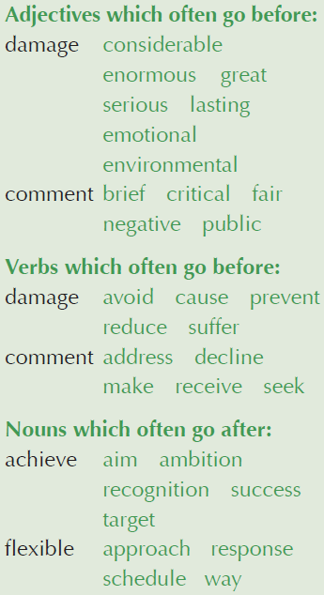
Language in use
Collocations
4 Complete the sentences with suitable expressions from the collocation box. Sometimes more than one collocation is possible.
1 In future wars, we could ________ ________ to buildings and the death of millions of people if nuclear weapons were abandoned.
2 We’re aiming to ________ the __________ of 10 per cent reduction in casualties in the next year.
avoid damage
achieve aim / target

Slide 9
Language in use
3 ____________________________ ________ was caused by the Nazis as they invaded Europe.
4 I wonder if you would make a(n) _____ ________ about the situation in Syria?
5 In particular circumstances, a more ______ ________ is better than following general guidelines.
6 Would you be able to ________ the ________ that the Prime Minister made about the Middle East talks?
Considerable / Enormous / Great damage
brief comment
flexible approach
address comment

Slide 10
Language in use
Translation
5 Translate the paragraph into Chinese.
The Nobel Peace Prize is one of the five Nobel Prizes created by the Swedish industrialist, inventor, and armaments manufacturer Alfred Nobel, along with the prizes in Chemistry, Physics, Physiology or Medicine, and Literature. Since 1901, it has been awarded annually (with some exceptions) to those who have “done the most or the best work for fraternity between nations, for the abolition or reduction of standing armies and for the holding and promotion of peace congresses”. The prize has been awarded to individuals like Martin Luther King, Jr., as well as institutions like the International Committee of the Red Cross. The Chairman of the Norwegian Nobel Committee presents the Nobel Peace Prize in the presence of the King of Norway on 10 December each year (the anniversary of Nobel’s death).

Slide 11
Language in use
诺贝尔和平奖是瑞典实业家、发明家、军火制造商阿尔弗雷德· 诺贝尔设立的五个诺贝尔奖项之一，其他奖项包括诺贝尔化学奖、物理学奖、生理学或医学奖和文学奖。自1901 年以来，诺贝尔和平奖每年（特例除外）都颁发给那些“为促进民族团结友好、取消或裁减常备军队以及为和平会议的组织和宣传尽到最大努力或作出最大贡献的人”。诺贝尔和平奖既颁发给像马丁· 路德· 金这样的个人，也颁发给像国际红十字委员会这样的机构。每年12 月10 日（即诺贝尔的忌日），挪威诺贝尔奖委员会的主席在挪威国王的见证下颁发诺贝尔和平奖。

Slide 12
Language in use
6 Translate the paragraph into English.
“和”的观念在中国文化中占有重要位置。儒家思想主张“和为贵”，认为人们可以通过完善道德修养把事情处理得恰到好处，营造和谐的社会关系。不仅儒家，佛、道、墨诸家，也大都主张人与人之间、族群与族群之间的“和”。中国人为人处事向来以和为贵，他们知道和睦的人际关系与和谐的社会环境对于人的生存和发展至关重要。在构建和谐社会的今天，“和”的思想显得更为重要。

Slide 13
Language in use
“Harmony” is one of the most cherished values in Chinese culture. Confucianism advocates the idea that “Harmony is most precious”, believing that with their ethical attainments people can handle affairs properly and create harmonious social relationships. Buddhism, Taoism and Mohism, as well as Confucianism, all advocate a harmonious relationship between people and between ethnic groups. Chinese people have always given priority to a harmonious relation in dealing with people in everyday life, as they know that a harmonious human relationship and society is of vital importance to human survival and development. Today when we’re constructing a harmonious society, the idea of harmony has become even more important.

