Slide 1
The Milesians

Slide 2
Sources for the Presocratics
We don’t have complete writings for most of the Presocratics. Instead we only have quotations other writers made of their works (i.e. fragments).
Thales didn’t write anything that we know of, Anaximander wrote one book-- only a sentence survives; Anaximenes wrote one book.

Slide 3

Thales
Aristotle tells us that the natural philosophers looking for a fundamental stuff/principle (an arche)

Slide 4
Thales
For Thales this first principle was water—which means either that everything is fundamentally water, and/or that everything comes from water.

Slide 5

Amaximander (610-546 BCE)
The first principle for Anaximander is not a traditional element (the Aristotelian elements are: Earth, Water, Air, and Fire) but instead is “the boundless” or apeiron.

Slide 6
Amaximander (610-546 BCE)
It “gives birth” to the hot and the cold. From these contraries (the hot and the cold) arise elements and the natural world:
(Earth) Dense Mist )Stars )Moon )Sun
Earth Mist Flame

Slide 7
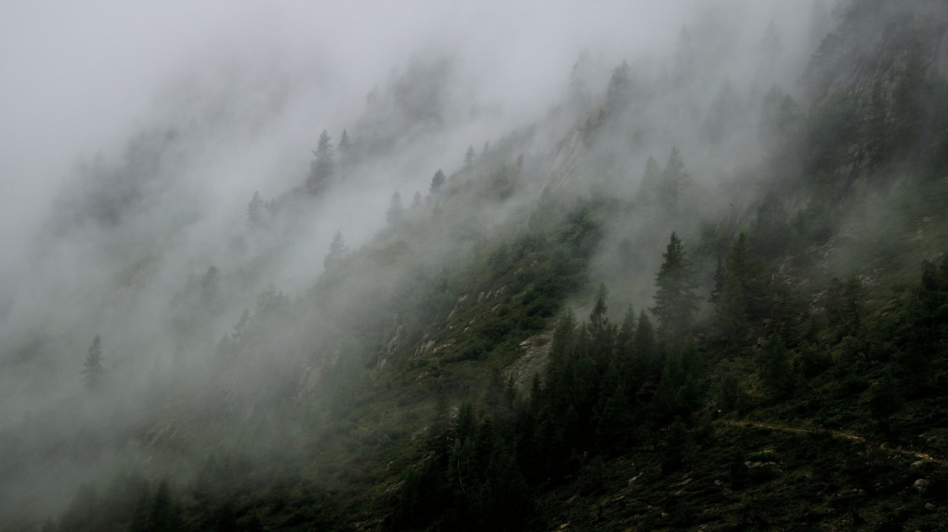
Anaximenes (d. c.528 BCE)
Underlying nature is one, but not something as mystical as Anaximander’s “boundless.” Not indeterminate, it is aer. (Not ordinary air like we think of, but rather a “dense mist.”)

Slide 8

Anaximenes’ Cosmos
For the first time, we get an account of how ordinary objects are made out of the fundamental stuff: rarefaction and condensation (of the aer).
stones earth water cloud wind fire
<most condensed----------------------- most rarefied>
Is this a good scientific theory? Well, we don’t exactly accept this. But the important point here is that Anaximenes has a theory.

Slide 9
Next Topic: Parmenides (Russell Chapter V)

