Slide 1
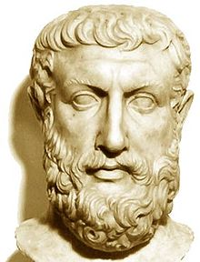
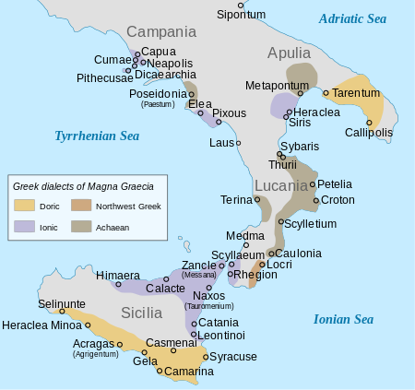
Parmenides of Elea (b. 515 BCE)

Slide 2
On Nature
The Poem of Parmenides (On Nature) is traditionally divided into three sections:
-The Proem (B1)
-Truth (B2-B8.49)
-Mortal Opinions (B8.50-B19)

Slide 3
The Proem (B1)
The proem tells the story of a young traveler who proceeds along a road (possibly the path of Truth itself) to the house of the (unnamed) goddess.
The route is “far from the beaten path of humans.” The goddess welcomes the traveler and says that the traveler will learn all things: both Truth itself, as well as how things appear (i.e. mortal opinions.)

Slide 4
Truth(B2)
The goddess proceeds in B2 to identify two possible “routes for thinking.”

Slide 5
Truth(B2)
The First is:
‘___ is’
That is, what exists. We’ll call what exists Being.

Slide 6
Truth(B2)
The other possible route for thinking turns out not to be possible after all: “it is not” or generally
‘__ is not’
Thinking about non-being is not merely incorrect; it is not even a possible way to think, according to Parmenides.
It is a “path entirely unable to be investigated” (B2.6)..

Slide 7
Being
For Parmenides, because we cannot say of anything that
“____ is not”
No sentence of that form is even really thinkable. This fact has certain (strange!) consequences, described in B8.

Slide 8
Being is:
-ungenerated (i.e. it didn’t come from anywhere)
-imperishable (it isn’t going anywhere)
-whole
-of a single kind
-complete
-has no past or future (i.e. time doesn’t exist)
-doesn’t have any parts (B8.22)
-not divisible (B8.22)
-unchanging (B8.26)
-is the same thing as thinking about being (B3)

Slide 9
Time, Change, and Difference
Being is all that there is. (Since it is the only thing we can think about.) Now this means, that there is no change at all; and there can be no such thing as difference, either. Why not? Because if I want to describe a change, I’ll have to say something like:
(1) “Before, it was not _____, now it is _____.”
(2) “Before, it was not here.”
or even
(3) “Before, it was not now.”
(4) “In the future, it will not be now.”

Slide 10
Time and Motion
(3) and (4) are just trying to tell us that there is such a thing as time passing (which seems pretty obvious to us). But is it possible to say what things are not? Not according to Parmenides. So … there’s no such thing as time passing, and there is (therefore) no change.
And, there’s no motion. To describe a motion, you’d first need time (which we’ve already ruled out), and also you’d have to say about a thing that it is not (wherever it is supposedly moving to.)

Slide 11
Monism
This means that, if you can’t have difference, and you can’t have change, that there can be only one thing. (Because if you had two things, you would have different things.)
So, for Parmenides, there is only one thing. Namely, Being.

Slide 12
Parmenides’ Arguments
While Parmenides’ view (Monism) looks quite strange, he gives arguments for it.
An argument is an arrangement of statements such that some of the statements (the premises) support a conclusion.

