Slide 1




Parmenides’ Arguments
While Parmenides’ view (Monism) looks quite strange, he gives arguments for it.
An argument is an arrangement of statements such that some of the statements (the premises) support a conclusion.

Slide 2
An Example Argument
If it is raining, the road will be wet.
It is raining.
The road will be wet.
Here the statements above the line are the premises, and the support the conclusion that “The road will be wet.” Notice that in this case, that, if those premises are true, the conclusion has to be true.

Slide 3
Parmenides’ Main Argument Against the Generation of Being
If being was generated (i.e. came from somewhere) then non-being exists.
Non-being is impossible.
Being wasn’t generated.

Slide 4

ex nihilio nihil fit (from nothing, nothing comes)
If there were non-being, only non-being could have come from it.
There is being.
So there wasn’t non-being.

Slide 5
Reductio ad absurdum
This argument looks like a instance of a reductio ad absurdum (reduction to absurdity):
Assume P
From P follows a contradiction or impossible consequence
P must be false.

Slide 6
Zeno of Elea (born c.490 BCE)
Zeno was a follower of Parmenides who gave argument which supposedly demonstrated that motion is in fact impossible. Zeno’s arguments (sometimes called Zeno’s paradoxes) will be instances of reductio ad absurdum arguments in the following way:
Assume that there is motion.
If there is motion, absurd consequences follow.
There isn’t motion.

Slide 7
The Dichotomy
1. Assume that object a is moving towards endpoint p.
2. First, object a must travel half the distance to p.
3. Then, object a must travel half the remaining distance to p. ....
n. Then object a must travel half the remaining distance to p.
p. But, 2 through n is infinite.
q. So object a must complete an infinite list of tasks in a finite time.
r. But q is impossible.
Motion is impossible

Slide 8
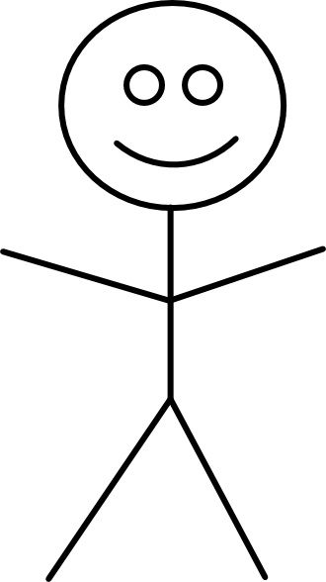
100m

Slide 9
50m
100m

Slide 10
50m
75m
100m

Slide 11
50m
75m
100m
87.5m

Slide 12
50m
75m
100m
87.5m
93.75

Slide 13
50m
75m
100m
87.5m
93.75
96.875

Slide 14
50m
75m
100m
87.5m
93.75
96.875
98.4375

Slide 15
and so on ...
50m
75m
100m
87.5m
93.75
96.875
98.4375
99.21875

Slide 16
Mohist “School of Names” Version of the Paradox
“The “School of Names” is the traditional Chinese label for a diverse group of Warring States (479–221 BCE) thinkers who shared an interest in language, disputation, and metaphysics.” (Fraser 2017)
They had their own version of this paradox (although it is not explicitly about motion).

Slide 17
Mohist “School of Names” Version of the Paradox
Take a one foot stick. Then every day, remove half of what remains.
There will always be something left.

Slide 18
So Motion Is Impossible?
One reply to Zeno’s argument is Diogenes’ refutation: silently walking. Which supposedly demonstrates that motion is possible.
This won’t satisfy a Parmenidean however, as they admit that things aren’t like they appear to be. Instead we need a refutation that uses reason to demonstrate that something is wrong with the argument.

Slide 19
Reflection Question
Conider either Zeno’s paradox or the Mohist “School of Names” Paradox.
What is the solution to the paradox you’ve chosen (if one exists!)?

