Slide 1
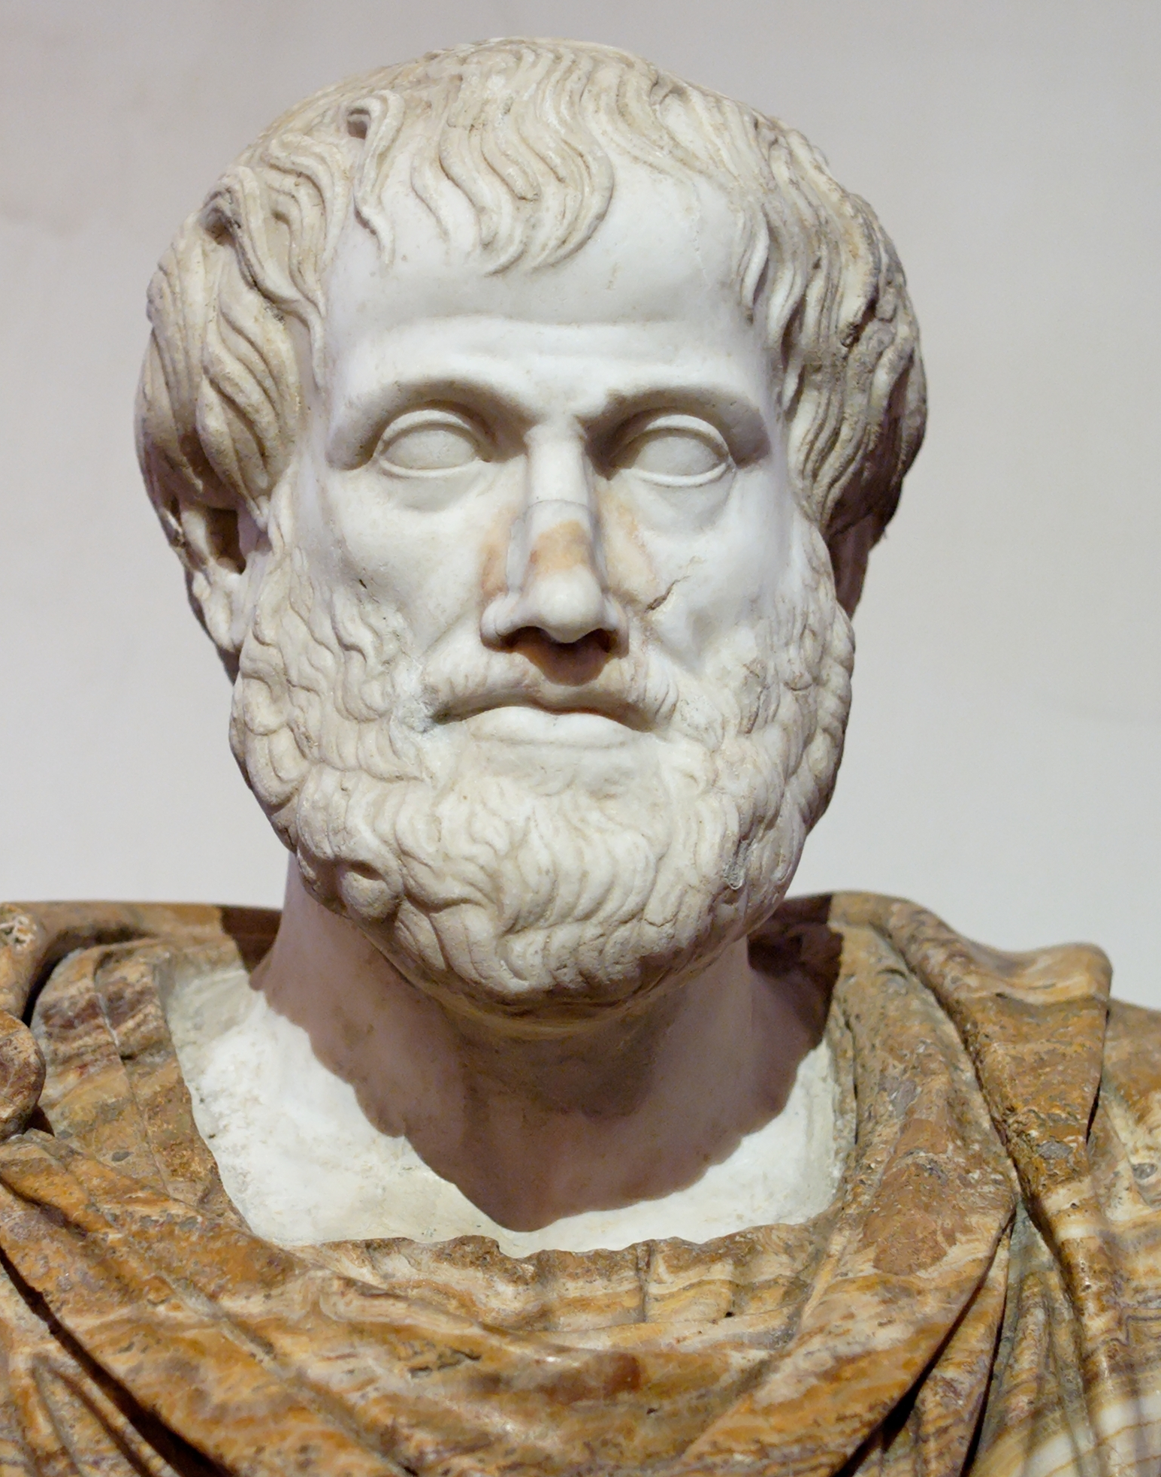
Aristotle’s (384-322 BCE Solution to the Paradoxes of Zeno

Slide 2
Zeno of Elea (born c.490 BCE)
Zeno was a follower of Parmenides who gave argument which supposedly demonstrated that motion is in fact impossible. Zeno’s arguments (sometimes called Zeno’s paradoxes) will be instances of reductio ad absurdum arguments in the following way:
Assume that there is motion.
If there is motion, absurd consequences follow.
There isn’t motion.

Slide 3
1. Assume that object a is moving towards endpoint p.
2. First, object a must travel half the distance to p.
3. Then, object a must travel half the remaining distance to p. ....
n. Then object a must travel half the remaining distance to p.
p. But, 2 through n is infinite.
q. So object a must complete an infinite list of tasks in a finite time.
r. But q is impossible.
Motion is impossible

Slide 4
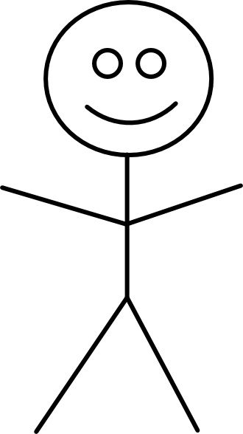
100m

Slide 5
50m
100m

Slide 6
50m
75m
100m

Slide 7
50m
75m
100m
87.5m

Slide 8
50m
75m
100m
87.5m
93.75

Slide 9
50m
75m
100m
87.5m
93.75
96.875

Slide 10
50m
75m
100m
87.5m
93.75
96.875
98.4375

Slide 11
and so on ...
50m
75m
100m
87.5m
93.75
96.875
98.4375
99.21875

Slide 12
Mohist “School of Names” Version of the Paradox
“The “School of Names” (ming jia) is the traditional Chinese label for a diverse group of Warring States (479–221 BCE) thinkers who shared an interest in language, disputation, and metaphysics.” (Fraser 2017)
They had their own version of this paradox (although it is not explicitly about motion).

Slide 13
Mohist “School of Names” Version of the Paradox
Take a one foot stick. Then every day, remove half of what remains.
There will always be something left.

Slide 14
So Motion Is Impossible?
One reply to Zeno’s argument is Diogenes’ refutation: silently walking. Which supposedly demonstrates that motion is possible.
This won’t satisfy a Parmenidean however, as they admit that things aren’t like they appear to be. Instead we need a refutation that uses reason to demonstrate that something is wrong with the argument.

Slide 15
Aristotle’s solution- two kinds of infinite
Aristotle’s solution:
two kinds of “infinite”
infinite in extent (i.e. without limit). The natural numbers are like this (although an infinite series of numbers is different than talking about infinite space of time).
infinitely divisible. That is, continuous. (Instead of being “discrete”). Zeno’s argument works because it looks like he is claiming space is infinitely divisible (i.e. continuous.) Aristotle says that we should apply this to time as well-- you aren’t doing a infinite series of tasks in a finite time; you are doing them in an infinite (in this second sense) time.

Slide 16
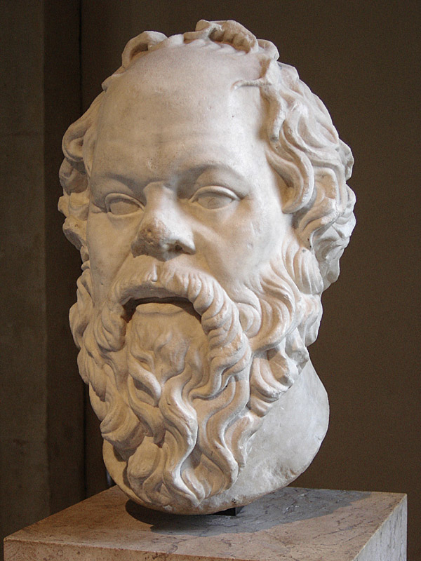
Socrates (469-399 BCE)
by Sting, CC BY-SA 2.5

Slide 17
Socrates
Our scene now shifts to Athens, where we find Socrates (469-399 BCE). Socrates didn't write anything, but we know of his philosophical work through his students, especially Plato.

Slide 18
The Method of Socrates
Socrates method for discovering the truth was to investigate through questioning. If someone claimed to know something, Socrates wanted to figure out what it was that the person supposedly knew, so he asked them questions about it.

Slide 19
aporia
These Socratic dialogues such as the Euthyphro (the early dialogues of Plato) usually end in aporia (puzzlement) for example, the question of what piety actually is is not really resolved in the Euthyphro.

Slide 20
Plato’s (429-347 BCE) Writings
Early (examples- Apology, Euthyphro, Crito) These are the "Socratic dialogues" discussed above.
Middle (examples- Meno, Republic) Here, Plato goes beyond Socratic discussion and develops positive ideas of his own.
Late (example- the Laws) These are technical (and often difficult) expansions, development, and clarification of Plato's ideas.

Slide 21
The Euthyphro
In the Euthyphro dialogue, Socrates meets Euthyphro outside the magistrate’s. Socrates is there because he is about to be put on trial.
Euthyphro is at the magistrate’s because he prosecuting his own father for murder.

Slide 22
piety
Socrates is surprised that Euthyphro would prosecute his own father, and Euthyphro claims that this shows how little people know about piety, which is the subject of the dialogue. Piety is something like “reverence for the gods,” etc.
Socrates says—okay great, you know all about piety, and if you can tell me what it is, this will help me at my trial, as I can say Euthyphro has taught me all about piety now.

Slide 23
Euthyphro’s first attempt
Euthyprho first attempts to define piety by saying that it is “doing as he is doing”-- in this case, prosecuting his father for murder.
But Socrates wants not a list of pious actions, but instead:
“the general idea which makes all pious things to be pious. Do you not recollect that there was one idea which made the impious impious, and the pious pious?”

Slide 24
Second attempt
“Piety, then, is that which is dear to the gods, and impiety is that which is not dear to them”
So, according to this definition, if the gods love something, it is pious. If they don’t love it, it is impious.

Slide 25
Socrates replies
The gods don’t all love the same things. While many things can be sorted out by some standard or measurement, when it comes to:
“the just and unjust, good and evil, honourable and dishonourable[, a]re not these the points about which [people] differ, and about which when we are unable satisfactorily to decide our differences, you and I and all of us quarrel, when we do quarrel?”

Slide 26
So this definition doesn’t work
Soc. Then the same things are hated by the gods and loved by the gods, and are both hateful and dear to them? Euth. True. Soc. And upon this view the same things, Euthyphro, will be pious and also impious? Euth. So I should suppose. Soc. Then, my friend, I remark with surprise that you have not answered the question which I asked. For I certainly did not ask you to tell me what action is both pious and impious: but now it would seem that what is loved by the gods is also hated by them.

Slide 27
Third attempt
Euthyphro says, okay, fine:
The pious is what is loved by all the gods.
Socrates replies by asking whether things are pious because the gods love them, or whether the gods love something because it is pious.

Slide 28
The “Euthyphro Dilemma”
Soc. Thus you appear to me, Euthyphro, when I ask you what is the essence of piety, to offer an attribute only, and not the essence-the attribute of being loved by all the gods. But you still refuse to explain to me the nature of piety.

Slide 29
The end of the dialogue- aporia
Soc. Then we must begin again and ask, What is piety? That is an enquiry which I shall never be weary of pursuing as far as in me lies; and I entreat you not to scorn me, but to apply your mind to the utmost, and tell me the truth. For, if any man knows, you are he; and therefore I must detain you, like Proteus, until you tell. If you had not certainly known the nature of piety and impiety, I am confident that you would never, on behalf of a serf, have charged your aged father with murder. You would not have run such a risk of doing wrong in the sight of the gods, and you would have had too much respect for the opinions of men. I am sure, therefore, that you know the nature of piety and impiety. Speak out then, my dear Euthyphro, and do not hide your knowledge. Euth. Another time, Socrates; for I am in a hurry, and must go now. Soc. Alas! my companion, and will you leave me in despair? I was hoping that you would instruct me in the nature of piety and impiety; and then I might have cleared myself of Meletus and his indictment. I would have told him that I had been enlightened by Euthyphro, and had given up rash innovations and speculations, in which I indulged only through ignorance, and that now I am about to lead a better life.

