Slide 1
The Apology
We have a couple accounts of the trial of Socrates (399 BCE), one written by Plato, and one by Xenophon. Apology doesn’t mean “apology” as in Socrates will say that he is sorry, rather it means something like a ‘defense’.

Slide 2
The Trial of Socrates
This trial is taking place in front of about 500 Athenian citizens, who are acting as the jury. Meletus, a poet, has brought the charges against Socrates-- he is officially charged with "not believing in the gods and corrupting the youth."

Slide 3
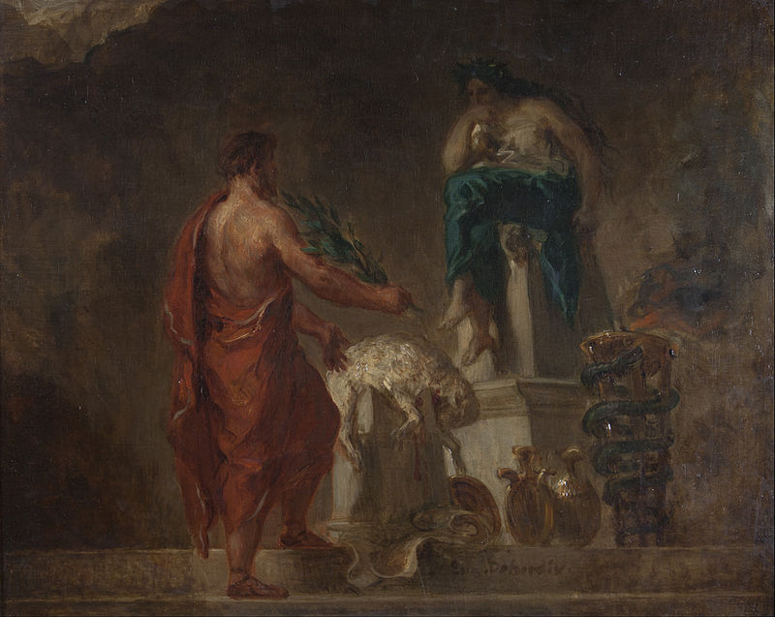
The Oracle at Delphi
Eugène Delacroix: Lycurgus Consulting the Pythia (1835)

Slide 4
“There is none wiser than Socrates”
So why do people think Socrates is wise if he doesn't claim to be? Here we get the story of the Oracle at Delphi-- Chaerephon went to Delphi and asked the priestess of Apollo if there was anyone wiser than Socrates, and the answer came back that there was no one wiser.
Socrates thought that this couldn't be right, because he didn't think that he was really all that wise-- so he set out to prove that this wrong, and to do this, all he had to do was find someone wiser than he was.

Slide 5
First attempt
So first he went to someone who had a reputation of being wise; but it turned out that this person wasn't wise, and when Socrates tried to explain this to him, instead of thanking Socrates, the person got upset.
So Socrates thought that he was better off than this person, because "although I do not suppose that either of us knows anything really beautiful and good, I am better off than he is-- for he knows nothing, and think that he knows. I neither know nor think that I know.”

Slide 6
Are the poets wise?
So next, Socrates tries to see if the poets are wise, but he finds out in talking to them that while the poets write good poetry, but they aren't really wise-- they can't explain what their poems mean.

Slide 7
What about craftspeople?
When he goes to talk to the artisans/craftspeople he finds that while they do have a technical knowledge about their craft (that is, techne) the problem is that the artisans think that knowing one thing means that they know everything-- including about virtue and a good human life.

Slide 8
Socrates discovers the meaning of the Oracle
Socrates says that proceeding like this "led to my having many enemies of the worst and most dangerous kind" ... and that he finally figured out what the god meant.
That Socrates is wise because he recognizes, that he really isn’t all that wise-- that the kind of wisdom human beings can get isn't very much; and keeping this in mind is to be as wise as is possible.

Slide 9
The Result of the Trial
The jury finds Socrates guilty-- Socrates doesn't want to be exiled, because the same thing will happen in a new city; and he will be driven out wherever he goes The jury accepts Meletus' proposed punishment of death.

Slide 10
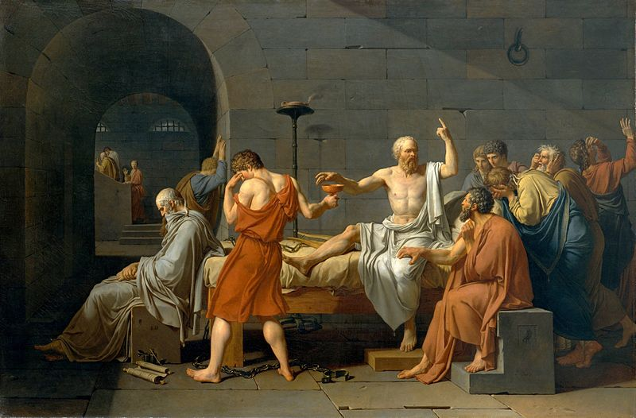
The Death of Socrates
Later, when his friends come to help him escape, Socrates refuses to go along with them out of loyalty to the city (this is the subject of the Crito), and he later carries out the death sentence by drinking hemlock.
Jacques-Louis David: The Death of Socrates (1787)

