Slide 1
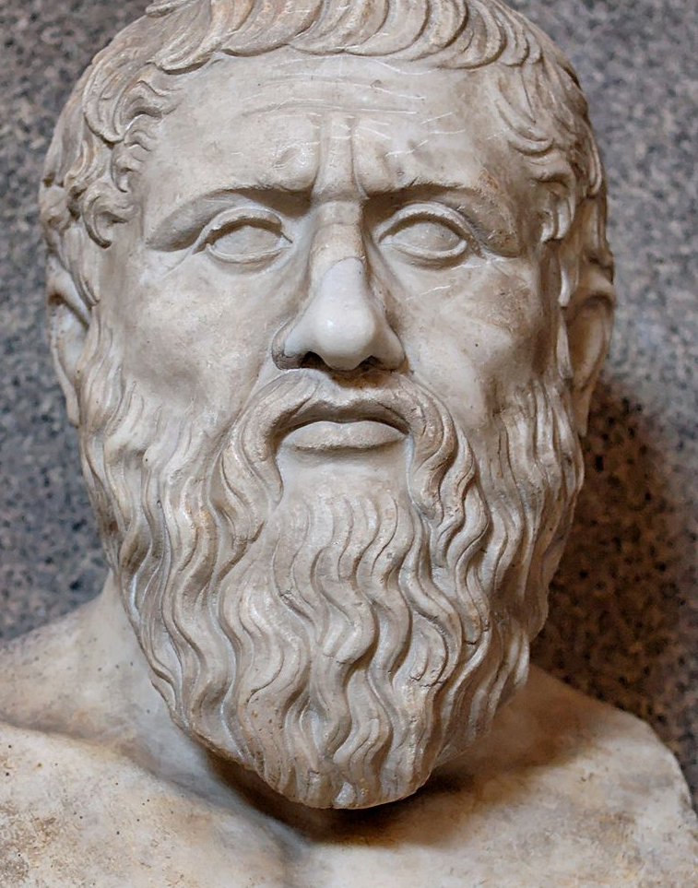
Plato 427-347 BCE

Slide 2
Plato’s (429-347 BCE) Writings
Early (examples- Apology, Euthyphro, Crito) These are the "Socratic dialogues" discussed above.
Middle (examples- Meno, Republic) Here, Plato goes beyond Socratic discussion and develops positive ideas of his own.
Late (example- the Laws) These are technical (and often difficult) expansions, development, and clarification of Plato's ideas.

Slide 3
The Meno
Meno asks Socrates whether virtue can be taught. Socrates replies that he doesn’t know what virtue is, so he doesn’t know whether it can be taught or not. Meno says that there are different virtues for different people, but Socrates replies that he wants to know what virtue in general is. Meno replies with a list of virtues that include justice, courage, temperance, wisdom, and “greatness,” but Socrates again replies that Meno still hasn’t told him what these virtues have in common which makes them virtues—that is, what virtue is “in the universal.”

Slide 4
The Paradox of Inquiry
Socrates says he is going to set out looking for virtue. Meno points out the following:
If you don’t know what virtue is, how will you know when you’ve found it?
This is the”paradox of inquiry”: If we knew what x was, we wouldn’t need to look for it; but if we don’t know what it is, we won’t be able to recognize it when we find it.

Slide 5
Theory of Recollection
Plato’s reply is to demonstrate that when we learn something we don’t really learn something new, but rather we are remembering what we have forgotten. This idea stems from the fundamental division in Plato of the eternal “soul” which at one time was in the “realm of the Forms”—or pure ideas, on the one hand, and the temporal body which is in the visible realm.

Slide 6

The Republic
Topic: Justice. This means “ethical uprightness.”
10 Books
A middle writing of Plato- so Socrates functions mostly as character of Plato to express Plato’s ideas.

