Slide 1




Republic Book I
Socrates visits the house of Polemarchus to spend the night. At the house is Polemarchus’ father Cephalus.
Cephalus says that justice (being morally upright) is more important that wealth for a good life.

Slide 2
What is justice?
First Try- “Telling the truth, paying your debts”
This definition doesn’t work, as it isn’t always right to tell the truth or pay a debt.
(example: lying to protect Jewish people from the Nazis).

Slide 3
What is justice? 2nd try
Second try: “To be just is to help your friends, and harm your enemies”
This doesn’t work- how do you know who is your friend or enemy?
Also, it doesn’t look like harming people is just (unless it is for some good reason such as enforcing the law, medical treatment, etc.)

Slide 4
The Challenge of Thrasymachus
Thrasymachus (a sophist): “Justice is to the advantage of the stronger.”
According to Thrasymachus, the just person will follow the law, and whomever writes the laws will write them to their advantage.
Not really a definition of Justice.

Slide 5
Socrates Replies to Thrasymachus
The craft (or “art”) of ruling isn’t for the benefit of the ruler, it is for the benefit of the ruled.
Consider the craft of sheep herding. While the shepherd wants to make money, making money is a different “art” than sheep herding itself.
Another example: medicine benefits the patient, not the doctor.

Slide 6
The Challenge of Thrasymachus
Thrasymachus changes his point- he says, fine, then the best thing to be is an unjust ruler: that is, to benefit yourself as much as possible.
In fact, Thrasymachus says that the unjust always get more than the just. (example: business dealings, etc.)

Slide 7
Republic Book II
Glaucon (Plato’s brother) picks up the point and wonders what kind of good justice is. Three kinds of goods:
1. Good for itself (happiness)
2. Good for itself and for another good (health)
3. Good only for another good (wealth)

Slide 8
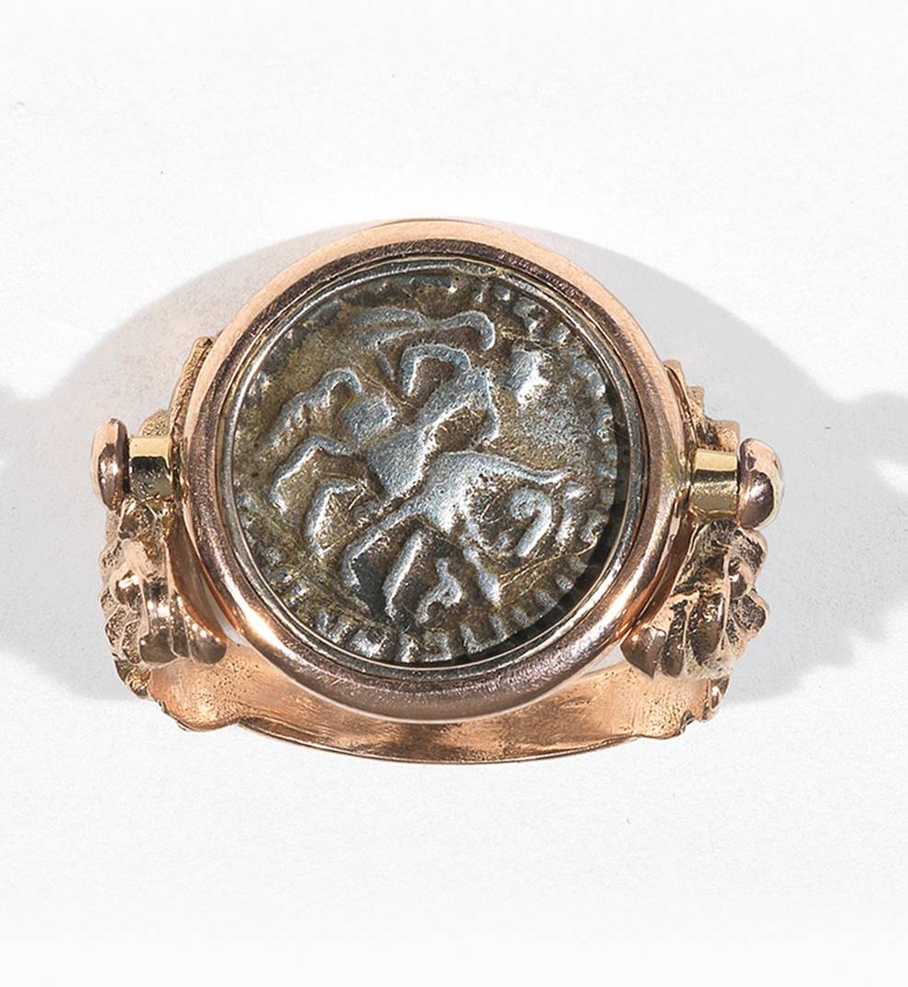
Two Reasons to Think It is 3rd kind of Good (Not the Best Kind)
First Reason: Ring of Gyges Glaucon says that since if people could get away with being unjust (consider the story of a ring which can make people invisible) they would do so, this proves no one chooses Justice for its own sake.

Slide 9
Two Reasons to Think It is 3rd kind of Good (Not the Best Kind)
Consider:
a. Unjust person who falsely has a reputation for justice
vs.
b. Just person who falsely has a reputation of injustice
Which person is better off? If it is (a), this further proves that justice isn’t good for its own sake.

Slide 10
Socrates’ Task: Defend Justice as the Best Kind of Good
Socrates needs to prove justice is choiceworthy in itself.
To do this, he needs to say what justice is.

