Slide 1
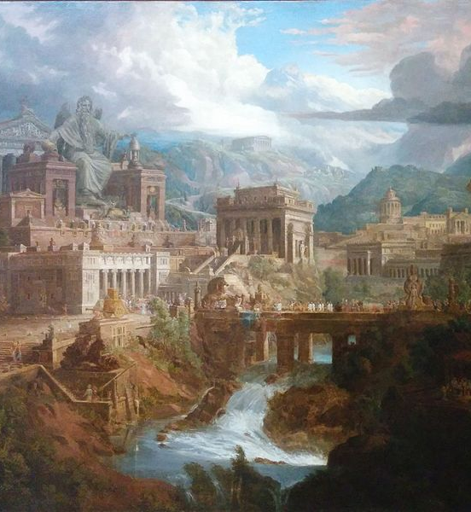
Socrates’ Plan
To discover what justice is, Socrates proposes to find it in a larger thing first-- so it will be easier to find.
So Socrates sets out to describe the just city.

Slide 2
Building the Just City
First City: Has Basic Trades. Simple life.
Glaucon objects that this city isn’t good enough.
Since we either need more stuff, or people will come and try to take our stuff, we need to protect our city/be able to fight in wars.

Slide 3
The Character Traits of the Guardians
What kind of people should we pick? We need to select the right kind of people:
Physical ability: speed, strength
“Philosophical” ability: to know who is an enemy and who is an ally- Allows them to be harsh to the enemy, and gentle to the people of the city.

Slide 4
Education of the Guardians
Basic education has two components:
1. Musical education
2. Physical education

Slide 5
Musical Education
Musical education comes first
“Music” also includes stories and poems.
Some stories/poems are prohibited. Examples: stories that would make the Guardians overly fearful of death, stories where the wicked go unpunished, etc.
Rhythms and harmonies must also be appropriate to “ordering the soul” properly.

Slide 6
Physical Training/Regimen
Guardians have simple diet.
Complicated regimens, treatments, diets, etc. to be avoided.

Slide 7
Plato’s Theory of Medicine
For Plato, medicine is only of use to healthy people-- to restore healthy people to health (when they get sick, injured, etc.)

Slide 8
Harmonizing Musical and Physical
Too much musical training → Guardians will be too “soft”. Too much “philosophical element.”
Too much physical training → Guardians will be too “tough”. Too much “physical element.”
Need to use correct amount of each, relative to the individual character of a candidate Guardian.

Slide 9
The True Guardians
We picked people with best natures suited to be guardians and educated them.
Therefore, none of the potential guardians would willingly betray the city.
However, some of them might be able to be tricked or compelled into doing so and so unwillingly betray the city.

Slide 10
Testing the Guardians
We subject the Guardians to trials and tests.
These include:
- hardships
- feasts, fine things, etc.
Plato thinks that the second kind of thing is more dangerous! He compares such luxuries to a gentle soap which washes away virtue.

Slide 11
Testing the Guardians,
“... subject our young people to fears and then plunge them once again into pleasures, so as test them much more thoroughly than people test gold in a fire. And if any of them seems to be immune to sorcery, preserves [their] composure throughout, is a good guardian of [themselves] and of the musical training [they have] received ... [they are] the sort of person who would be most useful, both to [themselves] and the city. … But those who do not, should be rejected …” (413e).

Slide 12
True Guardians and the Auxiliaries
Those who survive the tests are the True Guardians.
Others are still very valuable, but they cannot be trusted to lead- they are the Auxiliaries.
The Auxiliaries carry out the orders of the Guardians.

Slide 13
The Structure of the City– Everyone has a job to do
Guardians
Auxiliaries
Tradespeople/Craftspeople

