Slide 1
Socrates’ Task: Defend Justice as the Best Kind of Good
Socrates needs to prove justice is choiceworthy in itself.
To do this, he needs to say what justice is.

Slide 2
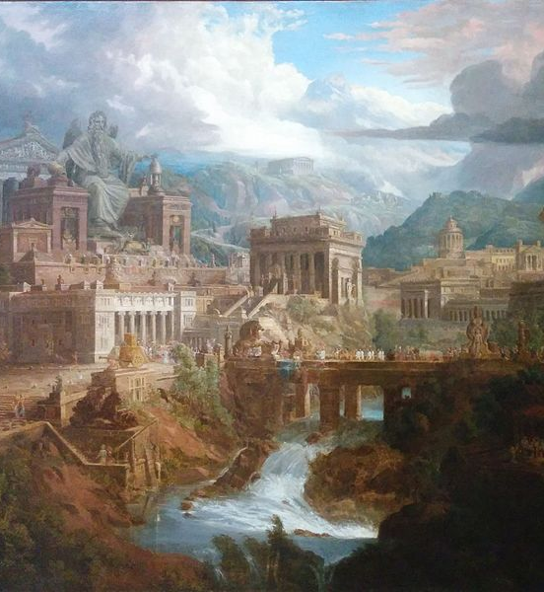
Socrates’ Plan
To discover what justice is, Socrates proposes to find it in a larger thing first-- so it will be easier to find.
So Socrates sets out to describe the just city.

Slide 3
The Happiness of the Guardians
The Guardians and Auxiliaries live together in simple quarters so they do not worry about private affairs.
Protecting the overall happiness of the city requires that things be this way-- we want to set things up so that everyone is “the best possible craftsmen at their own work; and then, with the whole city developing and being governed well, leave it to nature to provide each group with its share of happiness.” (421c).

Slide 4
Games, Manners, Laws
1. Children must play games that teach rule-following.
2. If they do, old customs (standing up in the presence of elders, proper appearance, etc.) will be rediscovered.
3. A lawful society results.

Slide 5
The Structure of the City
Guardians
Auxiliaries
Tradespeople/Craftspeople

Slide 6
The Virtues of the City
Since our City is good, it has the following virtues:
1. Wisdom
2. Courage
3. Temperance
4. Justice

Slide 7
Wisdom
Wisdom is a result of prudence and prudence is a kind of knowledge.
Who possesses this knowledge? The guardians do-- this is the technical knowledge of their craft (ruling). (428d).

Slide 8
Courage
Courage is the power to “preserve through everything the correct and law-inculcated belief about what should inspire terror and what should not.” (430b).
What should inspire terror? Not the enemy, or death, but rather the thought of betraying the city, or the city falling into injustice.

Slide 9

Courage is like dyeing
In order for one to be courageous, the belief has to be “fully soaked in to” the nature of someone who has it (such that it can’t be “washed out”).
This was the effect of education on our guardians and auxiliaries-- and so this is where we find courage in the city.

Slide 10
Temperance
“Temperance is surely a sort of order, the mastery of certain sorts of pleasures and appetites.” (430e).
Plato claims that the term “self-mastery” (or we might say “self-control”) is “ridiculous” as the same self is “controlling” as is “being controlled”-- the relevant thing is which part of ourselves is doing the controlling.
The temperate person has the correct sort of order in their souls with respect to which part of their souls does what job-- which part of their soul is ruling, and which part of their soul is ruled.

Slide 11
Justice
“Listen, then, and see whether there is anything in what I say. You see, what we laid down at the beginning when we were founding our city, about what should be done throughout it-- that, I think, or some form of that, is justice. And surely what we laid down and often repeated, if you remember, is that each person must practice one of the pursuits of the city, the one for which he is naturally best suited … Moreover, we have heard many people say, and have often said ourselves, that justice is doing one’s own work and not meddling with what is not one’s own. … This, then, my friend, provided it is taken in a certain way, would seem to be justice-- this doing one’s own work.” (433a)

Slide 12
Justice in the Individual
Now that we have indeed found justice in a larger thing (the city), we can find in an individual soul.
Justice will be the parts of the soul doing the job that is proper to it.

Slide 13
The 3 Parts of the Soul (the “Tripartitie Soul”)
1. Reason
2. Thumos (“spirit”)
3. Bodily Appetites

Slide 14
What Job is Proper to Each Part?
1. Reason- ruling. Reason can act on behalf of the entire person.
2. Thumos- carrying out the decisions of reason.
3. Appetites- keep us alive.

Slide 15
Justice in the Soul
“It means that he does not allow the elements in him each to do the job of some other, or the three sorts of elements in his soul to meddle with one another. Instead, he regulates well what is really his own, rules himself, puts himself in order, becomes his own friend, and harmonizes the three elements together …” (443d).

Slide 16

Is it Better to be Just of Unjust?
We’ve come up with the best possible arrangement, and said that Justice is each class in the city and part of the soul doing the job proper to it.
So is it better to be Just or Unjust?

Slide 17
It is Obviously Better to be Just
“But, Socrates, that question seems to me, at least, to have become ridiculous, now that the two have been shown to be as we described. Life does not seem worth living when the body’s natural constitution is ruined, not even if one has food and drink of every sort, all the money in the world, and every political office imaginable. So how-- even if one could do whatever one wished, except what would liberate one from vice and injustice and make one acquire justice and virtue-- could it be worth living when the natural constitution of the very thing by which we live is ruined and in turmoil?” (445a-b).

