Slide 1

What is Philosophy?

Slide 2

Logic
concerns the relational structures between statements or other elements

Slide 3

Ethics
discusses how we should act, "what is the right thing to do?"

Slide 4

Aesthetics
what is beauty? what is art and what is its function?

Slide 5

Social Theory
discusses how societies function/interact

Slide 6

Metaphysics
what is the nature of reality? what is everything made out of?

Slide 7

Epistemology
the study of knowledge itself

Slide 8
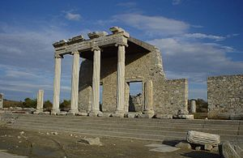
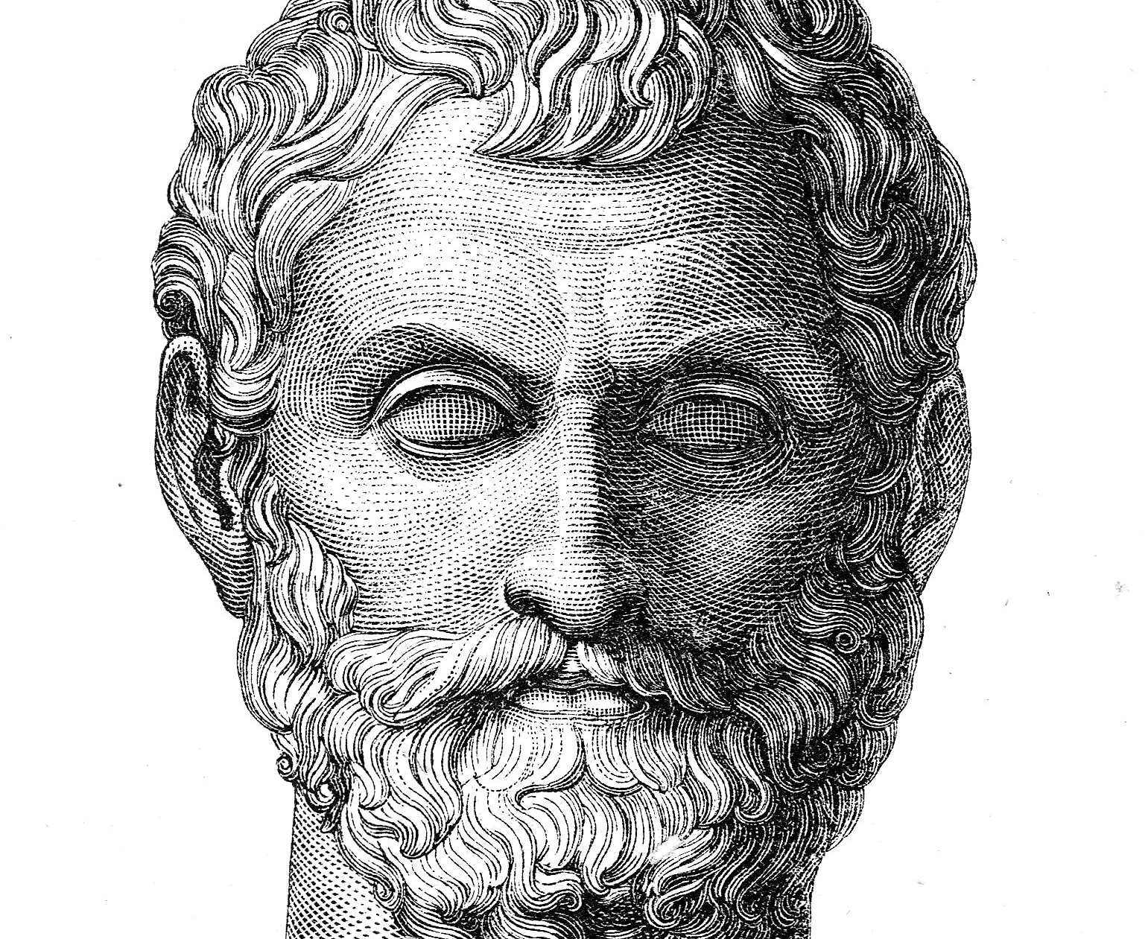
Where/when did this begin?
Our topic is mostly western philosophy-- the beginning of western philosophy is associated with Thales of Miletus (b. c.625 BCE).

Slide 9

Reading:
Please read Chapter 2:
The Milesian School

