Slide 1
The Presocratics: Thales and the Milesians

Slide 2
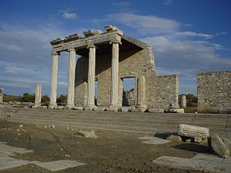
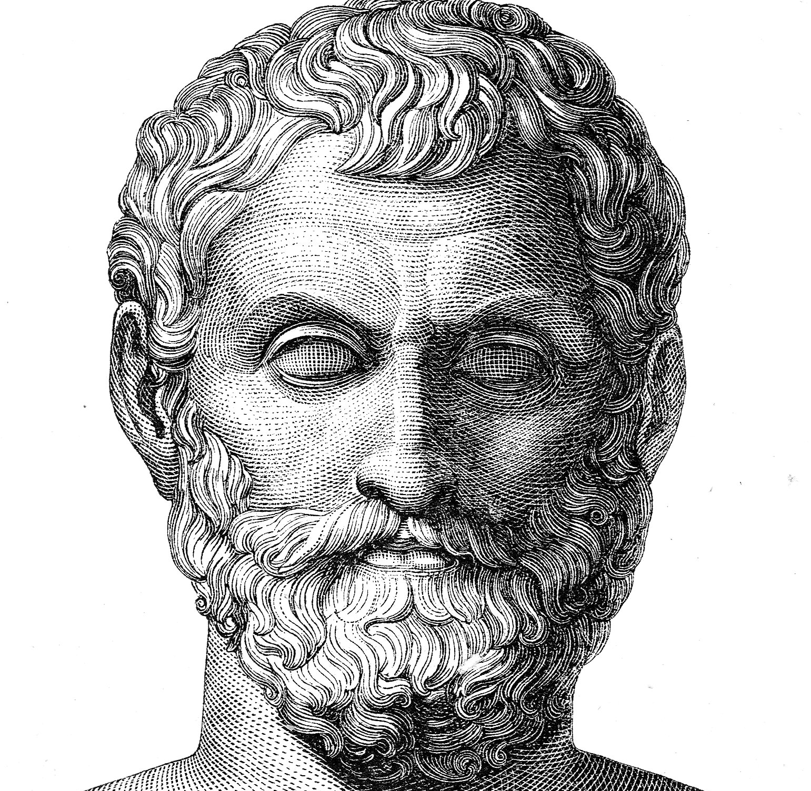
Where/when did this begin?
Our topic is mostly western philosophy-- the beginning of western philosophy is associated with Thales of Miletus (b. c.625 BCE).

Slide 3
Historical Context
Over 2 mya to about 3000 BCE - The Stone Age
3000 BCE- around 1100 BCE- the Bronze Age
Greek Late Bronze (1500 BCE-1100 BCE): Trojan War/the Heroic Age
-the Trojan War is the subject of the Iliad
1100 BCE-800 BCE: The Greek Dark Age
776 BCE- Olympic Games
750 BCE - 700 BCE: the Homeric poems are recorded
-about the same time- life/work of Hesiod
Thales born- 625 BCE
Trial of Socrates- 399 BCE

Slide 4
The Greek Epic Poets
According to tradition, Homer wrote, among other things, the Iliad and the Odyssey-- although scholars aren’t sure about this, or even if “Homer” is a single person.
Hesiod wrote, among other things, a Theogony- an account of the origins of the gods and, by extension, all things, including the natural world.

Slide 5
The Poets’ Justification
Hesiod- Theogony 114: “Tell me these things, Muses, who dwell on Olympus …”
Homer- Illiad 2.484: “Tell me now Muses, who have dwellings in Olympus / for you are goddesses and present and know everything, while we hear only rumor and we know nothing …”
Homer is asking for divine inspiration to know about events which happened hundreds of years earlier.

Slide 6
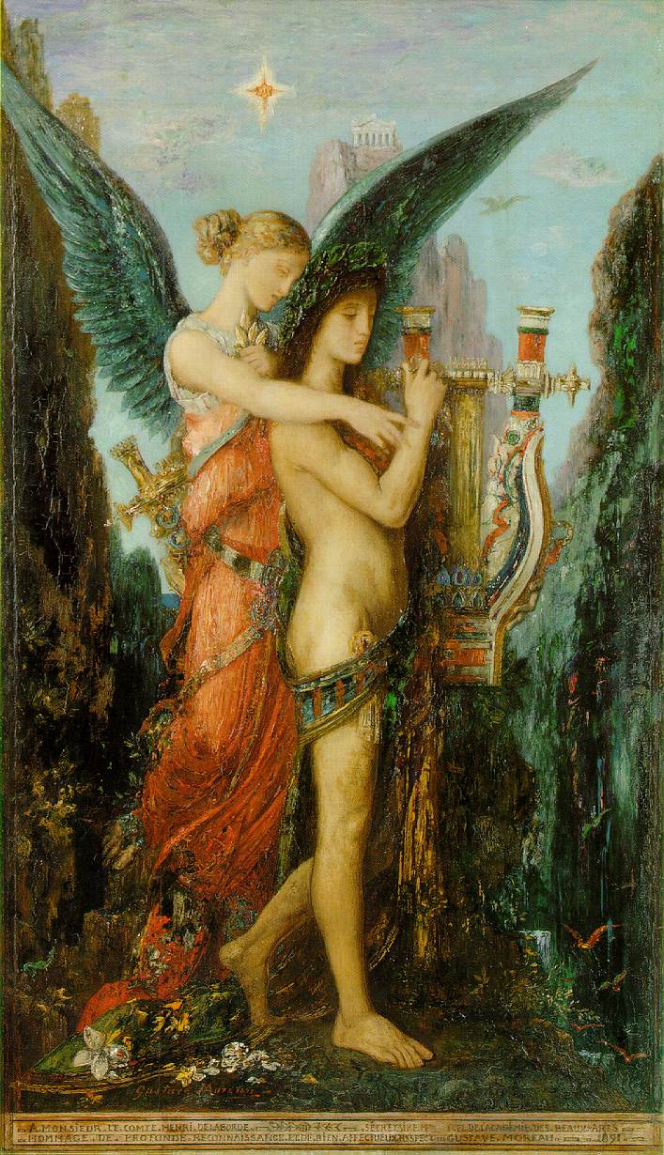
Gustave Moreau: Hesiod and the Muse (1891)

Slide 7
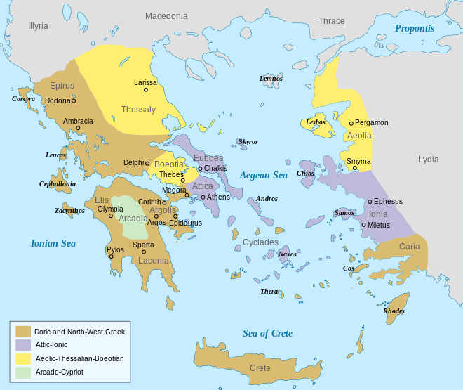
Thales and the Milesians

Slide 8
Miletus
Thales, and his followers are from Miletus in Ionia (present day Turkey).
Founded around 1100 BCE: trading center/ manufacturing. Known for woolen goods- out on the frontier of Greek influence.
Was there a possible Iranian/Babylonian/Indian influence on the early western philosophers? Probably. However, we are going to put this issue to the side as it ultimately of more historical than philosophical interest.

Slide 9
Justification for The Natural Philosophers
Argument and evidence
Empirical observation-- that is, relying on direct experience of information received through the senses.

