Slide 1
动态调控技术
孙新晓

Slide 2
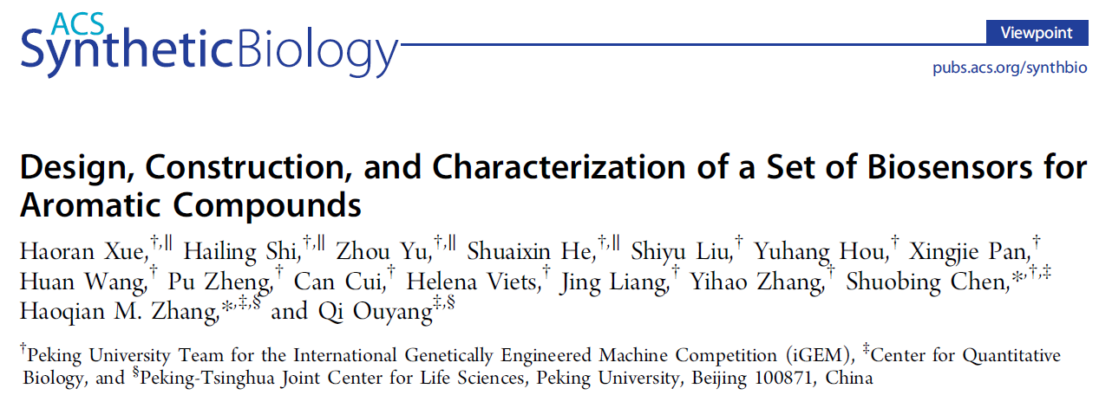
ACS Synth. Biol. 2014, 3, 1011−1014

Slide 3
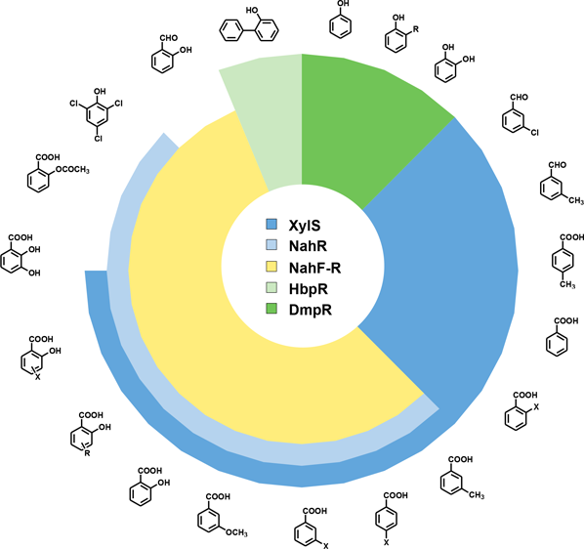
鉴定了对一系列芳香化合物有响应的生物传感器

Slide 4
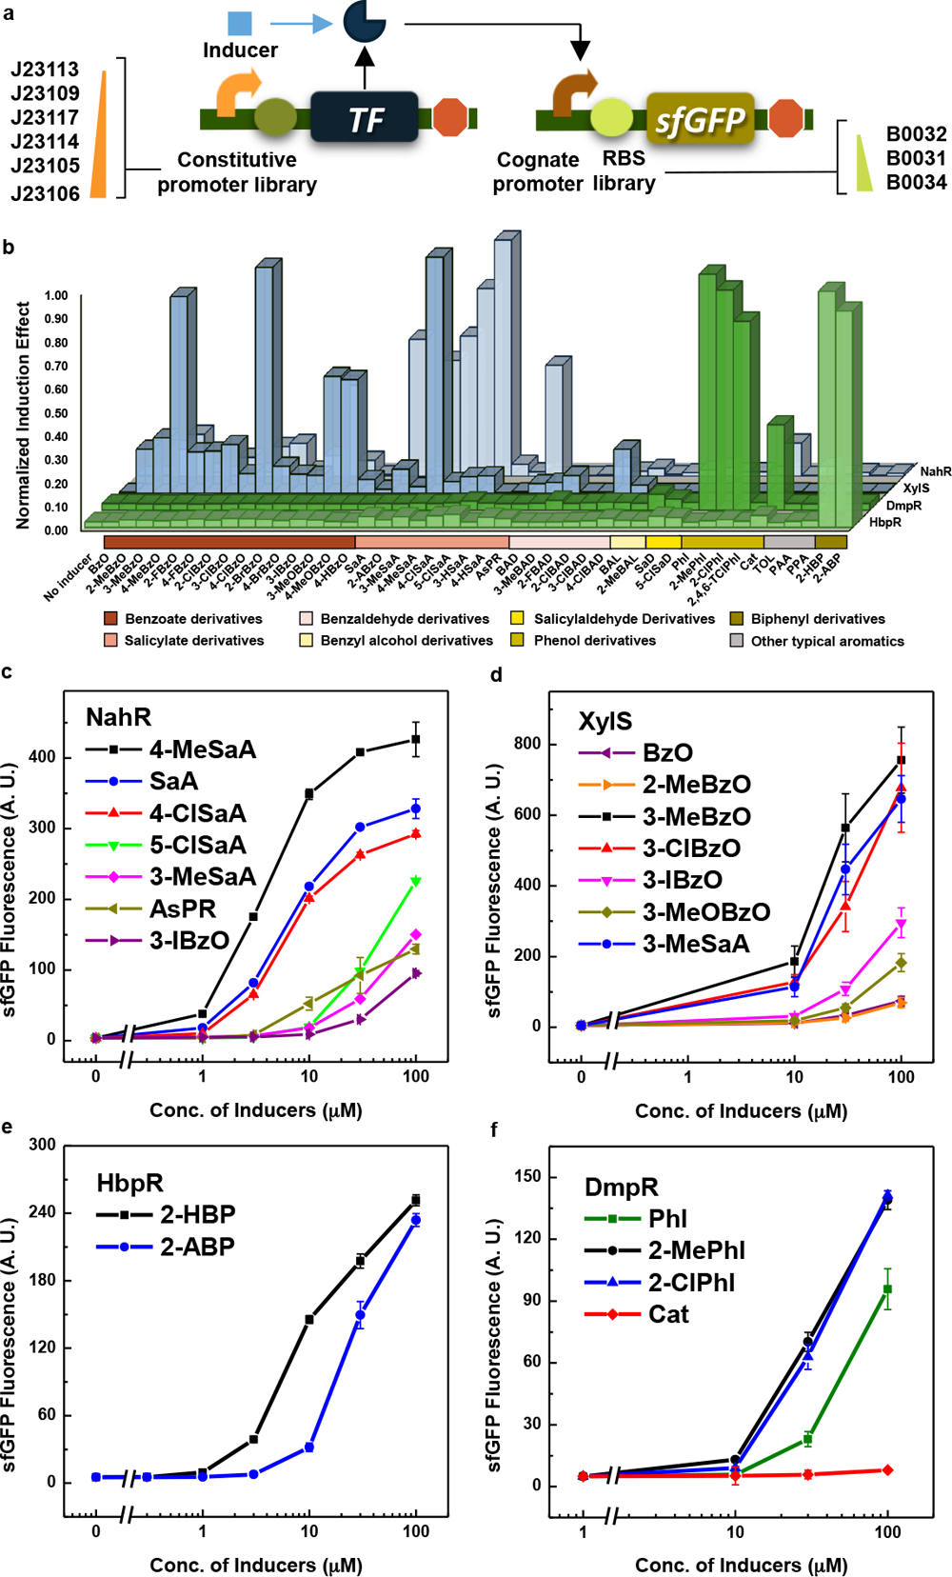

Slide 6
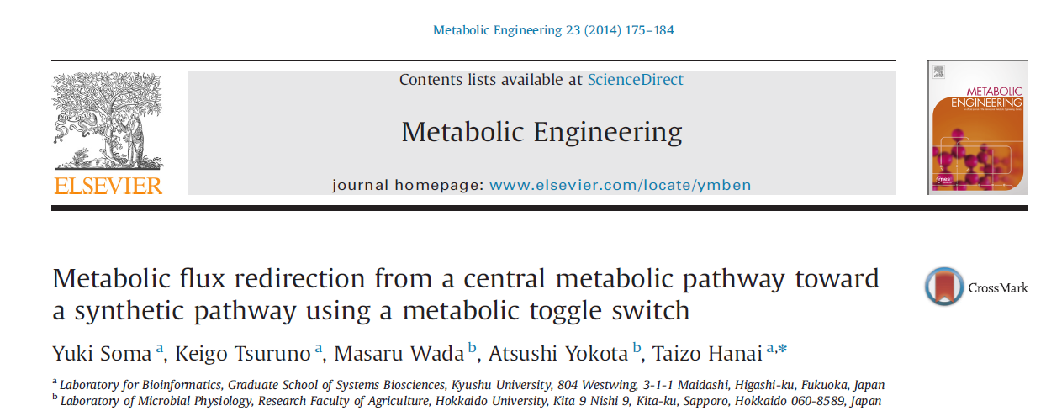

Slide 7
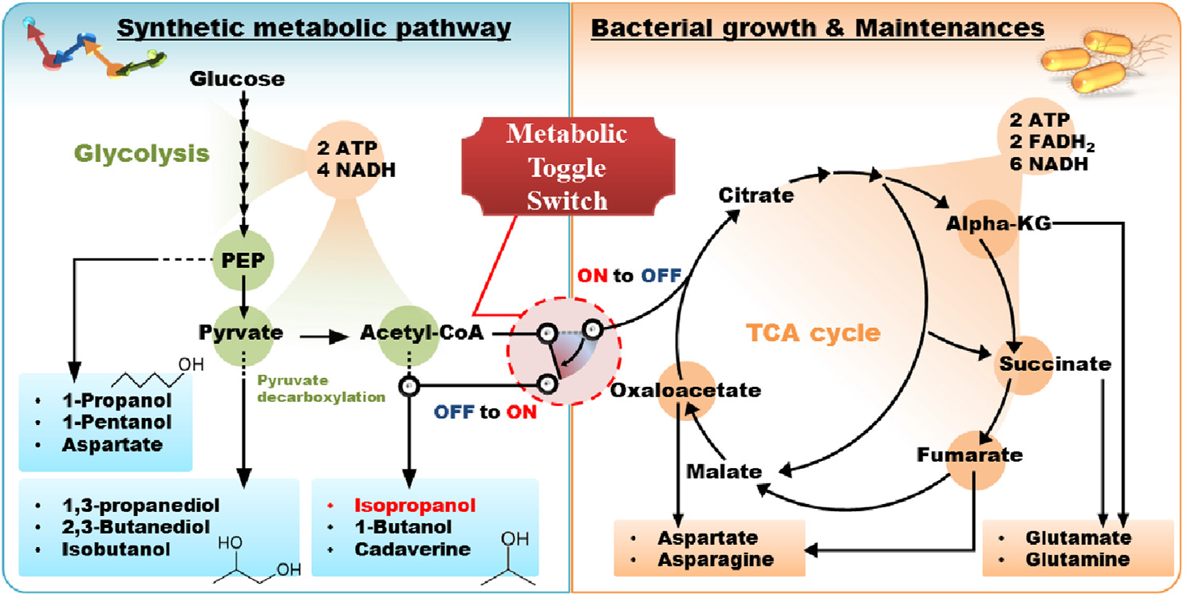
Metabolic flux redirection from a central metabolic pathway toward a synthetic pathway using a metabolic toggle switch

Slide 8
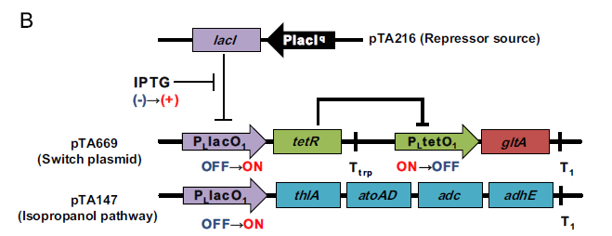

Slide 9
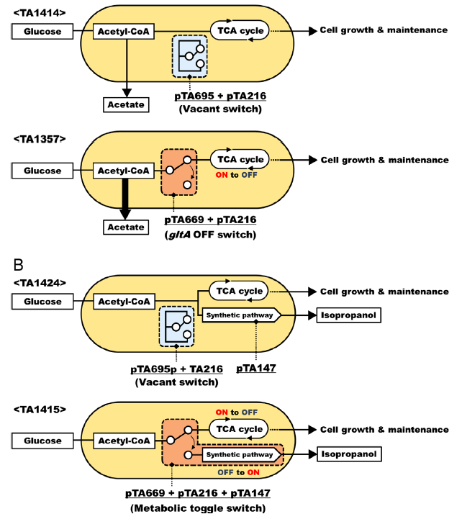
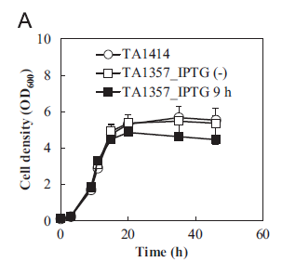
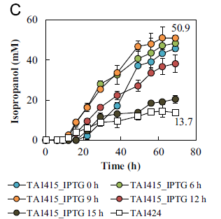

Slide 10
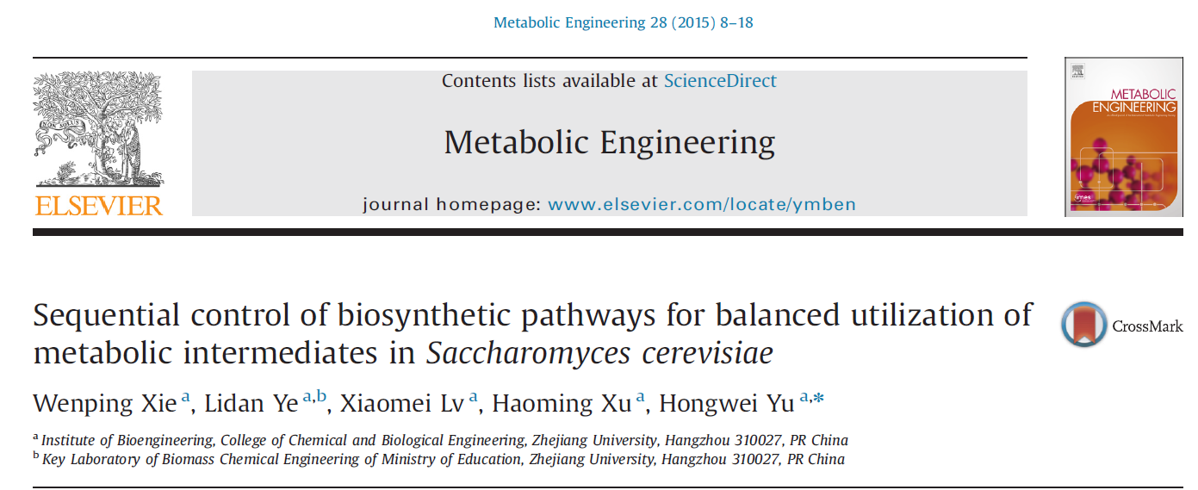

Slide 11
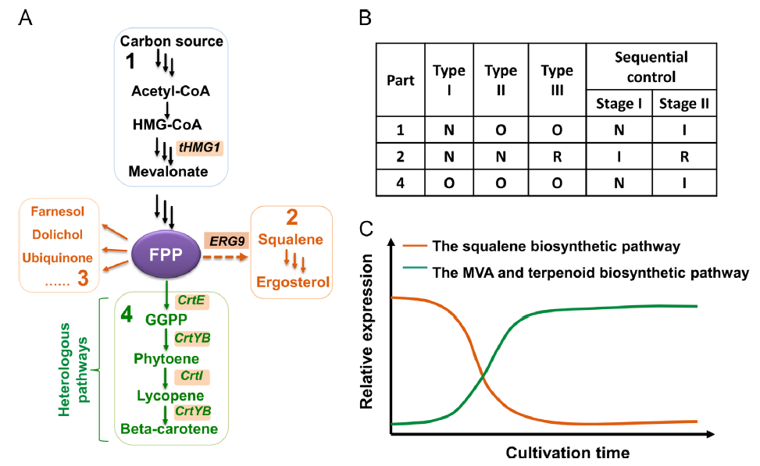
Sequential control of biosynthetic pathways for balanced utilization of metabolic intermediates in Saccharomyces cerevisiae
N: Normal gene expression level, O: Overexpression, R: Repression, I: Induction.

Slide 12
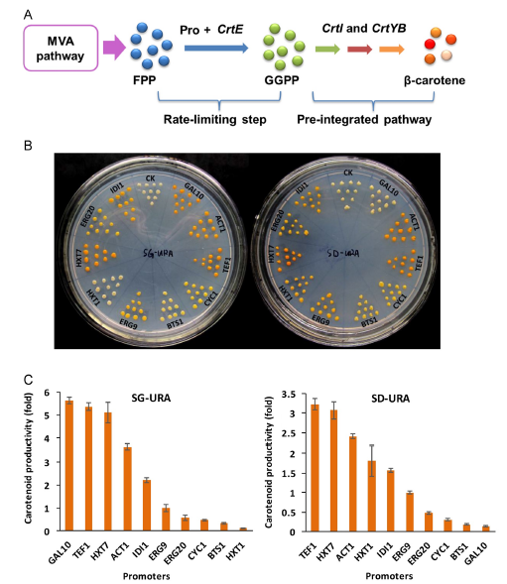

Slide 13
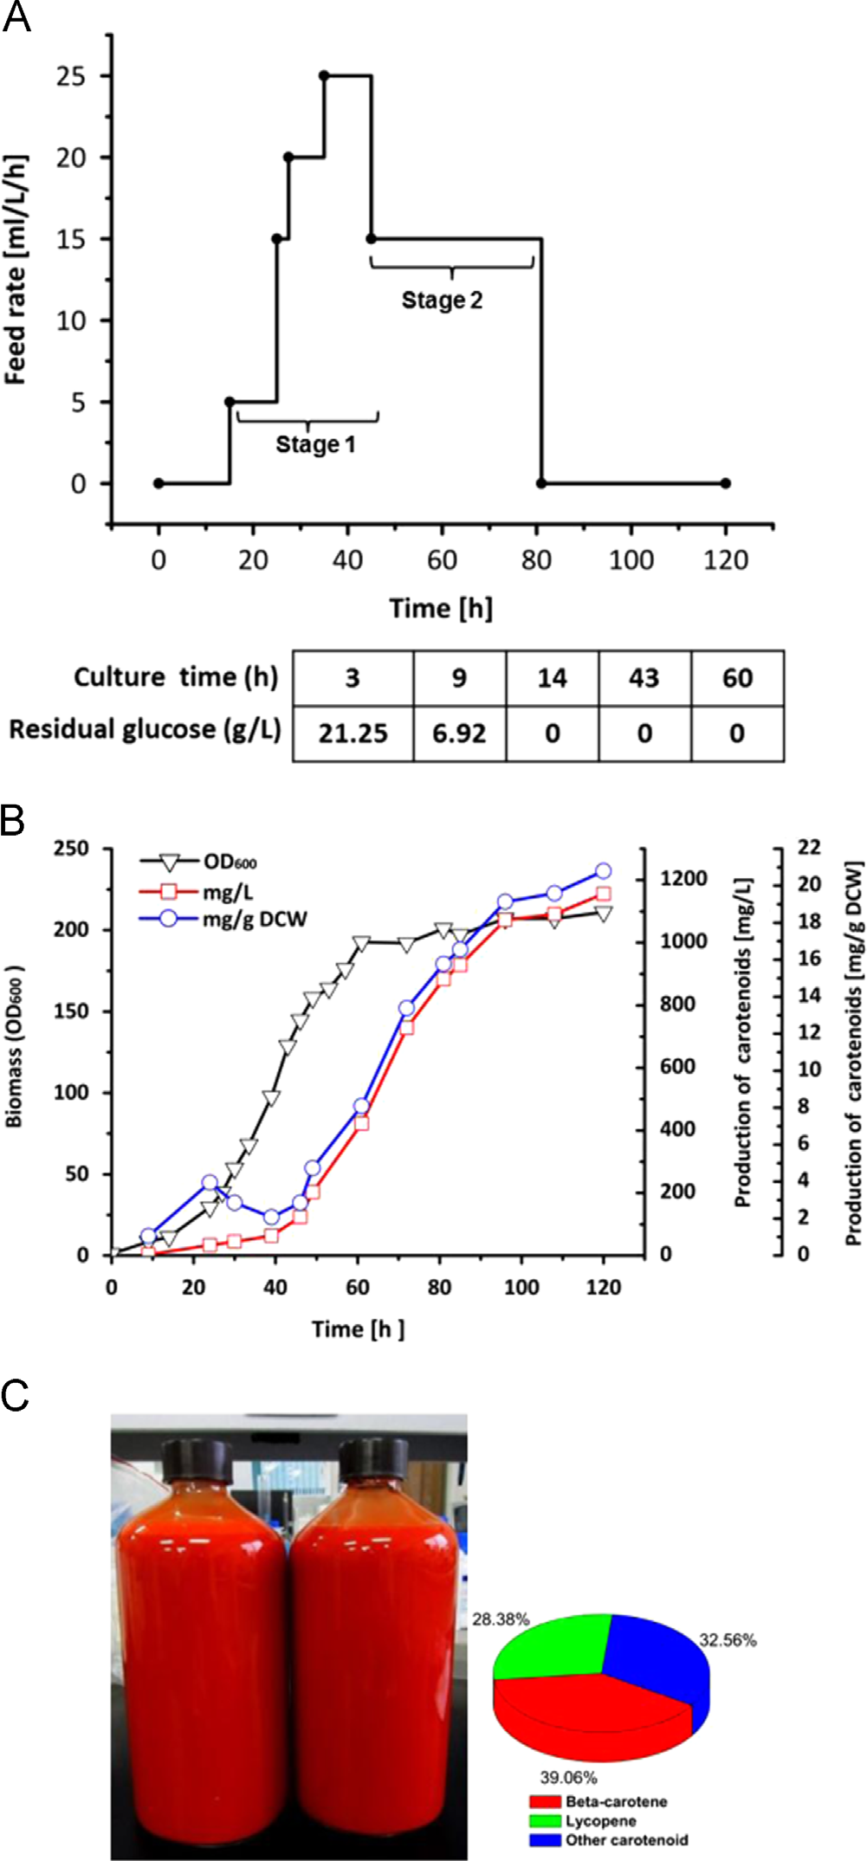

Slide 14
文献阅读
Engineering dynamic pathway regulation using stress-response promoters

