Slide 1
Language in use
1 Complete the sentences with the words in brackets
2 Rewrite the sentences using mean
3 Complete the sentences with suitable expressions
4 Translate the paragraph into Chinese
5 Translate the paragraph into English

Slide 2



Language in use
1 Complete the sentences with the words in brackets and
-ment, -ism or post-.
1 What is the __________ going to do about this problem? (govern)
2 _____________ refers to a contemporary way of thinking, and is not easy to define. (postmodern)
3 After the Second World War, economic ___________ led to the creation of new universities in the 1960s. (develop)
4 We must combat money worship and extreme ___________ . (individual)
5 The two groups discussed for a long time, but couldn’t reach an _________ . (agree)
government
Postmodernism
development
individualism
agreement

Slide 3

Language in use
6 The best __________ we can make for the future is to provide opportunities for the younger generation. (invest)
7 The ___________ of Wordsworth is evident in his poem on the French Revolution. (romantic)
8 The immediate ________ period saw the expansion of services except for housing, health and education. (war)
investment
romanticism
post-war

Slide 4
Language in use
mean
When we want to say what something involves or what its result is, we use the verb mean followed by a noun phrase or the V-ing form. Don’t use an infinitive.
2 Look at the sentence.
When you went to college you had your first taste of real freedom.
You can rewrite it like this:
Going to college meant your first taste of real freedom.
Now rewrite the sentences using mean.

Slide 5
Language in use
1 When you start out at college you meet lots of interesting people.
Starting out at college means meeting lots of interesting people.
2 If you go to bed too late you won’t be able to concentrate the next day.
Going to bed too late means not being able to concentrate the next day.
3 When you do a course in Literary Theory you spend a lot of time on difficult subjects.
Doing a course in Literary Theory means spending a lot of time on difficult subjects.

Slide 6
Language in use
4 To be interested in literature is to have an open mind about other ways of life.
Being interested in literature means having an open mind about other ways of life.
5 When you go to college today you spend a lot of time thinking about what you will do afterwards.
Going to college today means spending a lot of time thinking about what you will do afterwards.

Slide 7
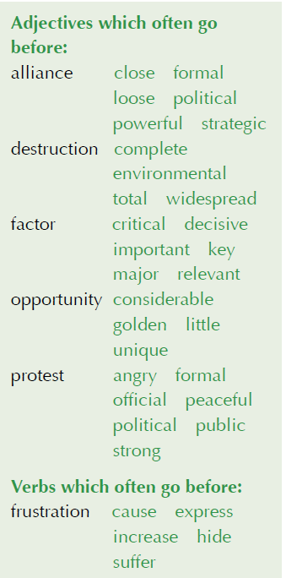
Language in use
Collocations
3 Complete the sentences with suitable expressions from the collocation box. Sometimes more than one collocation is possible.
1 They were mostly _______________ but then they became more violent.
2 The violent tactics of the riot police ______ the demonstrators a great deal of _________ and anger.
3 A(n) __________________________
_______________ in de Gaulle’s decreasing popularity was he lacked understanding of the language of protest.
peaceful protests
caused
frustration
critical / decisive / important /
key / major factor

Slide 8
Language in use
4 In the last years of the 20th century, there was a(n) ________________________ to bring back enthusiasm and idealism into politics.
5 The British and the Americans have always had a(n) _____________________ because of their shared language and culture.
golden / unique opportunity
close / powerful alliance

Slide 9
Language in use
complete / total destruction
6 The _______________________ of the World Trade Center on 9/11 brought about a change of focus to radical politics in the West.
7 Some protesters wanted the ________ ______________ of the political system, but most were much more moderate.
complete /
total destruction

Slide 10
Language in use
Translation
4 Translate the paragraph into Chinese.
The sport of basketball was created by a physical education teacher named James Naismith, who in the winter of 1891 was given the task of creating a game that would keep track athletes in shape without risking them getting hurt a lot. Basketball quickly became popular on college campuses. When the professional league was established in the 1940s, the National Basketball Association (NBA) drafted players who had graduated from college.

Slide 11
Language in use
This was a mutually beneficial relationship for the NBA and colleges — the colleges held onto players who would otherwise go professional, and the NBA did not have to fund a minor league. The pervasiveness of college basketball throughout the nation and the NCAA’ s (美国大学体育协会) marketing of “March Madness” (officially the NCAA Division I Men’ s Basketball Championship), have kept the college game alive and well.

Slide 12
Language in use
篮球运动是一个名叫詹姆斯·奈史密斯的体育老师发明的。1891年冬天，他接到一个任务，要求他发明一种运动，让田径运动员既保持良好的身体状态，又能不受伤害。篮球在大学校园里很快流行起来。20世纪40年代，职业联赛开始之后，美国职业篮球联赛一直从大学毕业生里招募球员。

Slide 13
Language in use
这样做对美国职业篮球联赛和大学双方都有好处：大学留住了可能转向职业篮球赛的学生，而美国职业篮球联赛无需花钱组建一个小职业篮球联盟。大学篮球在全国的普遍推广以及美国大学体育协会对“疯狂三月”（即美国大学体育协会甲级联赛男篮锦标赛）的市场推广，使得这项大学体育赛事一直在蓬勃发展。

Slide 14
Language in use
5 Translate the paragraph into English.
现在中国大学生参加志愿活动已成为常态。他们到社区为老年人服务，到山区助学，举办爱心捐赠活动，或到世博会（World Expo）或奥运会等重要国际活动担任志愿者。参加志愿活动有助于学生获取专业技能，丰富社会经验，提高道德水平。多数大学生都认为参与志愿服务是自己应尽的社会责任和义务，希望能做一些有意义的事情来回报社会，积极推动社会和谐发展。

Slide 15
Language in use
Volunteering has now become the norm for college students in China. The volunteers may provide community services for senior citizens, support students in mountain areas in education, organize fundraising activities to help those in need, or work for major international projects such as the World Expo and the Olympic Games. Doing volunteer work is a useful way for students to enhance their professional skills and social experience as well as promoting their moral development. The majority of college students believe that it is their duty and obligation to participate in volunteer activities. They hope that they can do something meaningful and promote the development of social harmony.

