Slide 1
Language in use
1 Complete the sentences so that they are true for you
2 Decide what have something done means
3 Decide the meaning of the sentences
4 Answer the questions about the words
5 Translate the paragraph into Chinese
6 Translate the paragraph into English

Slide 2



Language in use
There is no escaping the fact that ...
We use this pattern to say that something is definitely true or important, even though you may prefer to think that it is not.
1 Look at the sentence from the passage Stolen identity.
There is no escaping the fact that right now fraudsters are finding identity crime all too easy.

Slide 3

Language in use
Now complete the sentences so that they’re true for you, even if you prefer to think they’re not.
There is no escaping the fact that when I ...
1 speak English, _____________________.
2 go online, ______________________________________.
3 do an assignment, _____________________.
4 go back home to see my parents,____________________ ___________________________________.
5 stay up late, _____________________________.
6 go shopping, _________________________.
I make a lot of mistakes
I waste a lot of time chatting to people about nothing
I always start it too late
I spend too much time
on the phone instead of talking to them
I am useless in class the next day
I spend far too much money

Slide 4
Language in use
have something done
2 Look at the sentence from the passage Stolen identity.
If you haven’t had your identity stolen, it’s only because they haven’t got to you yet.
Now decide what have something done means in this context.
(a) arrange for something to be done, or for someone to do something for you
(b) have something unfortunate happen to you by someone you don’t know

Slide 5
Language in use
3 Look at the sentences with have something done. Decide which meaning in Activity 2 they have.
(a) arrange for something to be done, or for someone to do something for you
(b) have something unfortunate happen to you by someone you don’t know
1 If you had my computer hacked into, you would be able to get my bank details.
2 You can arrange to have your new checkbook delivered to you personally.
(b)
(a)

Slide 6
Language in use
(a) arrange for something to be done, or for someone to do something for you
(b) have something unfortunate happen to you by someone you don’t know
3 If you have your pocket picked, make sure you cancel your credit cards.
4 You can have money removed from your bank account without your knowledge.
5 You can have your personal details searched and used to steal your identity.
6 You can have your mail collected from a mailbox by a neighbour if you’re away for more than a day.
(b)
(b)
(b)
(a)

Slide 7
Language in use
Collocations
4 Answer the questions about the words.
regular
1 … the ink can be removed with the help of a regular household chemical … Is this likely to mean (a) frequent, or (b) ordinary?
2 It looked like a regular dollar bill, but actually it was a fake. Does this mean the dollar bill was (a) damaged, or (b) normal?
Collocations
4 Answer the questions about the words.
regular
1 … the ink can be removed with the help of a regular household chemical … Is this likely to mean (a) frequent, or (b) ordinary?
2 It looked like a regular dollar bill, but actually it was a fake. Does this mean the dollar bill was (a) damaged, or (b) normal?

Slide 8
Language in use
bad
3 More than 1.2 million bad checks are issued every day … Is a bad check one which (a) doesn’t pay the money it offers to pay, or (b) is likely to cause problems?
4 … they have also got a lot of bad publicity. Is this publicity (a) of very low quality, or (b) likely to cause problems?
bad
3 More than 1.2 million bad checks are issued every day … Is a bad check one which (a) doesn’t pay the money it offers to pay, or (b) is likely to cause problems?
4 … they have also got a lot of bad publicity. Is this publicity (a) of very low quality, or (b) likely to cause problems?

Slide 9
Language in use
stuff
5 So it’s not a problem if they’re trying to sell me stuff. Is this likely to mean (a) a variety of objects and things, or (b) a basic material used for making something?
6 Banks keep all this personal stuff about you on computer. Is this likely to mean (a) your property, or (b) information about you?
stuff
5 So it’s not a problem if they’re trying to sell me stuff. Is this likely to mean (a) a variety of objects and things, or (b) a basic material used for making something?
6 Banks keep all this personal stuff about you on computer. Is this likely to mean (a) your property, or (b) information about you?

Slide 10
Language in use
false
7 ... to create a false identity. Is this likely to be an identity (a) based on a mistake, or (b) not real and intended to trick people?
8 Pierre gave me the false impression that he was rich. Does this mean (a) he didn’t tell the truth, or (b) his documents contained wrong information?
false
7 ... to create a false identity. Is this likely to be an identity (a) based on a mistake, or (b) not real and intended to trick people?
8 Pierre gave me the false impression that he was rich. Does this mean (a) he didn’t tell the truth, or (b) his documents contained wrong information?

Slide 11
Language in use
mention
9 I haven’t mentioned identity theft yet, but surely that’s what this is leading to. Does this mean the author (a) is going to explain identity theft in detail, or (b) just refers to identity theft but he is not going to discuss it in detail?
10 If we’ve learned one thing from terrorists, not to mention action movies, it’s that a tool is also a weapon. Does this mean the author (a) is going to talk about action movies, or (b) is not going to do so?
mention
9 I haven’t mentioned identity theft yet, but surely that’s what this is leading to. Does this mean the author (a) is going to explain identity theft in detail, or (b) just refers to identity theft but he is not going to discuss it in detail?
10 If we’ve learned one thing from terrorists, not to mention action movies, it’s that a tool is also a weapon. Does this mean the author (a) is going to talk about action movies, or (b) is not going to do so?

Slide 12
Language in use
Here are some more collocations.
Tim seems like a regular guy.
They come here on a regular basis.
He was very handsome, with strong regular features.
Too much salt can be bad for your heart.
This milk smells bad.
Tim felt bad about leaving without saying goodbye.
What’s all this stuff on my desk?
I think he has the right stuff for the job.
If you have any questions, John really knows his stuff.
I think it’s worth mentioning that we did most of the work.
The report mentions that the cost is higher than expected.
Now you mention it, I did see a strange man outside.

Slide 13
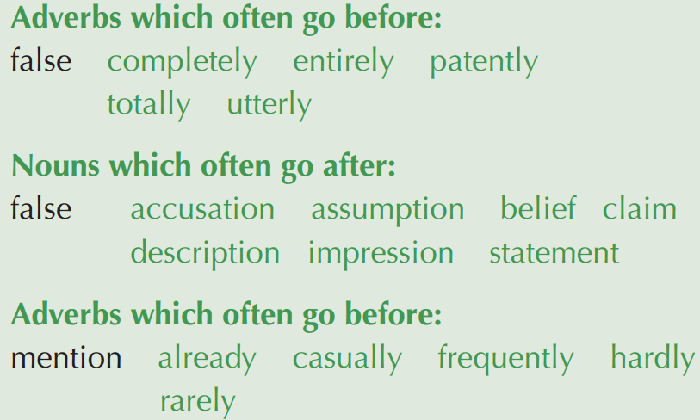
Language in use

Slide 14
Language in use
Translation
5 Translate the paragraph into Chinese.
There have been many remarkable technological innovations in recent years, including the Internet, personal computer systems, and handheld devices. The Internet continues to evolve, and to make our daily lives easier. However, despite all the benefits of high-tech advancement, it also poses new problems that we have to deal with. One of these is cybercrime, which is a growing concern for ordinary people as well as experts. Experts have developed various ways to prevent cybercrime targeted at individuals, families, businesses, and government agencies. We can also protect ourselves against cybercrime targeted at individuals by limiting the amount of personal information we put online. We must never provide any personal data to unknown agencies or individuals online. It is also important to be cautious about opening email attachments and installing programs on our computers.

Slide 15
Language in use
近年来涌现了许多重大技术发明，其中包括互联网、个人电脑系统及掌上设备。互联网技术不断发 展，给我们的日常生活带来了诸多便利。然而，虽然高科技的发展带来了种种好处，它也带来了有 待解决的新问题，其中一个就是网络犯罪。网络犯罪已成为普通民众及专家日益关注的问题。专家 们提出了各种方法来预防针对个人、家庭、企业及政府机关的网络犯罪。在预防针对个人的网络犯 罪方面，我们必须尽量减少在网上发布个人信息以自我保护。我们应避免向陌生的在线机构和个人 提供个人信息。要格外提防那些要求在电脑上进行安装的网站或邮箱附件，这一点也十分重要。

Slide 16
Language in use
6 Translate the paragraph into English.
20世纪中后期，随着科学技术的迅速发展，以网络技术为代表的高科技相继问世。但与此同时，以网络犯罪为代表的各种高科技犯罪也开始出现，对社会的健康发展带来潜在的威胁。如何预防和减少高科技犯罪已成为受到普遍关注的问题。中国也面临着同样的问题。为避免或减少由此带来的损失，在日常生活中，我们应该提高警惕，避免上当受骗。

Slide 17
Language in use
In the middle and late 20th century, the rapid development of science and technology witnessed the birth of high technology, represented by the Internet. But at the same time various high-tech crimes, as represented by cybercrime, also arose, constituting a potential threat to the healthy development of society. How to prevent and reduce high-tech crimes has become a common concern. China is facing a similar situation. To avoid or reduce losses caused by high-tech crimes, we should keep alert in our daily lives, so as not to be deceived.

