Slide 1
Financial System Architecture
Virtual Card Platform – Request–Response and System Overview

Slide 2
Introduction
This presentation describes the architecture of a financial system
that provides virtual cards to users. The system supports:
• User authentication and management
• KYC verification
• Card provisioning via third-party APIs
• Fraud detection through a rules engine
• Payment processing and notifications

Slide 3
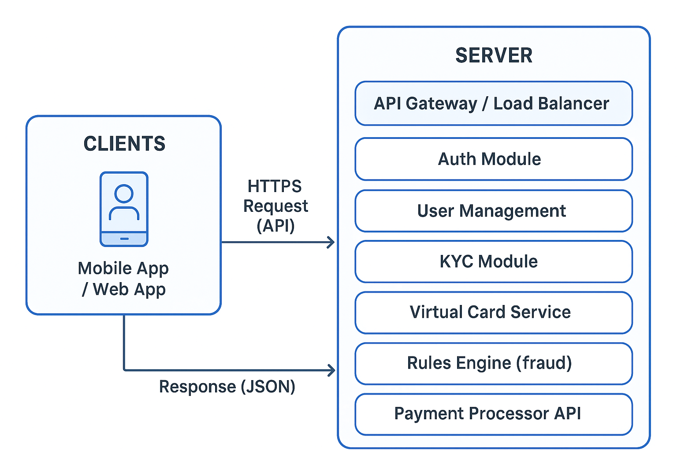
Request–Response Architecture

Slide 4
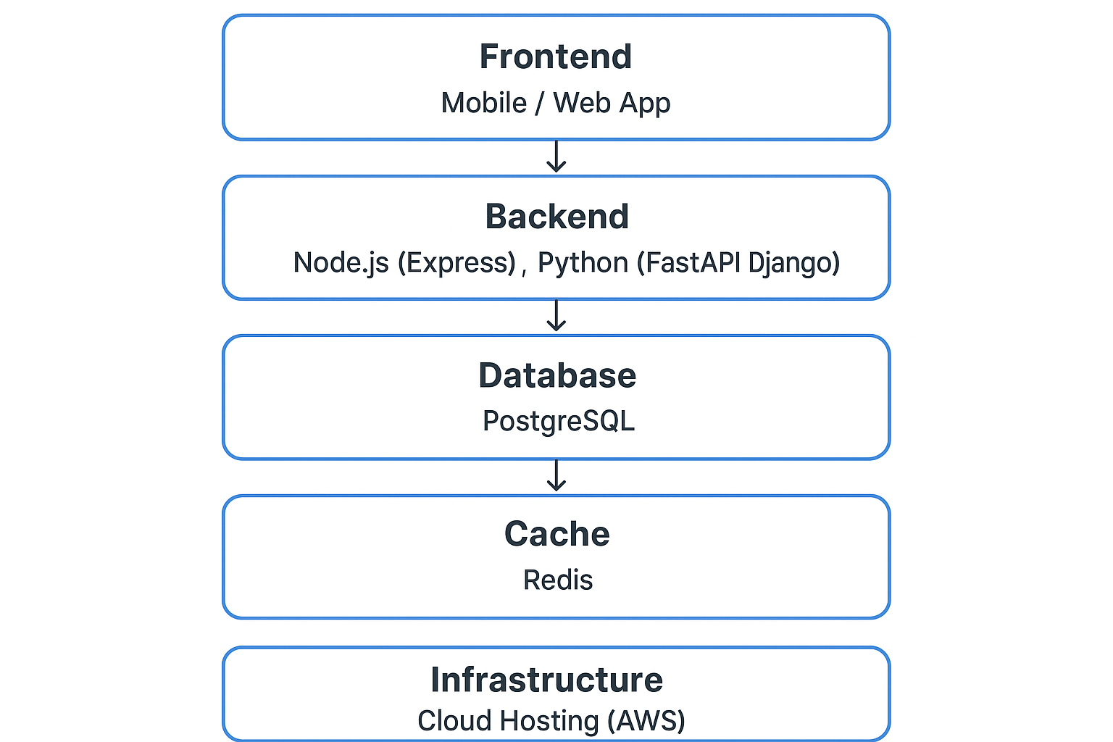
System Stack Architecture

Slide 5
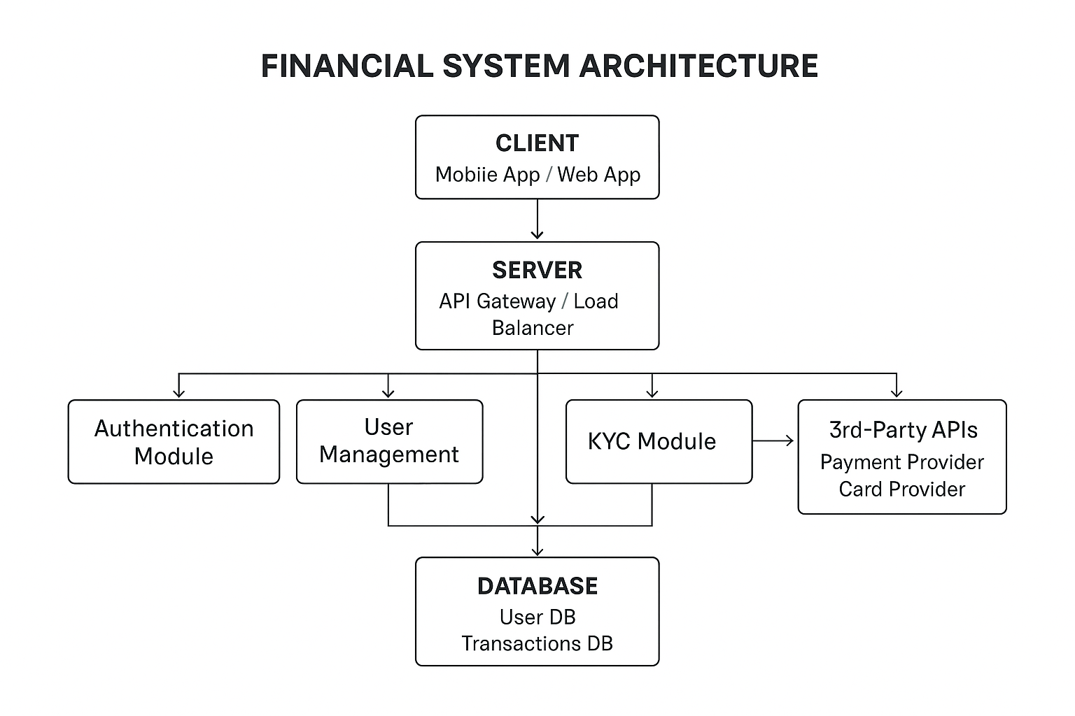
Overall System Architecture

Slide 6
Technology Stack
Frontend: React or Flutter
Backend: Node.js (Express) / Python (FastAPI)
Database: PostgreSQL
Cache: Redis
Hosting: AWS or Docker
Authentication: JWT / OAuth2
3rd Party: Stripe, Visa, Twilio

Slide 7
Security Considerations
• All communication secured with HTTPS
• Passwords and sensitive data encrypted at rest
• Role-based access control (RBAC)
• Regular audit logs for transactions

Slide 8
Conclusion
This architecture ensures scalability, modularity, and strong security
for financial applications offering virtual cards. It enables flexible
integration with third-party providers while maintaining compliance and reliability.

