Slide 1

A
Real Time Project Report on
“FLOOD DETECTOR SYSTEM”
Submitted in partial fulfilment of the requirement for the award of degree of BACHELOR OF TECHNOLOGY
IN
INFORMATION TECHNOLOGY
Submitted By
D.MADHU HASINI
G.ARYAN REDDY K.HARIDEEP M.YAMINI
238R1A12E4
238R1A12F0
238R1A12G0
238R1A12H5
Under the Guidance of
Mr.GIRIJA SHANKAR DEWANGAN
Assistant Professor IT DEPARTMENT
CMR ENGINEERING COLLEGE
DEPARTMENT OF INFORMATION TECHNOLOGY
(Approved by AICTE, Affiliated to JNTUH, Accredited by NBA, NAAC) Kandlakoya (v), Medchal, Telangana.

Slide 2
CMR ENGINEERING COLLEGE
DEPARTMENT OF INFORMATION TECHNOLOGY
(Approved by AICTE, Affiliated to JNTUH, Accredited by NBA, NAAC) Kandlakoya (v), Medchal, Telangana.
CERTIFICATE
This is to certify that the project entitled “FLOOD DETECTOR SYSTEM” is a bonafide work carried out by
D.MADHU HASINI
G.ARYAN REDDY K.HARIDEEP M.YAMINI
238R1A12E4
238R1A12F0
238R1A12G0
238R1A12H5
in partial fulfillment of the requirement for the award of the degree of BACHELOR OF TECHNOLOGY in INFORMATION TECHNOLOGY from CMR Engineering College, affiliated to JNTU, Hyderabad
under our guidance and supervision.
The results presented in this project have been verified and are found to be satisfactory. The results embodied in this project have not been submitted to any other university for the award of any other degree or diploma.
Internal Guide Project Coordinator Head of the Department
Mr.Girija shankar dewange Mrs. Lavanya Dr.P.Madhavi
Assistant Professor Assistant Professor Professor & H.O.D
Department of IT Department of IT Department of IT
CMREC CMREC CMREC
Hyderabad Hyderabad Hyderabad

Slide 3
DECLARATION
This is to certify that the work reported in the present project entitled" FLOOD DETECTOR SYSTEM " is a record of bonafide work done by us in the Department of Computer Science and Engineering, CMR Engineering College, JNTU Hyderabad. The reports are based on the project work done entirely by us and not copied from any other source. We submit our project for further development by any interested students who share similar interests to improve the project in the future.
The results embodied in this project report have not been submitted to any other University or Institute for the award of any degree or diploma to the bestof our knowledge an
D.MADHU HASINI
G.ARYAN REDDY
K.HARIDEEP
M.YAMINI
238R1A12E4
238R1A12F0
238R1A12G0
238R1A12H5

Slide 4
ACKNOWLEDGEMENT
We sincerely thank the management of our college CMR ENGINEERING COLLEGE for providing during our project work.
We derive great pleasure in expressing our sincere gratitude to our principal Dr.A.S.REDDY for his timely suggestions, which helped us to complete the project work successfully.
It is the very auspicious moment we would like to express our gratitude to Dr.MADHAVI PINGILI Head of the Department, IT for his consistent encouragement during the progress of this project.
We take it as a privilege to thank our project coordinator Ms.LAVANYA, Associate Professor, Department of IT for his ideas that led to complete the project work and we also thank his continuous guidance, support and unfailing patience, throughout the course of this work.
We sincerely thank our project internal guide Mrs.K.SUSHMA, Assistant professor, Department of IT for his guidance and encouragement in carrying out this project

Slide 5
DECLARATION
This is to certify that the work reported in the present project entitled “FLOOD DETECTOR ” a record of a bonafide work done by us in the Department of Information
Technology, CMR Engineering College, JNTU Hyderabad. The reports are based on the project work done entirely by us and not copied from any other source. We submit project for further development by any interests to improve the project in the future.
The results embodied in this project report have not been submitted to any other University or Institute for the award of any degree or diploma to the best of our knowledge and belief.
D.MADHU HASINI
G.ARYAN REDDY
K.HARIDEEP
M.YAMINI
238R1A12E4
238R1A12F0
238R1A12G0
238R1A12H5

Slide 6
CONTENTS
Topic Page no.
ABSTRACT..................................................................................................................................... 1
INTRODUCTION........................................................................................................................ 2
LITERATURE SURVEY ............................................................................................................. 3
EXISTING MODEL...................................................................................................................... 4
PROPOSED MODEL................................................................................................................... 5
SOFTWARE AND HARDWARE REQUIREMENTS.................................................................. 7
SYSTEM DESIGN....................................................................................................................... 8
CODE IMPLEMENTATION ...................................................................................................... 13
OUTPUT/RESULT ..................................................................................................................... 19
CONCLUSION .......................................................................................................................... 20
FUTURE ENHANCEMENT..................................................................................................... 21
BIBLIOGRAPHY AND REFERENCES .................................................................................. 22

Slide 7
ABSTRACT
Flooding is a natural phenomenon which has attracted global attention as a result of its negative impact on the society. Developing nations such as India have been predicted to experience
increased flood occurrences in the coming decade.The events of flooding are unlikely to change,however, its impact on our society can be very well reduced. There are some places that are more prone to flooding than other places, the implementation of flood alert systems near any major
water area or body of water provides critical information that can protect property and save lives. Hence we are designing this project to inform the people about the upcoming flood by making use of the concept of Internet of Things. For that purpose we are going to use an android Application to intimate the users. This Project focuses on providing early detection of flooding and the measures to minimise and avoid floods. The system involves the deployment of sensor nodes at specific flood vulnerable locations for real-time flood monitoring and detection. Flood events relating to flash flooding and run- off water or overflow are successfully monitored in real time which saves individuals plenty of time to prepare against predicted flood occurrence, saving them from the aftermath of flood disaster

Slide 8
1. INTRODUCTION
The Floods are one of the most frequent and devastating natural disasters across the world, especially in developing countries like India. They result in significant loss of life, damage to infrastructure, displacement of people, and disruption of daily life. With changing climate conditions and increasing urbanization, the risk of flooding has become even more unpredictable and severe.
Traditional flood monitoring systems are often expensive, slow, and limited in coverage. In
contrast, the integration of the Internet of Things (IoT) into disaster management provides a modern solution. IoT allows for real-time data collection, remote monitoring, and automated alerts, making it ideal for flood detection systems.
This project proposes an IoT-based Flood Detection System that uses an Arduino microcontroller and a set of sensors to monitor critical environmental factors such as
temperature, humidity, water level, and flow rate. The system continuously collects and
displays this data and transmits it over the internet to provide timely alerts in case of rising flood risks. This allows individuals, authorities, and communities to take preventive action
before a disaster strikes.
Main Objectives
To develop a low-cost, real-time flood detection and alert system using IoT technology.
To monitor key environmental parameters (water level, flow rate, temperature, and humidity) using appropriate sensors.
To integrate an Arduino-based system capable of collecting, processing, and transmitting
data.
To display live sensor data on an LCD and send it to an IoT platform for remote monitoring.
To trigger alerts automatically when predefined thresholds are exceeded, ensuring early
warning and quick response.

Slide 9
2. LITERATURE SURVEY
In 2017,author Swapnil Bande and Dr. Virendra V. Shete [bande, n.d., 1] has created a model using environmental parameters such as humidity, temperature, pressure and rainfall were used by an array of sensors and thenthe data created is compared using ANN techniques. Further, different machine learning techniques are compared and then the best results are obtained. The advantage in this model is that the author has used the Levenberg-Marquardt algorithm which uses momentum learning and gives 88% accurate results.An android application [kartika, n.d., 2] have been made by author Ni Komang Ega Kartika, Muhammad Ary Murti and Casi Setianingsih in 2019. The application predicts output for next three months using Radial Basis Function Neural Network and Antares. Antares uses a RESTful approach for developing API. the output that are obtained by using datasets that are further carried out by three steps, they are testing, training and prediction.
In 2017, an alert application of flood was developed by author Jayashree S, Sarika S, Solai A L,Soma Prathibha [prathibhha, .d., 3].They have used ZigBee technology and the application also works when
the network is not present. This means that this application is network independent. The user can make an emergency call or might send the SMS to their family members. The alert application consists of user registration, display of dam water levels and safe zone mapping. Which means that the user can regularly
get updates of the water level and can move to a safer place where the flood may not arise.
In 2019, author Arjun N, Prof. Nikhil Binoy C, Keerthi C, Sreerag S and Ashwin H Nair [nair, n.d., 4] have searched about the water levels at two different places that are Dam and Canal. This means that the prediction of flood will be at two levels: Dam prediction andCanal prediction. Here in this model Multilayer Perceptron is used as a Neural Network. And as an activation function Backpropagation and Tan-Sigmoid function for the network. The accuracy of this model is 78%.

Slide 10
3.EXISTING MODEL
Several flood detection systems are currently in use, ranging from manual monitoring to semi-automated IoT systems. These existing models help in identifying rising water levels and alerting people in danger- prone areas. Below are some commonly used models:
Manual River Gauging Systems
Water levels are manually recorded by authorities using scale markers installed near rivers and dams.
Radar and Satellite-Based Monitoring
Used by government agencies and weather departments, these systems rely on high-end sensors and satellite imaging to monitor large-scale flooding.
GSM-Based Alert Systems
Basic systems that use a water level sensor with a GSM module to send SMS alerts when water reaches a critical level.
IoT-Based Models (Limited Scope)
Some newer models use single sensors connected to an IoT platform (like Blynk or Thingspeak) to monitor water level and notify users via mobile apps or dashboards.
Drawbacks of Existing Models
Despite their usefulness, the current systems suffer from several limitations:
❌ Limited Parameters Monitored: Most models track only one or two parameters (usually just water level), which isn't enough for accurate flood prediction.
❌ No Real-Time Alerts in Manual Models: Manual monitoring is slow, dependent on human availability, and lacks immediate response capability.
❌ High Cost of Satellite Systems: Satellite-based solutions are expensive and unsuitable for small communities or rural setups.
❌ Limited Connectivity in GSM Models: GSM modules depend on mobile network coverage and don’t support data logging or visual dashboards.
❌ Lack of Integration: Many IoT systems are not integrated with local alert mechanisms like buzzers or LED indicators.
4

Slide 11
4. PROPOSED MODEL
The proposed system is a smart, real-time flood detection and alert system using IoT and Arduino. Unlike traditional systems that focus on a single parameter, this model integrates multiple sensors to monitor various environmental conditions that contribute to flooding. The system is designed to be cost-effective, scalable, and suitable for both urban and rural areas.
How It Works:
Sensors continuously collect environmental data.
The Arduino processes this data and checks it against predefined safety thresholds. If any value (e.g., water level or flow rate) exceeds the danger level, the system
Triggers a local alert via buzzer/LED
ADVANTAGES
Early Detection
Cost-Effective
Remote Monitoring
Scalability
Automatic Alerts
Environmental Impact
5

Slide 12

4.SOFTWARE AND HARDWARE REQUIREMENTS
Hardware Components:
1. Arduino Uno: is a micro-controller board that is opensource hardware based on the ATmega328P (data sheet). It is used along with the Wi-Fi module which is used to provide IoT connectivity through the local Wi-Fi connection. Features[12]:
Micro-controller: ATmega328P
•
•
•
Operating Voltage: 5V Output Voltage: 6-20V Digital I/O Pins: 14
Input Voltage: 7-12V
DHT 11 Temperature & Humidity Sensor: The
DHT11 is a basic, ultra-low-cost digital temperature and humidity sensor. This sensor uses a capacitive humidity sensor with a thermistor to evaluate the neighboring air and spits out a digital signal on the info pin where no analog input pins are needed [13]. It is fairly simple to use but requires mindful timing to grab data. You can get new data from it once every 2 seconds, so when using the library from Adafruit, sensor readings are often up to 2 seconds old [9].
It is used to check the temperature and humidity, to check whether there is heavy rainfall or no rainfall in that particular area so that it will give us the indications that whether there are chances of any flood or not.
Specifications:
3 to 5V power and I/O
Max current use during conversion:2.5mA
Humidity: 20%-80% with 5% accuracy
Temperature 0-50 °C with +-2 °C accuracy
Body size 15.5mm x 12mm x 5.5mm
4 pins with 0.1" spacing
Water Flow Sensor: This consists of:
a copper body
a water rotor
a hall-effect sensor
When water goes through the rotor, rotor rolls, its speed changes with different rate of flow. And the hall-effect sensor gives the corresponding pulse signal. It is used to exhibit the flow of water [11]. For supply, the voltage required is 5V to 18V of DC.

Slide 13
HC SR04 Ultrasonic Range Finder and Distance sensor: It works on the principle of SONAR. To measure distances using ultrasonic waves to determine the distance of an object from the sensor.
HC-SR04 Sensor Features:
Operating voltage: +5V
Theoretical Measuring Distance: 2cm to 450cm
Practical Measuring Distance: 2cm to 80cm
Accuracy: 3mm
Measuring angle covered: <15°
Operating Current: <15mA

Slide 14


SOFTWARE REQUIREMENTS:
1. Arduino IDE
Arduino IDE is an open source software that is mainly used for writing and compiling the code into the Arduino Module. It is an official Arduino software, making code compilation too easy that even a common person with no prior technical knowledge can get their feet wet with the learning process. It is easily available for operating systems like MAC, Windows, and Linux and runs on the Java Platform that comes with inbuilt functions and commands that play a vital role for debugging, editing and compiling the code in the environment. The IDE environment mainly contains two basic parts: Editor and Compiler where former is used for writing the required code and later is used for compiling and uploading the code into the given Arduino Module. This environment supports both C and C++ languages.
2.Eagle Software
EAGLE stands for Easily Applicable Graphical Layout Editor, EAGLE is a scriptable electronic design automation (EDA) application with schematic capture, printed circuit board (PCB) layout, autorouter and computer-aided manufacturing (CAM) features. EAGLE contains a schematic editor, for designing circuit diagrams. Schematics are stored in files with. SCH extension, parts are defined in device libraries with .LBR extension. Parts can be placed on many sheets and connected together through ports. The PCB layout editor stores board files with the extension .BRD. It allows back-annotation to the schematic and auto-routing to automatically connect traces based on the connections defined in the schematic.

Slide 15

3.BLYNK IOT Platform
Blynk was designed for the Internet of Things. It can control hardware remotely, it can display sensor data, it can store data, vizualize it and do many other cool things. There are three major components in the platform:
Blynk App - allows to you create amazing interfaces for your projects using various widgets provided.
Blynk Server - responsible for all the communications between the smartphone and hardware. we can use Blynk Cloud or run your private Blynk server locally. It’s open-source, could easily handle thousands of devices and can even be launched on a Raspberry Pi.
Blynk Libraries - for all the popular hardware platforms - enable communication with the server and process all the incoming and outcoming commands.

Slide 16
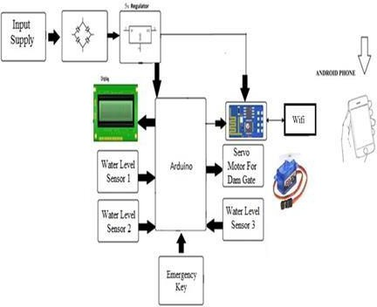
5.DESIGN METHODOLOGY
Sensors (Flood Sensors)
Water Level Sensors: These sensors detect the water level in specific regions of the stadium (pitch area, drainage areas, or near water bodies).
Types: Ultrasonic sensors, capacitive sensors, radar sensors.
Rainfall Sensors: Used to detect rainfall intensity.
Soil Moisture Sensors: Measure soil moisture, which may indicate flood risk.
Pressure Sensors: Can measure water pressure near drainage points to detect blockages or overflow.
Edge Devices/Controllers
Microcontroller/IoT Gateway: These devices collect sensor data and send it to the central system for processing.
Example: Raspberry Pi, Arduino, or an industrial IoT gateway.
Local Data Processing: In case of connectivity issues, edge devices can analyze and process data locally to trigger immediate alerts, ensuring real-time actions.
Connectivity: Wi-Fi, 4G/5G, or LoRaWAN for remote areas in the stadium.
Data Processing & Backend (Cloud/On-premise)
Real-time Data Processing: Once the data is received from sensors, it needs to be processed to identify potential flooding scenarios. This might involve:
Threshold-based Logic: Define flood risk levels based on water level measurements.
Predictive Algorithms: Use weather data, historical water levels, and rainfall predictions to assess flood risk.

Slide 17
Alerting System
Notification System: If water levels surpass a threshold, a notification should be triggered.
SMS/Email Alerts: Send notifications to stadium officials, ground staff, and IPL security.
Mobile App/Push Notifications: For quicker responses.
Voice Alerts: Automated phone calls or voice alerts in extreme cases.
o
Web Dashboard/Control Center
Real-Time Monitoring Dashboard: A web application showing real-time water levels, rainfall statistics, and flood alerts across different parts of the stadium.
Data Visualizations: Graphs for water levels, rainfall, soil moisture, etc.
Historical Data Review: To identify flood patterns and predict future occurrences.
Access Control: Authorized personnel can access the dashboard based on roles (e.g., stadium management, maintenance crew).
Integration with Existing Infrastructure
Irrigation Systems: Ensure that the flood detection system can communicate with the irrigation system to prevent overwatering or flooding in certain areas.
Drainage System Monitoring: Ensure the flood detection system is integrated with the drainage
system, allowing automatic alerts for system malfunctions like blockages.
As we follow along the block diagram it is evident the the the CPU used here is the Atmels ATmega328p which is a single chip CPU and all the different modules and sensors are connected to it.
We are using a pair of the Y89 soil moisture sensors to detect the water level in accordance with the ground,
whereas for determining the reference of the water level in a stored water body like Dams or reservoirs we have used an HC SR04 Ulrasonic Sensor.
The 16x2 LCD display is used to determine the operation status of the project on the board and the connectivity to the internet is made possible through the ESP 8266 wifi module. The provision to disperse the
critical level of water in the water body is being relalised through connecting a servo motor which represents the heavy duty motors that can be used to control the Dam gates as the need arises.
For alerting the users in the area of the flood the BLYNK IOT platform and the Android application on the smartphone is being used where all the alerts for the user can be delivered and the data about the crisis can
disaster control can be obtained by the user as necessary.Submit your manuscript electronically for review. prepare it in two-column format, including figures and tables(untill it don't fit properly and data is not
visible).

Slide 18
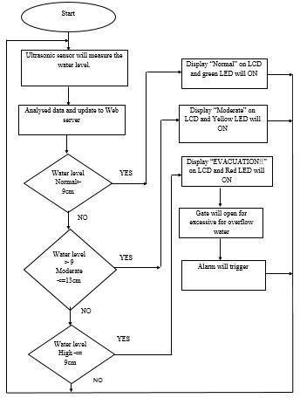
FLOWCHART FOR FLOOD DETECTOR SYSTEM:
Based on flowchart in Figure 4, Smart IoT Flood Monitoring System is developed to alert the public closest to the area when there is upcoming flood. The process is starting when ultrasonic sensor measures level of water in the river. The collected data from the sensor are gathered and will be forwarded to microcontroller and data will be displayed at web server. Then, data will be analysed and compared. As a user, he/she can control the stepper motor and buzzer wirelessly. Flood status dangerous will be determined based on that collected data. Thus, water level status will display on LCD and web server. LED will be turn on to indicate the water level. Furthermore, the stepper motor will be turn on for the passage of excessive flood when it reached at the highest threshold value and the alarm will be triggered immediately to alert the public. Hence, the citizens will be well prepared for evacuation before the flood occurred.

Slide 19
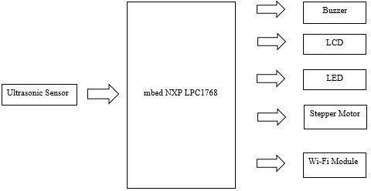
3.1 Block Diagram
From the block diagram in Figure 2, Ultrasonic HC-SR04 module sensor will be used to detect the water level of river. The mbed NXP LPC1768 is a microcontroller that will collect all the data in this system. Buzzer will act as an alarm to alert the public and authority when there is upcoming flood and data will be updated to web server. The function of LCD and LED are to display and indicate the level of water.
Figure 3: Block diagram Smart IoT Flood Monitoring System

Slide 20
WORKING PRINCIPLE
The main working principle behind this system is in connecting the soil moisture sensor, which was previously embedded into the plant, to the Arduino microcontroller, which is also connected to other electronic components listed above. Measurement of soil moisture is done by the sensor which forwards the information and parameters regarding the soil moisture to the microcontroller, which controls the pump. If the level of soil moisture drops below a certain value, the microcontroller sends the signal to the relay module which then runs a pump and certain amount of water is delivered to the plant. Once the enough water is delivered, the pump stops doing its work. Power supply has a task to power the complete system and the recommended voltage should respect the input supply range for the microcontroller, that is, from 7V to 12V. Relay module is a simple circuit consisting of a single transistor, several resistors, diodes and a relay and it is controlled digitally by microcontroller. Since the complete system should be embedded in a small box, Arduino Nano is a perfect microcontroller for this purpose because of its dimensions and its work performance. Soil moisture module is consisting of the two parts: amplifier circuit and probes. This module has digital and analog outputs, where digital output is set to logical 1 when the threshold is activated. The threshold is set by potentiometer. Analog output gives the real time information regarding the moisture in the plant and this output is used in the system. Water pump is connected to the relay module and it only works when the relay module gets a command from the microcontroller.

Slide 21
CODE FOR FLOOD DETECTOR USING GSM WITH ARDUINO
#include <SoftwareSerial.h>
// Pins
#define waterSensorPin A0 #define buzzerPin 8
// Threshold
#define floodThreshold 700 // Adjust based on sensor calibration
// GSM setup
SoftwareSerial gsmSerial(7, 8); // RX, TX for GSM bool alertSent = false;
void setup() { Serial.begin(9600); gsmSerial.begin(9600);
pinMode(buzzerPin, OUTPUT); digitalWrite(buzzerPin, LOW);
Serial.println("Flood Detector System Initialized."); delay(3000);
sendSMS("Flood Detector System Started.");
}
void loop() {
int waterLevel = analogRead(waterSensorPin); Serial.print("Water Level: "); Serial.println(waterLevel);
if (waterLevel > floodThreshold) { digitalWrite(buzzerPin, HIGH); if (!alertSent) {
sendSMS("⚠️ Flood Alert! Water level has exceeded the safe threshold."); alertSent = true;
}
} else {
digitalWrite(buzzerPin, LOW);
alertSent = false; // Reset alert flag when safe
}
delay(2000); // Read every 2 seconds
}
void sendSMS(String message) {

Slide 22
gsmSerial.println("AT+CMGF=1"); // Set SMS mode to text delay(1000);
gsmSerial.println("AT+CMGS=\"+91XXXXXXXXXX\""); // Replace with your phone number
delay(1000); gsmSerial.println(message); delay(100);
gsmSerial.write(26); // Ctrl+Z to send delay(3000);
Serial.println("SMS Sent!");
}

Slide 23
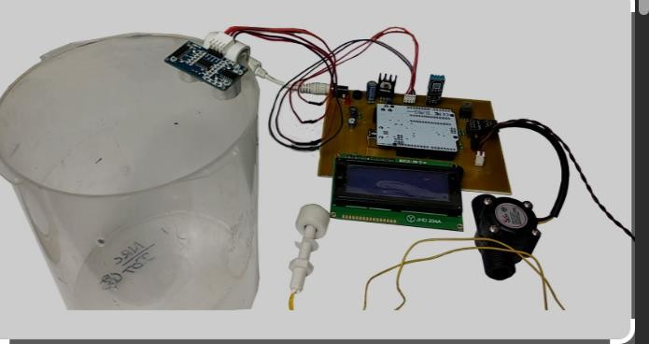
DEMONSTRATION OF THE “FLOOD DETECTOR SYSTEM”:
Demonstration Scenario:
Setup:
The project is set up with a model house or container representing a flood-prone area and a water source (e.g., a container or water tank) simulating a river.
Simulation:
The water level is gradually increased, simulating a rising river. The sensors detect the increasing water level.
Triggering the Alert:
Once the water level reaches a predefined threshold, the microcontroller triggers the alarm and the communication module sends alerts.
Observation and Discussion:
The demonstration highlights the importance of early detection and the effectiveness of the flood warning system in providing timely alerts.

Slide 24
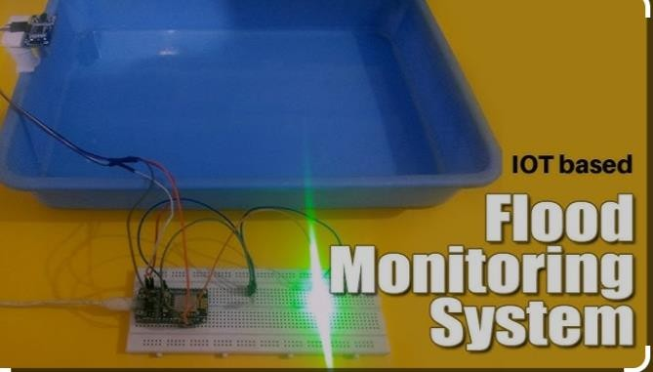

Slide 25
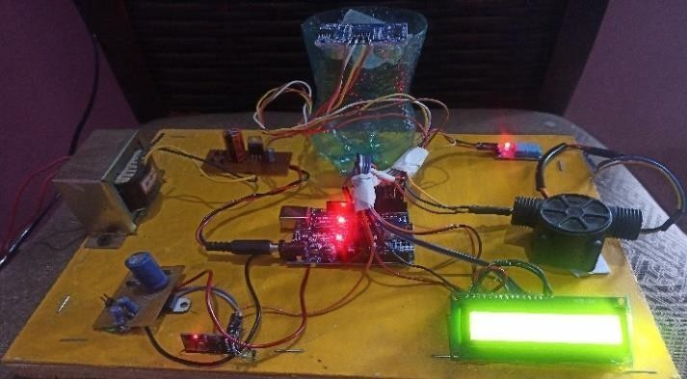
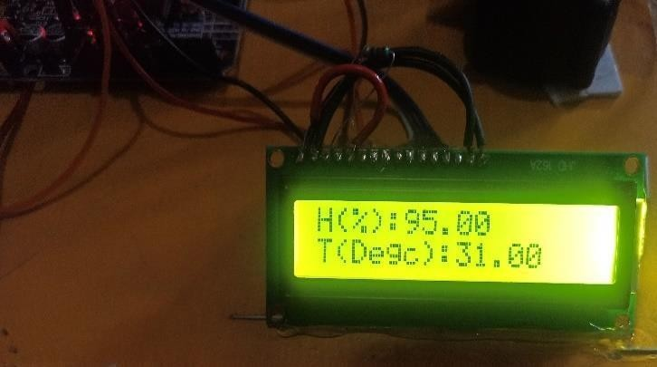
OUTPUT/RESULT:
The proposed method in this paper retrieves the information from the sensor at any point in time. Finally, the developed early flood detection and warning system utilizes an ultrasonic sensor to detect water level, functions perfectly according to the specification provided to the authorities.
1.
2.
Figure 3: Hardware Implementation
In Fig.3 we have shown how all the hardware components are connected and implemented in real world. All the mentioned hardware components are present here.
Figure 3.1: Humidity(H) and Temperature(T) display
Fig.3.1 displays the Humidity in percentage and temperature in degree Celsius. Both the parameters are measured with the help of DHT11 Temperature and Humidity Sensor.

Slide 26
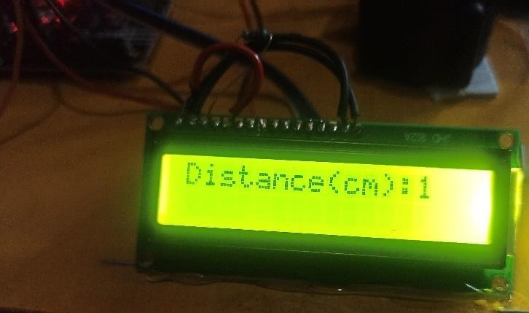
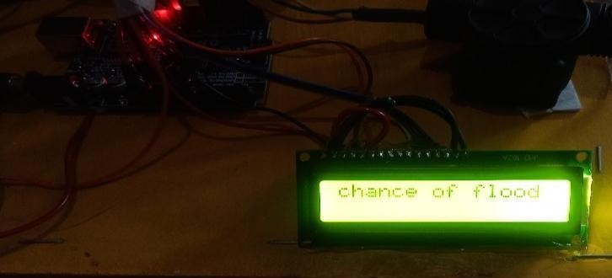
Figure 3.2: Distance Measurement
Fig.3.2 displays the distance of the water from the sensor. This is achieved by the help of HC SR04 Ultrasonic sensor, which uses ultrasonic waves to determine the distance.
Figure 3.3: Message Display
Fig.3.3 displays the alert message, “chance of flood”. This message is displayed on the LCD screen when the distance measured is less than or equal to 4cm

Slide 27
CONCLUSION:
The Flood Detector System designed and implemented as part of the Innovative Project Lab (IPL) stands as a significant step toward developing low-cost, reliable, and scalable flood monitoring solutions. With climate change leading to increasingly erratic weather patterns and a higher frequency of floods, there is an urgent need for early warning systems that can help mitigate loss of life, infrastructure damage, and disruption to essential services. This project addresses that need by integrating environmental sensing with real-time alerting and data analysis.
The system utilizes a combination of water level sensors, a microcontroller (Arduino), and communication modules (GSM or Wi-Fi) to continuously monitor water levels in flood-prone areas. When the sensor detects that the water level has crossed a pre-set safety threshold, the system activates local alerts using a buzzer and sends remote alerts via SMS or internet-based platforms. This dual-layered notification mechanism ensures that users are informed both locally and remotely, enabling timely intervention.
Throughout the development process, we learned to interface sensors with microcontrollers, calibrate input
readings for real-world accuracy, and manage communication protocols for sending alerts. The project demonstrated how embedded systems, IoT, and basic automation can be combined to create smart safety applications with tangible societal impact.
The modular nature of the system makes it highly adaptable—it can be easily expanded with additional sensors (e.g., rainfall, humidity, soil moisture), integrated into cloud platforms for data logging, or enhanced with
AI/ML algorithms for predictive flood modeling. Furthermore, it has applications beyond urban areas, including rural and agricultural environments, where early flood detection is often unavailable but critically
needed.
From an academic and practical perspective, the project exemplifies how engineering knowledge can be translated into innovative solutions for real-world problems. It fosters problem-solving, interdisciplinary thinking, and hands-on skills, all of which are core objectives of the Innovative Project Lab.
In conclusion, the flood detection system is not only a successful prototype but also a foundation for further research and development. It reflects a broader vision of how technology can serve society, and how young innovators can play a vital role in building a safer, s

Slide 28

FUTURE ENHANCEMENTS:
🌱 Future Enhancements – Flood Detector System
While the current flood detection system offers a functional and efficient solution for basic water level monitoring and alerting, there are several potential enhancements that can significantly improve its accuracy, scalability, and overall utility. These future improvements can help the system evolve into a more advanced and intelligent flood prediction and management tool:
1. IoT & Cloud Integration
Real-Time Data Monitoring on Cloud Dashboards: Integrate platforms like
ThingSpeak, Blynk, or Firebase to display real-time water levels and alerts online.
Data Logging for Analysis: Store sensor readings over time to analyze patterns, which is crucial for flood forecasting and urban planning.
Remote Configuration: Allow remote changes to system settings like alert thresholds, sensor calibration, or notification methods.
🤖 2. AI/ML-Based Prediction
Machine Learning Algorithms: Use historical flood data, rainfall intensity, and sensor readings to train models that can predict floods before they happen.
Anomaly Detection: Implement AI to identify unusual patterns in sensor data that might indicate sensor failure or sudden environmental changes.
🌦️ 3. Weather API Integration
Real-Time Weather Forecasts: Fetch live weather data from APIs like OpenWeatherMap to correlate rainfall predictions with water level trends.
Proactive Alerts: Use weather forecasts to send early warnings even before water levels
24

Slide 29
rise.
📡 4. Advanced Communication Systems
GSM with GPS: Use GPS to track the exact location of a flood alert, especially useful in large or remote deployments.
LoRaWAN/NB-IoT: For long-range, low-power communication in large fields or rural areas with limited connectivity.
Mobile App Alerts: Integrate push notifications through a mobile app for more convenient and reliable alerts.
5. Multi-Sensor Setup
Additional Environmental Sensors: Include sensors for rainfall, humidity, temperature, wind speed, and soil moisture to get a holistic view of flood risks.
Redundancy with Multiple Water Sensors: Deploy multiple water sensors in different areas for better accuracy and coverage.
⚙️ 6. Automated Response System
Auto-Controlled Drainage Systems: Trigger drainage pumps or open flood gates automatically when water levels cross critical limits.
Smart Irrigation Shutdown: Automatically disable irrigation systems to prevent worsening the flood situation during heavy rain.
7. Robust Hardware Improvements
Waterproof Enclosures: Protect electronics from water damage in outdoor deployments.
Battery Backup & Solar Power: Ensure continuous operation during power outages or in remote areas.

Slide 30
🌍 8. Scalability & Community Deployment
City-Wide Network: Connect multiple sensor units across different city zones to create a real-time flood monitoring network.
Community Alerts: Send flood alerts to local residents, municipal bodies, or disaster response teams.
□ Summary
These future enhancements aim to transform the flood detector system from a simple prototype into a smart, predictive, and responsive flood management platform. By incorporating cloud services, artificial intelligence, mobile connectivity, and automated actions, the system can become a critical tool for disaster prevention, agriculture safety, and urban planning, making it even more impactful and socially relevant.

Slide 31
BIBLIOGRAPHY AND REFERENCES:
[1] Chandra, Suresh (2003) "India: Flood managementDamodar river basin." World Meteorological Organization and the Associated Programme on Flood
Management. Integrated Flood Management. Case Study. [2] Prasad, Kamta (2005) Manual on community approach to flood management in India. Associated Programme on Flood Management.
Seal, Raha V., Maity A., Mitra S., Mukherjee S. K., A., & Naskar, M. K. (2012). A simple flood forecasting scheme using wireless sensor networks. arXiv preprint arXiv:1203.2511.
Udo, E.N. and Isong, E.B. 2013. Flood Monitoring and Detection System using Wireless Sensor Network. Asian Journal of Computer and Information Systems. 1, 4 (Dec. 2013).
Badamasi, Abdullahi Yusuf (2014) "The working principle of an Arduino." 2014 11th international conference on electronics, computer and computation (ICECCO).
IEEE(DOI: 10.1109/ICECCO.2014.6997578)
Latha, N. Anju, Murthy B. Rama, and Kumar K. Bharat (2016)"Distance sensing with ultrasonic sensor and Arduino." International Journal of Advance Research, Ideas and Innovations in Technology 2.5 (2016):(pp 1-5).
Singh Pushkar, and Sanghamitra Saikia (2016) "Arduino-based smart irrigation using water flow sensor, soil moisture sensor, temperature sensor and ESP8266 WiFi module." 2016 IEEE Region 10 Humanitarian Technology Conference (R10-HTC).
IEEE.(DOI: 10.1109/R10-HTC.2016.7906792).
Islam, Kamaruddin R., Ahmad R. , Jan S. A, S. J., & Anuar, A. R. (2016). A Review on Mechanism of Flood Disaster Management in Asia. International Review of Management and Marketing, 6(1) (pp- 29-52)
Srivastava, Deeksha, Kesarwani Awanish, and Dubey Shivani (2018) "Measurement of Temperature and
Humidity by using Arduino Tool and DHT11." International Research Journal of Engineering and Technology (IRJET) 5.12 (pp-876- 878). [10] Ghasemi, Parisa, and Karimian Noushin (2020). "A Qualitative Study of Various Aspects of the Application of IoT in Disaster Management." 2020 6th International
Conference on Web Research (ICWR).
IEEE.(DOI: 10.1109/ICWR49608.2020.9122323) [11] Mulik, Sharad S., et al.(2021) "Development and experimental assessment of a fluid flow monitoring system using flow sensor and Arduino interface." Innovative Design, Analysis and Development Practices in Aerospace and Automotive Engineering. Springer, Singapore (pp-115-122).
[12] Zahir, Binti Shahirah,(2019),et al. "Smart IoT Flood Monitoring System." Journal of Physics: Conference Series. Vol. 1339. No.
1. IOP Publishing
(doi:10.1088/1742-6596/1339/1/012043)

