Slide 1

Edge-Enabled Digital Twin Framework for DRL-Based CooperativePerception in Autonomous Vehicles​
​
Binbin Lu, Xumin Huang, Yuan Wu, Liping Qian, Dusit Niyato, Tony Q. S. Quek, Cheng-Zhong Xu ​
​
Group 1
Theme : Autonomous Vehicles​
Challenge : Task Scheduling​

Slide 2

OVERVIEW ​
​
​
CARLA Simulator: Used to generate realistic vehicle mobility data (position, speed, heading).
Python 3.7.9 Support: CARLA works smoothly with Python 3.7.9, making it easy to integrate with ML models.
Data Flow:
Collect vehicle coordinates and speed from CARLA.
Send this data to the LSTM model → predict future vehicle positions.
Use DRL (PPO) for Cooperative Vehicle (CoV) selection based on predicted states.
Objective: Reduce delay and improve perception quality in autonomous driving.

Slide 3
UPDATES
Setup & Implementation of CARLA – Installed CARLA and connected with Python 3.7.9.​
Created Simulation Environment – Built traffic scenarios in CARLA to generate vehicle mobility data.​
LSTM Prediction – Predicted Vehicle Under Test (VU) future coordinates using mobility traces.​
DRL for CoV Selection – Implemented PPO agent partially, integration in progress.​
Live Environment Capture – Captured and visualized CARLA frames using a computer vision module.​

Slide 4
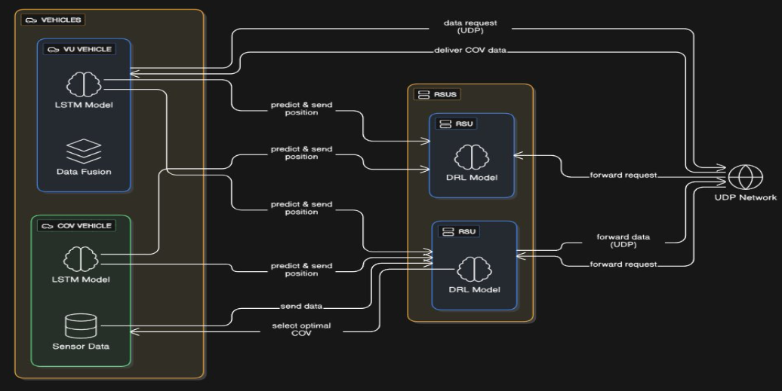
ARCHITECTURE

Slide 5
LSTM ?(LONG SHORTTERM MEMORY)​
LSTM is powerful for time-series andsequential data​
In driving:​
Learns temporal patterns (speed,steering angle, acceleration)​
Predicts future vehicle states​
Captures long-term dependencies​
Ensures smoother and data-driventrajectory prediction​

Slide 6
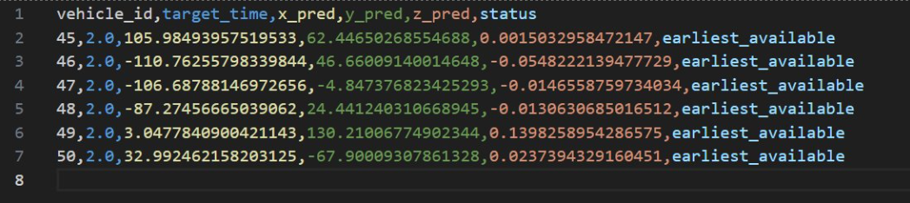
PREDICTED OUTPUTS OF LSTM MODEL​
vehicle_id → Unique identifier for each vehicle.​
target_time → Prediction horizon (here it looks like 2.0seconds ahead).​
x_pred, y_pred, z_pred → Predicted positions (ortrajectories) of the vehicle in 3D space.​
status → Availability flag (in your case,"earliest_available").​

Slide 7
INTRODUCTION TO DRL​
we use an LSTM predictor to learn vehicle motion patterns from trajectory data. This gives us the predicted future positions of the Vehicle Under Test (VU). ​
LSTM = sequence learning → prediction​
with multiple sources of cooperative perception (other vehicles and the Edge Digital Twin), how do we decide which one to rely on at each moment?​
DRL = decision-making → cooperative perception​

Slide 8
DRL FRAMEWORK​
State / Observations (what the agent sees):
LSTM-predicted next VU position.
Current positions of CoVs.
Communication latency, bandwidth, and trust of CoVs.
Digital Twin’s predicted position + fidelity.
Action (what the agent decides):
Pick one CoV OR pick the Edge Digital Twin.
Reward (what the agent learns to optimize):
High if the choice leads to accurate perception (close to true VU position).
Penalized if delay is high, bandwidth is costly, or trust is low.
Bonus if DT fidelity is high.

Slide 9
DRL CODE & MODULES
tensorflow / keras -used for loading and running the pre-trained LSTM model that predicts vehicle positions.​
gymnasium – environment interface with CARLA​
stable_baselines3 -provides the PPO reinforcement learning algorithm that trains the agent to choose between CoVs and Edge DT​
Loads vehicle trajectory data and an LSTM predictor to forecast the VU’s next position.​
Builds a Gymnasium environment where the agent can choose between CoVs or the Edge Digital Twin (DT).​
Trains a PPO (DRL) agent to learn the best selection policy by balancing accuracy, delay, trust ,bandwidth, and DT fidelity.​

Slide 10
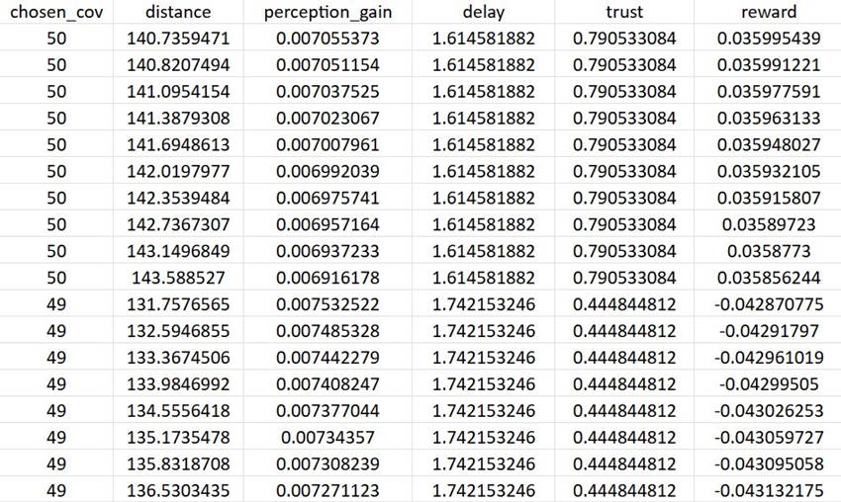
DRL – OUTPUT
chosen_cov → CoV (or DT) selected by the agent.
distance → Distance between VU and chosen CoV.
perception_gain → Improvement in perception accuracy.
delay → Communication latency (seconds).
trust → Reliability score of chosen CoV.
reward → Final performance score (good/bad choice).

Slide 11
DRL FRAMOVERVIEW PENDING TASKS (NOT YET DONE)
Digital Twin Implementation​
Still not built , only skeleton design is ready.​
To be integrated with CARLA + LSTM predictions.​
DRL Full Integration​
PPO partially implemented, but not yet connected with CARLA and DT.​
Result Visualization​
Graphs like real vs predicted coordinates, delay vs vehicles, PPO rewardcurve are pending.​
Next Steps:​
Complete Digital Twin coding.​
Integrate PPO DRL agent with DT and LSTM predictions.​
Add visualizations: trajectory plots, performance metrics, delay graphs.​

Slide 12
LSTM CODE
Edge Part Code

